Slide 1
Sample presentation Bank of Baroda Hackathon 2024
Your Team Name : Coder Syndicate
Your team bio :
Date :

Slide 2
Problem Statement?
Why did you decide to solve this Problem statement?
WORK SUPPORT : Implementing AI can reduce manpower and make efficient work by handling daily routine, documentation, processing work.
It Automated processes can operate 24/7, leading to quicker transaction processing and improved customer satisfaction.

Slide 3
Pre-Requisite
What are the alternatives/competitive products for the problem you are solving?
Operational efficiency in the banking sector is achieved by optimizing processes, reducing costs, and improving service delivery through various strategies such as digital transformation, process automation, data analytics, and workforce optimization. By integrating artificial intelligence (AI) into these strategies, banks can further enhance their efficiency. AI technologies such as chatbots, machine learning, and predictive analytics automate routine tasks, improve decision-making, and provide personalized customer experiences. For instance, AI-powered fraud detection systems analyse transaction patterns in real-time to prevent fraudulent activities, while automated underwriting processes speed up loan approvals and enhance accuracy. Additionally, AI-driven customer service tools like chatbots offer 24/7 support, reducing the burden on human agents and improving response times. Combining traditional operational efficiency strategies with AI-driven innovations enables banks to operate more effectively, reduce costs, and offer superior services to their customers.

Slide 4
Tools or resources
Azure tools or resources which are likely to be used by you for the prototype, if your idea gets selected
Robotic Process Automation
Chat bot and Virtual Assistants
Natural language processing (NLP)
API Integration Platforms

Slide 5
Any Supporting Functional Documents
Present your solution, talk about methodology, architecture & scalability
1.⁠ ⁠Identify Repetitive Tasks: Begin by identifying routine, rule-based tasks that can be automated. Common tasks include data entry, transaction processing, compliance reporting, and customer service inquiries.
2.⁠ Select RPA Tools: Choose a reliable RPA software that suits your bank's needs. Popular options include UiPath, Blue Prism, and Automation Anywhere.
3.⁠ ⁠Develop Automation Workflows: Work with RPA developers to create workflows that automate selected tasks. Ensure these workflows are tested thoroughly to avoid disruptions.
4.⁠ ⁠Integrate with Existing Systems: Ensure the RPA tools seamlessly integrate with existing banking software and databases.
5.⁠ ⁠Train Employees: Train employees on how to work with RPA systems, including how to monitor and manage automated processes.
6.⁠ ⁠Monitor and Optimize: Continuously monitor the performance of RPA systems and gather feedback to make necessary adjustments and optimizations.

Slide 6
Key Differentiators & Adoption Plan
How is your solution better than alternatives and how do you plan to build adoption?
Key Differentiator: Seamless Digital Channels Implementation: Mobile and Online Banking: Develop user-friendly mobile and online platforms that offer comprehensive banking services such as account management, transactions, and customer support . Digital Onboarding: Implement e-KYC (Know Your Customer) processes for faster and secure account opening and loan applications. Automation: Use automation for routine tasks like transaction processing and account maintenance to streamline operations and reduce manual errors . Impact on Efficiency : Reduces the need for physical branch visits, cutting down operational costs . Speeds up service delivery and enhances customer convenience . Automates routine tasks, freeing up staff for more complex activities.
Digital Transformation : Adoption of online and mobile banking platforms for seamless customer service. Integration of advanced technologies such as AI, machine learning, and blockchain to automate processes and enhance security . Customer-Centric Services : Personalized banking solutions based on customer data and predictive analytics.24/7 customer support through chatbots and virtual assistants.

Slide 7
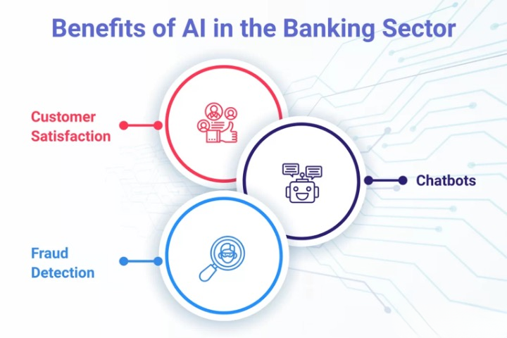
GitHub Repository Link & supporting diagrams, screenshots, if any
How far it can go?

Slide 8
Business Potential and Relevance
What are the business applications of the problem you are solving?
Data Privacy and Security:
Ensuring the security and privacy of customer data is crucial when implementing AI solutions.
Integration with Legacy Systems:
Banks need to address challenges related to integrating AI with existing legacy systems and infrastructure.
Ethical Considerations:
AI applications must be designed and implemented ethically, avoiding biases and ensuring transparency in decision-making processes.
Change Management:
Successful AI implementation requires effective change management to ensure staff are trained and processes are adapted to the new technologies.

Slide 9
Uniqueness of Approach and Solution
What is the unique aspects of the proposed idea?
Robotic Process Automation (RPA): AI-powered RPA automates complex, rule-based tasks across various departments, enhancing speed and accuracy while reducing operational costs. Unlike manual processes, AI can handle large volumes of data consistently and efficiently.
AI-Powered Customer Service: Chatbots and virtual assistants powered by AI provide personalized customer interactions 24/7. They analyze customer inquiries in real-time, offering tailored responses and recommendations, thus enhancing customer satisfaction and loyalty.
Agile Development: AI-driven solutions enable continuous improvement through iterative development and feedback loops. Banks can adapt quickly to market changes and customer feedback, ensuring that their operational efficiencies remain cutting-edge and relevant.

Slide 10
User Experience
How will your idea enhance the user experience?
Operational efficiency in the banking sector, facilitated by AI, significantly enhances user experience through streamlined processes and personalized interactions. AI-powered chatbots and virtual assistants provide instant, round-the-clock customer support, resolving queries swiftly and accurately. These systems analyze customer data to offer tailored recommendations and solutions, improving satisfaction and loyalty. Automated processes, such as loan approvals and account management, are expedited with AI, reducing wait times and errors. Predictive analytics anticipate customer needs, suggesting relevant products and services proactively. Moreover, AI enhances security measures, detecting and preventing fraud in real-time, ensuring transactions are secure and reliable. By automating routine tasks and optimizing service delivery, banks can focus more on delivering personalized, efficient experiences that cater to individual needs and preferences. This holistic approach not only enhances operational efficiencies but also fosters deeper customer trust and satisfaction, positioning banks competitively in a digital-first era.

Slide 11
Scalability
How effectively can your solution be scaled to accommodate growth without compromising performance?
Scalability is a critical advantage of implementing operational efficiency in the banking sector with AI, enabling institutions to adapt and expand their capabilities in response to evolving demands and opportunities. AI-driven solutions can scale vertically to handle increasing transaction volumes and customer interactions without compromising performance or service quality. For instance, robotic process automation (RPA) can automate repetitive tasks across departments, from customer service to back-office operations, efficiently managing fluctuating workloads.
Moreover, scalable AI solutions support global operations by standardizing processes across regions while accommodating local regulatory requirements and customer preferences. This adaptability empowers banks to maintain consistency in service delivery while tailoring experiences to diverse markets. Overall, scalability in operational efficiency with AI equips banks with the agility and resilience needed to meet growing demands, enhance customer satisfaction, and remain competitive in the digital age.

Slide 12
Ease of Deployment and Maintenance
Ease of deployment and maintenance are crucial factors in implementing operational efficiency solutions in the banking sector with AI, ensuring seamless integration and ongoing functionality without disruption.
Firstly, AI solutions designed for banking operations prioritize ease of deployment by offering pre-built modules and APIs that facilitate quick integration with existing systems. These modules are often scalable and modular, allowing banks to adopt AI capabilities gradually, starting with pilot projects before scaling up across departments. Cloud-based solutions further simplify deployment by eliminating the need for extensive on-premises infrastructure, reducing initial setup costs and accelerating time-to-market for new functionalities.
Maintenance of AI-driven operational efficiencies is streamlined through automated updates and monitoring mechanisms. AI platforms often include self-learning algorithms that continuously optimize performance based on real-time data and user feedback. This proactive approach minimizes downtime and ensures consistent service delivery, crucial for maintaining operational continuity in banking operations.
Furthermore, AI solutions in banking typically adhere to stringent security and compliance standards, with built-in protocols for data privacy and regulatory requirements. Automated maintenance routines, such as predictive maintenance algorithms, help banks pre-emptively address potential issues before they impact operations, enhancing reliability and customer confidence.

Slide 13
Security Considerations
What measures are incorporated to ensure the security and integrity of your solution?
Improving operational efficiency in the banking sector through security considerations involves balancing robust security measures with streamlined processes. Here are ways to achieve operational efficiency while addressing security concerns:
Advanced Threat Detection Systems AI and Machine Learning: Implement AI-driven security systems that use machine learning to detect anomalies and threats in real-time . Automated Threat Response: Integrate automated threat detection with response mechanisms to quickly address potential security breaches without manual intervention.2. Secure Digital Infrastructure Encryption : Employ strong encryption protocols for data in transit and at rest to protect sensitive information . Multi-Factor Authentication (MFA): Implement MFA for accessing sensitive systems and data to enhance security without significantly disrupting operations.
By focusing on these security considerations, banks can enhance their operational efficiency while maintaining a strong security posture, ultimately achieving a balance between effective security measures and streamlined operations.

Slide 14
Thank You
Team member names
Krishna A
Karthick S
Sanjay D
Danny P

