Slide 2
PenPulse: A Blogging Platform
Submitted to:
Department of Computer Science and Engineering

Slide 3
Supervised by: Prof. Santosh Varshney
Team Members
1. Jigyansh Sisodiya
2. Jaydeep Malvya
3. Krishna Bhawsar
4. Krishna Gupta

Slide 4
Project Presentation Outline
Introduction
Problem Statement
Survey of Existing Systems
Project Objectives
Requirement Analysis
Solution Proposed
Features
System architecture
User Interface
Testing Plan
The Outcome Discussion
Conclusions

Slide 5
Introduction
We're thrilled to present PenPulse, our innovative blogging platform designed to empower content creators and enhance user engagement. Join us on a journey through the world of PenPulse as we uncover how this platform is reshaping the blogging landscape with its intuitive design, versatile features, and cutting-edge technology.

Slide 6
The Problem Statement
To create a interactive and dynamic blogging platform

Slide 7
Survey of Existing Systems
Compare at least 5 existing systems/ software relevant to your project along with their characteristics/advantages/disadvantages.
The comparison should be such that specific gaps could be identified as to have the final project objectives.

Slide 8
Objectives
Enhance user engagement
Fast
Interactive
Improve content discovery
Multimedia integration

Slide 9
Requirement Analysis
Functional Requirement:
User Registration and Authentication
Content Creation and Management
Community Building Tools
Blog Publishing
User Interaction Features

Slide 10
Requirement Analysis
Non Functional Requirement:
Performance
Scalability
Security
Usability
Compatibility

Slide 11
Solution Proposed
Interactive Features: Introduce features such as comments, likes, polls, and interactive quizzes to encourage user engagement and interaction with blog posts.
Multimedia Integration: Allow users to easily incorporate multimedia elements such as images, videos, and GIFs into their blog posts to enhance visual appeal and storytelling.
Personalized Recommendations: Implement algorithms to analyze user preferences and behavior, providing personalized recommendations for blog posts and content tailored to individual interests.

Slide 12
Solution Proposed
Community Building Tools: Introduce features such as forums, groups, and messaging systems to facilitate connections and interactions among users, fostering a sense of community within the platform.
Social Sharing Integration: Enable seamless integration with social media platforms, allowing users to share their favorite blog posts with their networks and increase exposure and engagement.

Slide 13
Features
View Profile
Interactive Blog Post
Search Post
Comment
Like
Publish blog

Slide 14
System Architecture
Entity Relationship diagram

Slide 15
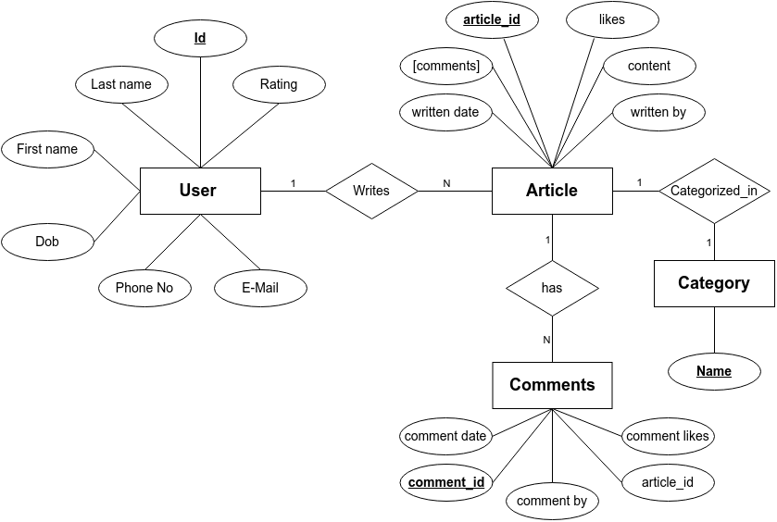

Slide 16
System Architecture
Data Flow diagram

Slide 17
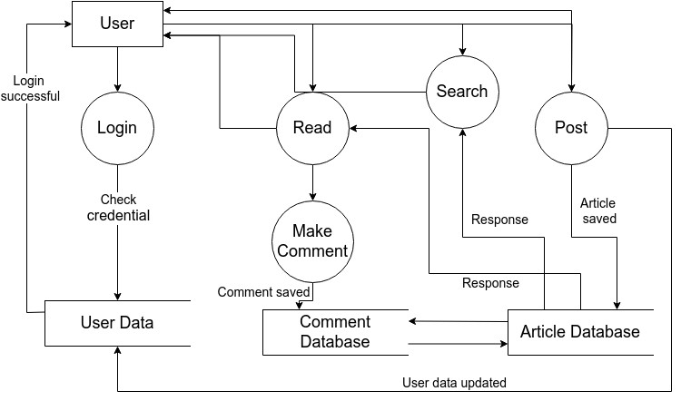

Slide 18
User Interface

Slide 19
The Outcome
Expected outcome of the project development work

Slide 20
Conclusion
Conclude your project idea.

Slide 21
Acknowledgment

Slide 22
Q&A

Slide 23
THANKS

