Slide 1
BANK MARKETING ANALYTICS
KRISHNA BIRADAR

Slide 2
OBJECTIVE :
To get insights about customers who subscribed term deposits. Insights include their demographical details and various indicators to know the customer better.
To get insights about the effectiveness of the marketing campaign on the customers. These insights help the company to take data driven decisions which will enable the bank get more revenues by acquiring more customers as well as in cost cutting.
KRISHNA BIRADAR

Slide 3
DATA SHARING AGREEMENT
Sample file name (ex bank-additional-full.csv)
Length of date stamp(8 digits)
Length of time stamp(6 digits)
Number of Columns
Column names
Column data type
KRISHNA BIRADAR

Slide 4
ARCHIETECTURE
KRISHNA BIRADAR

Slide 5
DATA OVERVIEW:
The zip file includes two datasets:
bank-additional-full.csv with all examples, ordered by date (from May 2008 to November 2010).
bank-additional.csv with 10% of the examples (4119), randomly selected from bank-additional-full.csv.
The smallest dataset is provided to test more computationally demanding machine learning algorithms (e.g., SVM).
The binary classification goal is to predict if the client will subscribe a bank term deposit (variable y).
Number of Instances: 41188 for bank- additional-full.csv
Number of Attributes: 20 + output
attribute.
KRISHNA BIRADAR

Slide 6
KEY PERFORMANCE INDICATOR
Key indicators displaying a summary of the Bank marketing Campaign’s results and subscribers’ information based on various parameters :
No of Subscribers based on age range.
Subscriber’s demographics such as age, job, education and marital status.
Credit default information and analytics
Employment variation rate - quarterly indicator
Consumer price index - monthly indicator (numeric)
Consumer confidence index - monthly indicator
(numeric)
Euribor 3-month rate - daily indicator (numeric)
Number of employees - quarterly indicator (numeric)
KRISHNA BIRADAR

Slide 7
INSIGHT SUMMARY:
Insight 1: People who work in Administration, technician and Blue-collar jobs subscribe to term deposit the most. Insight 2: People who are entrepreneur, unemployed or housemaid subscribe to term deposit the least.
Insight 3: Students, retired and unemployed are easiest to get whereas entrepreneur, blue-collar and
service people are difficult to get subscribed.
Insight 4: Conversion rate of married people is higher than the single and divorced people.
Insight 5: Customers who have either University degree or went High school or have enrolled in
professional course subscribed the term deposits most.
Insight 6: In the age between 60 to 80 and above the Leads conversion rate is maximum. Insight 7: People in the age range of (30-40) are targeted maximum.
Insight 8: All of the Customers who have subscribed term deposit have not defaulted on credit.
Insight 9: Approximately half of the total leads have a home loan on them.
Insight 10: Approximately 50% of the customers subscribed within 1 contact.
Insight 11: There are two types of people that is; Cellular and Telephone Users and out of which
there are 63.47% of the Subscribers are Cellular users.
Insight 12: Average duration per call for customers who subscribe to term deposit is 258.29 secs,
maximum call duration is 4918 secs and minimum is 0 sec.
KRISHNA BIRADAR

Slide 8
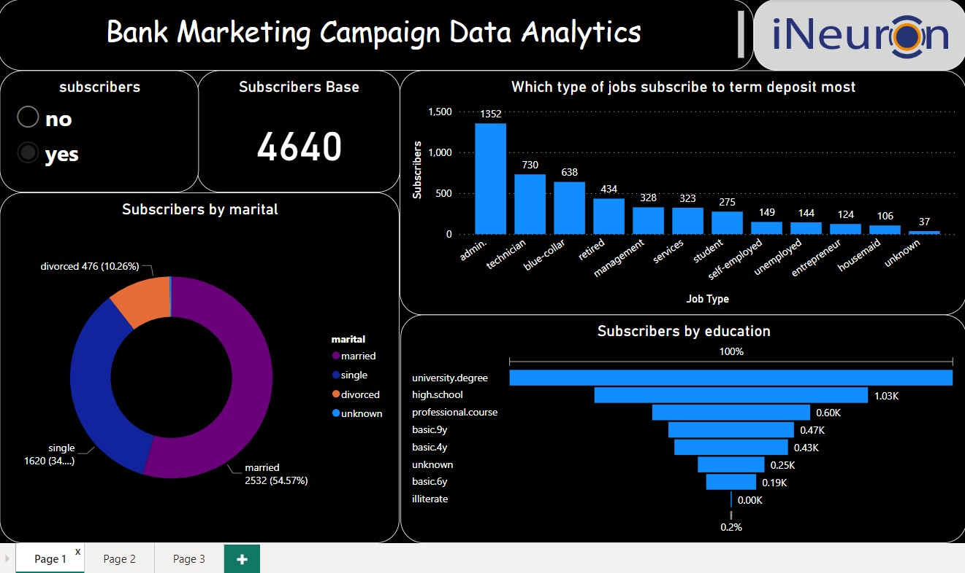
KRISHNA BIRADAR

Slide 9
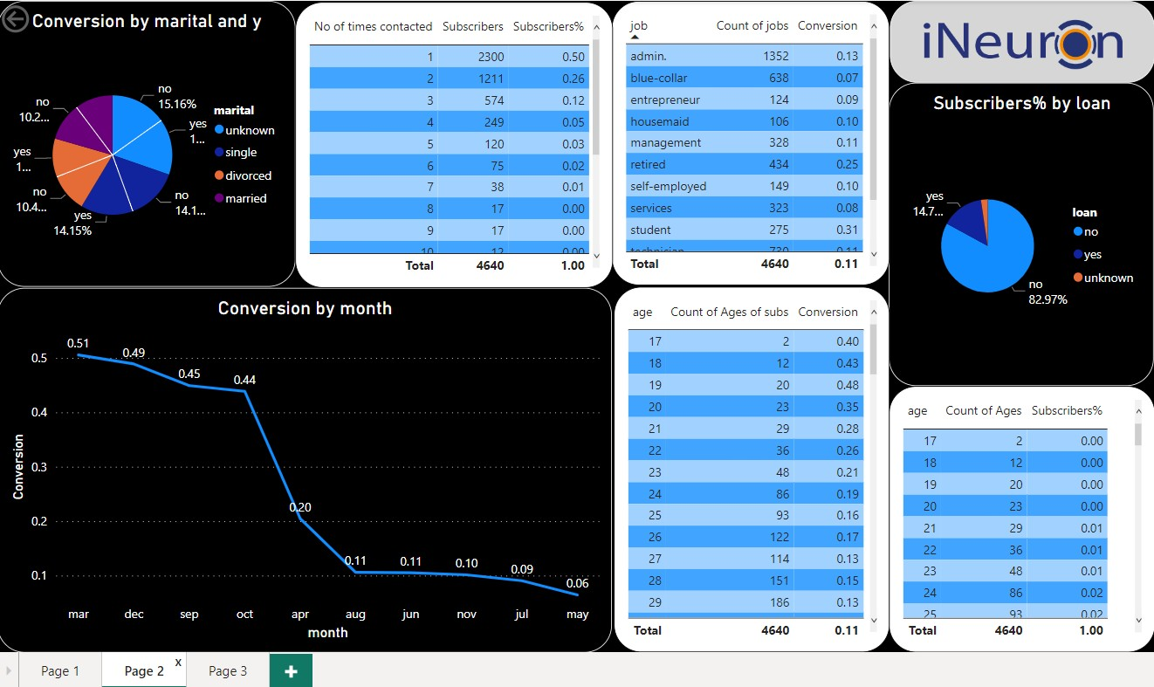
KRISHNA BIRADAR

Slide 10
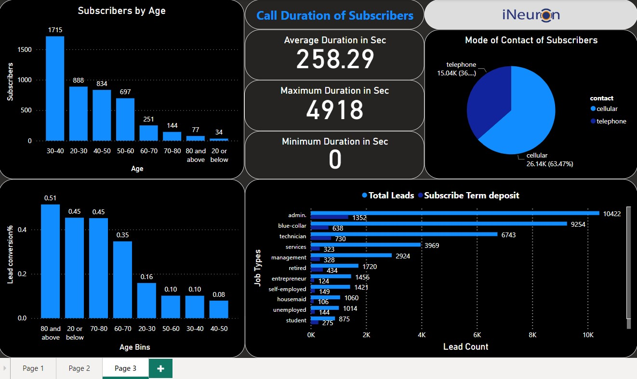
KRISHNA BIRADAR

Slide 11
INSIGHTS FROM DASHBOARD
A total of 41188 people were called during the campaign out of which 4640 subscribed to the term deposit.
Call duration time for age group 60-80 and above is more as compared to age group 20- 50 which indicates that younger customers need less time on call.
Out of 4640 customers, 54.57% of customers are married, 34.91% customers are single and 10.26% are divorced.
Many customers have a university degree or went to high school. Only 0.15% customers are illiterate.
KRISHNA BIRADAR

Slide 12
Most common jobs of customers are in Administration, Technicians and Blue-collar. Very few number of customers are entrepreneurs or housemaid.
In the month of April, May, Jun, Jul, Aug and Nov
the conversion ratio is least.
The highest leads conversion ratio stood at 0.51%
whereas lowest is 0.06%.
Maximum customers are in the age range of 20-60.
Maximum people were called in the age range of 20-50. Hence, leads conversion rate of people of age range 50-60 is highest
The lowest number of customers are age range of 80+ and 20 below. Usually, the people in the age range don’t have much time and earnings. So, they don’t invest in term deposit.
Average call duration of customers in 258.29 secs. Average consumer confidence index is -40.50 and Average Euribor 3m rate is 3.61.
KRISHNA BIRADAR

Slide 13
Question & Answer:
Q1) What’s the source of data?
This dataset is publicly available for research. Available at: [pdf] http://dx.doi.org/10.1016/j.dss.2014.03.001 titled “Bank Marketing (with social/economic context)”
Q 2) What was the type of data?
The data was contained in the zip folder in csv format.
Q 3) What’s the complete flow you followed in this
Project?
Refer all slides in sequence for better Understanding.
Q 4) What steps should I follow to get insights from the data?
Step1 – Download the data and store it in a location in
your PC.
Step2 – Open PowerBI_Report.pbix file in your pc and
then you can see all the insights.
KRISHNA BIRADAR

