Slide 1

Case Study
KRISHNA BIRADAR
8861937985

Slide 2
Agenda
1
2
3
4
5
Objective
Analysis
Insights
Recommendations
Dash Board

Slide 3


Objective
1.How can we grow business? Highlight 5 main focus areas with description & examples
2.What are the other insights from this data

Slide 4
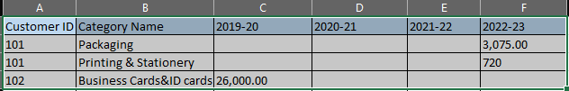

Analysis
Total number of Rows => 409
Total Number of columns => 6
Numeric Columns => 5
Categorical Columns => 1
No duplicates Present in This Data
After removing null values Total records => 402

Slide 5
Insights
2.What are the other insights from this data
Number of Orders is Highly Correlated with Total Sales for the Category of Printing & Stationery.
Number of Order is Moderately Correlated with Total Sales for the following Categories Signage ,Gifting & Calendars ,Diaries .
Maximum sales in year of 2022-23 for the category of Signage with price of 21,87,353
Maximum sales in year of 2022-23 for the category of Gifting with price of 718,91,211
Maximum sales in year of 2020-21 for the category of Printing & Stationery with price of 48,00,000
Maximum sales in year of 2019-20 for the category of Signage with price of 62,66,870
Minimum sales in year of 2022-23 for the category of Posters with price of 54
Minimum sales in year of 2021-22 for the category of Services with price of 100
Minimum sales in year of 2020-21 for the category of Printing & Stationery with price of 30
Minimum sales in year of 2019-20 for the category of Photo Products with price of 176

Slide 6
Insights
Financial year 2020-21 is the highest soldout year with sale of 31327315.85
The Category Poster is having least percentage of Overall Sales.
The category Gifting is having highest percentage of Overall Sales.
Average of sales with respect to Category & Year is 145701.1082
Photo Prints, Business cards & ID cards , Apparel having less number of orders with high amount of sales.
Customers showing more intrest on Category Printing & Stationery having orders of 139.
Financial year 2022-23 having highest number of Orders with sales of 22105350.11

Slide 7
Five Main Focus Areas
Calendars & Diaries
Here, No. of orders & Total sales are positively correlated hence we have to focus on generating more number of Orders so that if we increase No. of orders then Total sales will be increased.
Printing & Stationery
We are focusing on this because printing & stationery is highly correlated & having overall 14% of Total sales. This category having highest No. of Orders(139) which shows more demand to this category
1.How can we grow business? Highlight 5 main focus areas with description.
Increasing Margin on Printing & Stationery because it is already having highest number of Orders.
We have improve in the area of sales particularly for Calendars & Diaries.
Maintaining our existing customers for the category of Signage , Gifting, Printing & Stationery.
Focusing on customer service for the category of Photo Products to enhance more number of orders.
Overall percentage of Total sales is 29% & which is the highest category among all. So we have focus on sustainability to maintain constant revenue generation.
Gifting
Photo Products
Photo Products having less number of Orders but having High margin. So if we increase the number of orders then we can generate more revenue compared to all other category
Overall percentage of Total sales is 12% & which is the consistent category among all. So we have focus on sales to maintain constant revenue generation.
Signage

Slide 8
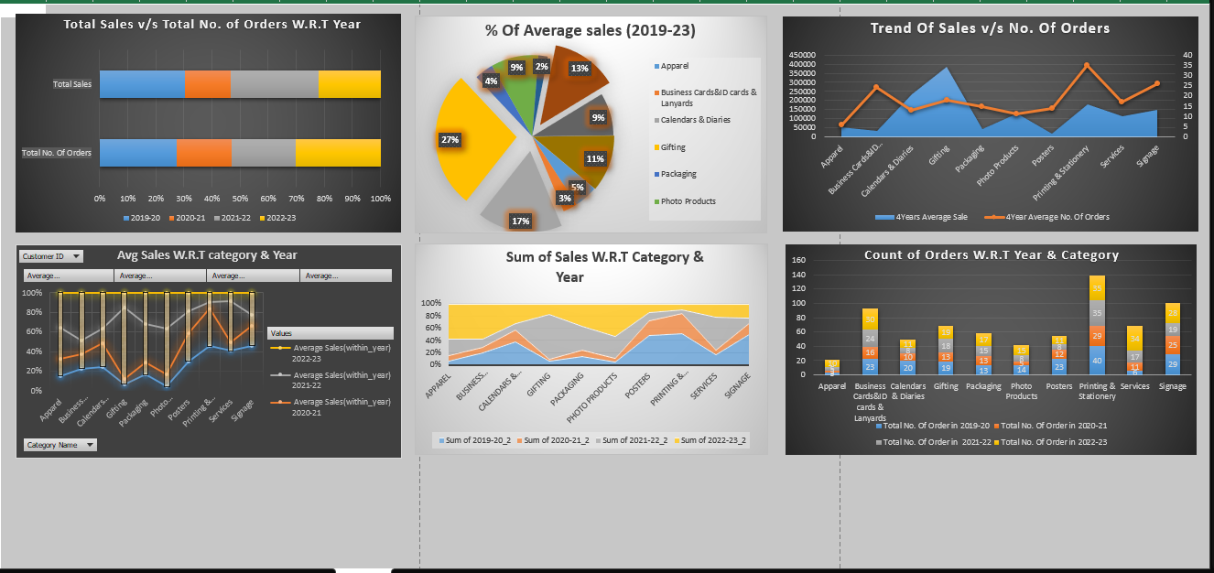
DashBoard

Slide 9
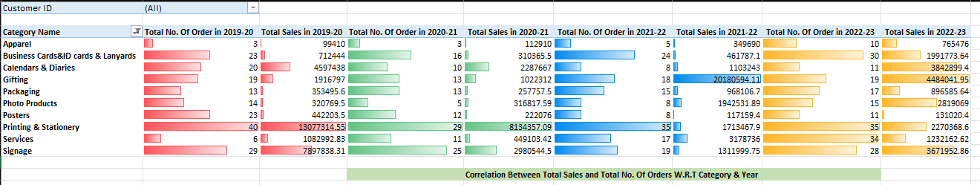
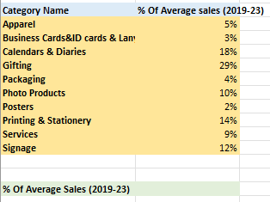
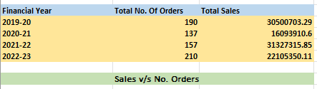
Pivot Tables

Slide 10
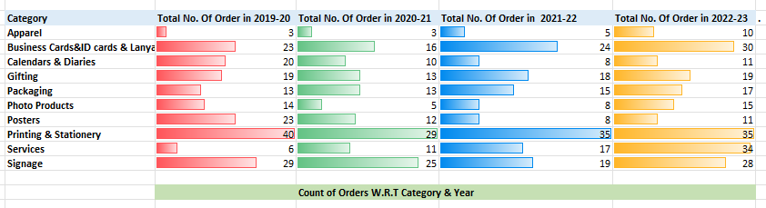
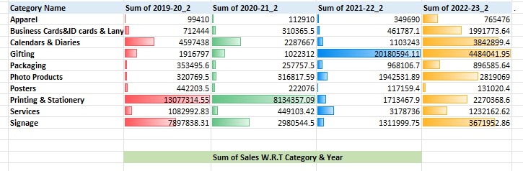
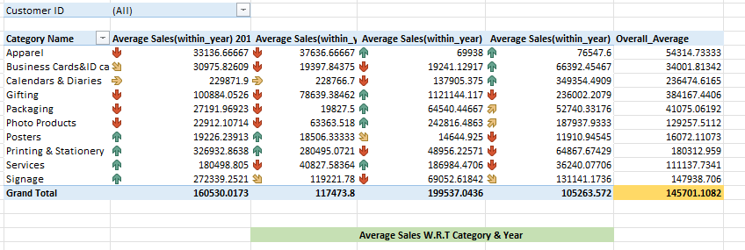

Slide 11
Thank you
KRISHNA BIRADAR
KITTYBIRADAR123@GMAIL.com
+918861937985

