Slide 1


SMART INDIA HACKATHON 2026
TITLE PAGE
Problem Statement ID –26037
Problem Statement Title- Adaptive Path Planning & Collision Avoidance for Autonomous Vehicles on Unstructured Indian Roads
Theme- Robotics and Drones
PS Category- Software
Team ID-
Team Name- MargDarshak

Slide 2
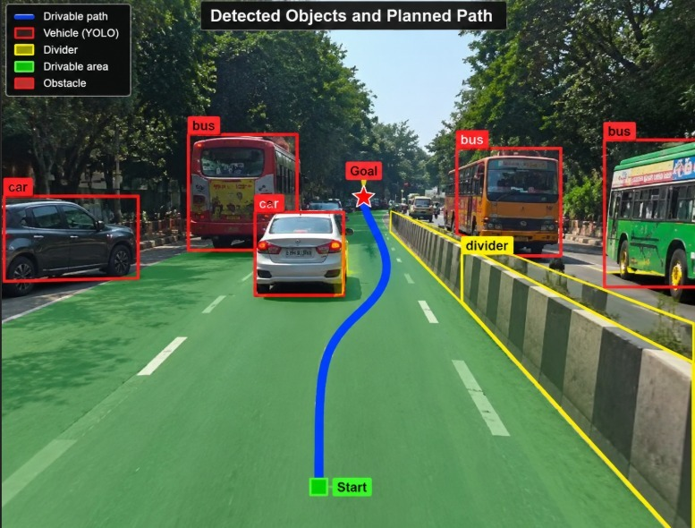
IDEA TITLE
MargDarshak
Problem Statement:
India witnessed over 4.8 lakh road accidents and 1.72 lakh deaths in 2024 alone, nearly 20 lives lost every hour, mostly on unstructured roads with no clear lanes, chaotic mixed traffic, and unpredictable right-of-way. Two-wheeler riders and pedestrians account for nearly two-thirds of these deaths, exposing the failure of conventional autonomous systems built for orderly, lane-disciplined roads abroad. This calls for an AI-driven path-planning and collision-avoidance system with robust perception, real-time prediction, and adaptive navigation built to survive the real chaos of Indian roads.
Pain points:
No lane markings, no fixed rules: Indian roads run on negotiated right-of-way (eye contact, honking), which current AV systems can't understand.
Heterogeneous traffic: cars, two-wheelers, autos, pedestrians, and animals all move differently; one-size-fits-all prediction models fail.
Dynamic road surface: potholes, encroachments, and parked carts constantly change the drivable space in real time, which most systems can't adapt to.
Our Approach:
Drivable-area detection- DeepLabv3+ (ResNet-18) trained on IDD, fused with lane detection + boundary-safety filter.
Obstacle detection- YOLOv8 merged with road-surface thresholding into one drivable mask.
Path planning- A* search + spline smoothing with safety validation.
Control loop- Simulink vehicle model + Pure Pursuit controller, adaptive speed control.

Slide 3
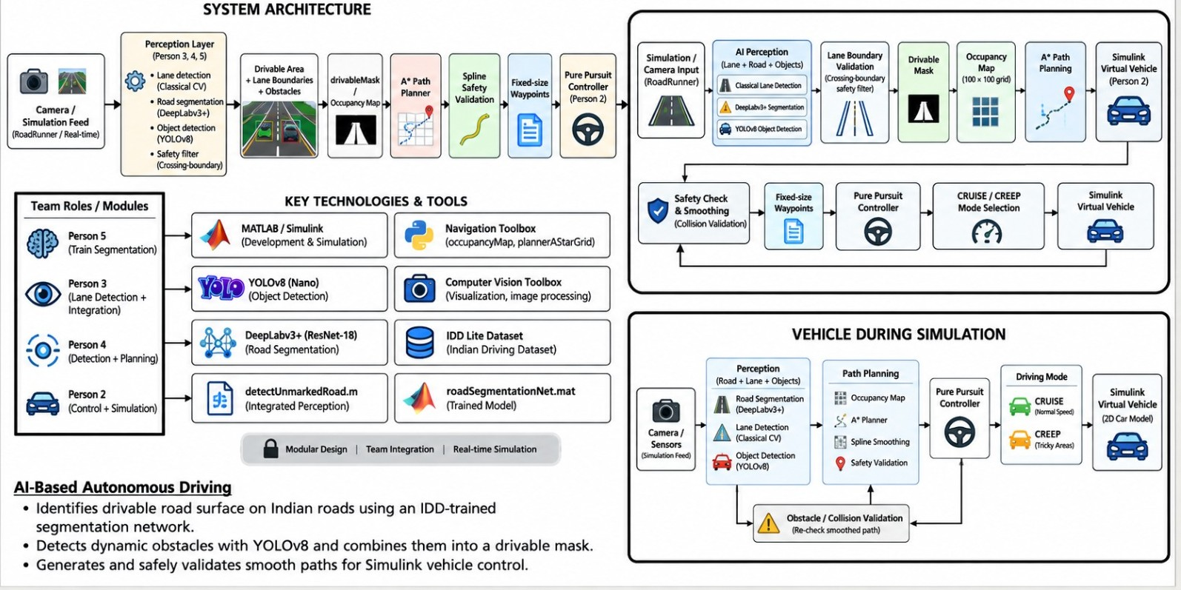
TECHNICAL APPROACH
MargDarshak

Slide 4


FEASIBILITY AND VIABILITY
MargDarshak
FEASIBILITY:
Proven AI Integration: Uses a DeepLabv3+ ResNet-18 model trained on real Indian road images (IDD dataset) achieving 96.9% accuracy for rapid deployment.
Modular & Scalable: Combines classical lane detection, learned segmentation, A* path planning, and Simulink control loop, letting each module be upgraded or replaced independently.
Built entirely in MATLAB/Simulink and RoadRunner, requiring no extra external hardware or internet connectivity.
POTENTIAL CHALLENGE &RISK:
STRATEGIES TO OVERCOME:
Sim-to-Real Camera Parameter Mismatch Risk
Small Dataset.
Merging classical and learned detection.
Explicitly matching RoadRunner camera settings to MATLAB monoCamera parameters.
Collapsing seven classes into binary road/not-road to maximize training examples.
Building a crossing-boundary-pairs safety filter to reject invalid, contradictory boundary detections.
Viability:
Extend the current A* planner into the full Frenet lattice architecture for smoother production-grade planning.
Move from static test frames to full live real-time RoadRunner-Simulink co-simulation.
Retrain the segmentation network on larger, diverse Indian road datasets over time.

Slide 5
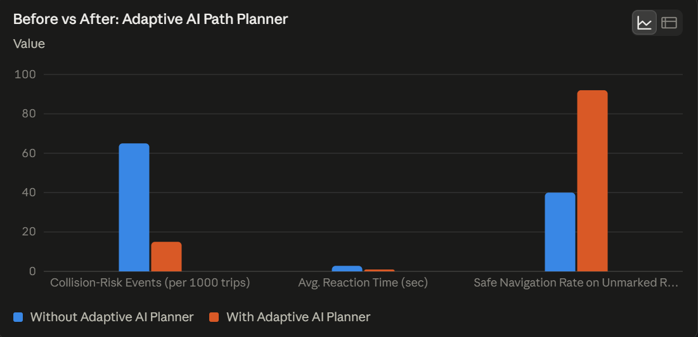
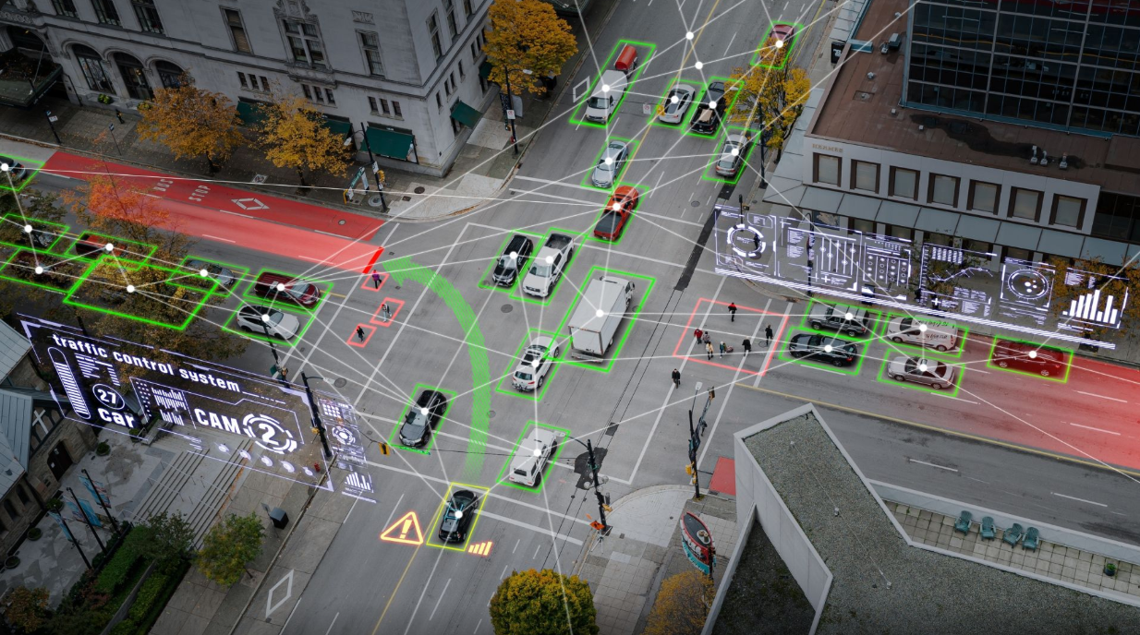
IMPACT AND BENEFITS
MargDarshak
IMPACT:
Social: Helps reduce India's ~1.7 lakh annual road deaths by making vehicles safer on chaotic, unmarked roads.
Economic: Builds India's own AV/robotics industry instead of relying on foreign tech that doesn't suit Indian roads.
Environmental: Smoother driving means less braking and accelerating, cutting fuel use and emissions.
Lives Saved: Prevent hundreds of two-wheeler and pedestrian deaths annually on unmarked, mixed-traffic roads.
BENEFITS:
No Lane Markings Needed: Detects drivable area directly from the road.
Filters Unsafe Paths: Rejects confusing road boundaries before planning.
Real-Time Obstacle Avoidance: Updates path instantly around pedestrians & vehicles.
Smart Speed Control: Auto-slows on unmarked or unpredictable stretches.
Tested End-to-End: Perception, planning & control validated together.

Slide 6

RESEARCH AND REFERENCES
MargDarshak
RESEARCH
REFERENCES
AEB cuts crashes by 43%: IIHS study, 43% fewer rear-end crashes, 64% fewer injury crashes.
Pedestrian AEB cuts risk by 25–27%: Real-world crash data shows significant drop in pedestrian crash & injury risk.
India-specific models perform better: IndiVNet (2025) hits 69.98% mIoU on Indian roads, beating Western-trained models.
Vulnerable users hit hardest: Two-wheelers & pedestrians make up most of India's ~1.72 lakh annual road deaths.
Existing solutions:
Minus Zero: Vision-based, handles unmarked roads, but still needs a safety driver.
Flux Auto: Autonomous trucking, limited to highways only.
Swaayatt Robots: Research-stage Level-5 autonomy, not deployed.
Indian Driving Dataset (IDD Lite), IIIT Hyderabad
https://idd.insaan.iiit.ac.in/
DeepLabv3+ (ResNet 18 backbone), MATLAB Deep Learning Toolbox
https://www.mathworks.com/help/vision/ref/deeplabv3plus.html
YOLOv8, Ultralytics
https://github.com/ultralytics/ultralytics
Hart, Nilsson & Raphael (1968), A Formal Basis for the Heuristic Determination of Minimum Cost Paths, IEEE Transactions on Systems Science and Cybernetics
MATLAB Navigation Toolbox (occupancyMap, plannerAStarGrid)
https://www.mathworks.com/products/navigation.html
Our Prototype: https://drive.google.com/drive/folders/12TVsPDQTXlqoxHVN5NpC-rVuWhECY4m5?usp=sharing

