Slide 1
AES Implementation
By Siva Chintapalli (20062580)
Sourav Bhowmik (20061723)

Slide 2
Talking Points
Introduction
Fun Fact
Coming back to point
Changes made
Approaching Decryption
Working of Driver
Padding
Authentication

Slide 3
INTRODUCTION
Why AES implementation?
Not easy
AES is very popular
What is AES?
Encrypts messages
NIST standard
Very secure

Slide 4
Fun Fact!
Accepting Moore’s Law, doubling the processor speed every 18 months, AES will be secure for another 109.5 years.
Source: Internet

Slide 5
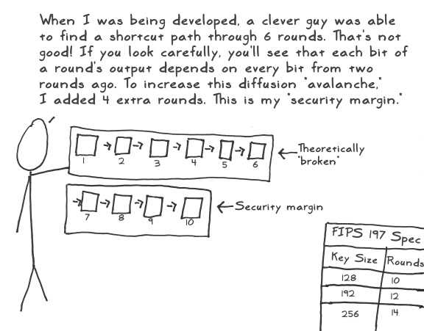

Slide 6
Coming back to the point
What we started with……
128-bit encryption implementation
What we achieved
128-bit decryption implementation
192-bit, 256-bit encryption and decryption implementation
Padding scheme

Slide 7
Changes made for extending from 128-bits to 192 and 256-bits
 | 128 | 192 | 256
Size of W | 4*44 | 4*52 | 4*60
No. of Rounds | 10 | 12 | 14
Changes in Code | Nw=4 | Nw=6 | Nw=8, extra AES S-boxSubstitution() for column no divisible by 4 and not by 8

Slide 8
Approaching Decryption
Exact reverse of encryption process
Three additional methods implemented
InverseShiftRow()
replaces aesShiftRow()
InverseSBoxSub()
replaces InverseSBoxSub()
InverseColumnMix()
replaces InverseColumnMix()

Slide 9
Continued….
InverseGaloisMatrix=
0E 0B 0D 09
09 0E 0B 0D
0D 09 0E 0B
0B 0D 09 0E
where:
x*9=(((x*2)*2)*2)^x
x*11= ((((x*2)*2)^x)*2)^x
x*13=((((x*2)^x)*2)*2)^x
x*14=((((x*2)^x)*2)^x)*2

Slide 10
Working of driver.java:
The driver can accept input in 2 ways:
From text file
From Standard Input

Slide 11
From text File:
Exactly 4 lines.
The first line should contain exactly one of '0', '1' or '2'.
The second line should contain either 'e' or 'd'.
The key.
The message.

Slide 12
Sample Text File
1
e
000102030405060708090a0b0c0d0e0f1011121314151617
5468617473206D79204B756E67204675

Slide 13
From Standard Input:
User enters the data manually.
guided with appropriate prompts.

Slide 14
Padding Scheme:
The length of the message is first determined.
Next, the no. of characters(say n) needed to make the message a multiple of 32 is determined.
The message is padded n/2 times with the value n/2.
This padding scheme was chosen because it is very simple to understand and easy to implement.

Slide 15
Suggested Authentication Mechanism:
HMAC-SHA-3
Why?
HMAC is efficient and easy to implement.
SHA-3 (Keccak) not yet been broken, tough to break.

Slide 16

Got Questions?

