Slide 1

SENSITIVE ATTRIBUTE IDENTIFICATION AND PROTECTION
Presented by
Lakshmi Sri Lasya T
125156063
3rd Year / CSE(AI & DS)
Guided by
Dr.M.Sumathi
AP-III / IT/ SOC
SASTRA Deemed to be University, School of Computing

Slide 2
BASE PAPER
Base Paper Title: F-Classify: Fuzzy Rule Based Classification Method for Privacy Preservation of Multiple Sensitive Attributes
Journal Name: Sensors
Year of Publication: 2021
Publisher Name: MDPI
2
22-03-2024

Slide 3
INTRODUCTION
In today's world personal details such as name, phone number, email-id and password are the most crucial elements to protect. In healthcare domain information, such as personal details, details of diseases, and details of treatments, is extremely sensitive.
Protecting sensitive information is therefore a fundamental and top need in the medical industry.
The entire attribute encryption take more processing time and reduce data usability to authorized users.
To provide security to personal data and reduce processing time, the need for identifying and securing sensitive information has become more crucial than ever.

Slide 4

Literature Review
Sl . No | Paper Title | Technique Used | Merits | Limitations
1 | Personalized Privacy Preserving Approaches for Multiple Sensitive Attributes in Data Publishing: Lancaster, PA, USA, 2016 | The approach used generalization with suppression and anatomy. | The approach reduces positive and negative disclosure risks are reduced by analyzing correlation. | It caused the utility to decrease. High information loss.

Slide 5
Literature Survey
Sl . No | Paper Title | Technique Used | Merits | Limitations
2 | Implementation of slicing for multiple column multiple attributes: Privacy preserving data publishing. Int. J. Recent Innov. Trends Comput. Commun. 2015 | The proposed approach is for the MSAs anonymization, and QIs are overlooked. | Better data service and also used for enrollment Acknowledgment conservation. | It is sensitive to skewness attacks and similarity attacks.

Slide 6
Literature Review
Sl . No | Paper Title | Technique Used | Merits | Limitations
3 | Privacy-preserving data publishing for multiple numerical sensitive attributes. Tsinghua Sci. Technol. 2015, | This approach works on numerical data and the technique used is bucketization. | Good results on numerical data. No high information loss. | Do not work on textual data.
6

Slide 7

PROBLEM STATEMENT
The entire attribute protection slows down the processing of the data and decreases its usability for authorized users. Applying protection to a sensitive attribute instead of an entire attribute increases usability for authorized users and protects sensitive attributes.

Slide 8
OBJECTIVE
To classify sensitive attributes from a structured and semi-structured data by using fuzzy-rules and natural language processing techniques and also ML and DL techniques. Applying protection to sensitive attributes by using attribute-based encryption.

Slide 9
DATA SET
The dataset is from GitHub page.
The dataset is chosen for its high amount of records.
https://github.com/DhilipSanjay/Detection-of-Sensitive-Data-Exposure-in-Images/tree/main/text_dataset
‘Sensitive.json’ comprises of 15576 records.
‘NonSensitive.json’ comprises of 16000 records.
9
22-03-2024

Slide 10
METHODOLOGY
Step1: The sensitive and non-sensitive dataset is loaded.
Step2: The dataset is pre-processed for implementation of ML and DL algorithms.
Step3: Now DL model such as CNN and ML models like Random Forest and Decision Tree are implemented.
Step4: Fuzzy rules are made by observing the data in data sets. System is simulated.
Step5: Now the ML and DL models are evaluated by their accuracy.
Step6: Fuzzy system is evaluated by its sensitivity rate prediction.

Slide 11
Hardware and Software Requirements
Hardware:
4GB RAM
256GB external memory
Software:
Visual Studio
Python

Slide 12
System Architecture / Flow diagram of the work
Models
Data Pre-processing
Load
Sensitive and non sensitive
dataset
ML
Pre-processing of text by Tokenizer
Transform sentences to integers by word index
DL
Fuzzy logic and NLP
Fuzzy System
Splitting data
Models
Data
Fix Antecedent,
Consequent
ML
Random Forest, Decision Tree
Evaluation Metrics
Models
DL
CNN
Sensitivity measure
Formulate rules and membership functions
Accuracy
Set values for user input by re (NLP)
Test
Train
Simulate and compute results
12
12

Slide 13
MODULES
Module 1: Data pre-processing and splitting.
Module 2: Implementation of CNN on ‘Sensitive.json’ and ‘NonSensitive.json’.
Module 3: Implementation of decision tree, random forest.
Module 4: Implementation of fuzzy logic.

Slide 14
Module1
Data Pre-processing:
1.Load dataset: use loadDataset(filename) to load JSON data
2.Remove Stop words: Extract and process sentences to remove stop words.
3.Create Data Frames: Convert processed sentences and labels to data frame.
4. Balance Data set: Implement down sampling and then split into features(X) and labels(y).
5.Tokenization: Tokenize sentences into words.
6.Word Index: Map words to their numerical identifiers.
7.Split Data set: Use train_test_split to split dataset.
14
22-03-2024

Slide 15
Module2
CNN:
1.Model Creation: A sequential model is created using Keras. The model includes an Embedding layer, a Batch Normalization layer, a 1D Convolution Layer, a Dropout layer, a Global Average Pooling layer, another Batch Normalization layer, a Dense layer with ReLU activation, another Dropout layer a final Dense layer with sigmoid activation.
2.Compile Model: The model is compiled with cross-entropy as the loss function, Adam as the optimizer.
3.Display of model summary: Model summary is displayed.
15
15
22-03-2024
22-03-2024

Slide 16
Module2
CNN contd..
4.Set the Epochs: The number of epochs for training is set to 10.
5. Model is trained using fit method.
6.Passing validation data to fit method, model evaluates after each epoch.
7.The model is evaluated by accuracy measure.
16
16
16
22-03-2024
22-03-2024
22-03-2024

Slide 17
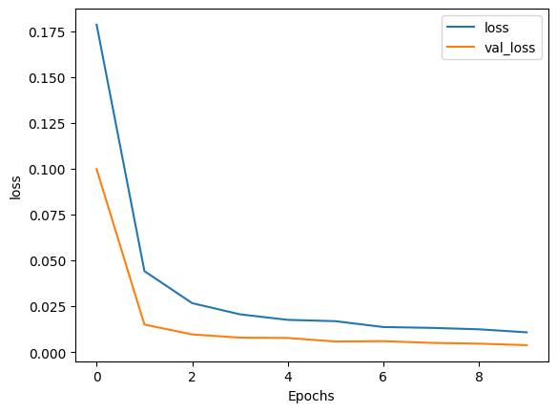
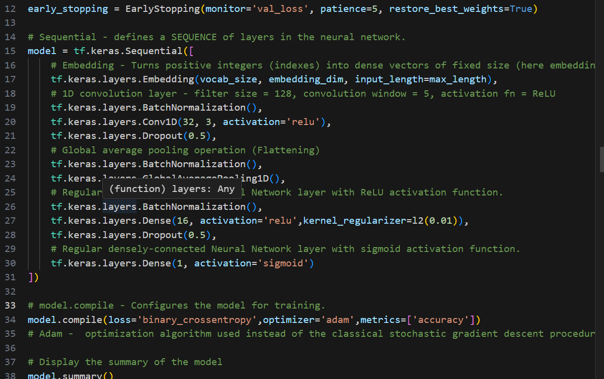
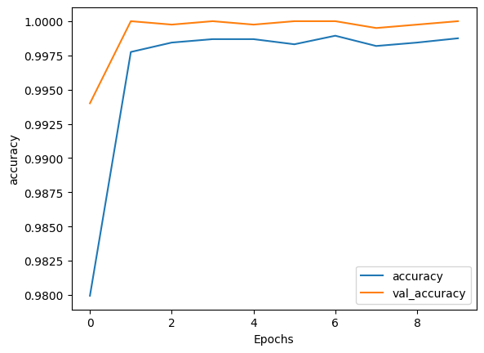
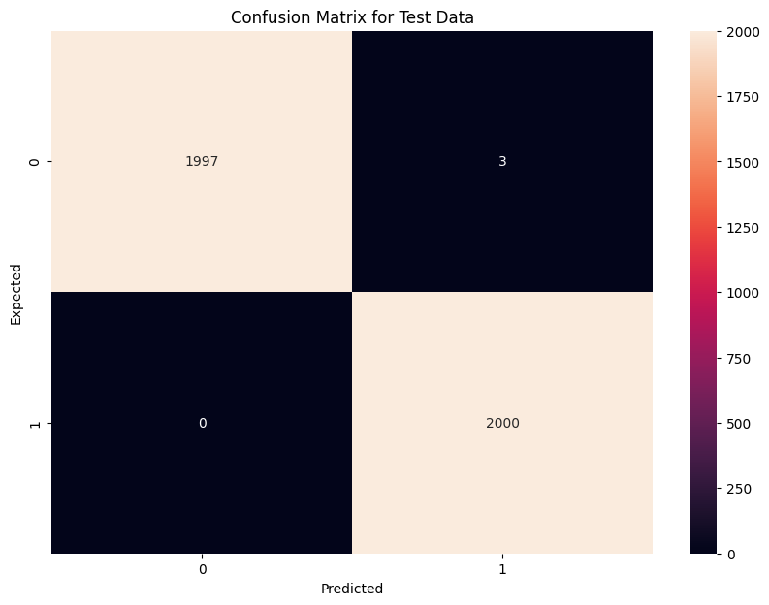
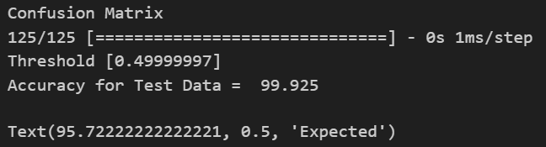
CNN OUTPUTS:

Slide 18
Module3
Random Forest and Decision Tree:
1.The data is processed using CountVectorizer which converts collection of text documents to a matrix of token counts.
2. Now a RandomForestClassifier is created with n_estimators=1 and the model is fitted by X_train and y_train and then the model is tested on X_test and accuracy is observed.
3.Similarly DecisionTreeClassifier is created with criterion=‘entropy’, random_state=0,max_depth=3 and model is trained, tested and evaluated.
18
18
22-03-2024
22-03-2024

Slide 19
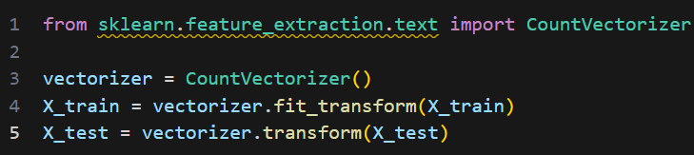
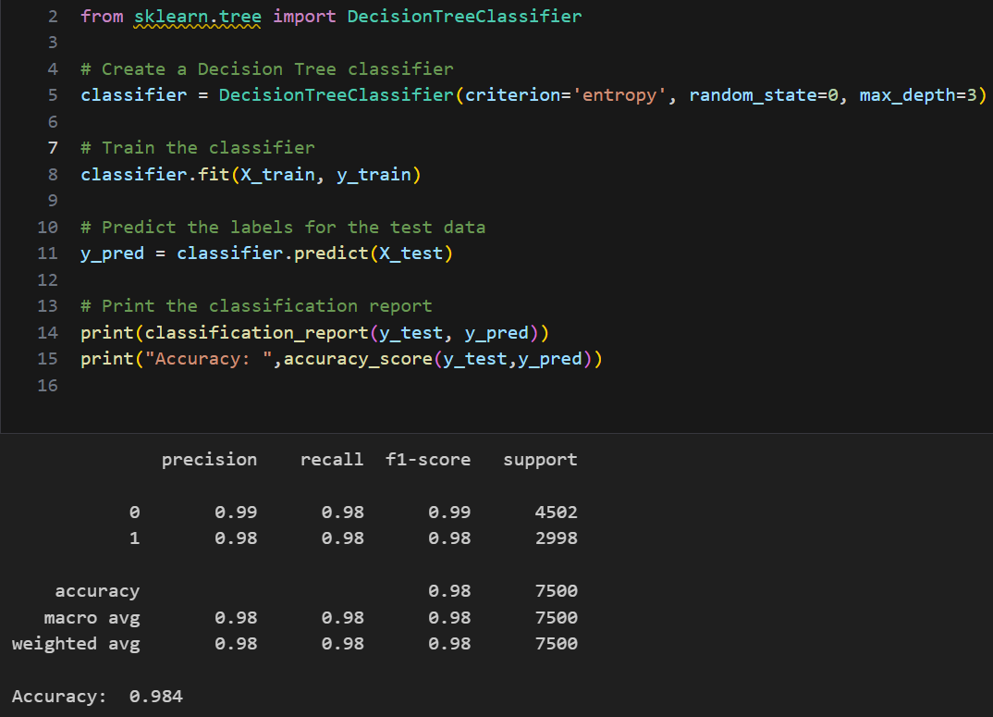
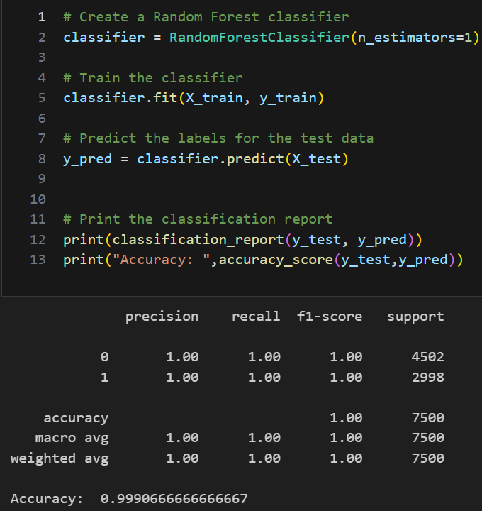

Slide 20
Module4
Fuzzy System Algorithm:
1.Define Variables:
Let X={x1,x2,x3,x4,x5} represents set of user attributes.
2. Membership functions:
automf(n) denote the automatic membership function which divides universe of discourse for each xi into n fuzzy sets.
trimf(x,[a,b,c]) denote triangular membership function where a,b,c represent the points of triangle.
3.Fuzzy Rules:
Ri : X1 ∧ X2 ∧ X3….. → Y where x1,x2,x3 are antecedents and y is consequent
4.Control System:
Let C be the control system then Y = C(X)
5 Simulation:
Define input, apply C on input variables and use defuzzification on fuzzy outputs.
20
20
22-03-2024
22-03-2024

Slide 21
Module4
Fuzzy logic :
1.Define universe discourse for 'username', 'password', 'email', and 'phone_number’ as inputs, and 'sensitivity’ as the output.
2. Membership functions are defined with automf(3) function which automatically creates three fuzzy sets for each input variable: poor, average, and good. For the output variable 'sensitivity', three fuzzy sets are manually created: low, medium, and high with trimf().
3. Define Fuzzy rules: There are seven rules defined here. For example,if the username, password, email, and phone number are all 'poor', then the sensitivity is 'low’.
4.Define Control System : This system takes the inputs and applies the rules to determine the output.
5. Simulation: Create a control system simulation to apply fuzzy control. This will be used later to input the values and get the output. Regular expressions are used to identify the presence of sensitive attributes and then they are valued based on their presence.
6.Sensitivity graph: Use view() function to observe how sensitivity varies.
21
21
21
22-03-2024
22-03-2024
22-03-2024

Slide 22
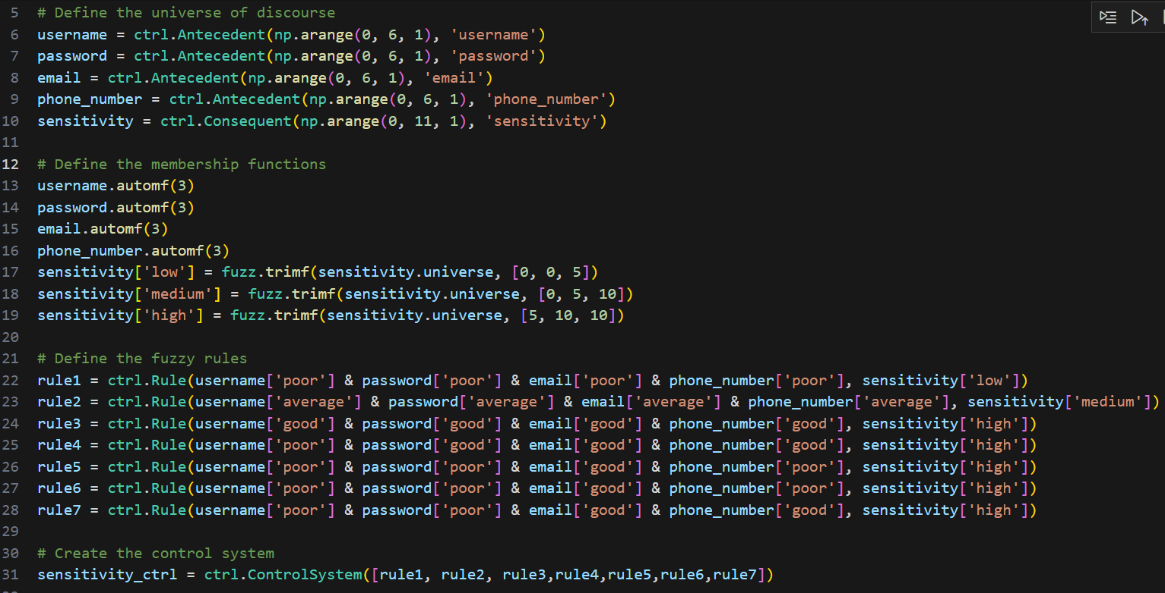
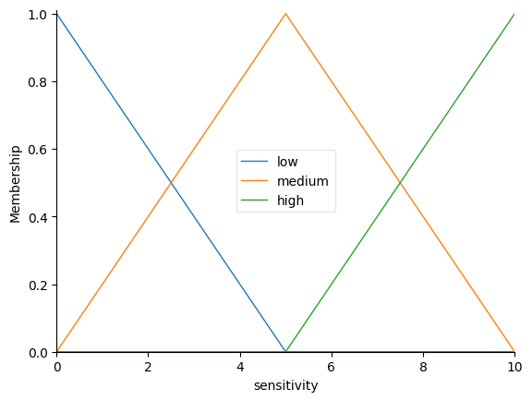
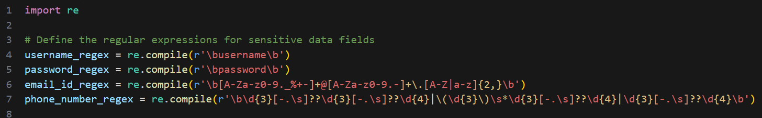
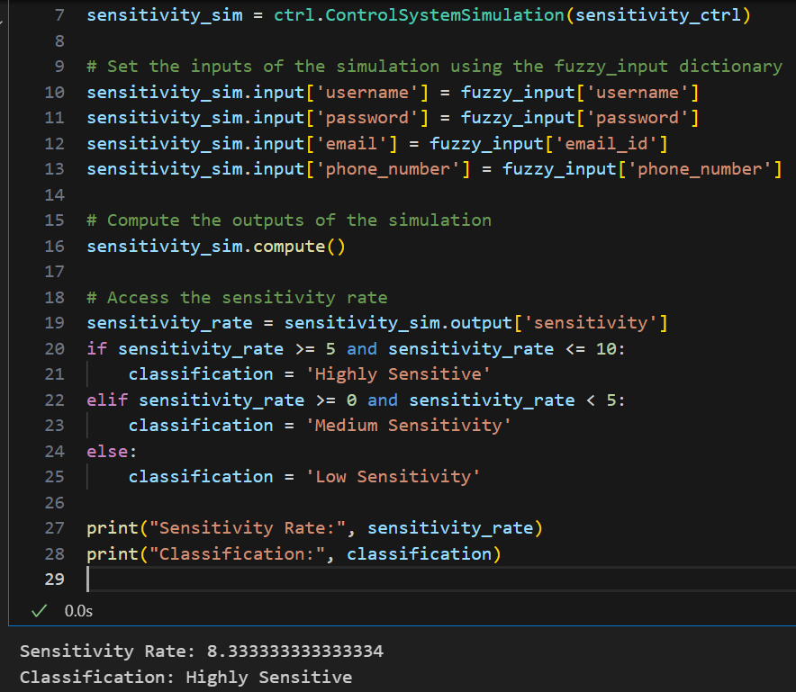
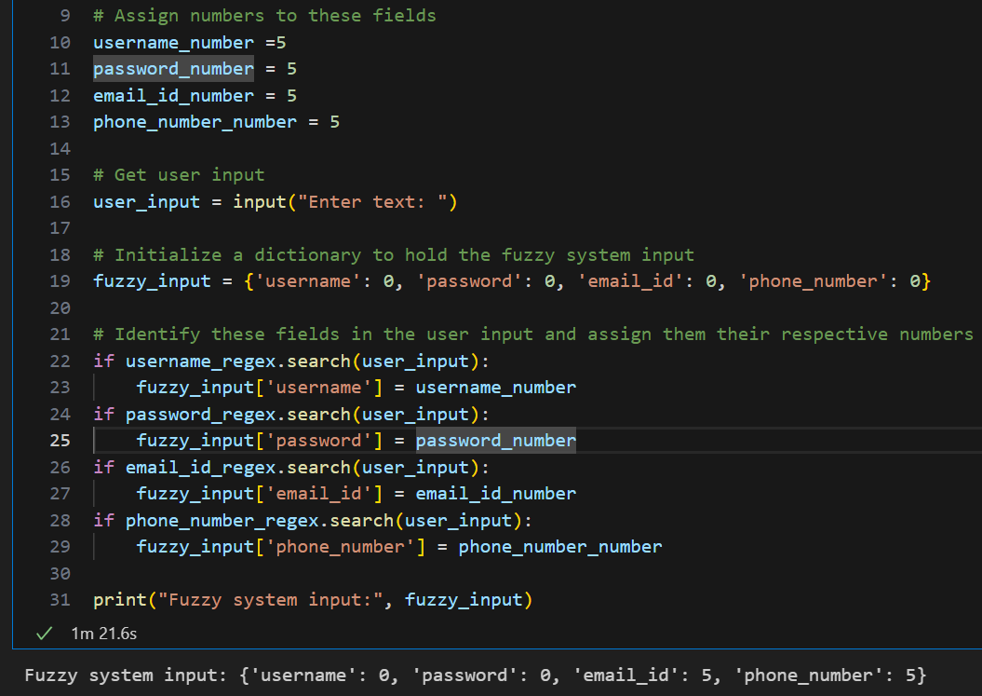
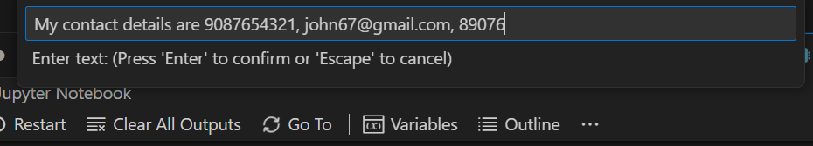

Slide 23
Work Plan
Review Period | Work Particulars | % of Work Completed
Zeroth Review | Base paper Confirmation Problem identification Hardware and Software Requirement Analysis | -
First Review | Fuzzy implementation and NLP implementation | 40%
Second Review | ML and Neural Networks Implementation Comparative Analysis Identification of sensitive attributes by best algorithm and applying encryption techniques | 100%

Slide 24
THANK YOU

