Slide 1


A PROJECT REPORT On
“Gir Wildlife Sanctuary”
Submitted in partial fulfillment for the
BCA 5th Semester To
Affiliated To:
KRISHNA DAVE (ENROLMENT NO: 3051900062)
ANJALI BHATT (ENROLMENT NO: 3051900056)
BY:
Project Internal Guide Principal
(Prof. Pooja Pandya) (Dr. Vimal Parmar)

Slide 2
Dr. Subhash College of Computer Science Junagadh
Certificate
Enrollment No. 3051900062, 3051900059
This is to certify that the Project / practical work was satisfactorily carried out and hence submitted this report is the bonafide work of Ms. KRISHNA DAVE & Ms.
BHATT ANJALI Student of Bachelor of Computer Applications Sem 5 in the
_____________________________ Laboratory of Dr. Subhash College of Computer Science Junagadh during the academic year 2020-21.
_____________ _______________
Internal Guide HOD
________________
Principal

Slide 3
ACKNOWLEDGEMENT
I take this opportunity to express our sincere gratitude to all those who helped us in various ways in undertaking this project and devising the report.
I am privileged to express our sense of gratitude to our respected project guide Prof. Pooja Pandya’s unparalleled knowledge, moral fiber and judgement along with her know-how, was an immense support in completing the project.
I am also grateful to Dr. Vimal Parmar, the Principal and all other faculties of BCA for the brainwave and encouragement given. I take this opportunity to thank our friends and contemporaries for their cooperation and compliance.
And lastly, I would like to pay my sincere regards to my parents and to our near and dear ones whose moral support and guidance helped us to complete and submit the project well before the due date.

Slide 4
DECLARATION
I am College of Computer Science BCA for the Bachelor of Computer Application Sem 5th. And this project is not submitted to anywhere else in the market of use a system.
I also assure you that no copy of this project is share with any other student and developed by us with guidance of our faculties.

Slide 5
Index
Sr. No | Title | Page. No
1 | Introduction 1.1 Project Profile 1.2 Project Definition 1.3 System Specification 1.4 Tools / Platform | 1 2 3 4 5
2 | Project Analysis 2.1 About Existing System 2.2 Limitations of Existing System 2.3 Proposed System 2.4 Advantages of Proposed System 2.5 Feasibility Study 2.5.1 Economic Feasibility 2.5.2 Technical Feasibility 2.5.3 Operational Feasibility | 6
3 | Diagrams 3.1 Data Flow Diagram 3.2 Use Case Diagram 3.3 Data Dictionary
4 | Screen Shots
5 | Project Sample Code
6 | Testing Mechanism 6.1 Unit Testing 6.2 Black Box Testing 6.3 White Box Testing
7 | Future Scope of the Project
8 | Limitations Of the Project
9 | Bibliography

Slide 6
1. INTRODUCTION:
1.1 PROJECT PROFILE:-
Project Title | Gir Wildlife Sanctuary
Project Type | Web Application
Language Used | PHP
User Interface | HTML, CSS, JS, NODE JS
Database | MYSQl
Web Browser | Google Chrome, Mozilla, Firefox
Software | XAMPP

Slide 7



DIAGRAMS: -
Data Flow Diagram (DFD):
Touriest
Gir Wildlife Sanctuary
Admin

Slide 8
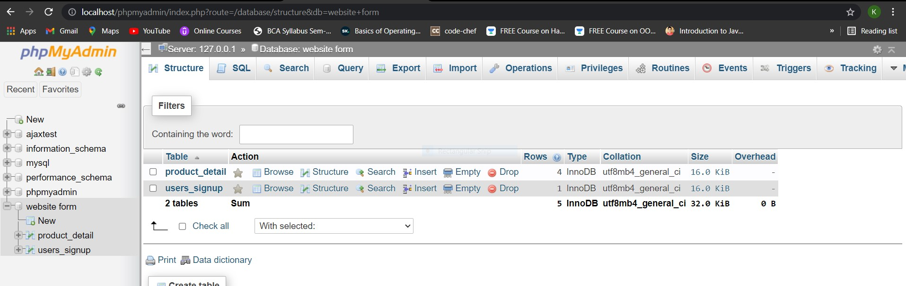
Data Dictionary:

Slide 9
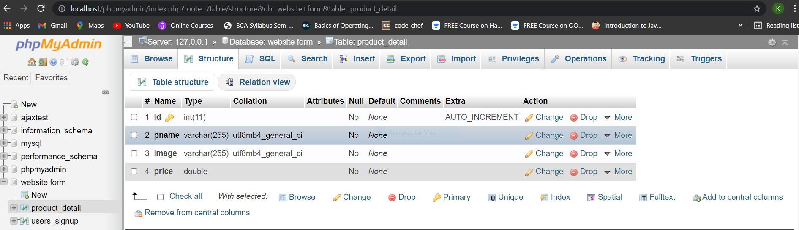

Slide 10
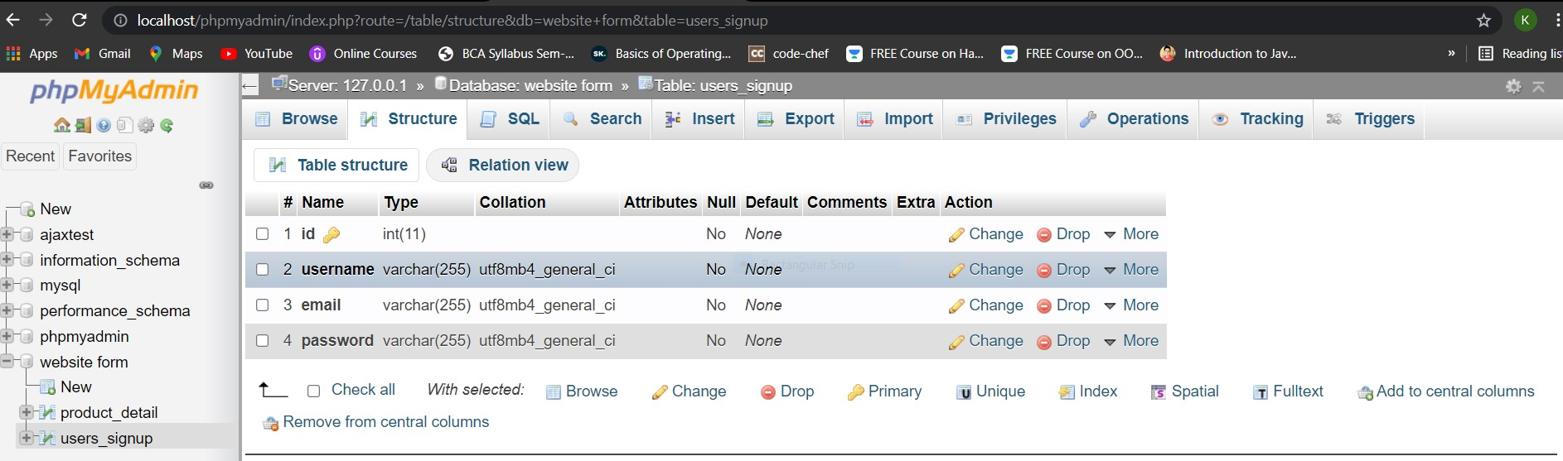

Slide 11
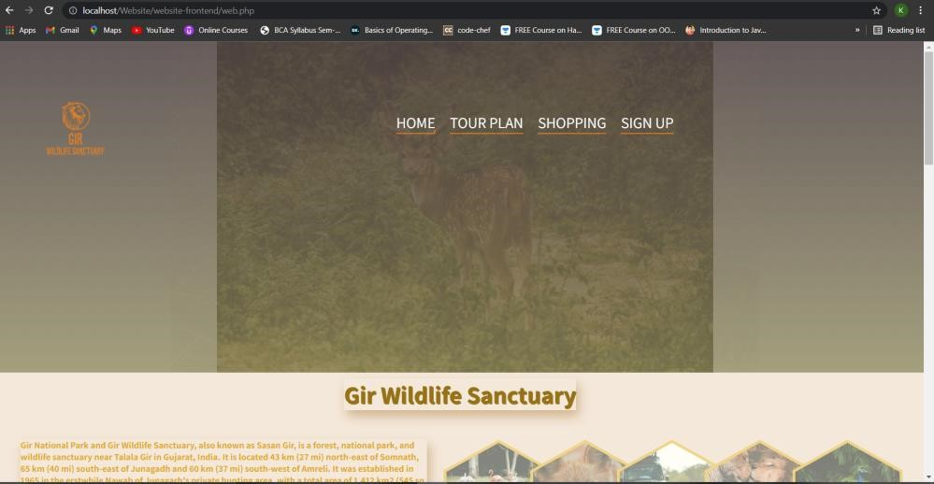

Slide 12
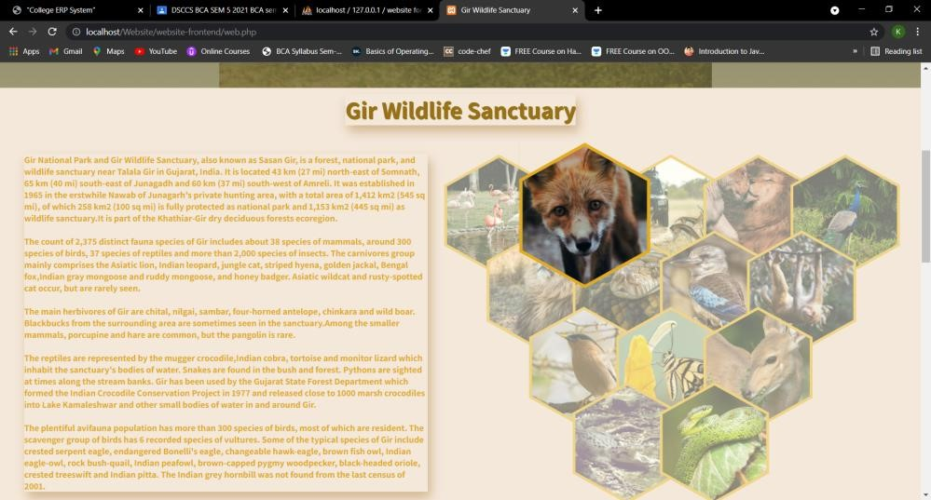
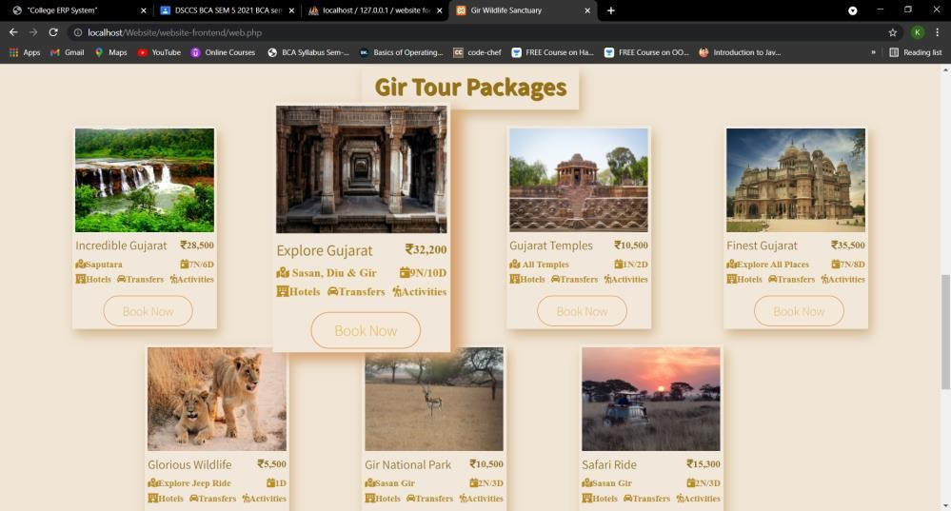

Slide 13
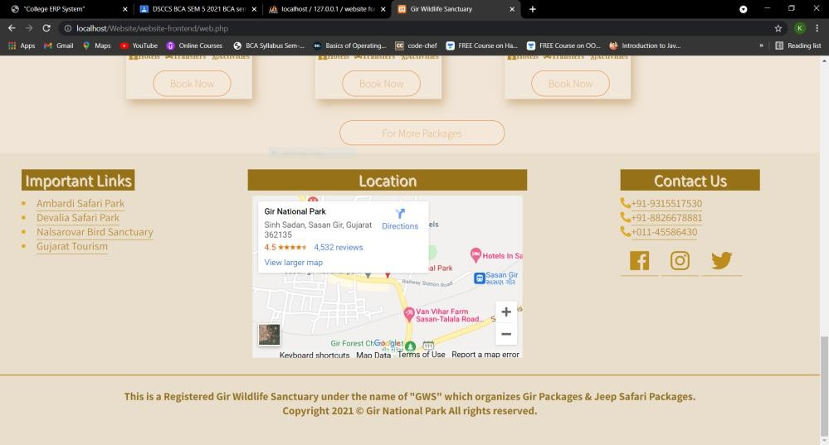
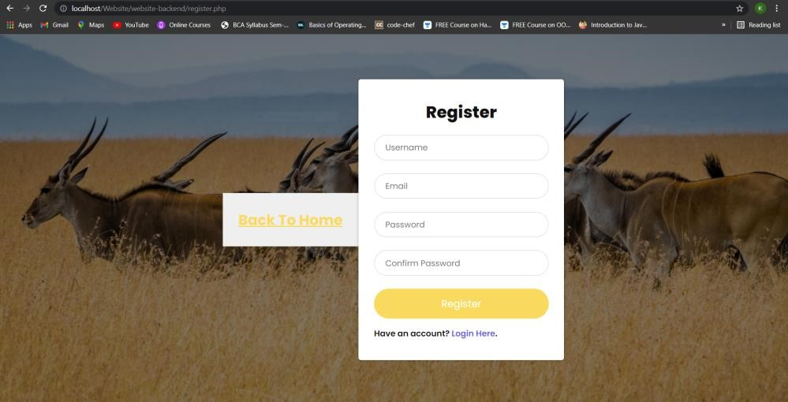
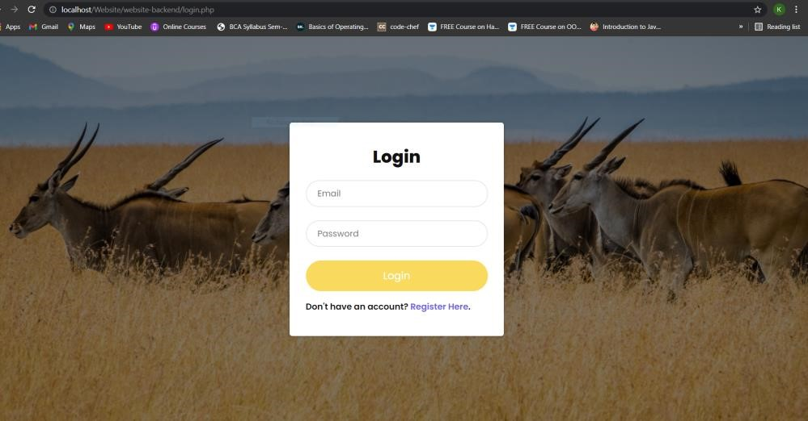

Slide 15
Future Scope of the Project:
Adding Payment Facilities
Adding details of Jeep Safari
• Adding Booking Facilities of Resorts

Slide 16
Bibliography:
https://www.youtube.com/
https://github.com/
https://www.girnationalpark.in/

