Slide 1
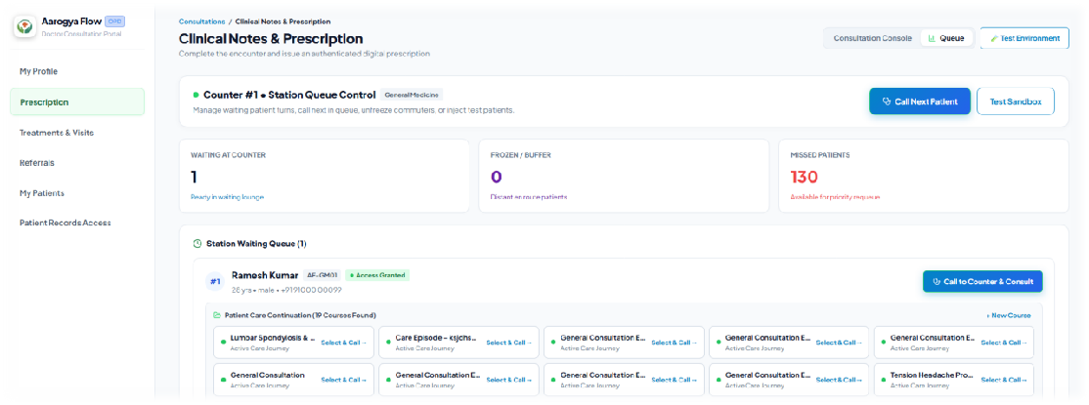
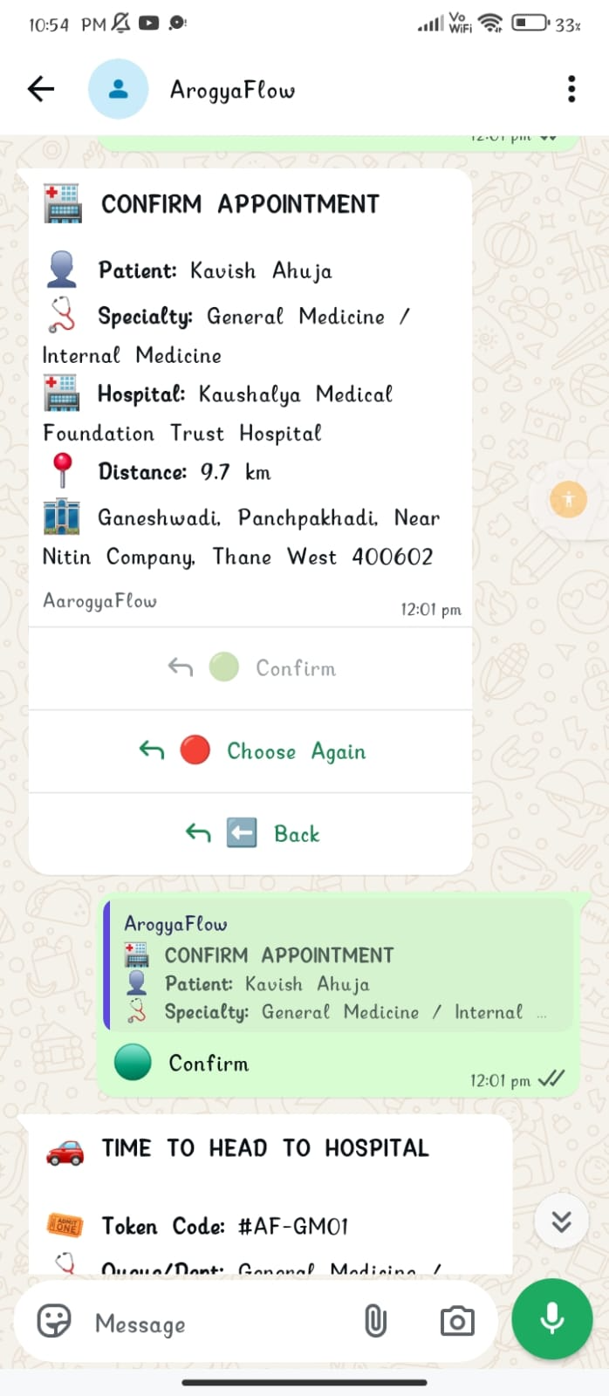
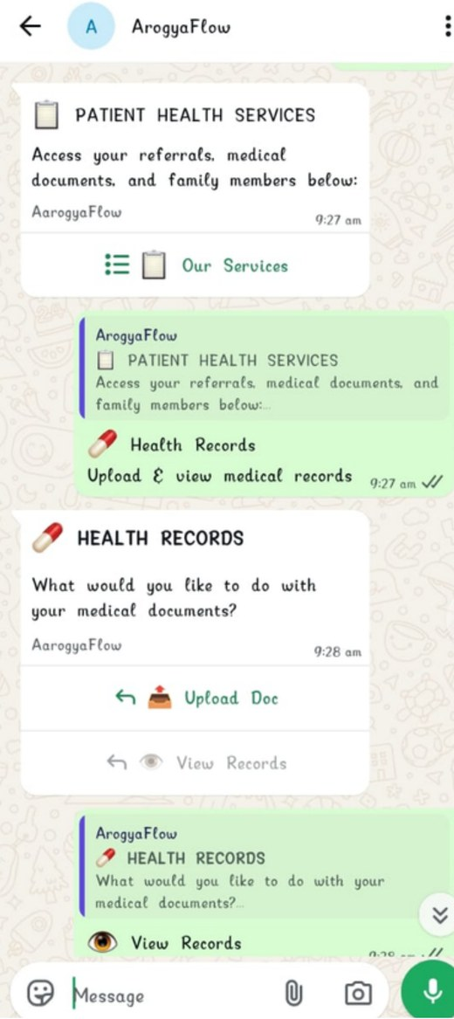
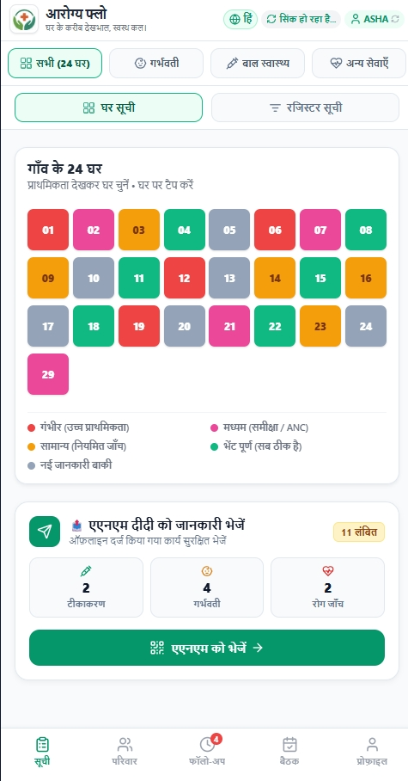
SEVA INNOVATION CHALLENGE 2026 • HEALTHCARE ACCESSIBILITY & DIGITAL HEALTH
AarogyaFlow
Care that doesn’t break between the queue, the record, the referral and the follow-up
A WhatsApp-first platform that links travel-aware OPD queues, consent-based health records, closed-loop referrals and an offline-first ASHA app, built on ABDM, ABHA and FHIR R4.
94.6%
1 platform
No app
shorter in-clinic wait in UAT (92.96 → 5 min via dynamic ETA)
for patient, doctor, front desk and ASHA/ANM/CHO
to install for patients: WhatsApp or web
▶ Demo video
WhatsApp bot
Live site
GitHub
UAT certificates
Working prototype: doctor workbench, zero-install patient app, WhatsApp bot, and offline ASHA grid
Team Swayambhu
Notes:
OPENING (30 sec): “Care in rural India doesn’t fail at the doctor. It fails in the gaps between the queue, the prescription, the referral and the ASHA’s diary.” AarogyaFlow connects those four gaps into one care journey: WhatsApp for patients, a web workbench for doctors and front desks, and an offline-first app for ASHA, ANM and CHO.
SAY IN ONE BREATH: working prototype, accepted at two clinics, average wait 92.96 → 5 min in UAT, and the next step is a government field pilot.
BEFORE UPLOADING: replace the three grey bracketed fields (institution, team representative, official email/mobile) exactly as entered in the Seva application form. Confirm 'Swayambhu' matches the team name in your Seva application.
LINKS (clickable in the PDF): Demo video, WhatsApp bot (+91 91201 23877), live site, GitHub, UAT certificates folder. Make sure the WhatsApp bot and site are running during the evaluation window.
'94.6%' = (92.96 - 5) / 92.96 = 94.62%, from the team UAT at two clinics (21-22 Sep 2026).

Slide 2
2
The Problem
Public healthcare breaks at the hand-offs: the queue, the record, the referral and the follow-up.
What is the problem?
Who is affected, and where?
Patient unable to get treatment on time due to rush/distance/shortage of speciality/fragmented records
ASHA workers issues regarding less incentive based earning due to weak tracking system / Registry maintenance
Rural patients & daily wagers travelling up to 40 km to district OPDs
10.29 lakh ASHA workers [4], plus ANM and CHO supervisors
Overburdened OPD doctors and hospital front desks managing crowding
98.6 min
mean OPD wait vs 6.5 min with the doctor (Kolkata tertiary hospital, 80% rural patients) [1]
Evidence
Current gaps
59 min mean wait vs 6.9 min with the doctor in a Maharashtra tertiary hospital [2]
57 ASHAs: paper diaries hard to read, confusing & claim delays [3]
ASHA incentives are claim-based; unrecorded work means lost livelihood [5]
Waiting is invisible: patients travel blindly, wait hours, or forfeit turns
Records and referrals do not travel across primary & district tiers
No back-referral : the loop never closes between DH & ASHA
Paper diaries and weak signal slow high-risk ANC/NCD follow-up
Why it matters
A referral is not complete when a patient gets a paper slip. It is complete when the next tier of care is reached, the specialist consults, and the back-referral loop closes with community follow-up.
Sources: [1] Datta, Indian J Community Med 49(7), 2024
[2] Acharya et al., IJCMPH 2023
[3] Patel & Tandon, Soc Sci Med 382, 2025
[4] NHM/NHSRC (Jun 2024) · [5] CHW payment study, 2 states, 2025
Seva Innovation Challenge 2026 | Slide 2 of 6
Notes:
KEY MESSAGE: The problem is not just reaching a doctor. It is that queue, records, referrals and community follow-up run as four disconnected workflows, so care breaks after the first contact.
HEADLINE STAT: 98.6 min mean waiting time vs 6.5 min consultation (SD 45.4 and 13.7), tertiary-care hospital, Kolkata, May-June 2023; 80.1% of participants lived in rural areas; General Medicine OPD averaged 122 min. Source [1] Datta M, Indian Journal of Community Medicine, vol 49 no 7, 2024 (abstract 210), doi:10.4103/ijcm.ijcm_abstract210. Note: this is a conference abstract in IJCM.
This independently supports your own baseline of 92.96 min.
[2] Acharya A, Kendre V, Jadhav Y, Tambe M (2023), tertiary hospital in Maharashtra, Int J Community Med Public Health: mean wait 59.0 min (SD 39.5), mean consultation 6.9 min (SD 7.7).
[3] Patel S & Tandon P (2025), 'Challenges in data documentation and retrieval in the ASHA diary from a usability perspective', Social Science & Medicine vol 382, doi:10.1016/j.socscimed.2025.118370. 57 ASHA workers. NOTE: the first author is SAKSHI Patel (your SIH slide says 'Swati').
[4] NHM: over 10.29 lakh ASHAs as of June 2024. NHSRC Annual ASHA Update 2020-21: about one ASHA per 979 rural population.
[5] 'Community health worker payment processes: a qualitative assessment of experiences in two Indian states' (53 in-depth interviews, 8 FGDs): the payment process starts with recording of work, then claim submission, verification, processing and payment.
CLOSE ON: the 'referral is complete when the follow-up is closed' line. It is the idea the whole product is built around.
TALK TRACK (45 sec): Four hand-offs break: the queue (blind waits), the record (paper slips), the referral (verbal, never closed) and the follow-up (paper diaries). Then the evidence: two peer-reviewed or published hospital studies on waiting, one study of 57 ASHAs on diary usability, one on how ASHA pay depends on recorded work. Close on the referral line.
LIKELY QUESTION: “Are these studies about your target hospitals?” ANSWER: No, they are independent evidence that long OPD waits are common in tertiary hospitals (Kolkata, Maharashtra). Our own baseline of 92.96 min comes from our two UAT clinics and is the same order of magnitude.

Slide 3
3
Our Solution & Innovation
One connected workflow for patient access, hospital treatment and community follow-up.
What makes it new?
Our solution in brief
 | Existing approach | Our approach
Cost | Wasted trips, lost wages, paper registers | Software-first; ≈ ₹0.11 via Meta / free via NIC SMS
Speed / time | 59–99 min crowded waiting room idle time | 92.96 → 5 min in-clinic wait in UAT (dynamic ETA)
Reach / access | Paper diaries, app-only tools, high drop-off | Zero-install WhatsApp/web + 100% offline ASHA app
Ease of use | Verbal referrals, manual diary searches | Multilingual voice entry & color-coded 24-grid
Continuity | Records & referrals stop at each hand-off | Single FHIR R4 course; automated back-referral loop
AarogyaFlow connects the whole patient journey end-to-end.
Patients book and track OPD tokens on WhatsApp or web without app install.
Doctors keep every visit, FHIR prescription and referral in one treatment course.
ASHA workers use an offline, voice-enabled household app that flags overdue high-risk visits.
How it works
1
2
3
Input
›
Process
›
Output
Patient :- token request + live GPS location.
Doctor :- consult, FHIR R4 Rx & digital referral.
ASHA :- voice & grid entry offline;
auto-sync.
Pre-locks slots for distant patients by travel ETA without holding up active clinic flow.
Emergency instant book and alert notify with automated call about sudden events
“Leave now” WhatsApp alerts with multilingual calls
consent document access (web+whatsapp)
closed-loop ASHA back-referrals.
Key USP
Smart OPD Queues: Travel-aware arrival notifications & dynamic buffer.
Digital Health Records: Secure, consent-based ABDM / FHIR R4 exchange.
Referral Tracking: Closed-loop back-referral auto-assigned to ASHA.
Offline ASHA App: Multilingual voice surveys and offline SQLite sync.
DPDP Act Compliant: Granular consent revocation & privacy-by-design.
Seva Innovation Challenge 2026 | Slide 3 of 6
Notes:
KEY MESSAGE: Most tools fix one step (a queue, or a record, or a diary). AarogyaFlow connects all three user groups so a patient's journey does not break between PHC, OPD and home.
HOW IT WORKS: (1) Input: patient requests a token on WhatsApp/web and shares location or DIGIPIN; doctor records consultation, prescription, referral; ASHA records household surveys by voice, offline. (2) Process: the queue engine compares travel ETA with queue wait; sends WhatsApp + voice 'leave now' alerts; late patients get a grace window and exponential push-back (1, 2, 4, 8, 16 positions) instead of instant forfeiture; the engine keeps a few verified patients staged so the doctor is never idle; emergencies are inserted instantly. Records and referrals chain into one treatment course (FHIR R4 bundles, consent by QR, revoke via WhatsApp). (3) Output: timely arrival, searchable consent-controlled history, tracked referrals with back-referral, prioritised ASHA visits.
TABLE: 'Cost' compares workflow overhead, not rupee prices of a competing product. ≈ ₹6/visit is the marginal messaging + voice cost (basis on slide 4 notes). 59-99 min = Maharashtra 59.0 and Kolkata 98.6 (slide 2 sources). 92.96 -> 5 min is the team's UAT figure.
PATENT: none filed, so the template's patent line is intentionally omitted.
WHAT WAS ADDED TO THE SLIDE (from your SIH deck and PRD): staged-patient buffer so the doctor is never idle; late patients demoted by exponential back-off (1, 2, 4, 8, 16 places) instead of being struck off; emergencies inserted instantly; back-referral generated automatically when no onward referral happens; 7/14/30-day auto-check → reminder → risk escalation for open referrals and visits; consent by QR with revoke by WhatsApp reply.
VERIFY BEFORE PRESENTING: back-referral, the 7/14/30-day escalation and the FROZEN → ACTIVE / staged-buffer logic appear in your SIH deck but NOT in the PRD. Confirm each one runs in the live prototype, because a juror may ask you to show it.
LIKELY QUESTION: “Why not just use an existing token app?” ANSWER: those fix one step. Ours compares live travel time with queue wait, and the same record chain carries the patient from the ASHA to the PHC to the hospital and back to the ASHA for follow-up.

Slide 4
4
Feasibility & Implementation
Cost basis: Meta India ₹0.115/message (from 1 Oct 2026), Twilio India ≈ $0.05/min, ~100 tokens/day. Assumptions in speaker notes.
A working, clinic-tested prototype with a costed 12-month path to a government field pilot.
Current stage: Working Prototype ✔ UAT-accepted at 2 clinics. Next: Field Pilot
✔
✔
✔
Idea
Proof of Concept
Working Prototype
Field Pilot
Ready to Deploy
done · UAT-accepted
UAT proof: signed certificates from Sai Siddhi Clinic (21 Sep) and Shiv Clinic, Mumbai (22 Sep 2026): “Accepted for production / go-live” (view)
Technology
Estimated cost
Timeline
Partners
Backend: Java 21, Spring Boot 3.3.x, PostgreSQL 16 (PgBouncer), Docker
Apps: React 19 web workbench; Expo offline mobile PWA; no hardware
Integrations: WhatsApp Cloud API, Eka Care ABHA/ABDM, FHIR R4
≈ ₹0.115 per WhatsApp session; NIC SMS / Web Push fallback (< ₹0.05)
≈ ₹8k per month for cloud hosting, container runtime and backups
≈ ₹3–4 lakh for a 6-month pilot (~25 ASHAs covering ~25k pop; ₹12–16/person)
0–3 mo Pick corridor, baseline waits, data rules, staff training
3–6 mo Run pilot: waits, missed tokens, referral and follow-up completion
6–12 mo Compare with baseline, publish cost per visit, scale with partner
Proposed (to be confirmed)
District Health Society / NHM district team
District hospital OPD + linked PHC corridor
ASHAs, ANMs, CHOs & community workers
In place
UAT with Sai Siddhi and Shiv Clinic
Eka Care ABDM APIs
Key risks → safeguards
Weak connectivity → offline-first SQLite, auto delta-sync to ANM
Health-data privacy → DPDP Act 2023, OTP/QR consent, role-based access
ABDM / API changes → Eka Care sandbox + strict FHIR R4 abstraction
Field adoption → voice entry, Marathi/Hindi UI, zero patient app
Seva Innovation Challenge 2026 | Slide 4 of 6
Notes:
KEY MESSAGE: This is a working, clinic-accepted prototype, not a slide-ware idea. We are honest about what is next: a government field pilot.
STAGE: Working Prototype, UAT-accepted. Evidence: two UAT sign-off certificates. (1) Sai Siddhi Clinic, 21 Sep 2026, 'Accepted for production / go-live'; remark: 'Show running number instead of waiting list'. (2) Shiv Clinic, Kandivali (East), Mumbai, 22 Sep 2026, 'Accepted for production / go-live'; remarks N/A. Both are small private clinics, so say plainly that a government-OPD field pilot is the next milestone. Live demo: WhatsApp +91 91201 23877 and the Vercel site.
TIP: check the handwritten date fields beside the signatures on both certificates (a few look inconsistent with the 21-22 Sep 2026 UAT dates); a reviewer opening the Drive folder may notice.
COST BASIS (indicative, Oct 2026; replace with real quotes when you have them):
- WhatsApp: Meta India rate card, from 1 Oct 2026, utility and authentication ₹0.115 per delivered template message; service replies get 1,000 free per number per month, then ₹0.115 each (excl. 18% GST). Assume ~12 messages per visit (about 8 booking replies + 4 alerts) = about ₹1.4, ₹1.6 with GST.
- Voice: Twilio India mobile about $0.05/min (twilio.com/voice/pricing/in); one 1-minute 'leave now' call is about ₹4-5 at ₹85-90/USD.
- Per visit total: about ₹6.
- Pilot (6 months): 100 digital tokens/day x 26 days x 6 months = 15,600 visits x ₹6 = about ₹0.94 lakh; hosting + managed DB + backups about ₹8k x 6 = ₹0.48 lakh; maps API buffer ₹0.15 lakh; training and onboarding ₹0.40 lakh; field support, security review and independent evaluation ₹1.0 lakh. Sum about ₹3.0 lakh; range ₹3-4 lakh with contingency.
- Per person covered: ₹3-4 lakh / about 25,000 people = ₹12-16.
The hosting, training, maps and field-support lines are team estimates, not quotes. The 100 tokens/day and ~25,000 population are planning assumptions.
TIMELINE metrics: median and 90th-percentile wait, missed-token and re-queue rates, referral completion before expiry, overdue household visits, ASHA data-entry time, offline sync success, cost per visit.
PARTNERS: no adopting department is confirmed yet, so the slide says 'Proposed (to be confirmed)'. If a district health officer or hospital gives even a letter of intent, put it here; the template says a named adopter scores higher.
NEW ON THIS SLIDE: a risk → safeguard strip (from your SIH feasibility slide) and tidier tracker labels.
VERIFY BEFORE PRESENTING: (1) your PRD says the ASHA app stores data in AsyncStorage while your SIH slide shows a SQLite logo; the slide now says only “offline-first”, so pick one answer for Q&A. (2) “WhatsApp with failover”: the PRD lists Meta Cloud API plus Evolution API. If Evolution runs in its web-session mode it is not an official channel, so present Meta Cloud API as the production path.
LIKELY QUESTION: “What does 5 minutes measure?” ANSWER: state exactly what you timed (token issue to doctor call, or time physically waiting at the clinic), and how many patients (n) in each UAT.

Slide 5
5
Impact & Scalability
One corridor first, then district by district. India already has 10.29 lakh ASHAs to build on.
~25,000
94.6%
~25 ASHAs
Beneficiaries reached
Shorter in-clinic wait
ASHA livelihoods supported
pilot target: 1 PHC catchment ≈ 25 ASHAs × ~1,000 people (~25,000 population)
92.96 → 5 min in-clinic waiting room time in UAT (≈ 88 min saved)
incentive-linked visits and high-risk follow-ups tracked in one app
Who benefits
Sustainability
Scale-up plan
Patients: know their turn, avoid wage loss (₹400–600), own digital records
Doctors: fewer idle gaps, pre-visit history with consent, closed referrals
ASHAs: overdue visits auto-flagged, faster incentive claim verification
National Fit: Directly aligns with ABDM, NHM; UN SDGs 3, 5, 10
Funded via NHM flexipool / District Health Society IT budget or CSR grants
Sub-₹0.15/visit marginal messaging via WhatsApp service & NIC SMS gateways
Open standards (FHIR R4, ABDM) avoid vendor lock-in & ensure HMIS interoperability
Baseline + 6-month pilot in one PHC–hospital corridor to prove referral closure
Prove gains in waits, missed tokens, referral completion, ASHA follow-up & earnings
Standardise onboarding, data governance, vernacular training & field support
Expand district by district; Docker + FHIR make rollout repeatable & scalable
Seva Innovation Challenge 2026 | Slide 5 of 6
Notes:
KEY MESSAGE: We quantify what we have measured (UAT) and are explicit about what is a pilot target.
BENEFICIARIES (~25,000): a planning assumption, not a measured figure. NHSRC reports about one ASHA per 979 rural population, so ~25 ASHAs cover about 25,000 people, roughly one PHC catchment. Adjust once the site is chosen.
SAVING (94.6%): (92.96 - 5) / 92.96 = 94.62%, from team UAT at two clinics on 21-22 Sep 2026. Be ready to answer: sample size, how waiting time was measured, and that these were small private clinics, not a government OPD. If you have n and the measurement method, add them here. NOTE: your SIH deck shows both 94.26% and 94.6%; 94.62% is the correct value.
LIVELIHOODS (~25 ASHAs): ASHAs are paid mainly through claim-based incentives, and the payment process begins with recording of work. Tracking incentive-linked tasks helps nothing get missed. Say 'potential' if challenged: earnings gain is not yet measured.
SOCIAL IMPACT: SDG 3 (good health), SDG 5 (ASHAs are women, and maternal/child follow-up is a core use), SDG 10 (vernacular, low-cost phones). Schemes: ABDM (ABHA, FHIR R4, consent), NHM (ASHA programme), Ayushman Bharat Health & Wellness Centres (CHO dashboard).
SUSTAINABILITY: costs scale with use (messages, calls) plus a small fixed hosting cost, so a hospital or district society can fund it from operating budgets. A real number comes out of the pilot.
SCALE-UP: containerised deployment and FHIR R4 make replication repeatable. A real-time multi-hospital bed/slot network is roadmap, not current.
NEW ON THIS SLIDE: impact is now stated by stakeholder (patients, doctors, ASHAs) and the scale-up plan names the pilot metrics, so the claim can be checked.
BUSINESS MODEL (if asked): test two models in the pilot, B2G with the district health society and a per-hospital subscription; the pilot's measured cost per visit sets the price.
HONESTY LINE: “The 94.6% is from two small private clinics. The pilot exists to measure it in a government OPD.” Saying this first is stronger than being asked.
DO NOT QUOTE as measured results: the PRD projections (3–5 h → 30–60 min, 40% lost prescriptions, 15% → 60% referral follow-through, 2–3x faster follow-up). They have no source or measurement yet; present them only as pilot hypotheses.

Slide 6
6
Team/Individual & Support Required
A team that has built the product end to end, and a clear ask to take it into the field.
Photo
Himanshu Gupta
Photo
Dipendra Chaturvedi
Support we are seeking
Product Lead & UAT
Backend & ABDM Architect
B.Tech, TCET Mumbai
B.Tech, TCET Mumbai
✔
Mentorship & technical guidance
Public-health workflows, epidemiologic metrics & DPDP compliance
✔
Pilot with a government department
District Hospital + linked PHC corridor; ASHA/ANM/CHO unions
✔
Funding / grant support
Photo
Kavish Ahuja
Photo
Pura Dinkar Gade
≈ ₹3–4 lakh: APIs, cloud hosting, vernacular training & field ops
Web & Patient Systems
ASHA App & Offline Sync
Incubation & workspace
B.Tech, TCET Mumbai
B.Tech, TCET Mumbai
✔
Testing, certification or IP support
ABDM Milestone 1/2/3 production certification; independent outcome audit
Built so far: 50+ REST APIs · 30+ web pages · 17 mobile screens · live WhatsApp bot · 2 clinic UATs · proposed quotation to BMC ASHA worker app
Seva support turns a UAT-accepted prototype into a measured government field pilot, and into the evidence districts need to adopt it.
Thank you | himanshuggupta16@gmail.com · 8879063655 | Team Swayambhu, TCET Mumbai
Seva Innovation Challenge 2026 | Slide 6 of 6
Notes:
BEFORE UPLOADING: replace every grey bracketed field. Names, qualifications and photos must match the Seva application. Roles shown are suggestions based on the product's workstreams (backend/integrations, web/patient flows, ASHA mobile, product/research/UAT); edit them so each role matches what that person actually did. If the team has fewer than four active members, delete the extra card(s) completely (card, photo circle and text). The UAT certificates name Krishna Dube and Himanshu Gupta as the software-provider testers.
BUILT SO FAR: counts (50+ REST APIs, 30+ web pages, 17 mobile screens) come from your PRD; re-verify against the repo before presenting.
THE ASK: mentorship (public-health workflows, data governance, security), a government pilot site (district hospital + linked PHC), funding for the pilot (see slide 4 cost basis), and independent testing/validation. 'Incubation & workspace' is left unticked on purpose; tick it if you want it.
CLOSING LINE: AarogyaFlow connects community care with hospital care.
THE ASK, WITH A NUMBER: funding of about ₹3–4 lakh covers a 6-month pilot (1 hospital, ~25 ASHAs); the breakdown is in the slide 4 notes.
CLOSING (15 sec): “We have built the connected journey. Help us prove it in one real corridor, with a baseline, so a district can decide with evidence.”

