Slide 1


SMART INDIA HACKATHON 2025
TITLE PAGE
Problem Statement ID –SIH25031
Problem Statement Title-Crowdsourced Civic Issue Reporting and Resolution System
Theme-Clean & Green Technology
PS Category- Software
Team ID- 34
Team Name : Accelerators

Slide 2
Idea/Approach
Accelerators
Lacks Transparency, accountability
Vision
Civic issue reporting system with public engagement and transparent resolution tracking.
Smart Sharing
Shareable links for social media to standardize unorganized issue reporting and tagging.
Public Dashboard
No login required. View all issues resolved and pending on an open-access dashboard.
Community Chat
Local users can discuss issues, share evidence (photos, documents), and collaborate in real time.
Responsibility Tracker
Display department (Sub-admin) contact details. Categorize issue stages into a well-defined structure.
Admin Updates
Admins communicate with departments to update issue status visible on the public dashboard.
Map Visualization
Interactive map shows issue density and resolution status across different regions.
Resolution Stats
Public dashboard displays resolved vs pending issues based on location and on the homepage for transparency.
Problems
Unaware about local Department
Issues cause inconvenience and even deaths.
Civic Issues India 2047 Vision Depends
Importance
Unavailability of local issue resolver system

Slide 3
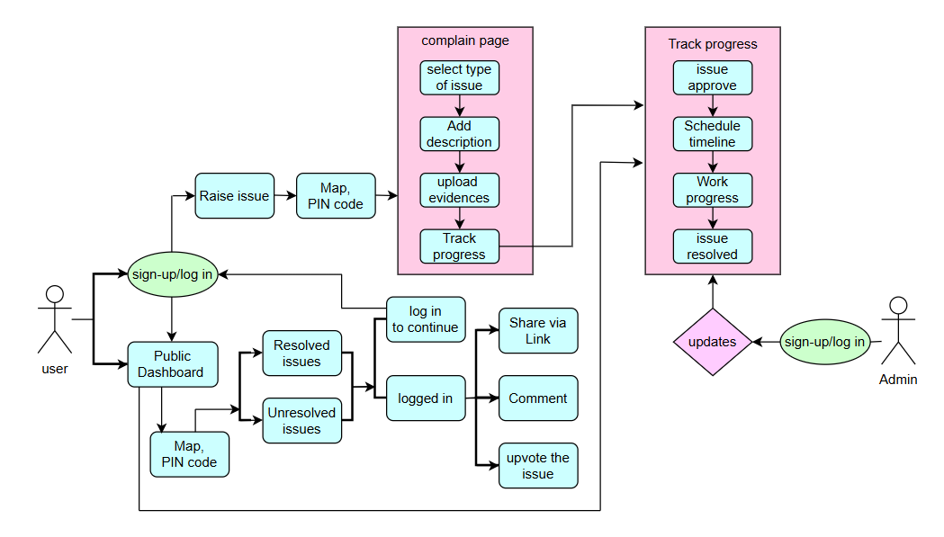
Userflow
Accelerators

Slide 4


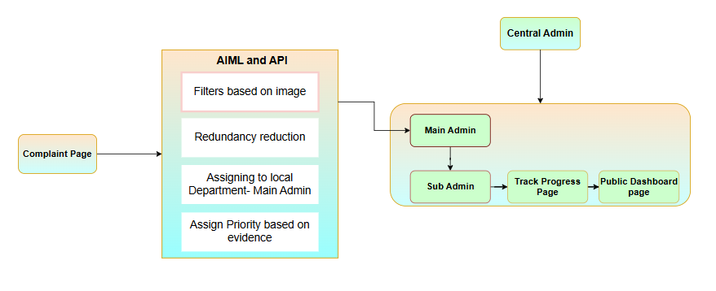






Technology Stack
Accelerators
Frontend :-
Figma→UI design
React.js → UI Implementation
CSS → styling.
Backend :-
Node.js + Express.js → REST API server.
JWT → authentication.
Multer → For image uploads.
Database:-
MongoDB
  Store users, issues, comments, progress,images.
APIs / Integrations
Leaflet.js (OpenStreetMap) → To show issue locations on a map.
Deployment
Frontend → Netlify.
Backend → Render / Railway.
Database → MongoDB Atlas.
Architecture

Slide 5
Impact and Benefits
Accelerators
Awareness :To reach a wider range of citizens ,users can share the issues on popular social media platforms.
Time Saved : Citizen Time Savings Reporting issues traditionally requires visiting municipal offices, making repeated phone calls, or filing written complaints, often taking 30 minutes or more. With a mobile-first platform supporting local languages, citizens can submit reports in under 3 minutes using geotagged photos and short descriptions
Municipal Staff Efficiency : Municipal bodies often manually register complaints and route them to various departments, consuming several minutes per complaint. Automated routing can reduce this process by least 50%.
Citizen Engagement & Trust : When citizens receive real-time updates on their complaints, trust in municipal
governance increases.
Faster Issue Resolution : Real time location tagging and multimedia uploads help authorities identify and fix
problems quickly.
A single platform to complain about various types of issues such as to inform about potholes,street light ,
Water leakage,etc.

Slide 6
RESEARCH AND REFERENCES
Accelerators
A Crowdsourced Complaint Resolution System Using Geotagging and Social Media Engagement (IRJMETS, 2023) – Proposes and develops a civic issue reporting system that leverages geotagging and social media to improve complaint visibility, enable faster authority response, and enhance citizen
participation.
Toward Understanding Civic Data Bias in 311 Systems: An Information Deserts Perspective (ResearchGate, 2020) – Looks at how digital access and citizen behavior skew complaint data in 311 systems, showing that poorer or marginalized neighborhoods tend to report fewer issues.
Smart Civic Issue Reporting System (India, 2022) – Presents a simple app for citizens to report street problems (like potholes, trash) with photos and location, speeding up how municipal authorities see and fix issues. Complaint Go: An Online Complaint Registration System using Web Services and Android (IOP Conf., 2017) – Delivers an Android-based system allowing citizens to file civic complaints via mobile or web, with officials notified and status tracking.
A Crowdsourced Complaint Resolution System Using Geotagging and Social Media Engagement (IRJMETS, 2023) – Proposes and develops a civic issue reporting system that leverages geotagging and social media to improve complaint visibility, enable faster authority response, and enhance citizen participation.

