Slide 1
PRODUCT REQUIREMENTS DOCUMENT
qDischarge
A WhatsApp-driven clinic queue management platform — booking, geo-aware
arrival, multi-counter routing and consent-based records on one rail.
PLATFORM
WhatsApp + Web + REST API
STACK
Spring Boot · PostgreSQL · React
DOMAIN
Outpatient queue & access management
VERSION
v2.0 — Hardened Release
AUTHOR
Krishna Dubey
DATE
16 Aug 2026
WHY IT EXISTS
Outpatient departments run on paper tokens and a crowded waiting hall: patients arrive early "just in case", front desks re-key the same details by hand, and a missed call means a lost turn. qDischarge replaces that with a number every patient already has — WhatsApp — plus a hospital-grade backend that tracks position, ETA and consent end to end.
Patients
Front-desk Admins
Doctors
Hospital Ops
SIH-style deck · qDischarge Team

Slide 2
PRD · PROBLEM STATEMENT
The Problem, and Our Vision
01
PROBLEMS
VISION
Paper tokens, no visibility
Patients queue on a printed number with no live wait estimate, so they arrive early and crowd the OPD hall.
“One WhatsApp number should take a patient from booking to being seen — with a live position, a geo-aware ‘leave now’ nudge, and a durable, consent-gated medical record trail behind it.”
Front-desk re-keying
Name, age and phone are re-entered by hand every visit; there is no durable per-patient visit trail to reuse.
Missed turns, lost slots
A missed announcement or a step-out and the token silently disappears — no recovery path back into the line.
0
apps to
install
24h
token
validity
N/A
front-desk
re-typing
Fragmented records
Prescriptions and reports live on paper or siloed apps; a doctor can't see them without the patient carrying them in.
WHO FEELS THE CHANGE
● Patients wait off-site and get pinged when it's really time to head over.
● Front desks stop re-typing history — every visit is already on file.
● Doctors see records the moment a patient grants access, not before.
qDischarge · PRD
qDischarge PRD · 2026

Slide 3
PRD · IDEA & APPROACH
Eight Ideas, One Queue
02
WhatsApp-First Booking
Book, track and get notified inside one WhatsApp thread — no app install, a session-driven bot flow end to end.
DIGIPIN Geo-ETA
Share location once; straight-line distance becomes an ETA that decides exactly when to send “leave now.”
Multi-Counter Routing
Each counter pulls only its own next-eligible token, so one busy counter never blocks the others.
Missed-Queue Recovery
Auto-skipped tokens land in a searchable missed queue — requeue to front or reject, never just vanish.
01
02
03
04
OTP-Gated Registration
Optional phone verification (Twilio Verify / SMS, WhatsApp fallback) required before a token is created.
Consent-Based Records
Patients upload prescriptions and reports; doctors see them only after a consent grant — revocable anytime.
Doctor Join + QR Access
Doctors join a hospital via a rotating code; access requests are short-lived QR codes claimed on the patient's device.
WhatsApp Provider Failover
Meta Cloud API and Evolution API back each other up, so one outage doesn't silently drop a patient notification.
05
06
07
08
qDischarge · PRD
qDischarge PRD · 2026

Slide 4
PRD · TECHNICAL APPROACH
System Architecture — Layered View
03
Patient
WhatsApp Bot
Patient
Web / PWA
Admin
Dashboard
Doctor
Portal
Spring Boot REST API · JWT Auth · BCrypt · Rate Limiting · CORS Allowlist · Bean Validation
SERVICE LAYER
Queue Manager
Counter
Assignment
Geo / ETA
Service
OTP Service
Access &
Consent
Doctor Service
WhatsApp
Dispatcher (Async)
DIGIPIN Codec
Meta WhatsApp
Cloud API
Evolution API
(auto-failover)
Twilio Verify / SMS
(OTP delivery)
PostgreSQL · Flyway-versioned schema — tokens · token_history · hospitals · patients · doctors · access_grants · counters
Docker Compose
app + Postgres · HikariCP pool
Client
Gateway
Service
Integration
Data
qDischarge · PRD
qDischarge PRD · 2026

Slide 5
PRD · TECHNICAL APPROACH
End-to-End Flow — Patient to Completed Visit
04
REGISTRATION
WhatsApp session
starts
OTP
required?
P
Enter name
& age
Verify OTP
(if required)
Create token
(status: waiting)
Assign queue
position
Patient
yes → verify code
no → skip straight through
A
Admin login
(JWT)
Admin
NOTIFICATION & ARRIVAL
SERVING & COMPLETION
Checked in via
QR before
turn comes up?
Share location
(optional)
Distance → ETA
computed
Send “leave now”
@ N tokens ahead
Counter calls
token
Mark status
serving
Complete → archive
to token_history
No → Auto-skip to Missed Queue — admin requeues to front of line or rejects (JWT-gated)
Legend: green = patient touchpoint · teal/cyan = registration & core queue logic · blue = notification engine · purple = decision · amber = exception path
qDischarge · PRD
qDischarge PRD · 2026

Slide 6


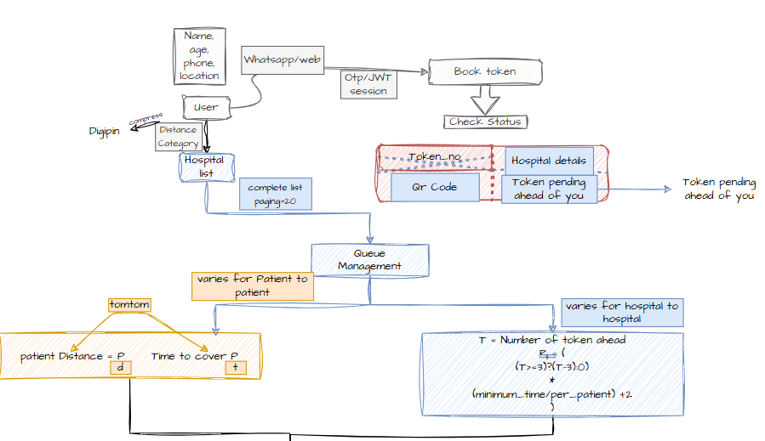
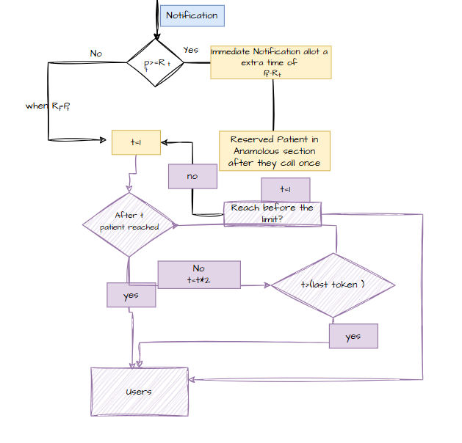
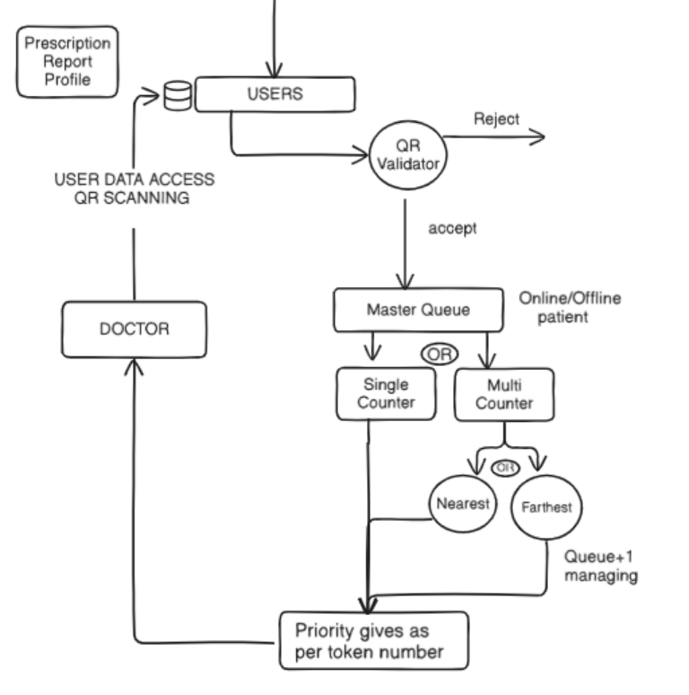
TECHNICAL APPROACH
Swayambhu
@SIH Idea submission- Template
3
Notes:
3

Slide 7

















PRD · TECHNICAL APPROACH
Technology Stack
05
BACKEND
INTEGRATIONS
Java 21
Spring Security /
JDBC
Spring Boot 3
WhatsApp
Cloud API
Meta for
Developers
DATA
FRONTEND
PostgreSQL
Flyway
Migrations
React
Axios
Vite
AUTH & SECURITY
DEVOPS & OPS
JWT
TLS / SSL
OWASP ASVS
Docker
Maven
Nginx (TLS
proxy)
Redis
(roadmap)
Also in the stack, without a public brand mark: BCrypt password hashing · Twilio Verify/SMS · ZXing QR generation · HikariCP pooling · Evolution API · a custom CORS allowlist & sliding-window rate limiter.
qDischarge · PRD
qDischarge PRD · 2026

Slide 8
PRD · FEASIBILITY & VIABILITY
Security Hardening & Scalability
06
SECURITY HARDENING
SCALABILITY & RELIABILITY
● Auth — BCrypt password check + signed, expiring JWTs; no shared static admin token.
● Passwords — BCrypt hash required in production; plaintext supported only as a dev fallback.
● Transport — TLS terminated natively or behind a reverse proxy; DB connection uses sslmode=require.
● CORS — restricted to an explicit ALLOWED_ORIGINS allowlist, never a wildcard.
● Validation — typed, jakarta-validated request DTOs replace raw untyped request maps.
● Rate limiting — per-IP sliding window on login, token creation and the WhatsApp webhook.
● Webhook — its own WEBHOOK_VERIFY_TOKEN secret, separate from admin auth.
● Async dispatch — WhatsApp sends run on a bounded background pool — never blocks HTTP worker threads.
● Stateless auth — JWTs carry no server session, so any number of replicas can validate independently.
● Connection pooling — HikariCP, configurable size, won't block startup if Postgres is briefly unreachable.
● Versioned schema — Flyway migrations plus indexes on every hot query path (phone, status, created_at).
● Health probes — liveness vs readiness split, safe for restart policies and load-balancer routing.
● Provider failover — a failed WhatsApp send automatically retries the second configured provider.
● Known limit — the in-memory rate limiter is per-instance; swap for Redis to share it across replicas.
qDischarge · PRD
qDischarge PRD · 2026

Slide 9
PRD · IMPACT & BENEFITS
What Changes for Everyone in the Loop
07
< 3 min
to register a token over WhatsApp — vs. a front-desk queue to even start
Live
queue position + geo-aware ETA replace guesswork and early arrival
Consent-
gated
record access — a doctor sees nothing until the patient grants it
Multi-
hospital
directory model — the same backend scales past a single OPD
WHO BENEFITS, AND HOW
The bottleneck in outpatient care is rarely the doctor's time — it's the queue built around not knowing when to show up, and the record left behind at the last visit. Fixing both on a channel patients already have (WhatsApp) is what makes qDischarge adoptable on day one, not after training.
● Patients — wait off-site, get a timely nudge, and keep one visit history instead of paper carried between visits.
● Front-desk staff — spend less time re-keying details and manually chasing missed patients back into line.
● Doctors — get instant, consented access to prior prescriptions/reports without the patient re-bringing them.
● Hospital administration — a live counter board, missed-queue recovery, and per-hospital analytics on one platform.
qDischarge · PRD
qDischarge PRD · 2026

Slide 10
PRD · ROADMAP & REFERENCES
What's Next, and What This Is Built On
08
ROADMAP
NOW — Hardened Core
› JWT + BCrypt auth, rate limiting
› Geo-ETA, multi-counter routing
› OTP-gated registration
› Consent-based patient records
NEXT — Frontend Parity
› UI for hospitals / geo / counters
› Missed-queue admin screens
› Doctor portal for record access
› Redis-backed rate limiter
LATER — Platform Scale
› Multi-hospital self-serve onboarding
› Analytics dashboards per hospital
› SMS/voice channel fallback
› Field-level record encryption
REFERENCES & FOUNDATIONS
● qDischarge README & configuration — this repository (Spring Boot port, hardening notes).
● DIGIPIN — India Post's open geo-coding scheme, used for hospital location and patient ETA.
● Meta WhatsApp Cloud API & Evolution API — messaging providers, with automatic failover.
● Twilio Verify / Programmable SMS — OTP delivery, with WhatsApp fallback on send failure.
● OWASP ASVS — reference checklist behind the auth, validation and rate-limiting choices.
qDischarge · PRD
qDischarge PRD · 2026

