Slide 1

MACHINE LEARNING FOR URBAN HOUSING PRICE PREDICTION
A Smart-City Decision Support Approach Using Random Forest
Project: Mumbai Housing Value Engine
MGM University • IICT
Ty ds (div 04)
Presented by:
Krishna Ghute • 2407023
Quadri Rushan Alam • 2207002
Guided by: Priyanka Hajare Ma’am

Slide 2
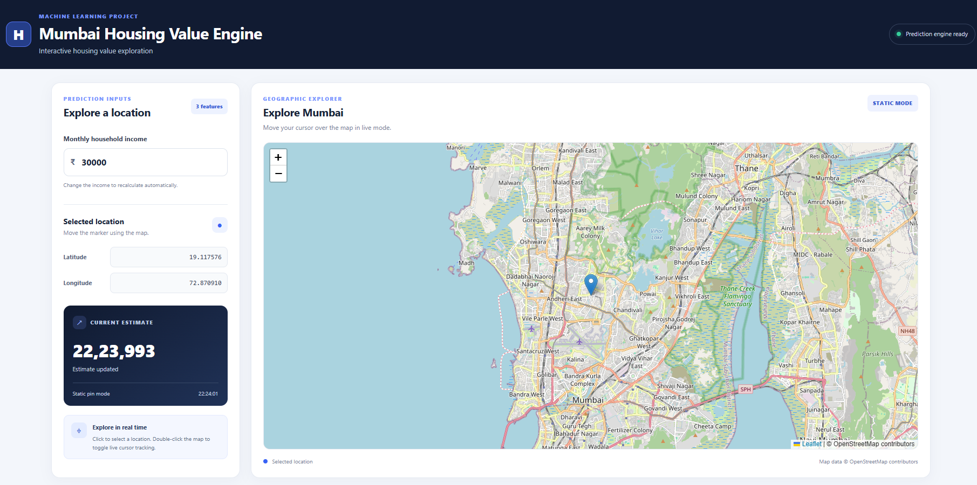
Project Overview
This project develops a machine-learning prototype for housing value prediction.
A Random Forest regression model learns patterns from housing data.
Income and geographic coordinates are used as model inputs.
A Flask web application connects the trained model to an interactive Leaflet map.
Users can explore locations and obtain predictions through the interface.
Project outcome: A working prototype combining machine learning, web deployment and geographic interaction.

Slide 3
Problem Statement
Housing values vary with location and socioeconomic conditions.
Manual estimation can be subjective and difficult to scale.
Housing datasets contain relationships that may not be captured by simple linear models.
A practical system is needed to connect predictions with an interactive geographic interface.
Problem statement: To develop a web-based machine-learning prototype that predicts housing values from selected dataset features and enables location-based exploration.

Slide 4
Objectives:
1.Prepare and analyse the housing dataset.
2.Select relevant features for prediction.
3.Train and evaluate regression models.
4.Deploy the selected Random Forest 5.model using Flask.
6.Build an interactive location interface using Leaflet.
Objectives and Scope
Scope:
1.Housing-value prediction from dataset features.
2.Interactive geographic exploration.
3.Model evaluation using regression metrics.
4.Prototype-level decision support.

Slide 5
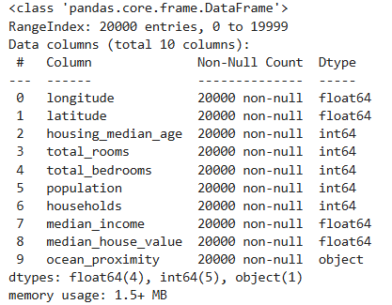
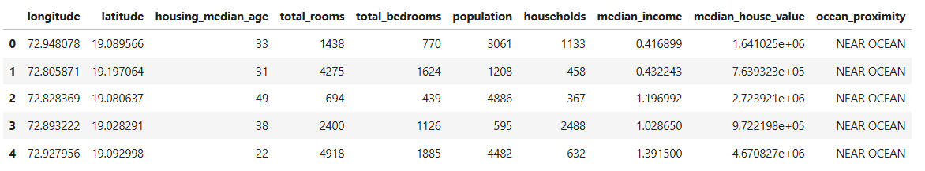
Dataset Description
Dataset: Mumbai Housing Prices
Source: github.com/hindav/Mumbai-Housing-Prices
Dataset size: Approximately 20,000 records, as described by the repository.
Target variable: median_house_value
Selected model features: median_income, latitude, longitude
Evaluation split: 16,000 training records and 4,000 test records.

Slide 6
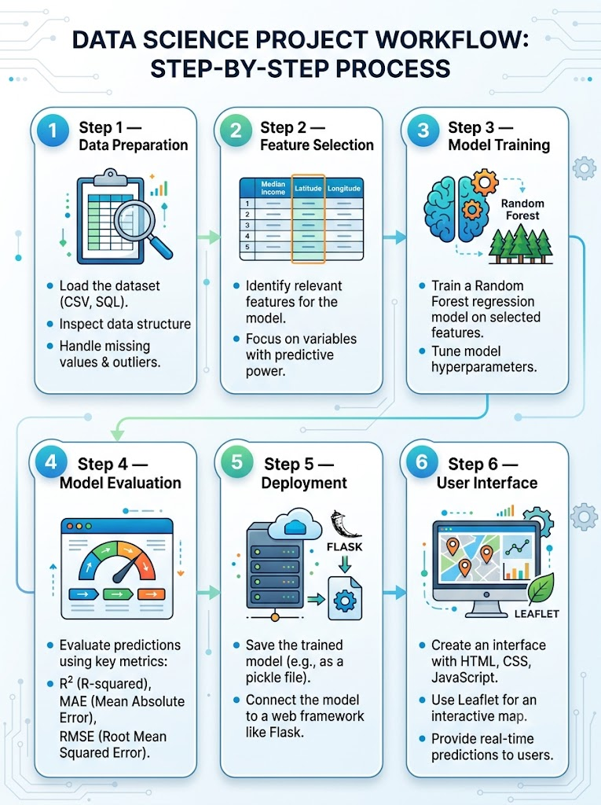
Proposed Methodology
Step 1 — Data Preparation
Load the dataset and inspect its structure.
Step 2 — Feature Selection
Use median income and geographic coordinates as model inputs.
Step 3 — Model Training
Train a Random Forest regression model.
Step 4 — Model Evaluation
Evaluate predictions using R², MAE and RMSE.
Step 5 — Deployment
Save the trained model and connect it to Flask.
Step 6 — User Interface
Use HTML, CSS, JavaScript and Leaflet to provide interactive predictions.

Slide 7
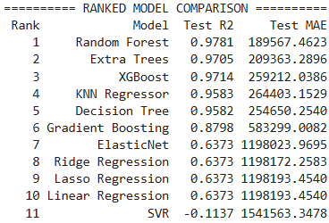
Model Development
Selected model: Random Forest Regressor
Combines predictions from multiple decision trees.
Can learn nonlinear relationships in structured data.
Suitable for regression problems involving multiple input features.
The trained model is saved as mumbai_housing_rf_model.pkl.
The Flask application loads the saved model for inference.

Slide 8
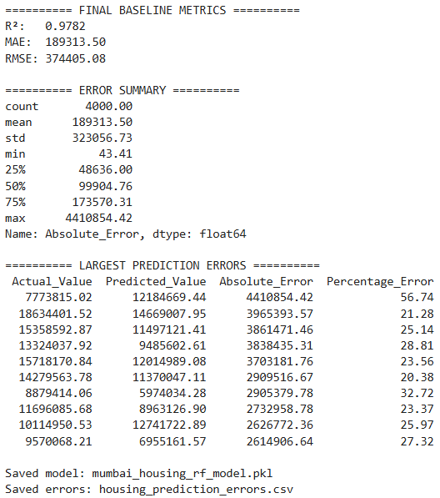
Model Evaluation and Results
The model achieved an R² score of approximately 0.978 on the test set.
MAE represents the average absolute prediction error.
RMSE gives greater weight to larger prediction errors.
These metrics describe performance on the held-out test set, not guaranteed performance for every new property.
Note: The repository describes the target values in rupees; validate the target units before presenting the monetary error values as rupee amounts.

Slide 9
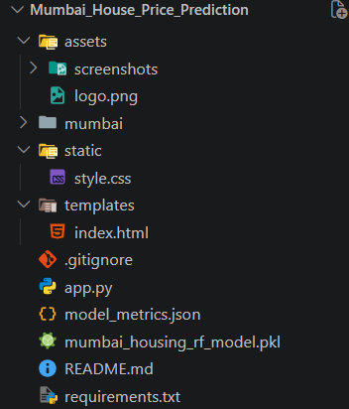
System Architecture
Frontend
HTML
CSS
JavaScript
Leaflet map
Backend
Flask application
Input handling
Prediction request processing
Machine-Learning Layer
Saved Random Forest model
Three selected model features
Predicted housing value returned to the interface

Slide 10
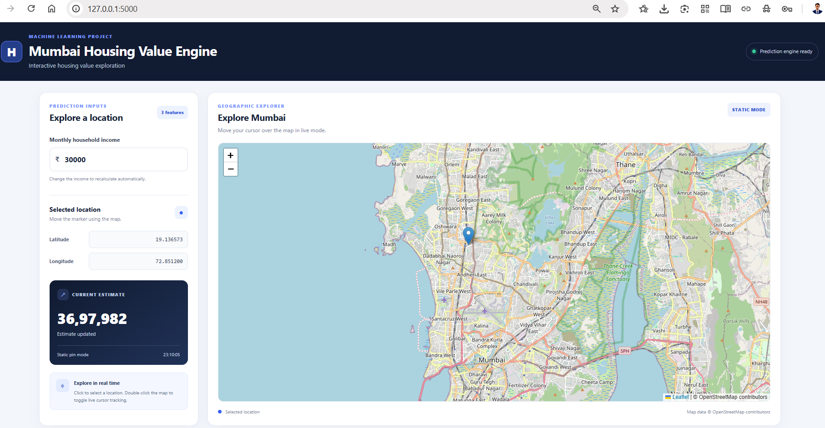
Application Interface
Browser-based application for housing-value prediction.
Interactive Leaflet map for geographic exploration.
Users can select a location and adjust the model inputs.
The map marker represents the selected coordinates.
The interface supports interactive prediction updates.
Important implementation detail: Only median_income, latitude and longitude affect the current model. Any extra fields displayed by the interface are not used in the prediction unless the model is retrained to include them.

Slide 11
Strengths and Limitations
Strengths:
Combines machine learning and web deployment.
Provides an interactive geographic interface.
Uses standard regression metrics for evaluation.
Demonstrates an end-to-end prediction workflow.
Limitations:
The model currently uses only three features.
A high random-split R² does not establish performance in unseen neighbourhoods.
Dataset provenance, price units and market representativeness require independent validation.
Predictions should not be treated as verified property valuations.

Slide 12
Conclusion:
1. A Random Forest regression model was trained and evaluated for housing-value prediction.
2. The model achieved a test-set R² score of 0.9782.
3. Flask and Leaflet were used to build an interactive prediction prototype.
4. The project demonstrates how a trained machine-learning model can be integrated into a geographic web application.
Conclusion and Future Scope
Future scope:
1. Validate the dataset and target units against reliable market data.
2. Conduct spatial or neighbourhood-based validation.
3. Evaluate additional features and alternative models.
4. Add SHAP-based explanations for individual predictions.
5. Improve prediction reliability and deployment.

Slide 13
References
[1] Deng, L., & Zhang, X. (2025). “Boosting the Accuracy of Property Valuation with Ensemble Learning and Explainable Artificial Intelligence: The Case of Hong Kong.” The Annals of Regional Science, 74, 32.
https://doi.org/10.1007/s00168-025-01365-7
[2] Asal, B. (2025). “Interpretable House Price Prediction Using Ensemble Learning and Explainable AI Techniques.” 2025 9th International Symposium on Innovative Approaches in Smart Technologies (ISAS).
https://doi.org/10.1109/ISAS66241.2025.11101915
[3] Noh, Y., & Park, C. Y. (2026). “Explainable Machine Learning for Urban Housing Prices: Policy Relevant Diagnostics Across Three Cities.” Cities, 176, 107266.
https://doi.org/10.1016/j.cities.2026.107266
[4] hindav. Mumbai-Housing-Prices Dataset. GitHub.
https://github.com/hindav/Mumbai-Housing-Prices
[5] Scikit-learn. Model Evaluation Documentation.
https://scikit-learn.org/stable/modules/model_evaluation.html

