Slide 1
Stock Price Prediction- Using Different Time Series Methods
Submitted By:
Krishna GoswamI

Slide 2
Agenda
Business Objectives
Data Preparation
Analysis
Models
Insights

Slide 3
Business Objectives
Analyze Stock Price of Tata Steel from Year 2010 till 2018.
Predict Monthly Average Stock Price using different time-series algorithms
Compare the errors between Actual and Predicted Monthly Stock Price and recommend the best method for prediction.

Slide 4
Data Understanding and Preparation

Slide 5
Brief about the dataset
The dataset contains Daily Stock Price of Tata Steel from Sep’2010 till Oct’2018.
Date column is converted into DateTime format for data processing.
The data is resampled as Monthly Average Stock Price for data processing.

Slide 6
Data Analysis

Slide 7
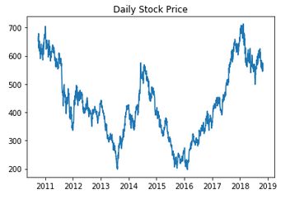
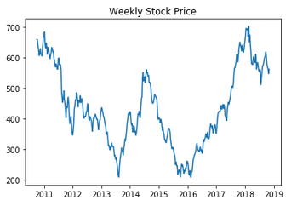
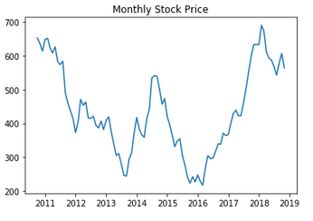
Daily/Weekly/Monthly Stock Price

Slide 8
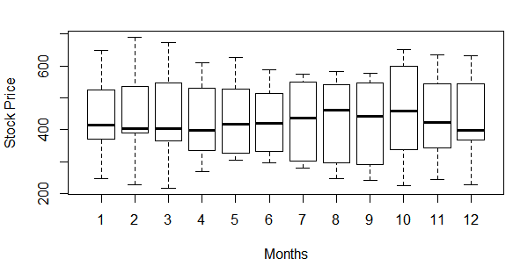
Monthly Stock Price Movement(Box Plot)

Slide 9
Modeling

Slide 10
Time Series Modeling
Following modelling techniques were applied to the dataset
Simple Average Method
Rolling Mean Average Method
FB Prophet Method
Holt-Winter Additive Method
Holt-Winter Multiplicative Method
Auto-Arima

Slide 11
Simple Average and Rolling Mean Average Method
In Simple Average Method, Average of previous stock price is taken as the predicted Stock price.
Root Mean Square (RMS) error is 118
In Rolling Mean Average Method, 12 months rolling window is considered to calculate the forecasted Stock price.
Root Mean Square (RMS) error is 114

Slide 12
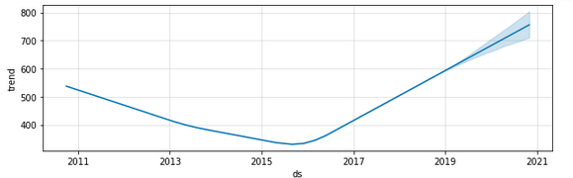
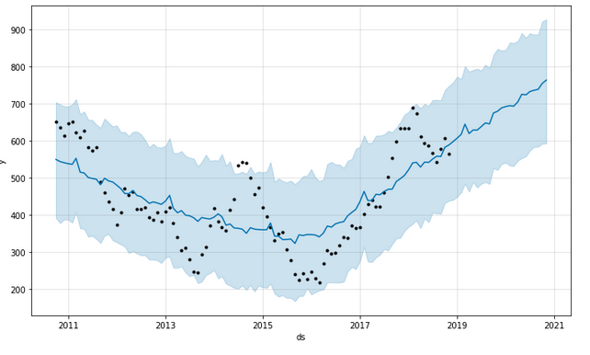
FB Prophet Method
Trend and Forecasted Stock Price plot after applying FB Prophet model is given below:
Root Mean Square Error is : 67

Slide 13
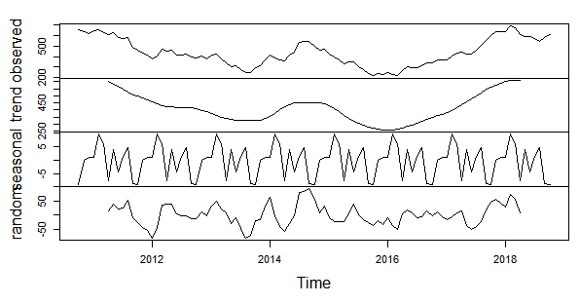
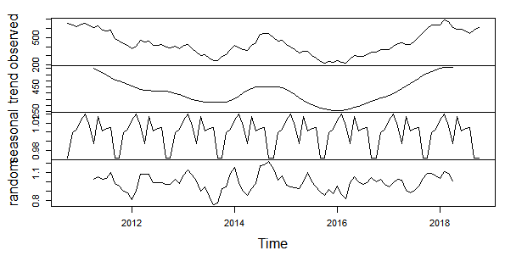
Holt-Winter Method
Decomposition of time series using Holt-Winter Additive Model:
Root Mean Square Error for Additive model is 38.45
Decomposition of time series using Holt-Winter Multiplicative Model:
Root Mean Square Error for Multiplicative model is 36.69

Slide 14
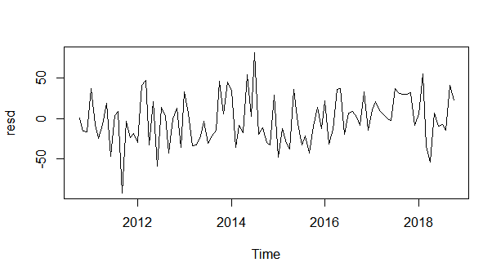
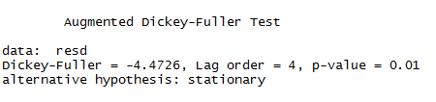
Auto-Arima Method
Auto-Arima method applied to Monthly Series data and below plot of residuals show that the residuals is stationary.
Result of Augmented Dicky-Fuller Test also shows that Residuals is stationary (p-value is less than 0.05):
Root Mean Square Error is : 25.57

Slide 15
Insights

Slide 16
Insights
Time Series Modeling using Auto-Arima provided the best result with lowest RMS value.
There is upward trend available in the stock price and also there is seasonal component.
The Stock price is Generally High during Aug, Sep and Oct month and lowest in Dec.

Slide 17
GitHub Reference
The project is developed using Python and R and the python/R code file is available in GitHub in the following location:
https://github.com/kgopal1982/Analytics/tree/master/Final/StockPricePrediction
Simple Average Method, Rolling Mean Average Method and FB Prophet Method are modelled using Python.
Holt-Winter Additive Method, Holt-Winter Multiplicative Method and
Auto-Arima are modelled using R.

Slide 18
Thank You

