Slide 1
Tomato Leaf Disease Detection
Using Deep Learning and Transfer Learning for Agricultural Diagnosis
Krishna Harish — 1MS24MC045
Guide: Prof. Komala R
Department of MCA, Ramaiah Institute of Technology
Academic Year: 2025–2026

Slide 2
Problem Statement
Tomato is one of the most widely cultivated vegetable crops, but it is highly affected by several leaf diseases.
Diseases such as bacterial spot, early blight, late blight, leaf mold, and viral infections can reduce crop quality and yield.
Manual identification of tomato leaf diseases requires expert knowledge and may be time-consuming for farmers.
Delayed diagnosis can lead to disease spread, increased pesticide usage, higher production cost, and crop loss.
An automated image-based deep learning system can help detect tomato leaf diseases quickly and accurately from leaf images.

Slide 3
Objectives
Build an image classification model to detect tomato leaf diseases using deep learning.
Classify tomato leaf images into 10 categories, including 9 disease classes and 1 healthy class.
Use the PlantVillage dataset for training and evaluation.
Apply transfer learning using pre-trained models such as ResNet18 and ResNet50.
Develop a real-time prediction system using a web-based interface such as Streamlit.
Provide disease prediction with confidence score from an uploaded tomato leaf image.

Slide 4
Tomato Disease Classes
The project focuses on the following 10 tomato leaf classes:
Tomato Bacterial Spot
Tomato Early Blight
Tomato Late Blight
Tomato Leaf Mold
Tomato Septoria Leaf Spot
Tomato Target Spot
Tomato Spider Mites
Tomato Mosaic Virus
Tomato Yellow Leaf Curl Virus
Tomato Healthy

Slide 5
Dataset Description
Dataset source: PlantVillage dataset.
The dataset contains labelled images of healthy and diseased tomato leaves.
Only tomato leaf images are selected from the complete PlantVillage dataset.
The selected dataset contains 10 tomato classes.
Each image belongs to one disease category or the healthy category.
The dataset is divided into training, validation, and testing sets.
Images are used to train the model to identify visual disease symptoms such as spots, yellowing, curling, mold, and blight patterns.

Slide 6
Methodology
Load tomato leaf images from the selected PlantVillage dataset.
Resize all images to a fixed size, such as 224 × 224 pixels.
Normalize image pixel values for stable model training.
Apply data augmentation techniques to improve model generalization.
Load a pre-trained deep learning model such as ResNet18 or ResNet50.
Replace the final classification layer according to the 10 tomato classes.
Train the model using tomato disease images.
Evaluate the model using accuracy, precision, recall, F1-score, and confusion matrix.

Slide 7
System Design
Input Module: The user uploads a tomato leaf image through the web interface.
Preprocessing Module: The uploaded image is resized, normalized, and converted into tensor format.
Feature Extraction Module: The deep learning model extracts visual features such as leaf spots, color changes, texture patterns, and damaged regions.
Classification Module: The trained model predicts one class from the 10 tomato disease categories.
Output Module: The system displays the predicted tomato disease name along with the confidence score.

Slide 8
Tools and Technologies
Programming Language: Python 3.x
Deep Learning Framework: PyTorch and torchvision
Transfer Learning Models: ResNet18 and ResNet50
Web Framework: Streamlit
Image Processing: PIL/Pillow, OpenCV, NumPy
Visualization and Evaluation: matplotlib, scikit-learn
Dataset: PlantVillage tomato leaf disease dataset

Slide 9
Implementation
Load the selected tomato disease dataset.
Organize images into class-specific folders.
Apply image transformations such as resizing, normalization, and augmentation.
Load a pre-trained ResNet18 or ResNet50 model.
Modify the final fully connected layer to output 10 tomato classes.
Train the model using the tomato leaf training dataset.
Validate the model using unseen validation images.
Save the trained model as model.pt.
Save the class names as classes.json.
Use the saved model for real-time tomato disease prediction.

Slide 10
Workflow
Step 1: Select tomato leaf images from the PlantVillage dataset.
Step 2: Divide the dataset into training, validation, and testing sets.
Step 3: Preprocess images by resizing and normalizing.
Step 4: Apply data augmentation to improve model performance.
Step 5: Train the ResNet-based transfer learning model.
Step 6: Evaluate the trained model using test images.
Step 7: Save the best model checkpoint.
Step 8: Launch the Streamlit web application.
Step 9: Upload a tomato leaf image.
Step 10: Display predicted disease name and confidence score.

Slide 11
Results
99.72%
Validation Accuracy
0.3228
Training Loss
1,359
Total Images (Train + Val)
83.32%
Prediction Confidence
Key Findings
Model trained for 1 epoch using ResNet-18 with transfer learning on 10 tomato disease classes.
Achieved 99.72% validation accuracy, confirming the pipeline works correctly on the smoke dataset.
Random validation image correctly predicted as Tomato Healthy with 83.32% confidence.
Second-highest prediction: Tomato Bacterial Spot at 16.68% confidence.
Pipeline validated end-to-end: dataset loading, preprocessing, training, saving, and inference.

Slide 12
Challenges and Solutions
Visual Similarity: Some tomato diseases have similar symptoms. Solution: Use transfer learning and fine-tune deeper layers.
Class Imbalance: Some disease classes may have fewer images. Solution: Use data augmentation and balanced sampling.
Overfitting: The model may memorize training images. Solution: Use augmentation, dropout, validation monitoring, and early stopping.
Field Image Variation: Real-world images may differ in lighting and quality. Solution: Train with diverse images and strong augmentation.
Disease Stage Difference: Early and severe symptoms appear different. Solution: Include images from different disease stages during training.

Slide 13
Demo
A Streamlit web application is used for real-time tomato disease prediction.
The user uploads a tomato leaf image through the interface.
The uploaded image is preprocessed automatically.
The trained deep learning model predicts the tomato disease class.
The output displays: Predicted disease name, Confidence score, Uploaded image preview.
The application makes the system simple and user-friendly.
The complete workflow is:
Tomato Leaf Image Upload → Preprocessing → Model Prediction → Disease Name + Confidence Score

Slide 14
Advantages
Provides fast tomato leaf disease detection.
Reduces dependency on manual expert diagnosis.
Helps farmers take early action against disease spread.
Supports identification of multiple tomato diseases.
Can be deployed as a web or mobile application.
Transfer learning reduces training time and improves performance.
The system can be used as a decision-support tool in agriculture.

Slide 15
Limitations
The model is trained mainly on PlantVillage images, which are captured in controlled conditions.
Real field images may contain background noise, shadows, blur, or overlapping leaves.
The model may misclassify diseases with similar visual symptoms.
The system only predicts disease class and does not provide complete treatment recommendations.
Performance depends on image quality and proper leaf visibility.
More real-world tomato leaf images are needed for better generalization.

Slide 16
Future Enhancements
Collect real-time tomato leaf images from farms.
Improve model accuracy using larger and more diverse datasets.
Deploy the system as a mobile application for farmers.
Add disease severity estimation.
Provide pesticide or treatment recommendations.
Add multilingual support for farmers.
Use explainable AI techniques such as heatmaps to show affected leaf regions.
Integrate the model with IoT or smart farming systems.

Slide 17
Conclusion
This project focuses on tomato leaf disease detection using deep learning and transfer learning.
The system classifies tomato leaves into 10 categories, including 9 diseases and 1 healthy class.
ResNet-based transfer learning helps achieve better performance with reduced training time.
The Streamlit interface allows users to upload tomato leaf images and receive instant predictions.
The proposed system can support farmers by enabling early and accessible tomato disease diagnosis.
Future improvements can make the system more practical for real-field agricultural use.

Slide 18
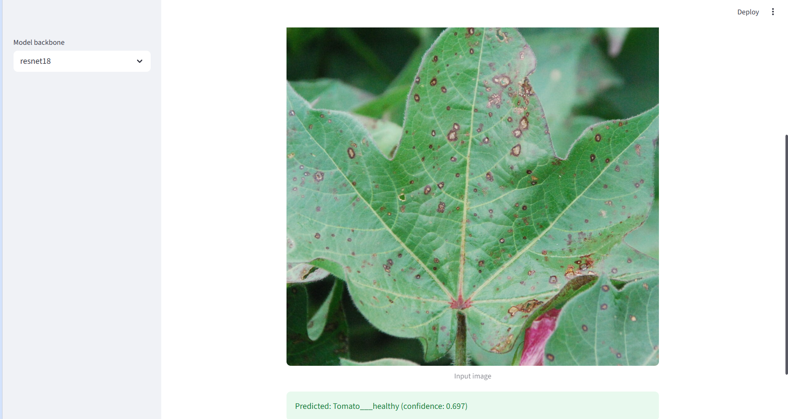
Demo

Slide 19
References
[1] PlantVillage Dataset — Tomato leaf disease image dataset.
[2] PyTorch Documentation — torchvision.models for ResNet18 and ResNet50.
[3] Mohanty, S. P., Hughes, D. P., & Salathé, M., “Using Deep Learning for Image-Based Plant Disease Detection,” Frontiers in Plant Science, 2016.
[4] Tugrul, B. et al., “Convolutional Neural Networks in Detection of Plant Leaf Diseases: A Review,” Agriculture, 2022.
[5] Streamlit Documentation — Web application development for machine learning models.

