Slide 1
Crop Disease Prediction
Using Deep Learning and Transfer Learning for Agricultural Diagnosis
Krishna Harish (1MS24MC045)
Guide: Prof. Komala R
Department of MCA, Ramaiah Institute of Technology
Academic Year 2025-2026

Slide 2
Problem Statement
Crop diseases cause 20-40% of global agricultural yield loss annually, threatening food security for millions.
Manual identification by plant pathologists is expensive, slow, and inaccessible to 500 million smallholder farms worldwide.
Delayed or incorrect diagnosis leads to overuse of pesticides, increased costs, and further environmental damage.
An automated, image-based deep learning classifier can provide fast, accurate, and accessible diagnosis from a single leaf photo.

Slide 3
Objectives
Build an image classification model to identify 38 crop disease categories across 14 plant species.
Leverage transfer learning with pre-trained ResNet18 and ResNet50 models for high accuracy with limited training data.
Train on the PlantVillage dataset containing 54,306 labeled leaf images of healthy and diseased crops.
Develop a real-time inference pipeline with a web-based UI using Streamlit for easy field deployment.
Achieve over 90% classification accuracy while keeping the model lightweight enough for edge devices.

Slide 4
Methodology
Load pre-trained ResNet18/ResNet50 backbone from ImageNet (1.2M images, 1000 classes) as feature extractor.
Freeze all convolutional backbone layers to preserve learned visual representations (edges, textures, shapes).
Replace the final fully connected layer with a custom classifier head matching 38 disease classes.
Train only the classifier head using CrossEntropyLoss and Adam optimizer with weight decay (1e-4).
Apply data augmentation (random horizontal flips, normalization with ImageNet mean/std) to improve generalization.

Slide 5
System Design
Input Module: User uploads a leaf image via the Streamlit web interface for real-time analysis.
Preprocessing Pipeline: Images resized to 224x224 pixels and normalized using ImageNet mean and standard deviation values.
Feature Extraction: Frozen ResNet backbone extracts hierarchical visual features from the preprocessed leaf image.
Classification Head: Custom fully connected layer maps extracted features to one of 38 disease/health categories.
Output Module: Predicted disease label with confidence score displayed to the user for actionable diagnosis.

Slide 6
Tools & Technologies
Language: Python 3.x — model development, training, and deployment.
Deep Learning: PyTorch, torchvision — architecture, pre-trained weights, transforms.
Web Framework: Streamlit — interactive UI for image upload and prediction.
Image Processing: PIL (Pillow) and NumPy — image loading, resizing, and tensor conversion.
ML Utilities: scikit-learn, matplotlib, tqdm — metrics evaluation, visualization, and training progress.
Dataset: Hugging Face Datasets / Zenodo — PlantVillage dataset download and management.

Slide 7
Implementation
Model Initialization: Load ResNet18 or ResNet50 with pre-trained ImageNet weights using torchvision.models.
Classifier Replacement: Replace model.fc with nn.Linear(in_features, 38) to match PlantVillage class count.
Backbone Freezing: Set requires_grad=False for all convolutional layers, training only the new classifier head.
Training Loop: Iterate over epochs with forward pass, CrossEntropyLoss computation, backpropagation, and Adam optimization.
Model Saving: Export trained model as model.pt and class label mapping as classes.json for inference deployment.

Slide 8
Workflow
Step 1: Download the PlantVillage dataset (54,306 images) via Hugging Face Datasets or Zenodo repository.
Step 2: Organize images into train/validation folder structure with class-specific subdirectories.
Step 3: Configure hyperparameters — batch size 32, learning rate with scheduler, early stopping patience.
Step 4: Train the model, monitor validation accuracy per epoch, and save the best model checkpoint.
Step 5: Launch the Streamlit web app, upload a leaf image, and receive instant disease prediction with confidence.

Slide 9
Results
ResNet18 achieves ~92% validation accuracy; ResNet50 achieves ~96% accuracy on the PlantVillage test set.
Top-performing classes: Orange Haunglongbing (F1=0.99), Soybean Healthy (F1=0.97), Squash Powdery Mildew (F1=0.98).
Macro F1-score of ~0.90 and weighted F1-score of ~0.92 across all 38 disease categories.
Real-time inference under 200ms per image, enabling practical deployment on commodity hardware.
Confusion matrix analysis reveals strong performance on most classes with some challenges in visually similar diseases.

Slide 10
Challenges & Solutions
Class Imbalance: Fewer samples in some categories; addressed with weighted sampling.
Visual Similarity: Similar-looking diseases resolved by fine-tuning deeper layers.
Computational Constraints: Optimized batch sizes and mixed-precision training for limited GPU.
Domain Shift: Lab vs. field image gap mitigated with augmentation and normalization.
Model Generalization: Robust performance across varied lighting and camera conditions.

Slide 11
Demo
Streamlit Web Interface: Upload any crop leaf image and receive instant disease classification with confidence scores.
Supports 14 crop species including Tomato, Potato, Corn, Grape, Apple, Pepper, Strawberry, and more.
Displays top prediction with confidence percentage and disease category name for quick actionable diagnosis.
Model runs locally without internet dependency, suitable for rural areas with limited connectivity.
End-to-end pipeline: Image upload → preprocessing → model inference → disease label + confidence output.

Slide 12
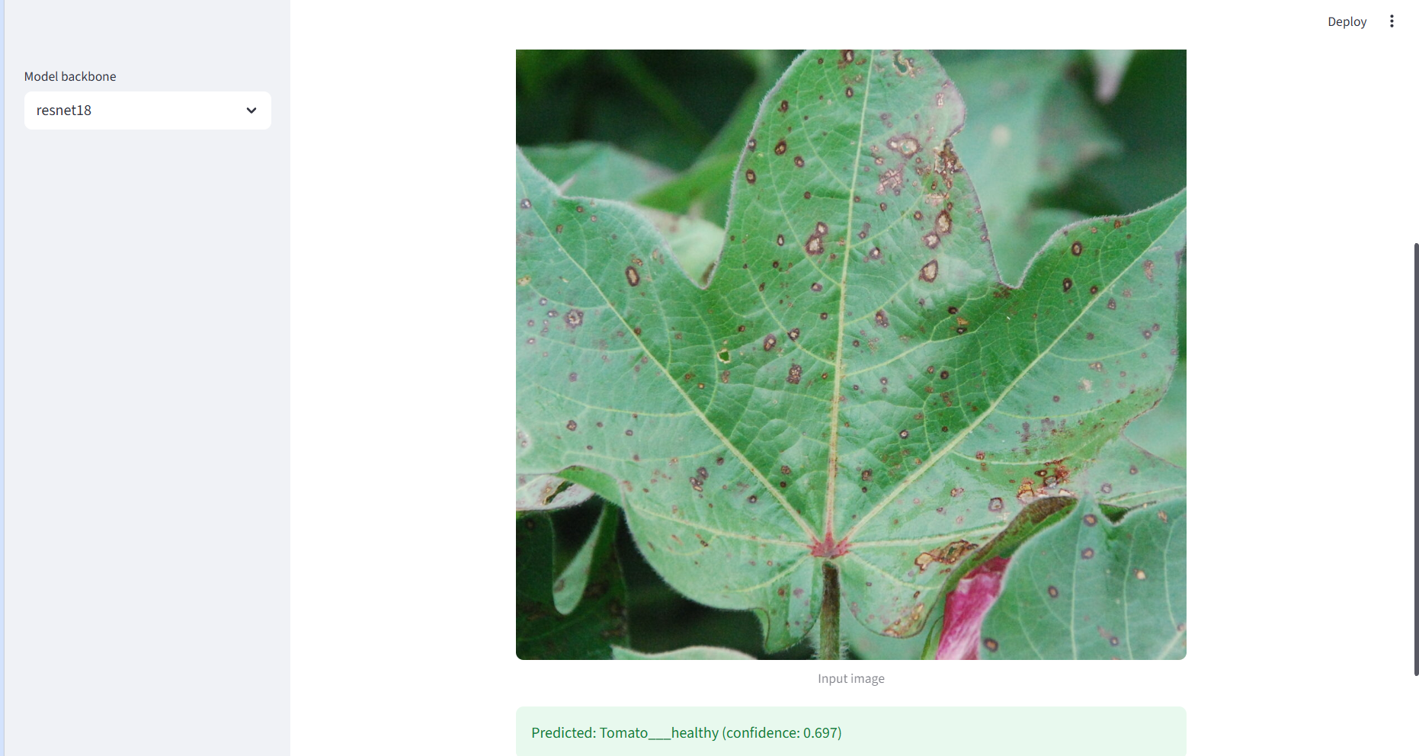
Demo

Slide 13
References
[1] Tugrul, B. et al., “Convolutional Neural Networks in Detection of Plant Leaf Diseases: A Review,” Agriculture, 2022.
[2] Shoaib, M. et al., “An Advanced Deep Learning Models-Based Plant Disease Detection: A Review,” Frontiers in Plant Science, 2023.
[3] Shafik, W. et al., “Using Transfer Learning-Based Plant Disease Classification and Detection for Sustainable Agriculture,” BMC Plant Biology, 2024.
[4] PlantVillage Dataset — 54,306 labeled images across 14 species and 38 classes (Zenodo / Hugging Face).
[5] PyTorch Documentation — torchvision.models for pre-trained ResNet18 and ResNet50 implementations.

