Slide 1
Introduction to Design & Analysis of Algorithms
By
Anany Levitin(3rd Edition)

Slide 2
CHAPTER-2
Asymptotic Notations
Mathematical Analysis of Recursive &
Non-Recursive Algorithms

Slide 3
Analysis of algorithms
Issues:
  correctness
  time efficiency
  space efficiency
  optimality
Approaches:
  theoretical analysis
  empirical analysis

Slide 4
Theoretical analysis of time efficiency
Time efficiency is analyzed by determining the number of repetitions of the basic operation as a function of input size
Basic operation: the operation that contributes most towards the running time of the algorithm
T(n) ≈ c_{op}C(n)
input size
running time
execution time
for basic operation
Number of times basic operation is executed

Slide 5
Input size and basic operation examples
Problem | Input size measure | Basic operation
Searching for key in a list of n items
Multiplication of two matrices
Checking primality of a given integer n
Typical graph problem

Slide 6
Input size and basic operation examples
Problem | Input size measure | Basic operation
Searching for key in a list of n items | Number of list’s items, i.e. n | Key comparison
Multiplication of two matrices | Matrix dimensions or total number of elements | Multiplication of two numbers
Checking primality of a given integer n | n’size = number of digits (in binary representation) | Division
Typical graph problem | #vertices and/or edges | Visiting a vertex or traversing an edge

Slide 7
Empirical analysis of time efficiency
Select a specific (typical) sample of inputs
Use physical unit of time (e.g., milliseconds)
or
Count actual number of basic operation’s executions
Analyze the empirical data

Slide 8
Types of formulas for basic operation’s count
Exact formula
e.g., C(n) = n(n-1)/2
Formula indicating order of growth with specific multiplicative constant
e.g., C(n) ≈ 0.5 n²
Formula indicating order of growth with unknown multiplicative constant
e.g., C(n) ≈ cn²

Slide 9
Order of growth
Most important: Order of growth within a constant multiple as n→∞
Example:
  How much faster will algorithm run on computer that is twice as fast?
  How much longer does it take to solve problem of double input size?
Notes:
Example: cn²
how much faster on twice as fast computer? (2)
how much longer for 2n? (4)

Slide 10
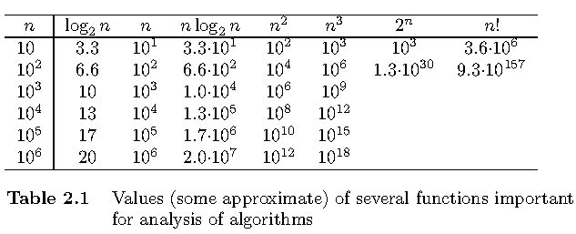
Values of some important functions as n → ∞

Slide 11
Best-case, average-case, worst-case
For some algorithms efficiency depends on form of input:
Worst case: C_{worst}(n) – maximum over inputs of size n
Best case: C_{best}(n) – minimum over inputs of size n
Average case: C_{avg}(n) – “average” over inputs of size n
  Number of times the basic operation will be executed on typical input
  NOT the average of worst and best case
  Expected number of basic operations considered as a random variable under some assumption about the probability distribution of all possible inputs

Slide 12
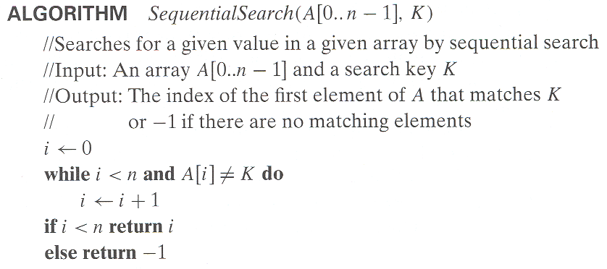
Example: Sequential search
Worst case
Best case
Average case

Slide 13
Example: Sequential search
Probability of a successful search is equal to 0≤ p ≤1
Probability of the first match occuring in the ith
position of the list is same for every i.
so the probability of the first match occuring in the ith position of the list is p/n for every i and number of comparisons made will be i.
For an Unsuccessful search , the number of comparisons is n with the probability of such a search being (1-p).

Slide 14
Example: Sequential search
C _{avg} (n) = ?
If p=1 (successful) , what is the time taken for C _{avg} (n)
If p=0 (unsuccessful), what is the time taken for C _{avg} (n)

Slide 15
Asymptotic order of growth
A way of comparing functions that ignores constant factors and small input sizes
O(g(n)): class of functions f(n) that grow no faster than g(n)
Θ(g(n)): class of functions f(n) that grow at same rate as g(n)
Ω(g(n)): class of functions f(n) that grow at least as fast as g(n)

Slide 16
Establishing order of growth using the definition
Big-oh
Definition: A function t(n) is said to be in O[g(n)]. Denoted t(n) ∈ O[g(n)], if t(n) is bounded above by some constant multiple of g(n) for all large n ie.., there exist some positive constant c and some non negative integer n_{o} such that t(n) ≤ cg(n) for all n≥n_{o.}
Examples:
10n is O(n²)
5n+20 is O(n)
Notes:
Examples:
10n is O(n²)
since 10n ≤ 10n² for n ≥ 1 or 10n ≤ n² for n ≥ 10
c n₀
5n+20 is O(10n)
since 5n+20 ≤ 10 n for n ≥ 4
c n₀

Slide 17
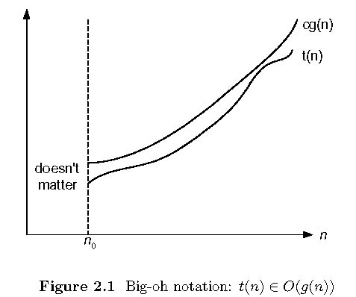
Big-oh

Slide 18
Big-theta
Definition: A function t(n) is said to be in θ [g(n)], denoted t(n)∈ θ (g(n)), if t(n) is bounded both above and below by some positive constant multiples of g(n) for all large n, ie., if there exist some positive constant c1 and c2 and some nonnegative integer n₀ such that
c₂g(n) ≤ t(n) ≤ c₁g(n) for all n ≥ n₀.
Example
½ n (n-1) ≤ ½ n²
Whereas ½ n (n-1) ≥ ¼ n²
Notes:
Examples:
10n is O(n²)
since 10n ≤ 10n² for n ≥ 1 or 10n ≤ n² for n ≥ 10
c n₀
5n+20 is O(10n)
since 5n+20 ≤ 10 n for n ≥ 4
c n₀

Slide 19
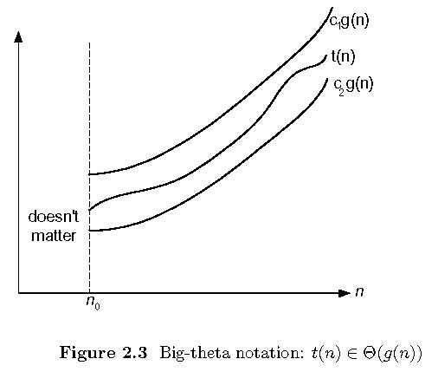
Big-theta

Slide 20
Big-omega
Definition: A function t(n) is said to be in Ω[g(n)], denoted t(n) ∈Ω[g(n)], if t(n) is bounded below by some positive constant multiple of g(n) for all large n, ie., there exist some positive constant c and some non negative integer n₀ such that t(n) ≥ cg(n) for all n ≥ n₀.
Example
n³ ≥ n²
Notes:
Examples:
10n is O(n²)
since 10n ≤ 10n² for n ≥ 1 or 10n ≤ n² for n ≥ 10
c n₀
5n+20 is O(10n)
since 5n+20 ≤ 10 n for n ≥ 4
c n₀

Slide 21
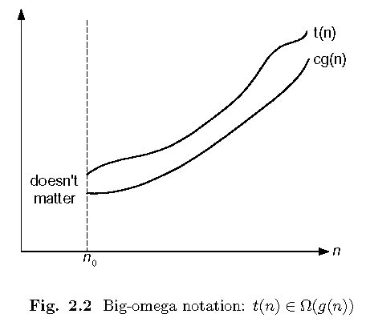
Big-omega

Slide 22
Some properties of asymptotic order of growth
f(n) ∈ O(f(n))
f(n) ∈ O(g(n)) iff g(n) ∈Ω(f(n))
If f (n) ∈ O(g (n)) and g(n) ∈ O(h(n)) , then f(n) ∈ O(h(n))
If f₁(n) ∈ O(g₁(n)) and f₂(n) ∈ O(g₂(n)) , then
f₁(n) + f₂(n) ∈ O(max{g₁(n), g₂(n)})

Slide 23
Establishing order of growth using limits
0 order of growth of T(n) < order of growth of g(n)
lim T(n)/g(n) =
c > 0 order of growth of T(n) = order of growth of g(n)
n→∞
∞ order of growth of T(n) > order of growth of g(n)
Examples:
10n vs. n²
n(n+1)/2 vs. n²

Slide 24
Basic asymptotic efficiency classes
Class | Name | Comments
1 | constant
log n | logarithmic
n | linear
n log n | n-log-n
n² | quadratic
n³ | cubic
2^{n} | exponential
n! | factorial

Slide 25
Mathematical Analysis of
NonRecursive Algorithms

Slide 26
Example 1: Maximum element
Algorithm Maxelement(A[0..n-1])
//Determines the largest elt in the list
//Input: A[0..n-1] of real numbers
//Output: Largest element in A
maxval ← A[0]
for i ← 1 to n-1 do
if A[i] > maxval
maxval ← A[i]
return maxval

Slide 27
Time efficiency of nonrecursive algorithms
General Plan for Analysis
Decide on parameter n indicating input size
Identify algorithm’s basic operation
Determine the time taken for executing the basic operation. Here, if it is depending on some additional property other than the input size n , then find worst, average, and best cases.
Set up a sum for the number of times the basic operation is executed
Simplify the sum using standard formulas and rules and either fined a closed form formula or establish its order of growth

Slide 28
Useful summation formulas and rules
Σ_{l≤i≤u}1 = 1+1+…+1 = u - l + 1
In particular, Σ_{l≤i≤u}1 = n - 1 + 1 = n ∈ Θ(n)
Σ_{1≤i≤n} i = 1+2+…+n = n(n+1)/2 ≈ n²/2 ∈ Θ(n²)
Σ_{1≤i≤n} i² = 1²+2²+…+n² = n(n+1)(2n+1)/6 ≈ n³/3 ∈ Θ(n³)
Σ_{0≤i≤n} a^{i} = 1 + a +…+ a^{n} = (a^{n+1} - 1)/(a - 1) for any a ≠ 1
In particular, Σ_{0≤i≤n} 2^{i} = 2⁰ + 2¹ +…+ 2^{n} = 2^{n+1} - 1 ∈ Θ(2^{n} )
Σ(a_{i} ± b_{i} ) = Σa_{i} ± Σb_{i} Σca_{i} = cΣa_{i} Σ_{l≤i≤u}a_{i} = Σ_{l≤i≤m}a_{i} + Σ_{m+1≤i≤u}a_{i}

Slide 29
Useful summation formulas and rules
u u
∑ c a_{i} = c ∑ a_{i} ----(R1)
i=1 i=1
u u u
∑ (a_{i} ± b_{i}) = ∑ a_{i} ± ∑ b_{i} ----(R2)
i=1 i=1 i=1

Slide 30
Useful summation formulas and rules
u
∑ 1 = u- l + 1 --- (S1 )
i=l
n
∑ i = 1+2+….+n = [n(n+1)]/2 ≈ ½ n² Є θ(n²) ----(S2)
i=0

Slide 31
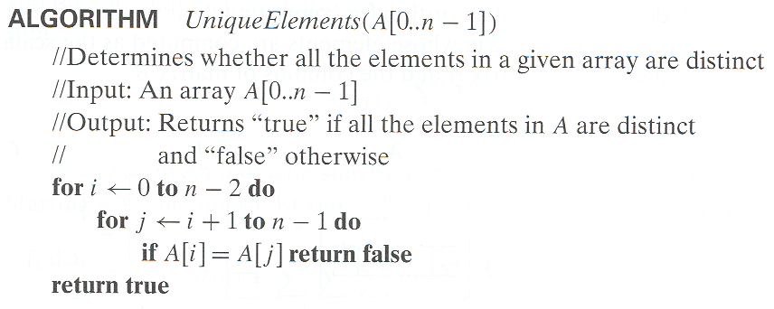
Example 2: Element uniqueness problem

Slide 32
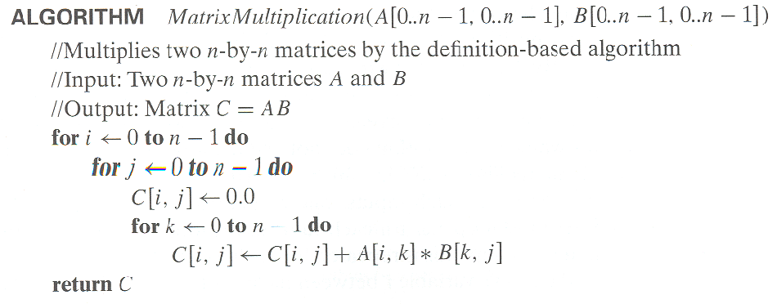
Example 3: Matrix multiplication
-

Slide 33
Plan for Analysis of Recursive Algorithms
Decide on a parameter indicating an input’s size.
Identify the algorithm’s basic operation.
Check whether the number of times the basic op. is executed may vary on different inputs of the same size. (If it may, the worst, average, and best cases must be investigated separately.)
Set up a recurrence relation with an appropriate initial condition expressing the number of times the basic op. is executed.
Solve the recurrence (or, at the very least, establish its solution’s order of growth) by backward substitutions or another method.

Slide 34
Example 1: Recursive evaluation of n!
Definition: n ! = 1 ∗ 2 ∗ … ∗(n-1) ∗ n for n ≥ 1 and 0! = 1
Recursive definition of n!: F(n) = F(n-1) ∗ n for n ≥ 1 and
F(0) = 1
Notes:
Note the difference between the two recurrences. Students often confuse these!
F(n) = F(n-1) n
F(0) = 1
for the values of n!
------------
M(n) =M(n-1) + 1
M(0) = 0
for the number of multiplications made by this algorithm

Slide 35
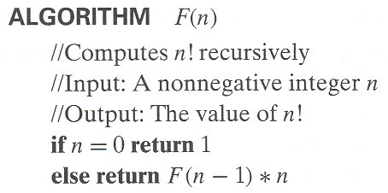
Example 1: Recursive evaluation of n!
Size:
Basic operation:
Recurrence relation:
Notes:
Note the difference between the two recurrences. Students often confuse these!
F(n) = F(n-1) n
F(0) = 1
for the values of n!
------------
M(n) =M(n-1) + 1
M(0) = 0
for the number of multiplications made by this algorithm

Slide 36
Solving the recurrence for M(n)
M(n) = M(n-1) + 1, M(0) = 0

Slide 37
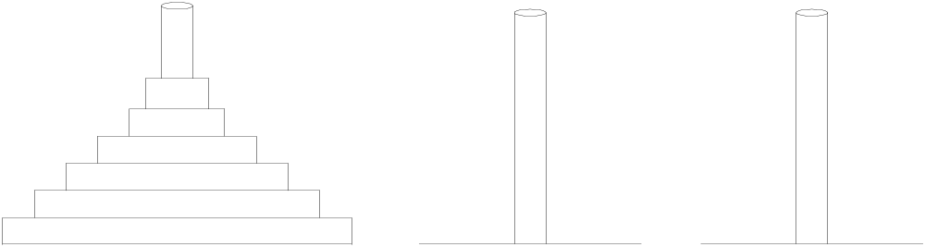
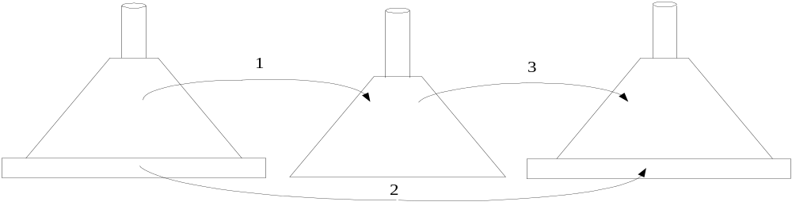
Example 2: The Tower of Hanoi Puzzle
Recurrence for number of moves:
M(n) = 2M(n-1) + 1, M(1) = 1

Slide 38
Algorithm
Algorithm Towers(n, S, D, Temp)
{
if (n=1)
Move Disk1 from S to D
// Move top n-1 disks from S to Temp using D
Towers(n-1, S, Temp, D);
// Move remaining disks from S to D
Move n-1 disks from Temp to D using S
Towers(n-1, Temp, S, D);
}

Slide 39
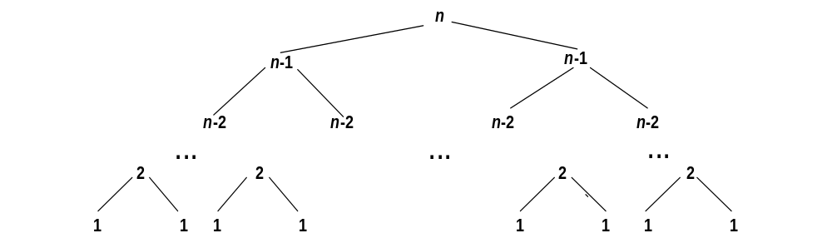
Tree of calls for the Tower of Hanoi Puzzle

Slide 40
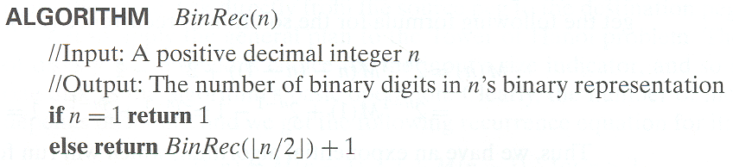
Example 3: Counting #bits

Slide 41
Example 3: Counting #bits
A(n) = A(n/2) +1 for n>1
A(1) = 0
Solve using smoothness rule

