Slide 1

Bitcoin Transaction Forensics for Suspicious Activity Detection
Using Behavioural and Network Analysis
Krishna Koushik, 23MIA1107
Peta Siva Nandhan Reddy, 23MIA1111
CSE4074 Forensic Analytics, Fall 2026-27
Professor: Dr. S. Johanan Joysingh
School of Computer Science Engineering and Information Systems (SCOPE), VIT Chennai
Notes:
Third review. The same content is in the interactive dashboard in the repository (dashboard/index.html). Every number in this deck comes from the notebooks and result files.

Slide 2
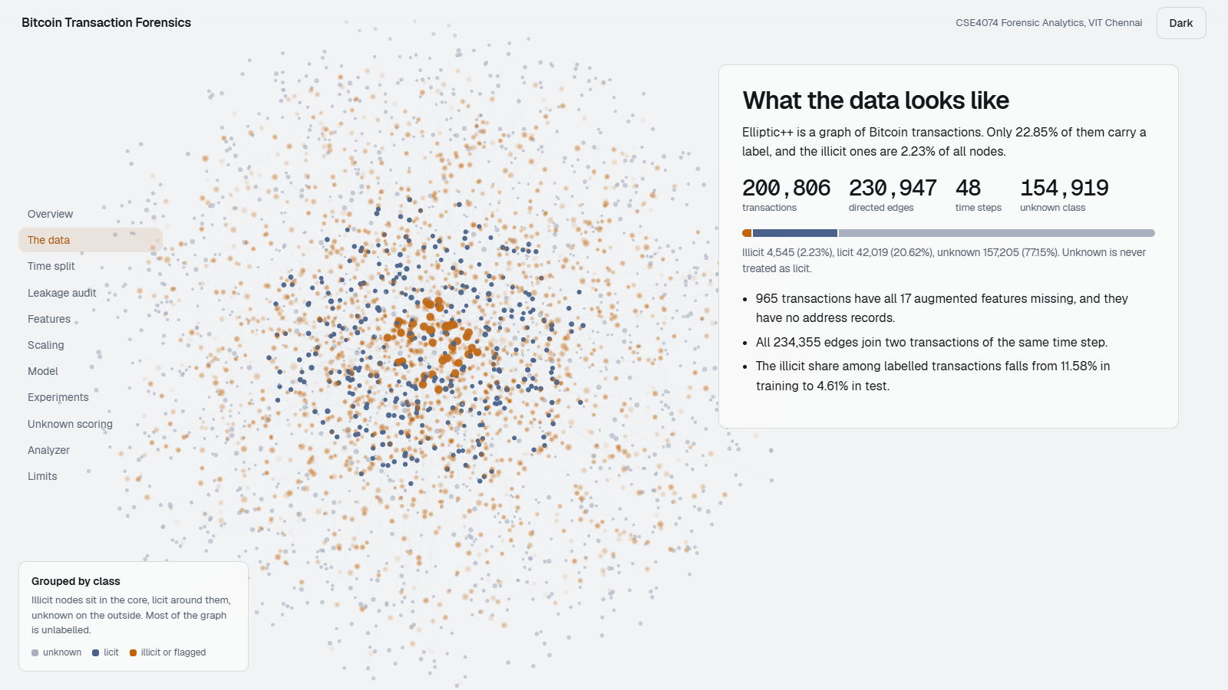
A public ledger does not say who is suspicious
Elliptic++ has 203,769 transactions and 234,355 edges between them.
Only 22.85% carry a label. Illicit transactions are 2.23% of all nodes.
Among labelled transactions the illicit share falls from 11.58% in training to 4.61% in test.
Unknown is never treated as licit.
The goal is a ranking with evidence, not a verdict.
Dashboard view: class mix of the graph. The nodes are an illustrative sample.
Notes:
Context. Elliptic++ is a graph of Bitcoin transactions. Most are unlabelled, and the illicit share drops over time, which is why accuracy is useless and why we split by time.

Slide 3
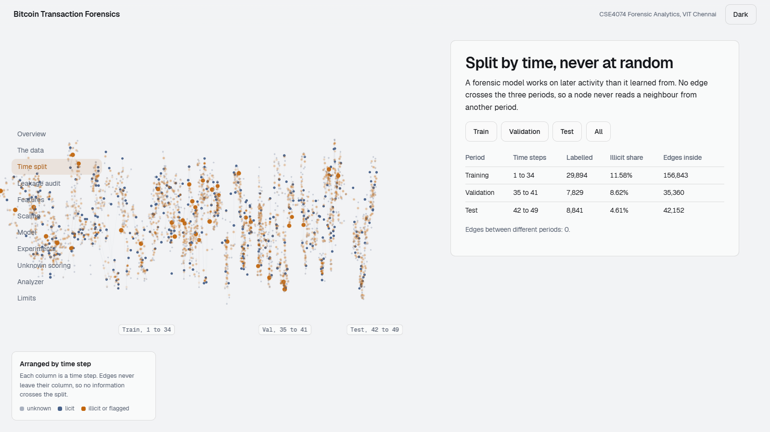
Split by time, never at random
Period | Time steps | Labelled | Illicit share | Edges inside
Training | 1 to 34 | 29,894 | 11.58% | 156,843
Validation | 35 to 41 | 7,829 | 8.62% | 35,360
Test | 42 to 49 | 8,841 | 4.61% | 42,152
Edges between different periods: 0.
A node never reads a neighbour from another period.
Order inside a time step cannot be recovered.
Dashboard view: each column is a time step.
Notes:
A forensic model is applied to later activity than it learned from. All 234,355 edges join two transactions of the same time step, so no edge crosses the periods.

Slide 4
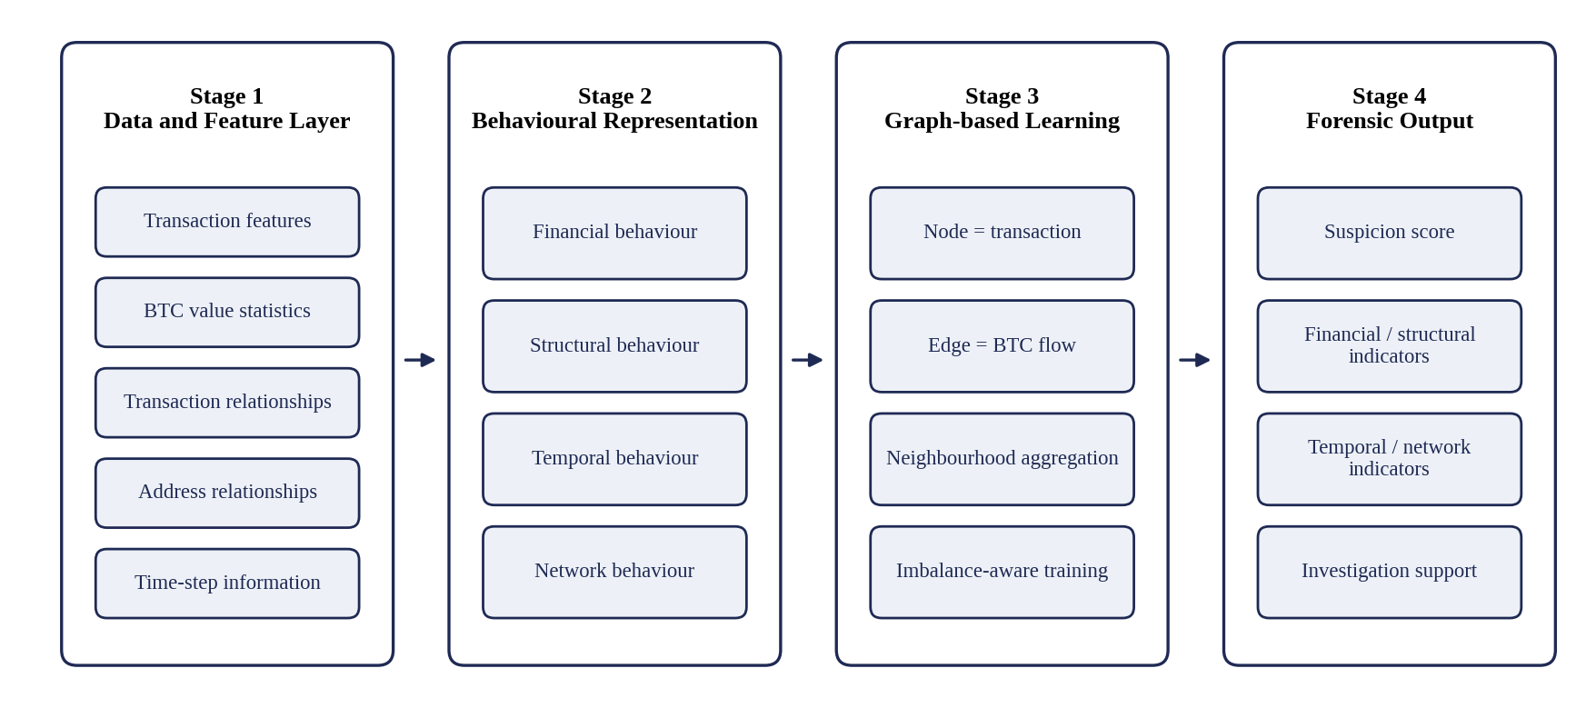
Four stages from data to evidence
Notes:
This is the architecture from Review I. The finished project follows it, with a temporal-availability audit added after the data audit and a frozen pipeline before Stage 4.

Slide 5
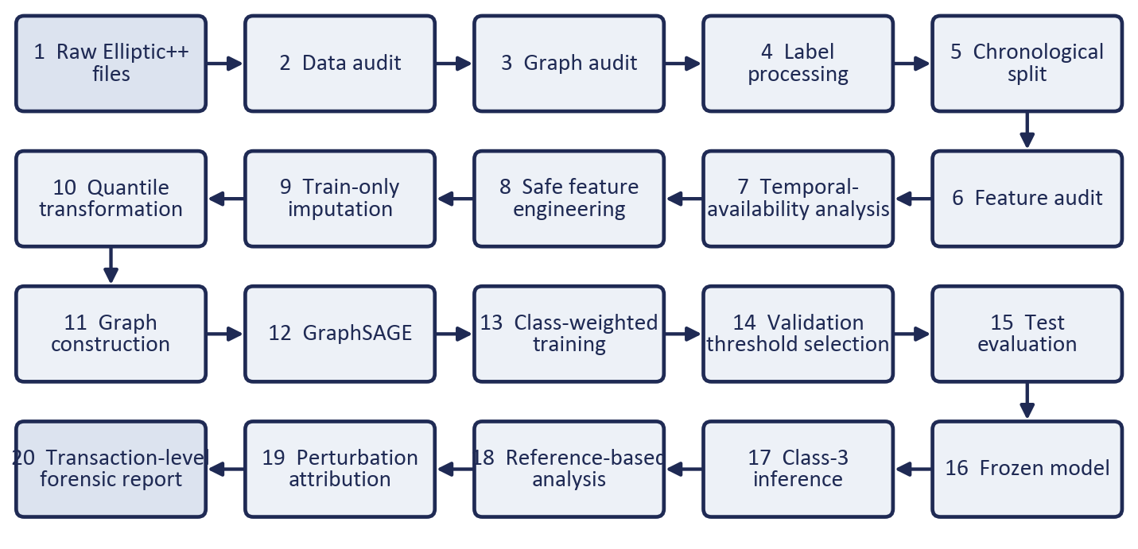
The implemented pipeline, step by step
Notes:
Twenty stages from raw files to the transaction-level report. The notebooks 01 to 08 hold these stages.

Slide 6
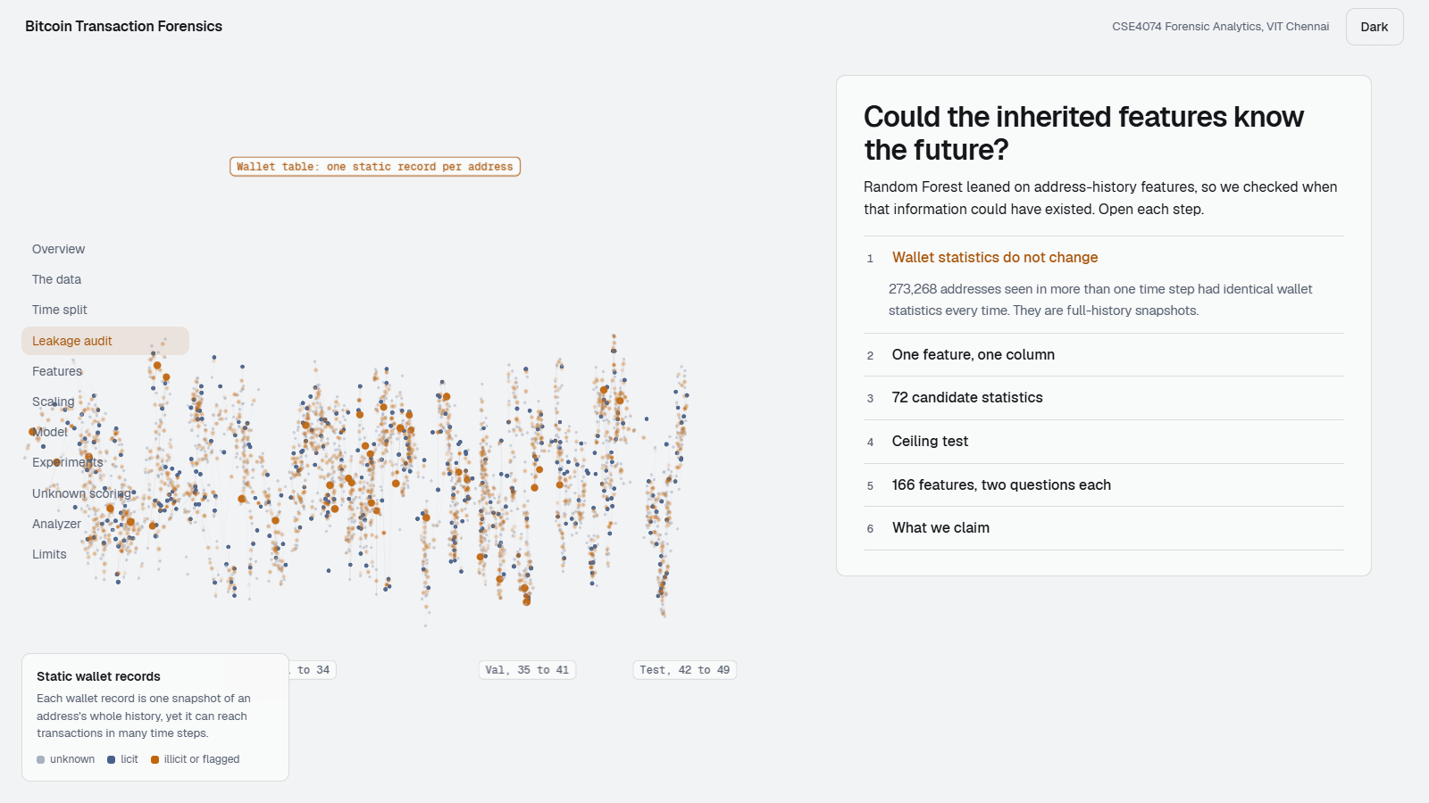
Could the inherited features know the future?
273,268 addresses: wallet statistics never change across time steps.
Local_feature_53 did not match its documented statistic (Spearman 0.451).
Local_feature_41 and 47 both match the sender count, against the dictionary.
All wallet columns together predict features 53, 41, 47 and 23 (R2 0.80 to 0.98).
Result: 13 features with strong evidence of a concern, 1 potential, 2 unclear.
Claim: a temporal-availability concern, not proof of leakage.
Dashboard view: static wallet records reach transactions in many time steps.
Notes:
We never say the features are leaked. We say strong evidence of a temporal-availability concern. 13 features, 1 potential, 2 unclear. 150 were not examined in depth.

Slide 7
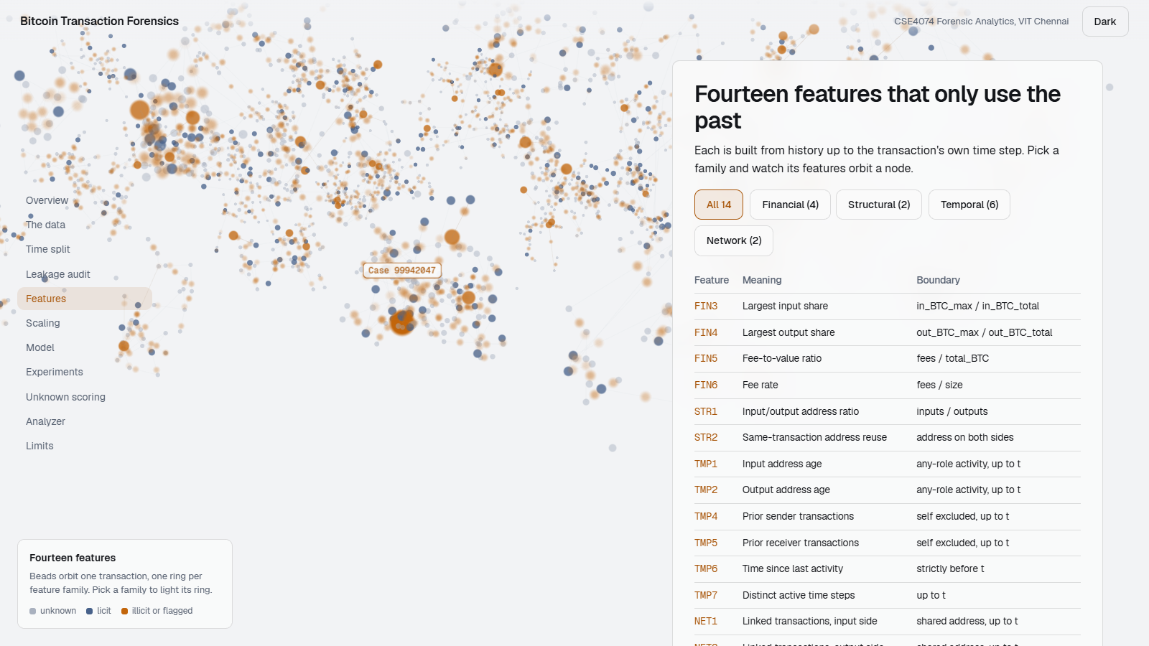
Fourteen features built only from the past
Family | Features | What they measure
Financial | FIN3 to FIN6 | Input and output concentration, fee ratios
Structural | STR1, STR2 | Input/output address ratio, address reuse
Temporal | TMP1, 2, 4, 5, 6, 7 | Address age, prior activity, recency
Network | NET1, NET2 | Earlier transactions linked by shared addresses
TMP6 is undefined for 84.53% of transactions, so a first-appearance flag keeps that fact.
Fixing the age bug changed 3,174 TMP1 and 688 TMP2 values.
FIN2 was dropped because the data cannot support it.
Dashboard view: feature families orbit one transaction.
Notes:
Each feature uses history up to the transaction's own time step. TMP6 uses strictly earlier steps. An early TMP1 and TMP2 bug measured age from one role only and was corrected.

Slide 8
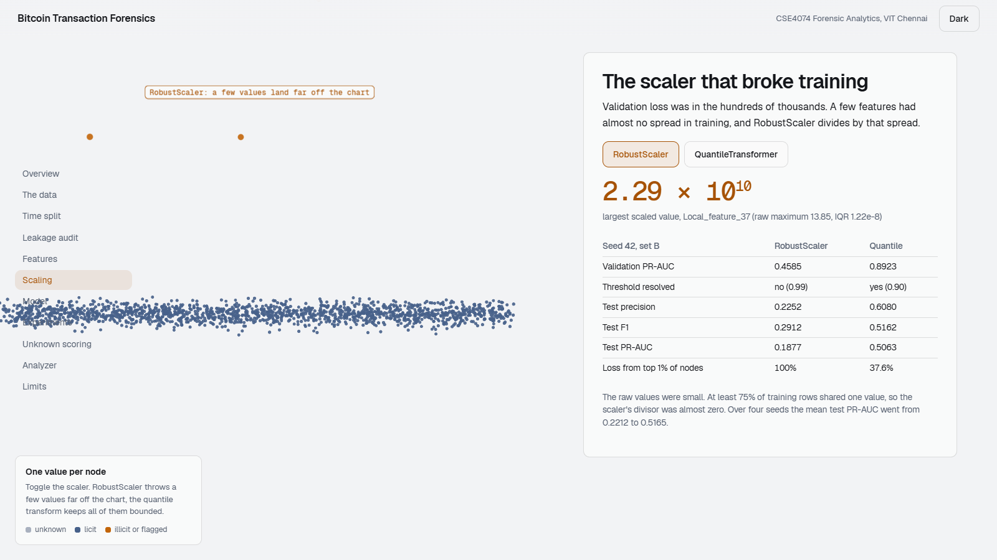
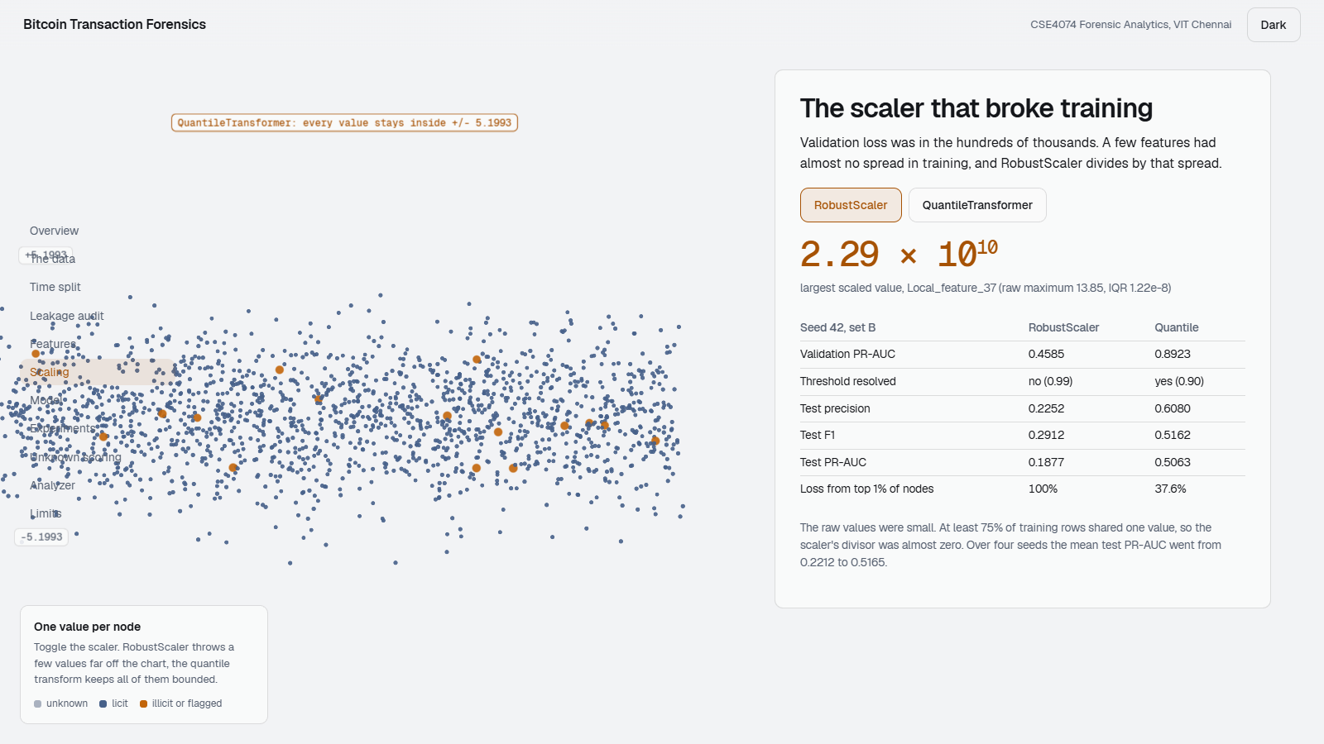
RobustScaler broke training, a quantile transform fixed it
RobustScaler: a few values far off the chart, up to 2.29e10.
QuantileTransformer: every value inside plus or minus 5.1993.
Mean test PR-AUC over four seeds: 0.2212 with RobustScaler, 0.5165 with the QuantileTransformer. Seed 42 loss share from the top 1% of nodes: 100% to 37.6%.
Notes:
Validation loss was in the hundreds of thousands. The cause was a divisor close to zero, not large raw values. One change, the scaler, took mean test PR-AUC from 0.2212 to 0.5165 over four seeds.

Slide 9
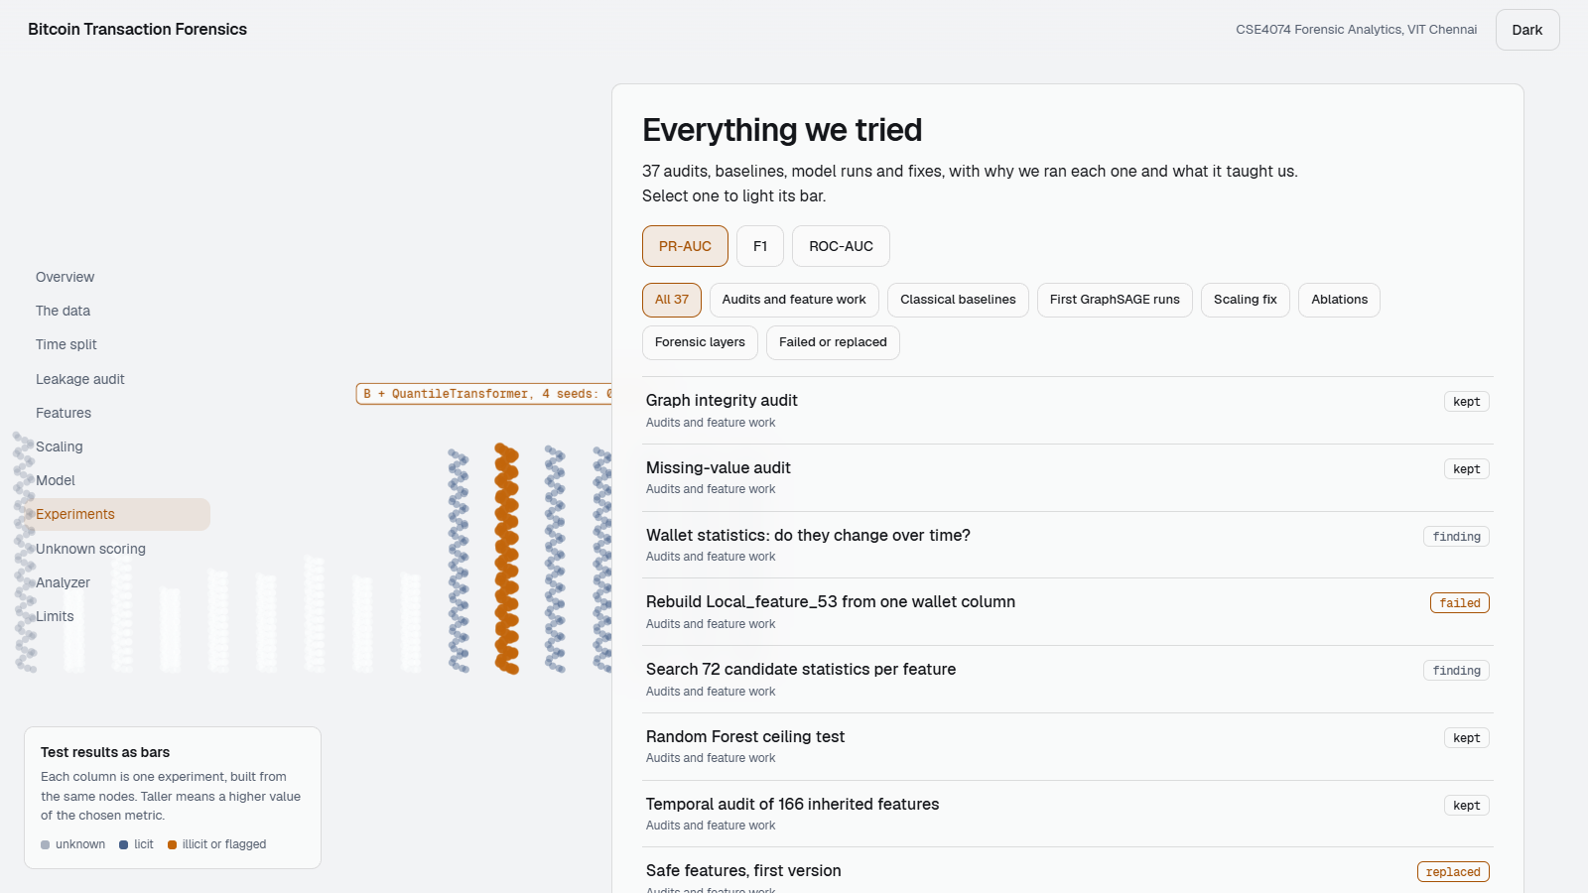
Thirty-seven experiments and audits
Group | Count | Takeaway
Audits and feature work | 11 | Static wallet snapshots found, age bug fixed, FIN2 dropped
Classical baselines | 2 | Random Forest sets a high bar
First GraphSAGE runs | 5 | Unstable runs and a huge loss
Scaling fix | 4 | One preprocessing change doubled PR-AUC
Ablations | 8 | Temporal removal lowers ROC-AUC only
Forensic layers | 7 | Scores, evidence layers and the analyzer
Dashboard view: each bar is one experiment.
Notes:
The dashboard lists every one with why we ran it, what changed, the result and what we learned. Failed and replaced ones are included.

Slide 10
Random Forest leads, the graph model is close
Random Forest: precision 0.8465, F1 0.6069, PR-AUC 0.5469.
GraphSAGE with quantile scaling, four seeds: PR-AUC 0.5165, ROC-AUC 0.8368, F1 0.5317.
Logistic Regression has the best ROC-AUC (0.8921) and a poor PR-AUC.
Notes:
We report Random Forest honestly. It is a single run on 184 features. GraphSAGE has four seeds. A fair Random Forest on feature set B is future work.

Slide 11
Removing temporal features lowers ROC-AUC only
Four seeds per configuration, quantile scaling.
Runs without temporal features: ROC-AUC 0.7724 to 0.8062. Full runs: 0.8240 to 0.8482.
PR-AUC and F1 stay within about one standard deviation across all six.
Adding the 14 features raised and steadied ROC-AUC, not PR-AUC or F1.
Notes:
Every run without temporal features has lower ROC-AUC than every full run. PR-AUC and F1 do not move robustly. The families overlap, so this is an association.

Slide 12
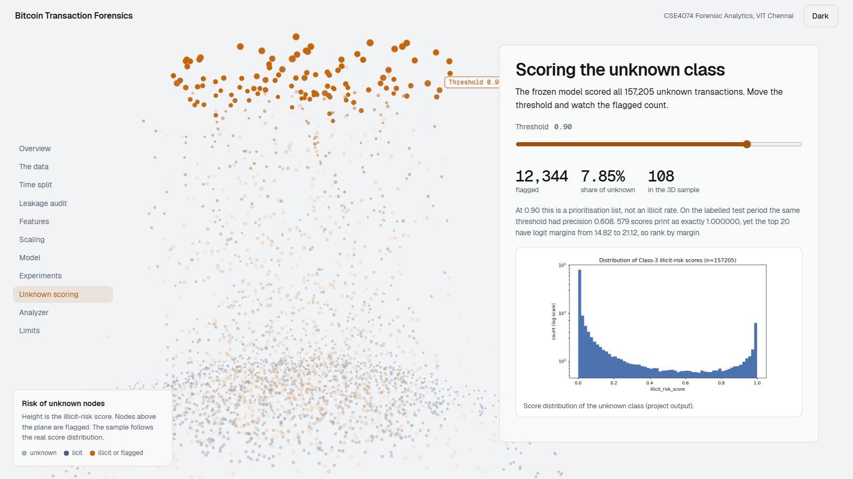
Scoring the 157,205 unknown transactions
12,344
flagged at the validated threshold 0.90 (7.85%)
Not an illicit rate: the unknown class has no labels.
579 scores print as exactly 1.000000, yet top-20 logit margins run from 14.82 to 21.12.
The threshold was chosen on validation and never tuned on the unknown class.
Dashboard view: nodes above the plane are flagged.
Notes:
At 0.90, 12,344 are flagged. That is a prioritisation list. On the labelled test period the same threshold had precision 0.608. Scores print as 1.000000 because of softmax saturation, so rank by logit margin.

Slide 13
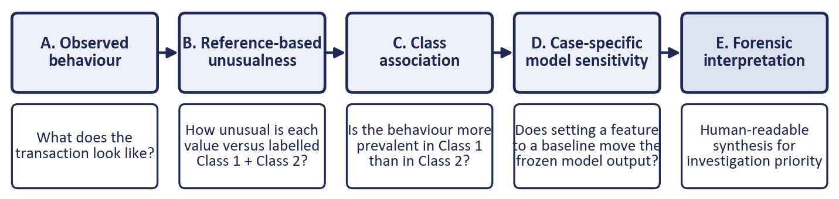
A score comes with five separate kinds of evidence
Unusualness is a percentile among labelled transactions only. HIGH is 95 or above, LOW is 5 or below.
Model sensitivity is the change in the illicit logit when one input is replaced by a training-only baseline.
Neither establishes illicit activity. Together they support prioritising a transaction.
Notes:
Each layer answers a different question. A feature can be unusual without moving the model, and the reverse. The analyzer never says fraud or not fraud.

Slide 14
Worked example: transaction 196098540
Feature | Observed | Overall median | Class 1 | Class 2 | Percentile | Unusualness | Sensitivity
Prior Receiver Transactions (TMP5) | 320 | 0 | 3 | 0 | 99.94 | HIGH | -0.4102
Output Address Age (TMP2) | 38 | 0 | 0 | 0 | 99.97 | HIGH | +0.2065
Fee-to-Value Ratio (FIN5) | 0.1744 | 0.0009 | 0.0023 | 0.0008 | 96.02 | HIGH | -0.0161
Largest Input Share (FIN3) | 1.0 | 1.0 | 1.0 | 0.9998 | 73.28 | NOT_EXTREME | -0.0906
Input Address Count | 1 | 1 | 1 | 2 | 26.72 | NOT_EXTREME | -0.1843
Fee Rate (FIN6) | 4.0e-6 | 1.03e-6 | 1.05e-6 | 8.98e-7 | 94.47 | NOT_EXTREME | -0.1820
The model is most sensitive to TMP5. FIN3 is not unusual, yet the model still reacts to it: unusualness and sensitivity are separate claims. Neither proves anything about the transaction.
Notes:
Class 3, time step 46, score 1.000000, band HIGH. TMP5 is 320 against overall and class medians of 0, 3 and 0. FIN3 equals 1.0 yet sits at the 73rd percentile, so it is not unusual, although the model reacts to it.

Slide 15
What this does not show, and what comes next
Limits
Next
One GraphSAGE configuration and one chronological split.
Illicit prevalence falls from 11.58% to 4.61%.
Random Forest is stronger and has not seen feature set B.
Most inherited features have no verified meaning.
Ablations are associations because the families overlap.
The unknown class has no ground truth.
Train Random Forest and boosting on feature set B.
Evaluate on several time boundaries.
Report precision among the top k flagged transactions.
Test the fingerprint rule alone on the test split.
Run ten seeds and repeat attribution with other baselines.
Audit the 150 inherited features not yet examined.
Notes:
Be direct about limits. The next experiment that matters most is Random Forest on feature set B with the same split.

Slide 16
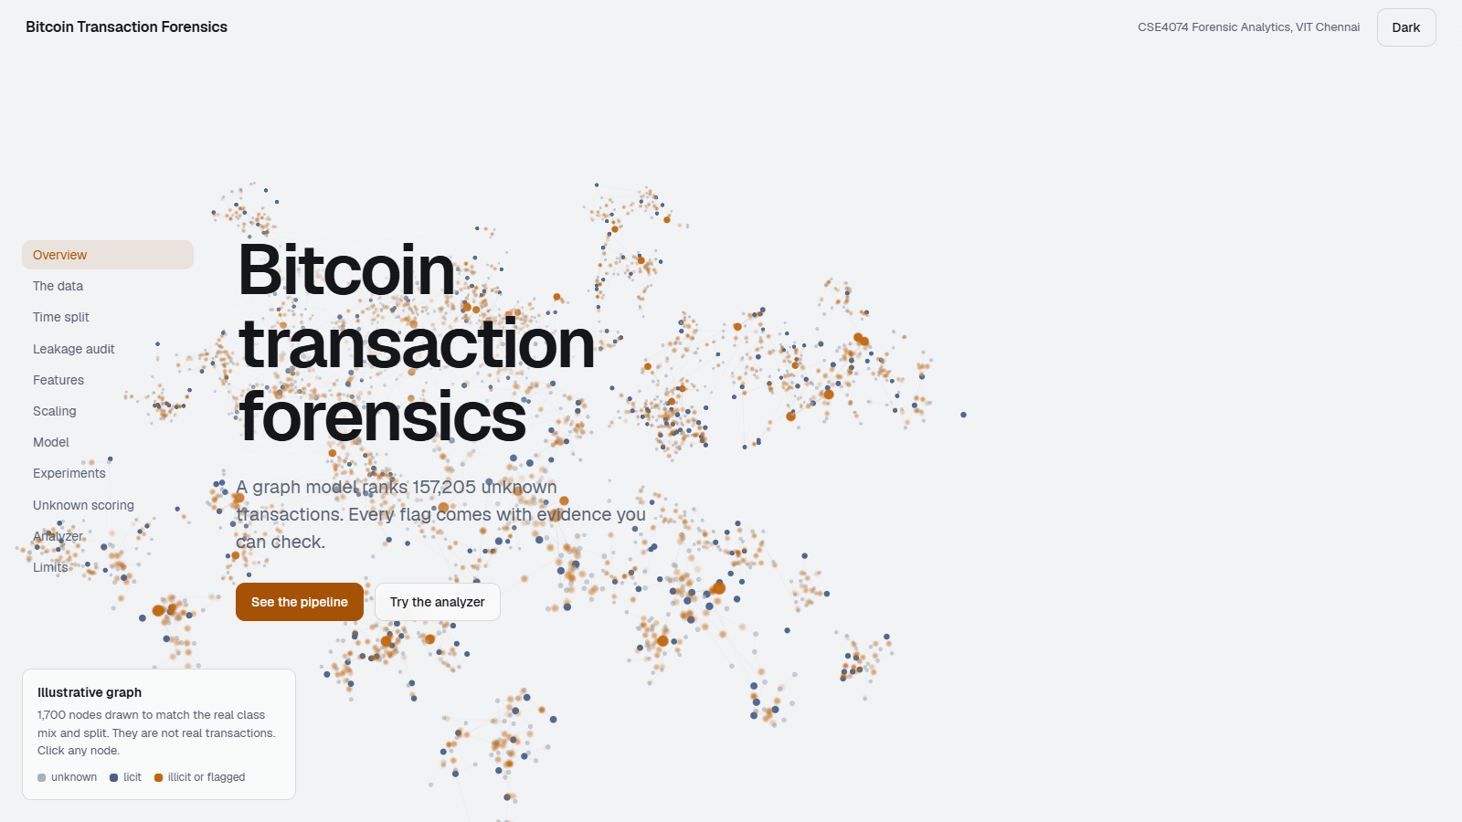
Explore it yourself
The dashboard lists every experiment with why we ran it and what it taught us.
Open dashboard/index.html from the repository root. No install needed.
The README explains setup and the order of the notebooks.
Suspicious is not proven fraudulent. The model supplies evidence, and the judgement stays human.
Dashboard landing view.
Notes:
Open dashboard/index.html from the repository. Click nodes, switch scalers, drag the threshold, and open any experiment.

