Slide 1
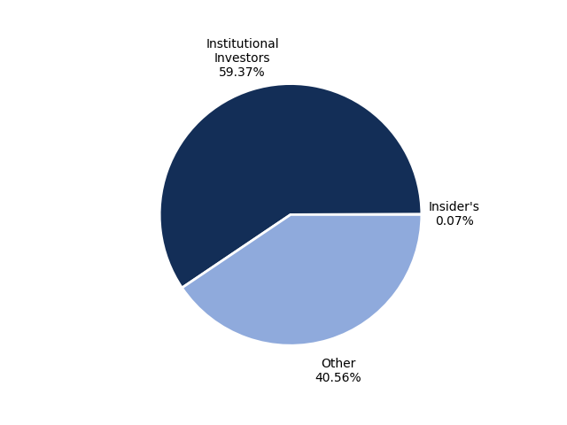
Ownership Structure
Ownership Structure

