Slide 1

Project Presentation For Steganography
Prepared by:-
Polamuri Mohana Krishna,
B.Tech (6th Semester), C.S.E
Guided By: Prof. Rajiv Ranjan Tewari

Slide 2
History Of Steganography
In his history of the Persian Wars, Herodotus tells of a messenger who shaved his head and allowed a secret message to be tattooed on his scalp. He waited until his hair grew back. Then he journeyed to where the recipient awaited him and shaved his head again. The message was revealed. It was history’s first use of steganography.
Ancient Romans used to write between lines using invisible ink based on various natural substances such as fruit juices, urine, and milk. Their experience was not forgotten: even nowadays children play spies and write secret messages that appear only when heated.

Slide 3
History Of Steganography
During the World War II the Germans developed the microdot.
A secret message was photographically reduced to the size of a period, and affixed as the dot for the letter 'i' or other punctuation on a paper containing a written message.
Microdots permitted the transmission of large amounts of printed data, including technical drawings, and the fact of the transmission was effectively hidden.

Slide 4
Introduction-Purpose:
One of the most important property of (digital) information is that it is in principle very easy to produce and distribute unlimited number of its copies.
This might undermine the music, film, book and software industries and therefore it brings a variety of important problems concerning the protection of the intellectual and production rights that badly need to be solved.
The fact that an unlimited number of perfect copies of text, audio and video data can be illegally produced and distributed requires to study ways of embedding copyright information and serial numbers in audio and video data.

Slide 5
Introduction-Purpose:
Steganography is main part of the fast developing area of information hiding.
Data security is the essential in the today’s world of internet and networking. In any organization information is critical.
In today’s world people are ready to spend millions of money in order to ensure high level of information security.
One of the ways to ensure security is to ensure that data is not visible to the hacker.
This can be done by hiding the message itself behind some other objects. Here we are achieving this data security concept through the technique of Steganography.

Slide 6
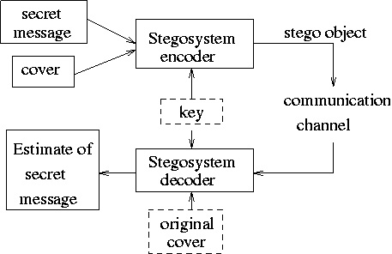
STEGANOGRAPHY SYSTEM

Slide 7
Introduction-Product Scope
It will embed any text data into any other suitable file such as image, audio, video, text file, without actually changing the content of the carrier file.
It will also allow user to transfer the file containing the information to other machine through LAN.
Consequently we will also retrieve the information from file in which information is embedded.
It will provide the mechanism to retrieve the text, image and audio file as it was embedded without changing the format or look of the file in which it was embedded.
It will also enable the digital data to embed multiple files simultaneously at the same time and during extraction the same files are retrieved with negligible loss of data and information

Slide 8
Introduction-Product Perspective
The advent of the Internet and the wide availability of computers and printers make digital data exchange and transmission a simple task.
However, making digital data accessible to others through networks also creates opportunities for malicious parties to make salable copies of copyrighted content without permission of the content owner.
This raised the need to develop a mechanism which prevents duplication of digital data.
Steganography was an excellent solution to this problem.
Various algorithms have been proposed and researchers are working on new robust techniques to prevent steganographed images from different attacks.

Slide 9
Introduction-Product Perspective
My motive in doing this project has been to transmission of secure information/confidential information through covert channels is concerned with Image Steganography.
This discipline of image processing further creates a divagation concerning the field of Steganalysis which is used to detect and decrypt the covert channels and means of communication being used by extremist organizations in their modes of communication.

Slide 10
Introduction-Product Functions
LSB substitution - the Least Significant Bit of a i-th binary block cki is replaced by the bit mi of the secret message.
The methods differ by techniques how to determine ki for a given ‘i’. For example, ki+1 = ki + ri, where ri is a sequence of numbers generated by a pseudo-random generators.
Substitution into parity bits of blocks. If parity bit of the block cki is mi, then the block cki is not changed; otherwise one of its bits is changed.
Substitution in binary images. If image ci has more (less) black pixels than white pixels and mi = 1 (mi = 0), then ci is not changed; otherwise the portion of black and white pixels is changed (by making changes at those pixels that are neighbors of pixels of the opposite color).
Substitution in unused or reserved space in computer systems.

Slide 11
Introduction-Product Functions
In Image Steganography the Exclusive-OR operation is performed on the last significant bit of the data in all three planes RGB since the mechanism is being performed in colored image.
Input 1 | Input 2 | Output
0 | 0 | 0
0 | 1 | 1
1 | 0 | 1
1 | 1 | 0

Slide 12
Introduction-Software Interfaces
Client on Internet: Web Browser, Operating System (Windows 7, 8 and all other compatible operating systems)
Client on Intranet: Client Software, Web Browser, Operating System (Windows 7, 8 and all other compatible operating systems)
Development End: MATLAB 2013Rb
Tool Box Used: Image Processing Toolbox available in MATLAB Version 8.2 with all its inherent (built-in) user-defined function files
NOTE: MATLAB should be fully installed with the user of the application

Slide 13
Introduction-Hardware Interfaces
Processor: Intel® Core™i5-4200U CPU @2.3GHz
System Type: 64-bit operating system, x64-based processor
Ram: 6GB(5.89 GB usable)
Hard disk: 1TB
Keyboard: 105 standard

Slide 14
GOALS
It should be capable of distinguishing the authorized and un-authorized users.
It should be capable of embedding text message into image file, audio file and video file.
On embedding the message, the format and look of the image, audio, video should not be distorted.
Reverse to embedding the message, it should also retrieve the message from image/audio/video file as it was embedded.
After embedding the message, it should retrieve the message from the file in the same format in which the message was previously embedded.
It should also decrypt the message which was encrypted by the sender.
It should be capable of embedding the whole text file into the image file, audio file and the video file, so that user could be able to embed large message in the form of text file.

Slide 15
GOALS
The format of data in file should not change during the process of transfer.
When the file is embedded in the image file, audio, video the visual interface of the file holding the file should not change.
Before embedding the file, the data of the file should be encrypted.
It should also decrypt the content of the file which was encrypted by the sender.
After retrieving the file from the image, audio, video file which holds the message the format of the image, audio, video file should not change.
Since this software is responsible for the data security, the software should be safe enough that it does not get misused.

Slide 16
PERFORMANCE REQUIREMENTS
The imperceptibility of the product image should be maintained in order to make it indistinguishable with the original image.
The PSNR values for the output image should be considerable enough and noise other types of distortions should not be detected in the image unless it has been simulated.
The image should be robust to the general type of compression attacks protecting its information at all costs.
In the process of steganography maximum number of text files, image files, audio files etc. must be embedded into the original image data to ensure the capacity of the system and its capabilities

Slide 17


EXPERIMENTAL RESULTS
Original Image
Steganographed Image

Slide 18
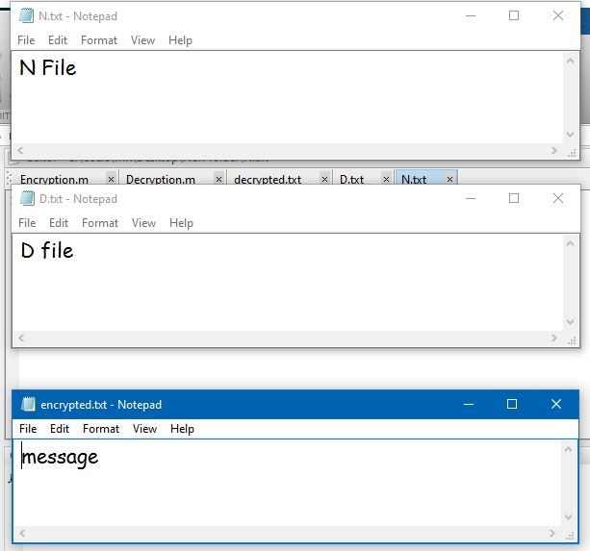
EXPERIMENTAL RESULTS
Files that were encrypted

Slide 19
Technologies And Softwares Used
MATLAB©:
Once the program starts, the MATLAB desktop window opens. The window contains four smaller windows: the Command Window, the Current Folder Window, the Workspace Window, and the Command History Window. This is the default view that shows four of the various windows of MATLAB. The Start button on the lower left side can be used to access MATLAB tools and features.
Command Window: The Command Window is MATLAB’s main window and opens when MATLAB is started. It is convenient to have the Command Window as the only visible window, and this can be done by either closing all the other windows (click on the x at the top right-hand side of the window you want to close) or by first selecting the Desktop Layout in the Desktop menu, and then selecting Command Window Only from the submenu that opens.
Figure Window: The Figure Window opens automatically when graphics commands are executed, and contains graphs created by these commands.
Editor Window: The Editor Window is used for writing and editing programs. This window is opened from the File menu.
Help Window: The Help Window contains help information. This window can be opened from the Help menu in the toolbar of any MATLAB window. The Help Window is interactive and can be used to obtain information on any feature of MATLAB.

Slide 20
CONCLUSIONS
Multiple data-embedding techniques were explored in the process of implementation and their importance in the field of cyber-security was realized in a generation where information is too fragile and in dire need of protection and security.
Various intricacies involving digital image processing establishing a strong research foundation to exploring the subject ahead as a major for research prospects.
This project enabled me to create a clear distinction between two similar data hiding techniques: Steganography & Cryptography. Both of these concepts are very confusing to a layman and hence this project is very instructive regarding the two and significant differences between them.
The ancient implementation of data security and its essentials has been realised in the modern day-generation in the digital image and this project stands out as one of the innumerable practical evidences for it.

Slide 21
THANK YOU

