Slide 1

EDA for Breast Cancer Survival Analysis

Slide 2
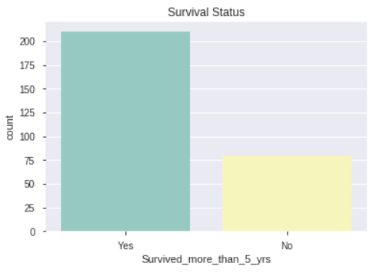
How many patients survived more than 5 years and died within 5 years?
Patients survived more than 5 Years – 210
Patients died within 5 years - 79

Slide 3
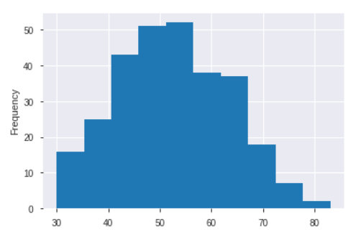
Which age group of people are affected more?
More no. of people affected are between the age 45 to 55

Slide 4
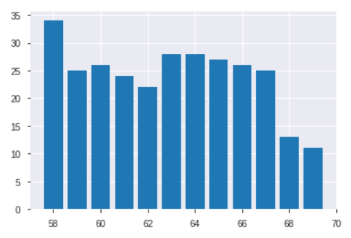
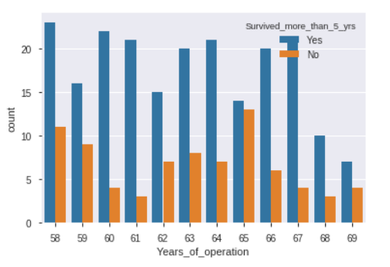
In which year more no. of operations happened?
In the year 1958 more no. of operations happened and in 1968 & 1969 the no. of operations happened is drastically low.

Slide 5
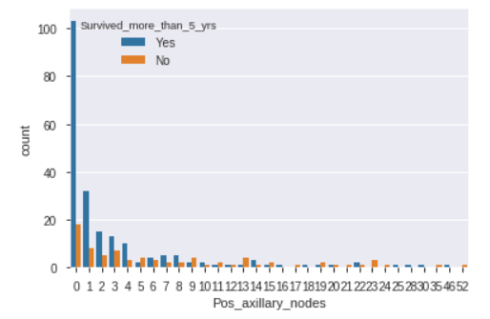
What is the survival rate w.r.t pos axillary node?
From the above plot, we can conclude that the chances of survival is more when Pos_axillary_nodes are less. The higher the no. of Pos_axillary_node the lesser the chances of survival
Almost 80 % of patients have less Pos_axillary_nodes
Patients who have more than 25 Pos_axillary_nodes have less chances of survival

