Slide 1


SMART INDIA HACKATHON 2024
Problem Statement ID – SIH1733
Problem Statement Title- SAR Image Colorization for Comprehensive Insight using Deep Learning Model
Team ID- 2055
Theme- Space Technology
PS Category- Software
Team Name- 6Tensors

Slide 2
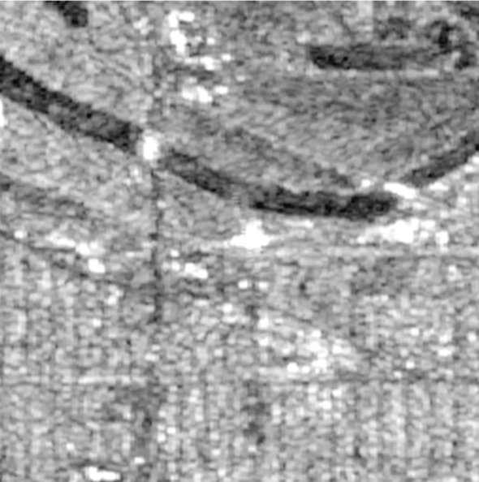
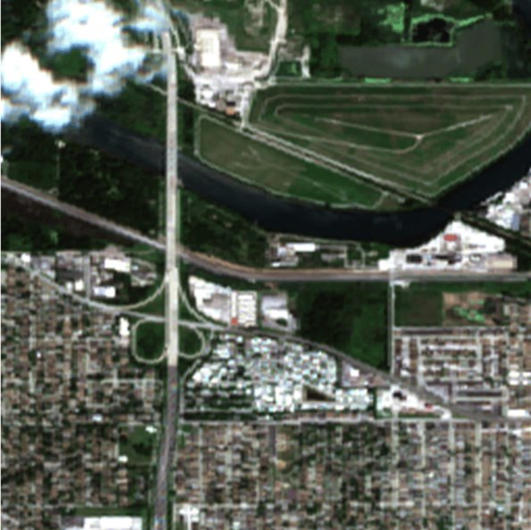
SARChroma- Unveiling Insights through SAR Image Colorization
6Tensors
Proposed Solution
SAR Images: They are rich in structural and textural details but lack color, making interpretation challenging for geological studies and environmental monitoring.
Proposed Solution: MC-GAN (Mask-Conditioned Generative Adversarial Network), an advanced deep learning model is designed to colorize SAR images.
Mask Vector: MC-GAN incorporates a mask vector to enhance the interpretability of SAR data by integrating distinctive color information from multiple regions.
Learning from Unpaired Datasets: Unlike existing models, MC-GAN can learn from unpaired datasets, making it more flexible and effective in various scenarios.
SAR Image
Colored representation

Slide 3
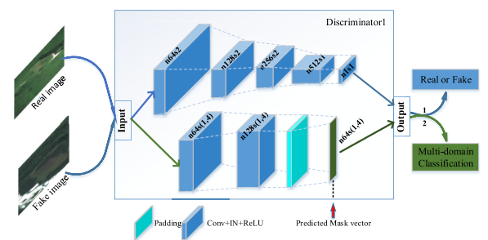
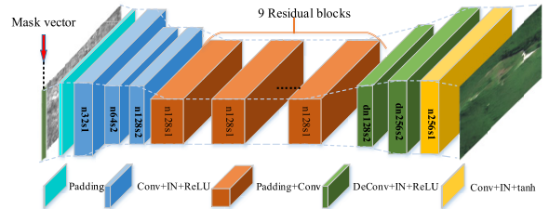
TE TECHNICAL APPROACH
6Tensors
Tech Stack for Web Interface
Frontend : React, Tailwind CSS
Backend : Flask API
TensorFlow and Keras libraries for model training
OpenCV for image processing
An n-dimensional one-hot vector is used to represent different regions, with SAR images considered a special region with grayscale representation.
The flowchart present on the right describes the architecture of the proposed model.
The model employs adversarial loss, cycle-consistency loss, and multidomain classification loss as loss functions to optimize both color accuracy and regional classification.
Structure of 2 discriminators[1]
Structure of 2 generators[1]

Slide 4
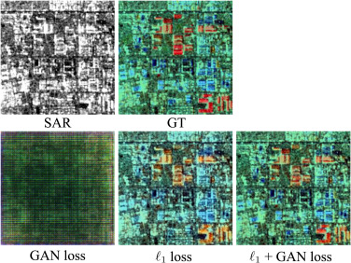
FEASIBILITY AND VIABILITY
6Tensors
  Technical Feasibility: It uses established deep learning techniques (e.g., CycleGAN) with significant enhancements, making it technically feasible for SAR image colorization.
  Operational Feasibility: The model's flexibility in handling unpaired data make it operationally feasible.
Challenges & Risks:
  Data Acquisition: Ensuring access to diverse and representative datasets covering multiple regions can be challenging.
  Model Generalization: Preventing overfitting and ensuring that the model generalizes well across different terrains and environmental conditions.
Strategies for Overcoming Challenges:
  Data Augmentation: Employ synthetic data augmentation techniques to expand the available dataset.
  Regularization Techniques: Implement advanced regularization methods to improve the model’s ability to generalize from training data to unseen real-world data.
Approaches for colorization using loss functions

Slide 5
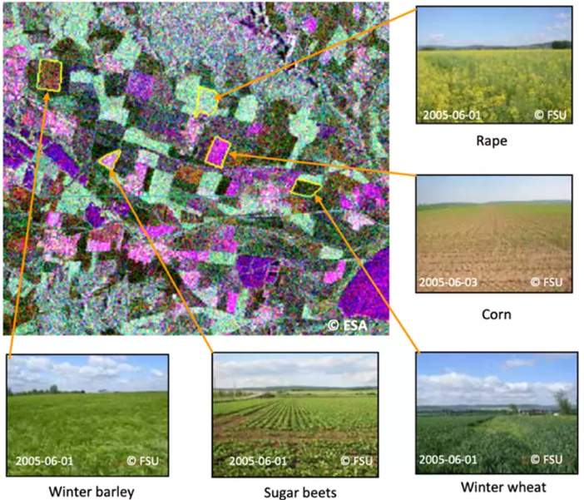
IMPACT AND BENEFITS
6Tensors
Social Impact:
  Improved Accessibility: The colorized SAR images make complex data easier to interpret, especially for non-expert users involved in remote sensing applications.
  Enhanced Decision-Making: It supports better decision-making in fields like disaster management and environmental monitoring.
Economic Impact:
  Cost Efficiency: Reduces the need for manual interpretation and analysis of SAR data, thus saving time.
Environmental Impact:
  Environmental Monitoring: It’s ability to monitor environmental changes, land use can lead to more informed conservation and resource management efforts.
Potential of colorized SAR data for crop‐type classification

Slide 6
RESEARCH AND REFERENCES
6Tensors
G. Ji, Z. Wang, L. Zhou, Y. Xia, S. Zhong and S. Gong, "SAR Image Colorization Using Multidomain Cycle-Consistency Generative Adversarial Network," in IEEE Geoscience and Remote Sensing Letters, vol. 18, no. 2, pp. 296-300, Feb. 2021, doi: 10.1109/LGRS.2020.2969891.keywords: {Radar polarimetry;Image color analysis;Optical imaging;Generators;Synthetic aperture radar;Optical losses;Training data;Cycle-consistency;multidomain;multidomain cycle-consistency generative adversarial network (MC-GAN);synthetic aperture radar (SAR) image colorization},
P. Wang and V. M. Patel, "Generating high quality visible images from SAR images using CNNs," 2018 IEEE Radar Conference (RadarConf18), Oklahoma City, OK, USA, 2018, pp. 0570-0575, doi: 10.1109/RADAR.2018.8378622. keywords: {Synthetic aperture radar;Speckle;Training;Image color analysis;Gray-scale;Noise measurement;Gallium nitride;Synthetic aperture radar image;despeckling;colorization},

