Slide 1

Medical AI as Service
for EHR Systems

Slide 2
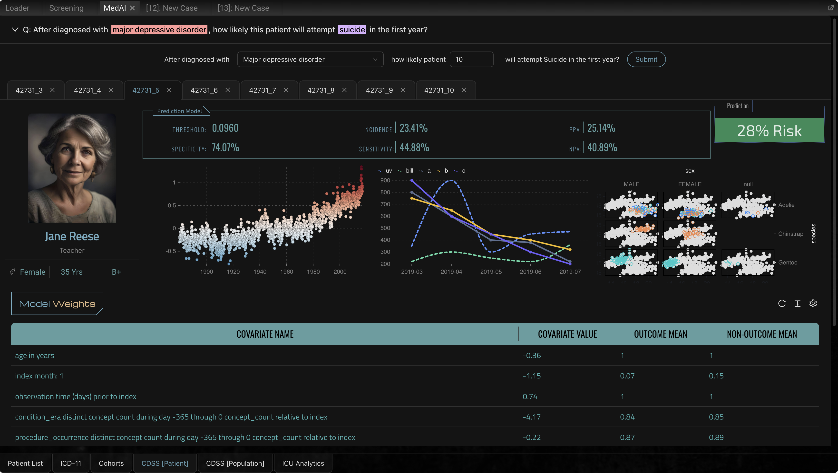
Medical AI
GK Palem
AI-driven Clinical Decision Support for Evidence-based Personalized Care
MEDICALAI
30-Apr-2024

Slide 3
What is the Problem?
Patient Safety in
Modern healthcare

Slide 4
What is the Problem?
Around 1 in every 10 patients is harmed in health care
More than 3 million deaths occur annually due to unsafe care
50% of harm (1 in every 20 patients) is preventable
half of this harm is attributed to medications
Patient Safety in
Modern healthcare
Medication Errors: affects 1 out of every 30 patients
Diagnostic Errors: occur in 5–20% of physician–patient encounters
Source: W.H.O. (Reference) 11-Sep-2023

Slide 5
What is the Problem?
Clinicians working under pressure
Patient Safety in
Modern healthcare
Challenges in the Modern Healthcare Setting
Diagnostic Errors
Treatment Delays
Data Overload
…

Slide 6
What is the Solution?
AI driven
Decision Support

Slide 7
What is our Solution?
Clinical Decision Support System (CDSS) integrated into the Provider’s EHR
Provides decision support to the Doctors at the point-of-care
AI driven
Decision Support

Slide 8
What is our Solution?
Clinical Decision Support System (CDSS) integrated into the Provider’s EHR
Provides decision support to the Doctors at the point-of-care
AI driven
Decision Support
Reduces Diagnostic Errors: provides real-time, evidence-based recommendations minimizing the risk of misdiagnosis.
Accelerates Treatment Delivery: offers immediate suggestions for treatment options based on the latest research and specific patient conditions, significantly reducing the time to treatment initiation.
Manages Data Overload: filters and prioritizes the relevant patient information and clinical guidelines, enabling the clinicians to focus on the critical decision-making without getting overwhelmed by the data.

Slide 9
What is our Solution?
Clinical Decision Support System (CDSS) integrated into the Provider’s EHR
Provides decision support to the Doctors at the point-of-care
AI driven
Decision Support
Reduces Diagnostic Errors: provides real-time, evidence-based recommendations minimizing the risk of misdiagnosis.
Accelerates Treatment Delivery: offers immediate suggestions for treatment options based on the latest research and specific patient conditions, significantly reducing the time to treatment initiation.
Manages Data Overload: filters and prioritizes the relevant patient information and clinical guidelines, enabling the clinicians to focus on the critical decision-making without getting overwhelmed by the data.
Demo

Slide 10
Value Proposition
Our CDSS helps the Clinicians:
formulate targeted inquiries
refine working diagnosis
refine the differential diagnosis
mitigate the risk of Adverse Drug Reactions (ADRs)
identify potential contra-indications for selected medication
access real-time shared knowledge at the point-of-care
Our CDSS helps the Providers:
Monitor and prevent drug (ab)use / opioid crisis
Our CDSS helps the Payers reduce the costs by:
avoiding mis-diagnosis
eliminating unnecessary medical tests
providing evidence-based care specific to the individuals
monitoring the progress and predicting the risks (individualized)
AI driven
Decision Support

Slide 11
Value Proposition
Key Features
Seamless integration with existing EHR systems via SaaS model.
Real-time Clinical Decision Support based on the latest clinical data and individual patient health records.
Customizable alerts and decision support tailored to specific workflows.
Doctors have full control over when to use the AI and when not to.
Can optionally override any AI suggestion anytime.
Works with in-patient models as well as Tele-health scenarios.
Audit log for compliance and monitoring.
Regular updates and audits ensure that the system meets all regulatory requirements, including HIPAA.
AI driven
Decision Support

Slide 12
Market Size
Global CDSS market size is valued at: USD 5.3B in 2023
Expected to expand at CAGR of 10.6% from 2023 to 2030
Source: Grand View Research, CDSS Market Size Report (Ref)
CAGR (2023-30):
10.6%
Key Drivers of Growth
Rising EHR Adoption
Rising Demand for Personalized Medicine
Growing Emphasis on Value-Based Care
Adoption of AI tools in Healthcare
Increasing Chronic Disease Burden
Expansion of Telemedicine and Remote Patient Monitoring

Slide 13
Target Audience
Providers and Practitioners
CDSS
Healthcare Organizations
Payers and Insurers
EHR System Builders

Slide 14
Target Audience
Healthcare Providers and Practitioners
Rely on CDSS for evidence-based guidelines, drug-interaction alerts, patient-specific recommendations etc.
Providers and Practitioners
Healthcare Organizations
Payers and Insurers
EHR System Builders

Slide 15
Target Audience
Healthcare Providers and Practitioners
Rely on CDSS for evidence-based guidelines, drug-interaction alerts, patient-specific recommendations etc.
Healthcare Organizations
Use CDSS to improve clinical workflows, enhance patient safety, reduce medical errors, and optimize resource utilization.
Providers and Practitioners
Healthcare Organizations
Payers and Insurers
EHR System Builders

Slide 16
Target Audience
Healthcare Providers and Practitioners
Rely on CDSS for evidence-based guidelines, drug-interaction alerts, patient-specific recommendations etc.
Healthcare Organizations
Use CDSS to improve clinical workflows, enhance patient safety, reduce medical errors, and optimize resource utilization.
Healthcare Payers and Insurers
Leverage CDSS to identify high-risk patients and implement targeted interventions to improve outcomes and reduce healthcare costs.
Providers and Practitioners
Healthcare Organizations
Payers and Insurers
EHR System Builders

Slide 17
Target Audience
Healthcare Providers and Practitioners
Rely on CDSS for evidence-based guidelines, drug-interaction alerts, patient-specific recommendations etc.
Healthcare Organizations
Use CDSS to improve clinical workflows, enhance patient safety, reduce medical errors, and optimize resource utilization.
Healthcare Payers and Insurers
Leverage CDSS to identify high-risk patients and implement targeted interventions to improve outcomes and reduce healthcare costs.
EHR System Builders
Can use our SaaS API to enable CDSS AI functionality in their EHR.
Providers and Practitioners
Healthcare Organizations
Payers and Insurers
EHR System Builders

Slide 18




Competitive Landscape
Heal
Heal is a health care service company that provides digital monitoring and telepsychology services to patients.
Last Funding Type: Series-D
Amount raised: USD 164.1M
Differentiation
Heal provides value-based, in-home primary care to seniors.
Their key focus area is in-home primary care for patients.
Their primary target audience: Patient
Where as our CDSS platform is primarily aimed at Clinicians and EHR providers.
Heal
Heal X
Bright.MD
Cyclica

Slide 19
Competitive Landscape
HealX
Healx is an AI-powered, patient-inspired technology company, pioneering the next generation of drug discovery for rare diseases.
Last Funding Type: Series-B
Amount raised: USD 67.9M
Differentiation
HealX is pioneering the next wave of drug discovery for rare diseases.
Their key focus area is AI-powered drug discovery for rare diseases.
Their primary target audience: Pharma.
Where as our CDSS platform is AI-powered decision support for Clinicians at the point of care with real-time knowledge and patient specific health records.
Heal
Heal X
Bright.MD
Cyclica

Slide 20
Competitive Landscape
Bright.MD
Bright.md is AI-powered virtual-care platform designed to modernize direct-to-patient telehealth for healthcare systems.
Last Funding Type: Series-C
Amount raised: USD 29.2M
Differentiation
Bright.MD is a telehealth platform that provides virtual care solutions for patients.
Their key focus is AI-powered direct-to-patient telehealth for patients.
They partner with healthcare organizations to offer telehealth for patients.
Whereas we partner with healthcare organizations to offer AI-powered decision support for Clinicians (for both in-patient and tele-health scenarios).
Heal
Heal X
Bright.MD
Cyclica

Slide 21
Competitive Landscape
Cyclica
Cyclica provides tools for the entire pre-clinical drug discovery process.
Last Funding Type: Series-B
Amount raised: USD 25.6M
Differentiation
Cyclica uses BioPhysics and AI to improve drug discovery practices.
Their key focus area is AI-powered drug discovery.
Their primary target audience: Pharma.
Where as our CDSS platform is AI-powered decision support for Clinicians at the point of care with real-time knowledge and patient specific health records.
Heal
Heal X
Bright.MD
Cyclica

Slide 22
Business Model
Revenue Streams
Recurring Revenue Model: A subscription-based SaaS model, offering tiered pricing plans based on:
Number of users (e.g., physicians, nurses)
Facility size and complexity
Level of customization required
Value-added Services: Offer value-added services such as patient data analytics, predictive modelling, and population health management tools to optimize clinical works flows and optimize resource utilization.
Monetized through add-on fees and consulting arrangements.
Partnerships and Integrations: Collaborate with electronic health record (EHR) vendors, telemedicine providers, and healthcare technology companies to integrate our CDSS AI capabilities into their systems.
Revenue generated through licensing fees, integration charges, and revenue-sharing agreements.
Subscription-based
SaaS Model

Slide 23
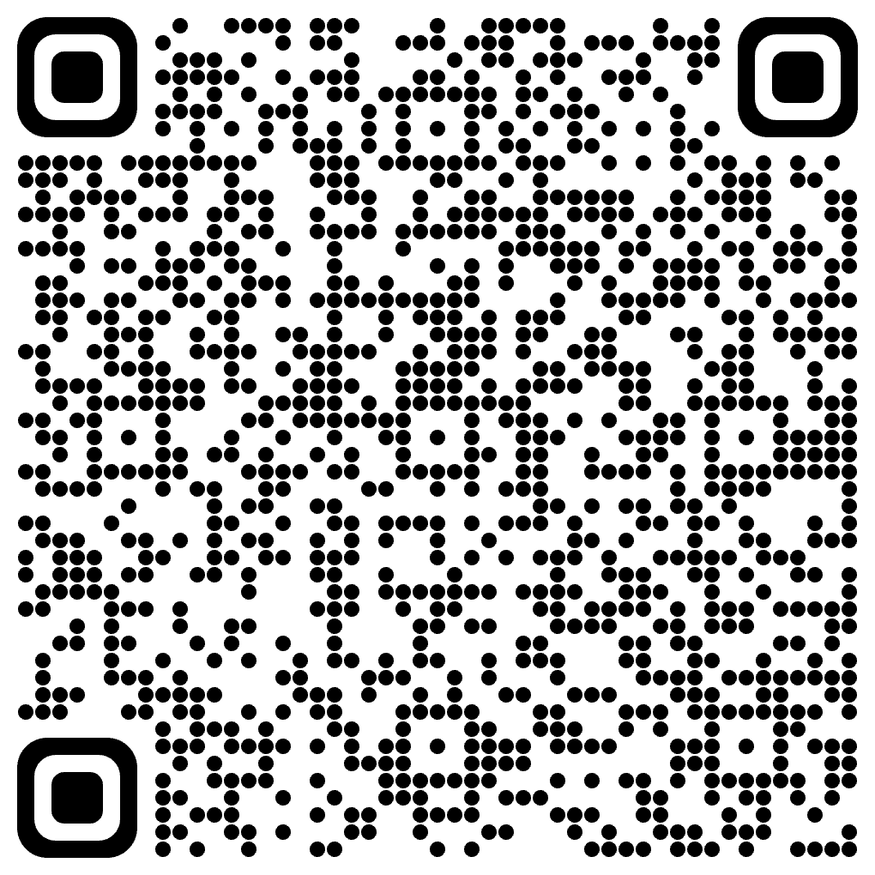
Thank you
Our CDSS SaaS platform presents a transformative opportunity to improve healthcare delivery and patient outcomes.
Next Steps:
We welcome the opportunity to discuss our vision and business model in further detail.
Contact:
Name: GK Palem
LinkedIn: https://linkedin.com/in/gpalem
Email: GK.Palem@Yahoo.com

