Slide 1

ENGINEERING EXPLORATION(20ME03)
PROJECT SEMINAR
ON
E-SCHOOL MANAGEMENT SYSTEM
Branch: IT-1
Aarthi - 160120737001
Akshita - 160120737002
Harini - 160120737003
Krishna - 160120737004
Manasa - 160120737005
Mentor: I.Sucharitha , Assistant Professor

Slide 2
CONTENTS
1. Abstract
2. Introduction
3. Problem Statement
4. System Design
5. Implementation
6. Results
7. Conclusion
8. Future Scope
9. References
2

Slide 3
ABSTRACT
An E-School Management System is an information management system for educational institutions to manage all students and teachers data.
The E-school management system will manage all the work in any school in particular order so that the time requirement and complexity of the system will be reduced.
The main objective of E-school management system is to computerize the paperwork in the system and automate the work.
E-School management system has been designed with features that make it possible for students to view their attendance records, grade checks, report cards and fee details in just a few clicks.
3

Slide 4
INTRODUCTION
E-School is a complete school information management solution. Today's schools need to manage more information than ever before.
E-School automates various activities of school and optimizes the use of premium resources. Concerned authorities can now easily and seamlessly use the system to access student details, otherwise a time consuming and tedious task.
School Management Software offers a strong backbone to the education system. It integrates information from various areas and brings them under one roof. This reduces the hassle involved in performing the task.
4

Slide 5
PROBLEM STATEMENT
To design a system to succeed in everyday tasks of schools and transforming schools system with high technology-enabled automation tools to support the academic and administrative processes. In educational Institutions the administrators and the teachers have to handle records of many students and the maintenance of such details is very difficult . There is scope for errors and retrieving of student details also becomes difficult . The space and cost consumed in physical storage of student records is huge. There is also a risk of files getting lost because of human error. Hence there is a need to upgrade the system with a computer based information management system.
5

Slide 6
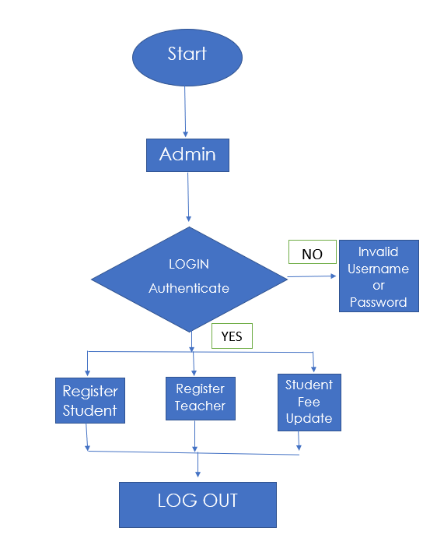
SYSTEM DESIGN
STEP 1:
Fig 4.1:Admin flow chart
6

Slide 7
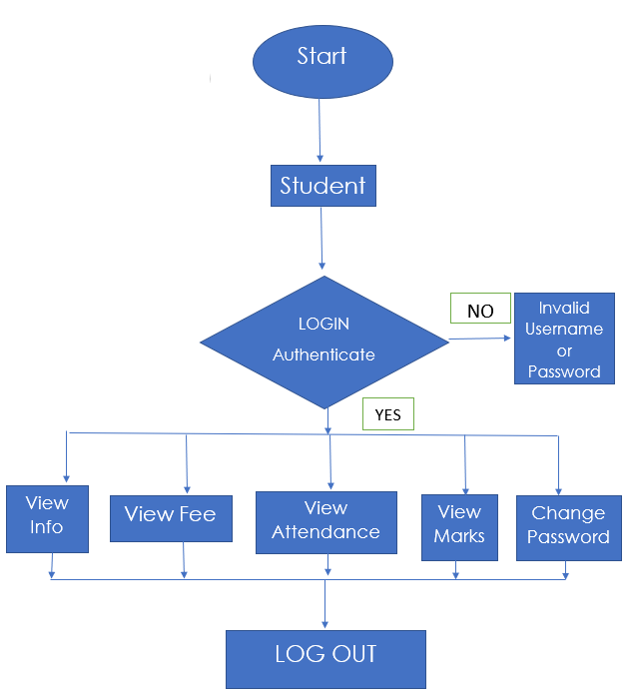
STEP 2:
Fig 4.2:Student flow chart
7

Slide 8
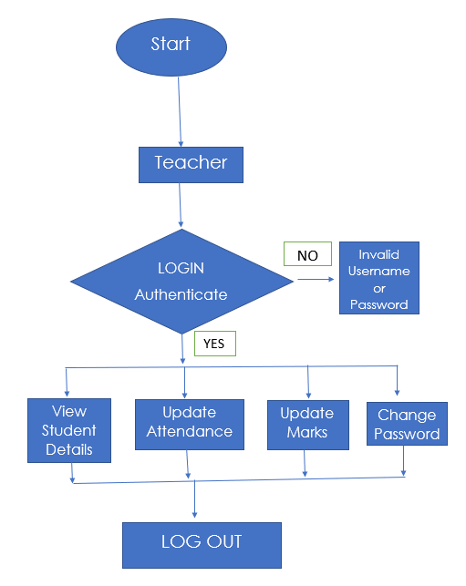
STEP 3:
Fig 4.3:Teacher flow chart
8

Slide 9
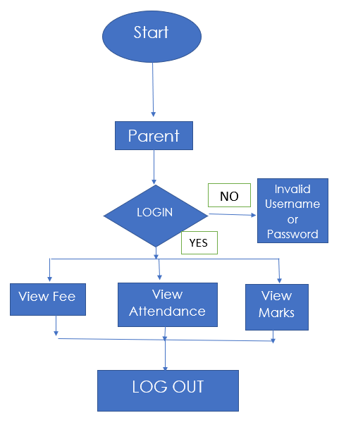
STEP 4:
9
Fig 4.4:Parent flow chart

Slide 10
IMPLEMENTATION
There are four main users for this system; these are Admin, student, teacher and the parent. Each user can perform several different functions during the use of the system.
Users have their respective usernames and passwords using which they can login.
LOG-IN:
This will help users to login into the system using institute id and password. A user who has the valid id and password can only log in to their respective accounts.
It will help the authentication of the user who enters the system. The module provides a layer of security over the system as only authorized personnel can login into the system . This prevents any anonymous person to enter the system and mishandle the records. It is better than the manual method as they do not have any security measure of who can access the system and who cannot.
10

Slide 11
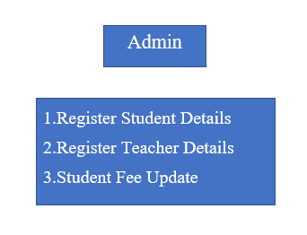
The admin can register student details , teacher details and update the fee status as per the fee payment.
The admin will register the student as the student is new in the educational institute. It will be formed like a structure where all the their details such as full name , class , mobile number , student password will be filled.
11

Slide 12
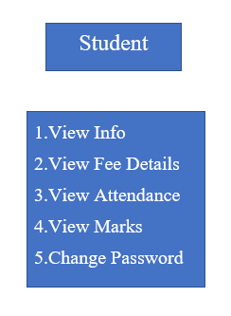
The student can view their personal details, view fee status, view attendance , view marks and change password.
Change password is available only for students of grade 11 and above.
Their attendance and marks/results can be viewed with respect to their subjects . The students can also change their password initially given by the admin.
12

Slide 13
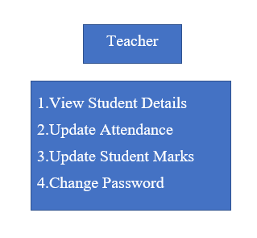
The teacher can view students details, update student’s attendance for the respective subject , update student marks, and change password .
The teacher can view a particular student details by entering the student ID number . They can also view the details of the entire class by entering the class Number.
The teacher can also change their password initially given by the admin.
13

Slide 14
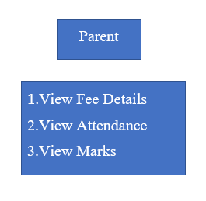
The parents can login to the system by giving their ward’s ID and mobile number .The parent can view fee status, attendance and marks of their ward.
The student’s attendance and marks/results can be viewed with respect to their subjects .
14

Slide 15
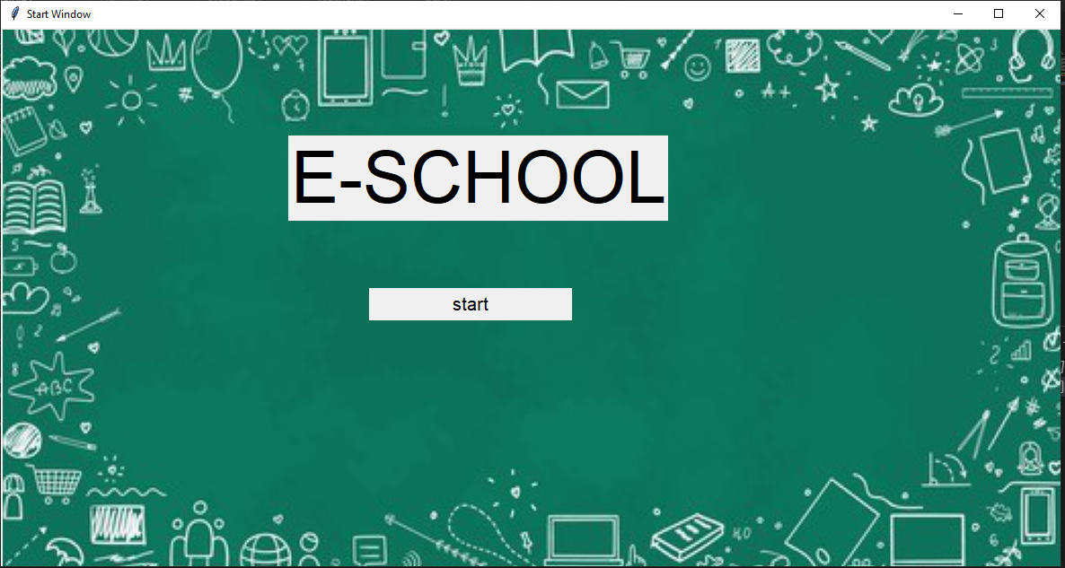
RESULTS
Fig 6.0: Start window

Slide 16
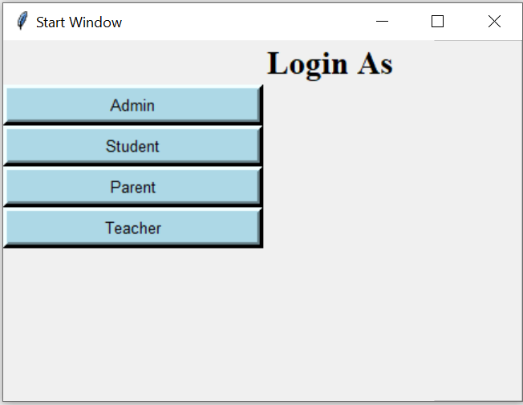
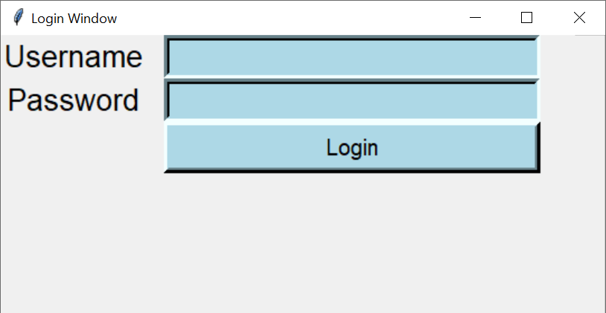
LOGIN: It is a multi-user login Interface where you can login as Admin ,Student ,Parent , Teacher . User can login by giving the username and password.
Fig 6.2:Login window
Fig 6.1:Log in As window
15

Slide 17
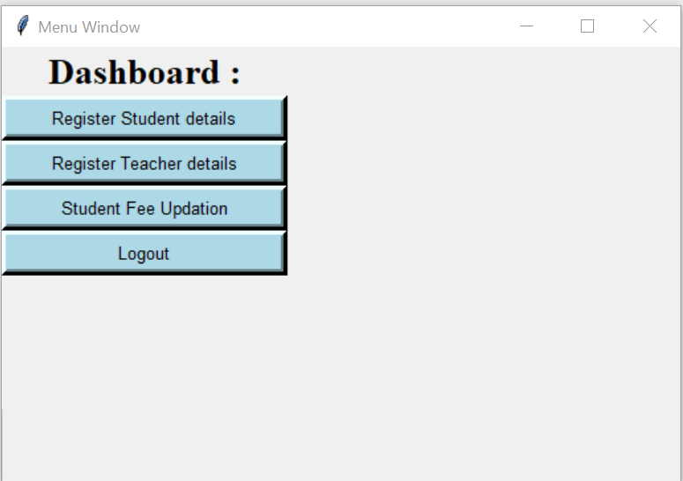
ADMIN MENU WINDOW:
Fig 6.3:Dashboard of Admin
16

Slide 18
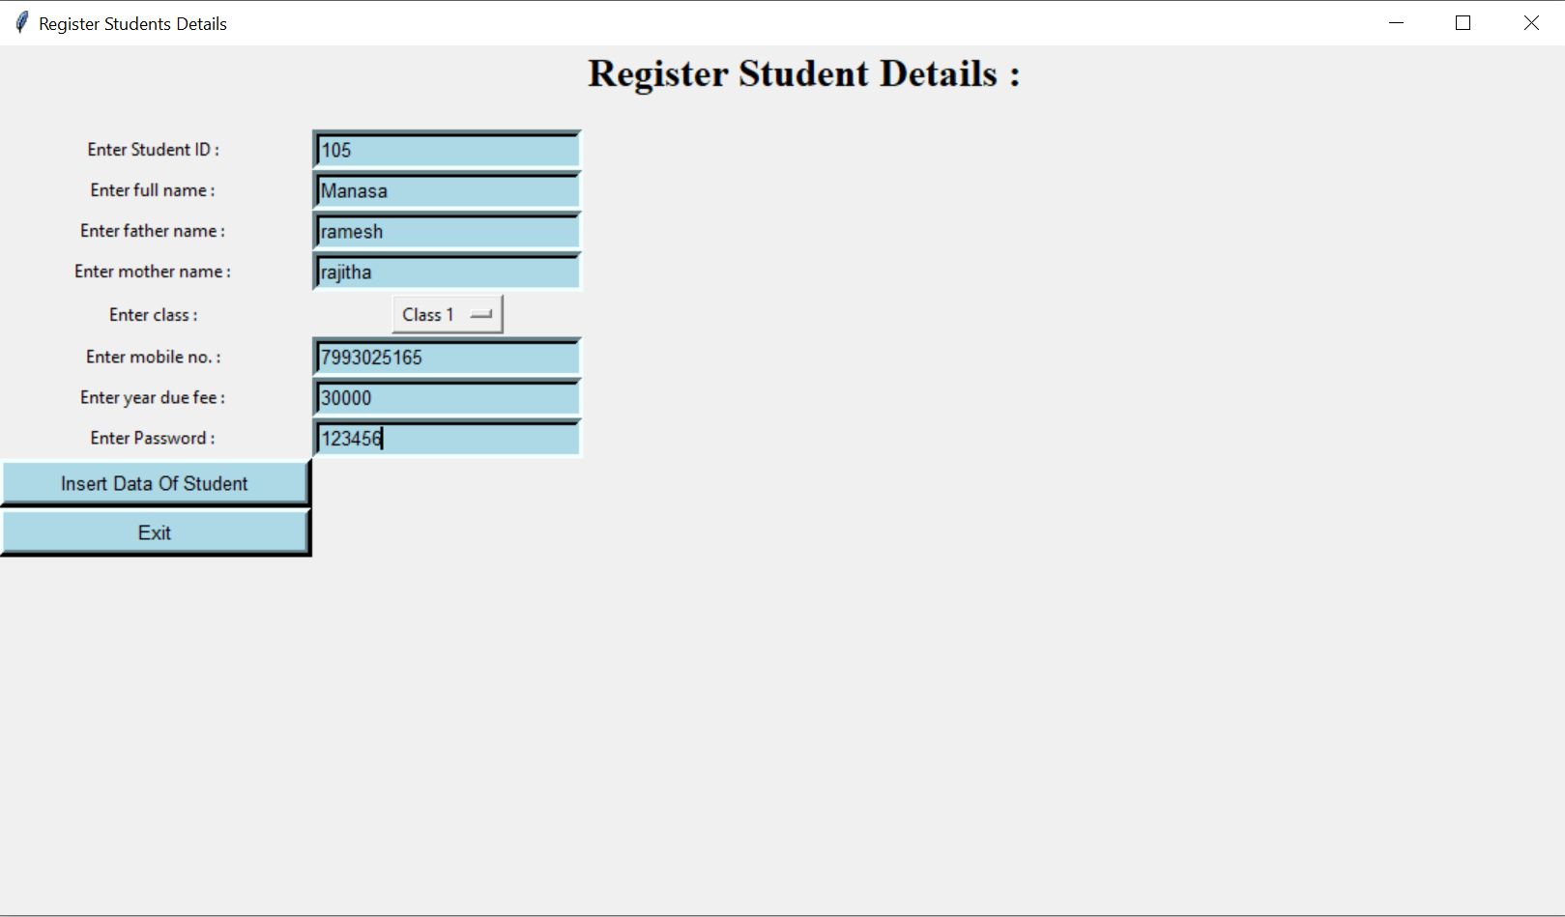
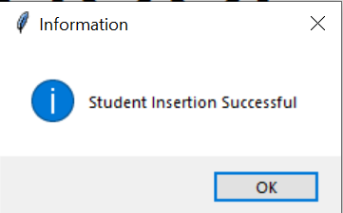
ADMIN: Register Student Details
Fig 6.5:Message of successful insertion
Fig 6.4:Admin registering student details
17

Slide 19
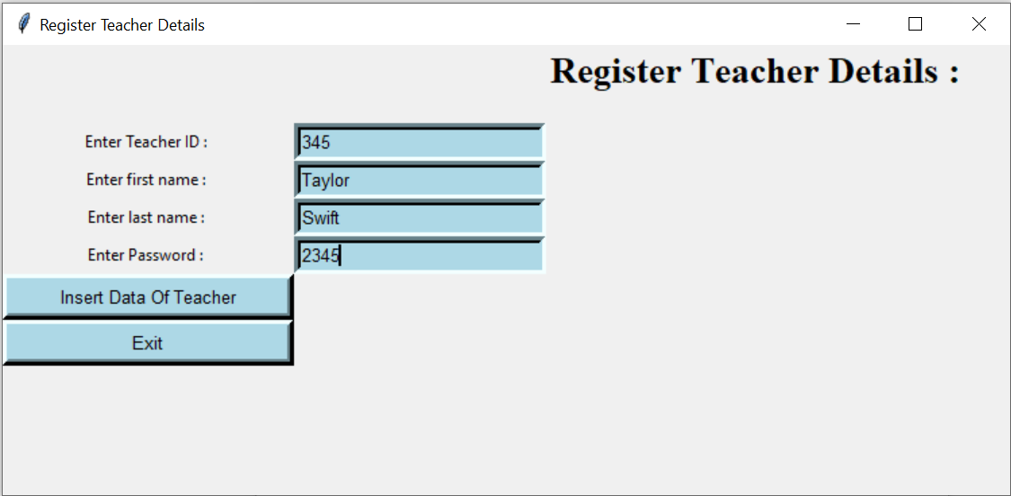
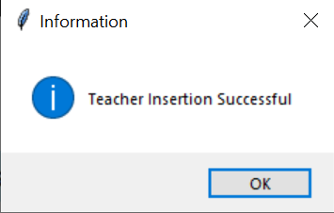
ADMIN: Register Teacher Details
Fig 6.7:Message of successful insertion
Fig 6.6:Admin registering teacher details
18

Slide 20
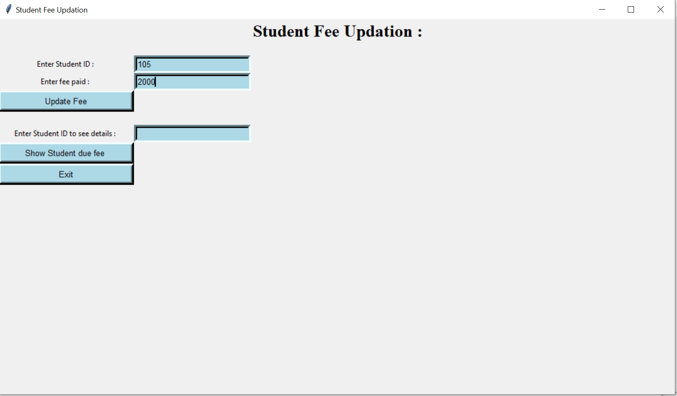
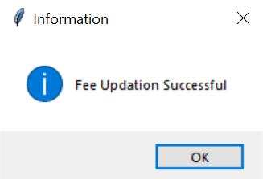
ADMIN: Student fee Update
Fig 6.9:Message of successful fee update
Fig 6.8:Admin updating student fee
19

Slide 21
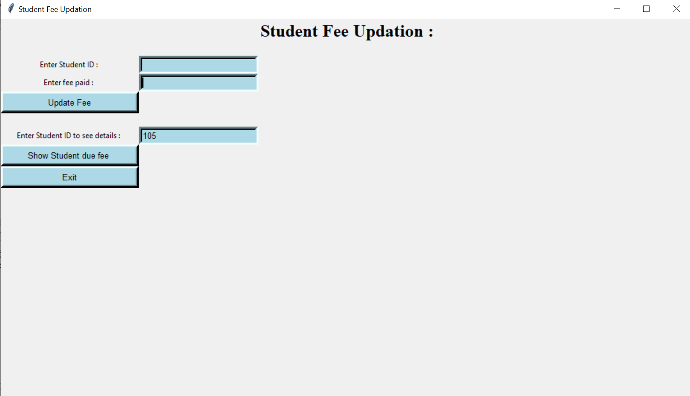
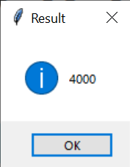
Continuation………
Fig 6.11:Displaying fee
Fig 6.10:Viewing student fee
20

Slide 22
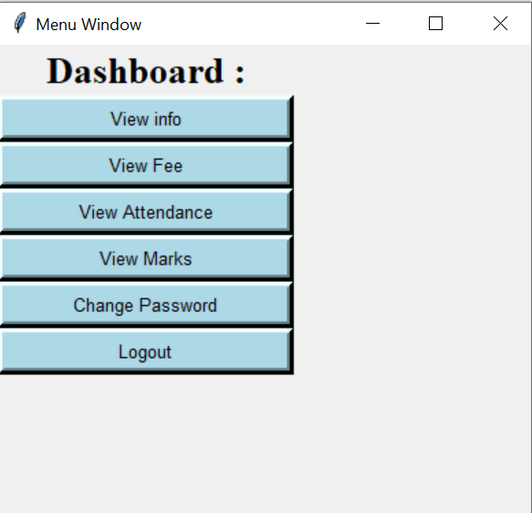
STUDENT MENU WINDOW:
Fig 6.12:Student Dashboard
21

Slide 23
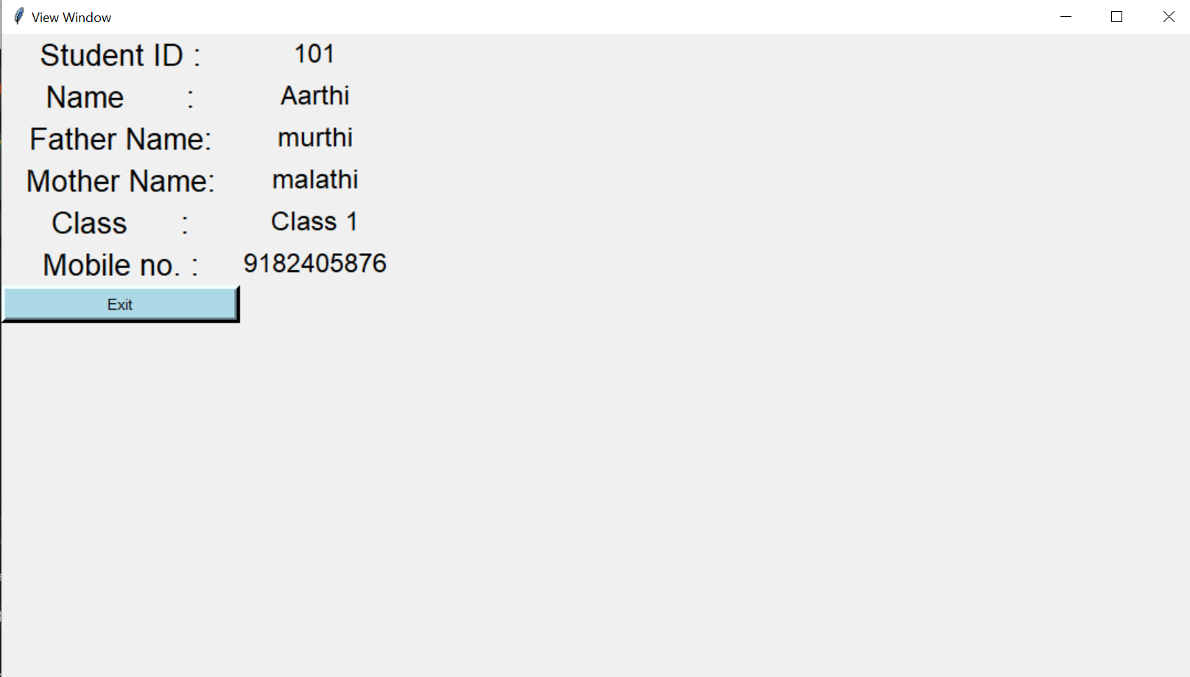
STUDENT: View info
Fig 6.13:Student viewing personal info
22

Slide 24
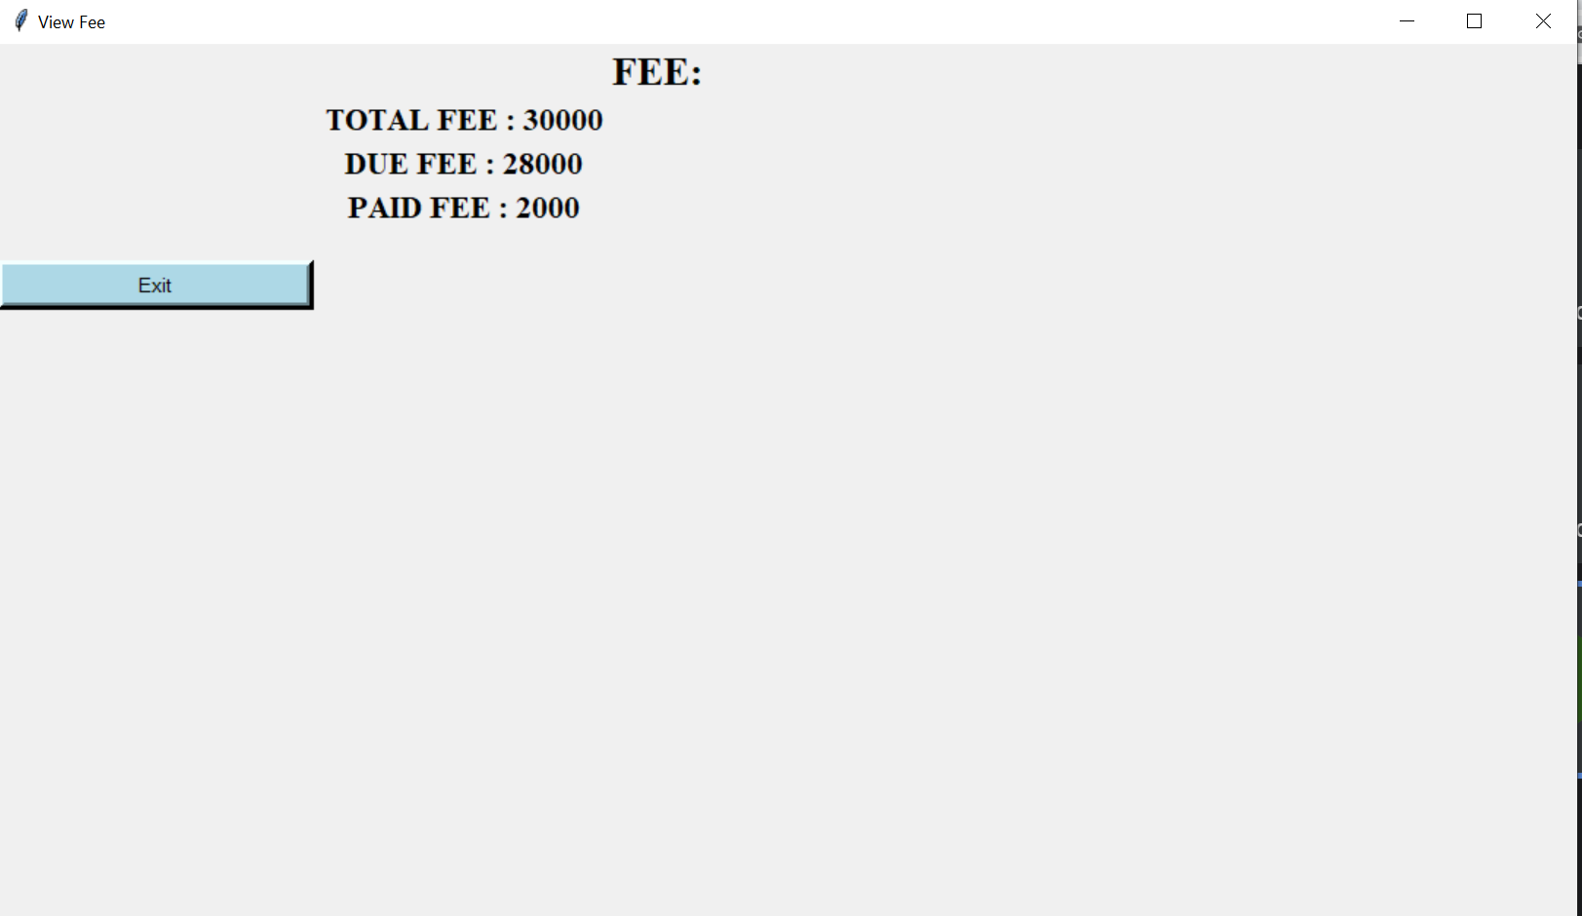
STUDENT: View Fee Details
Fig 6.14:Viewing fee details
23

Slide 25
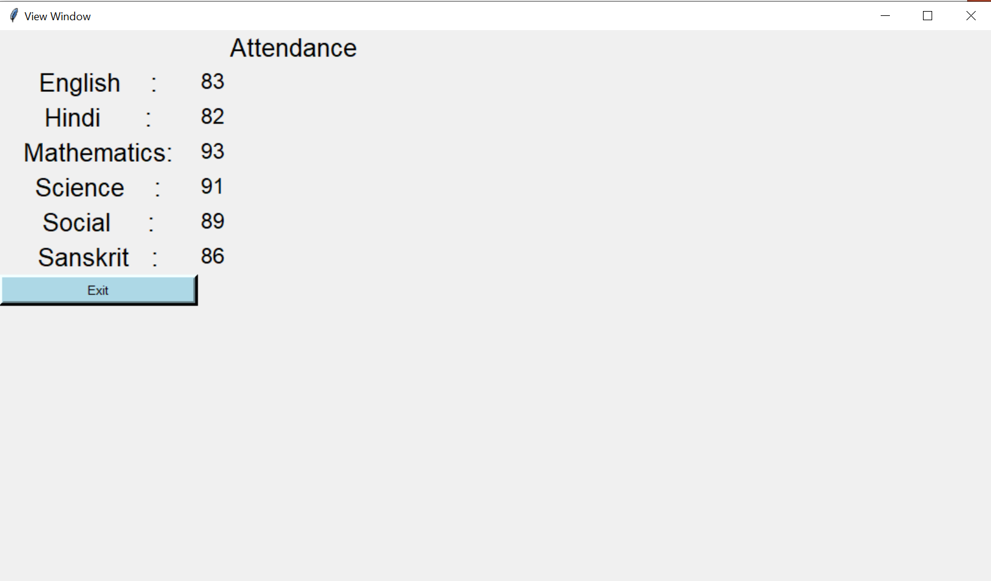
STUDENT: View Attendance
Fig 6.15:Student viewing attendance
24

Slide 26
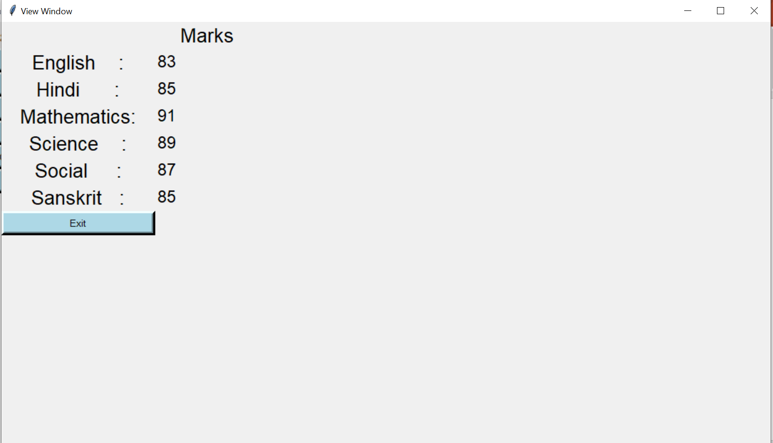
STUDENT: View Marks
Fig 6.16:Student viewing marks
25

Slide 27
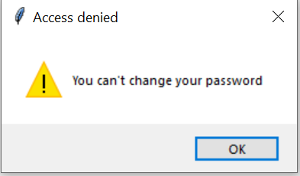
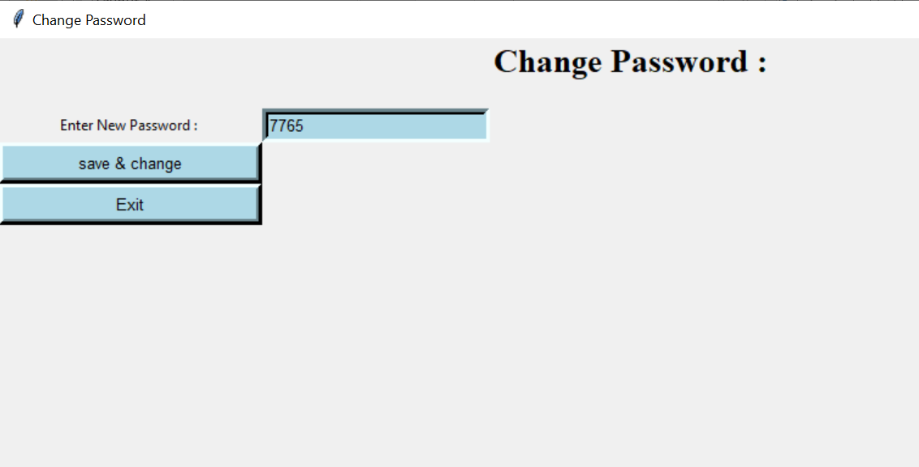
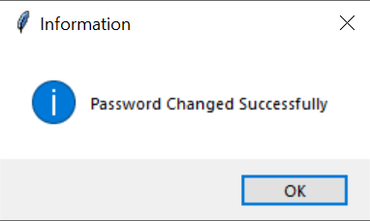
STUDENT: Change Password
For Class 1 to 10:
Fig 6.17:Access denying message
For class 11 and 12:
Fig 6.19:Message of successful password change
26
Fig 6.18:Changing password

Slide 28
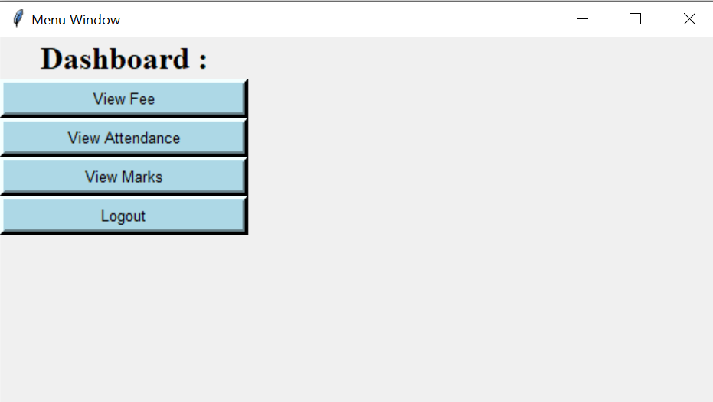
PARENT MENU WINDOW:
Fig 6.20:Parent dashboard window
27

Slide 29
PARENT: View Fee Status
Fig 6.21:Viewing fee details
28

Slide 30
PARENT: View Student Attendance
Fig 6.22:Parent viewing attendance
29

Slide 31
PARENT: View Student Marks
Fig 6.23:Student viewing marks
30

Slide 32
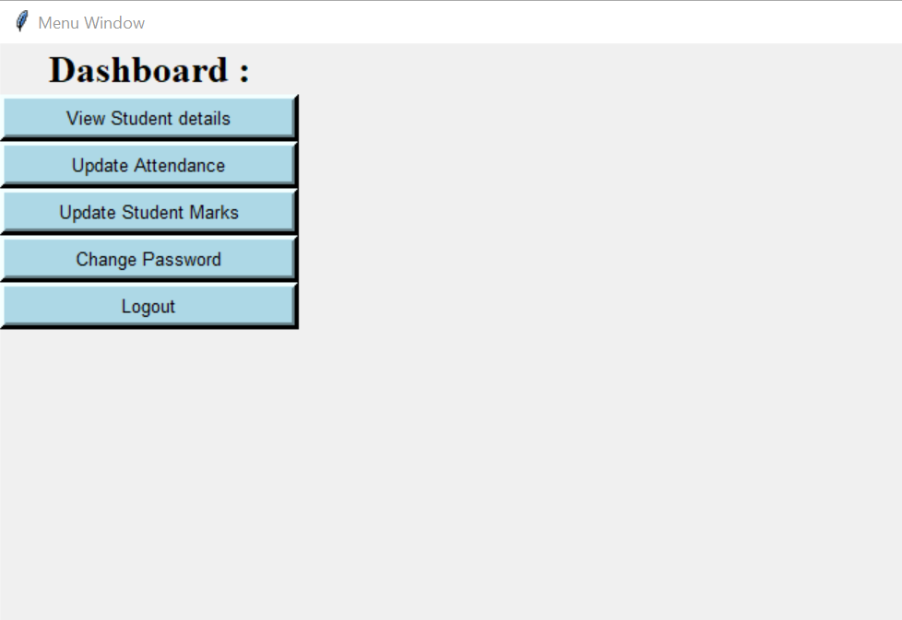
TEACHER MENU WINDOW:
Fig 6.24:Teacher Dashboard window
31

Slide 33
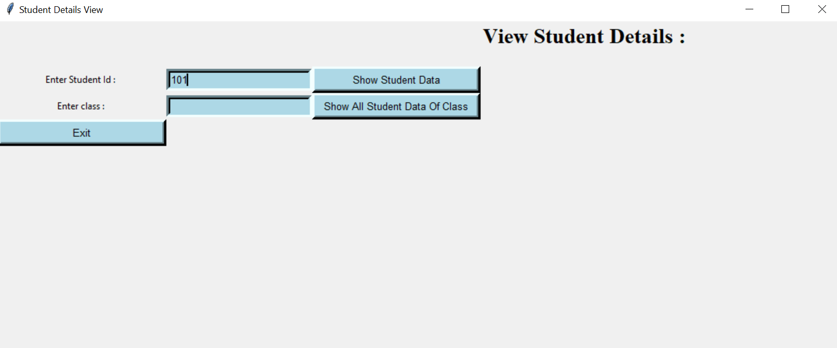
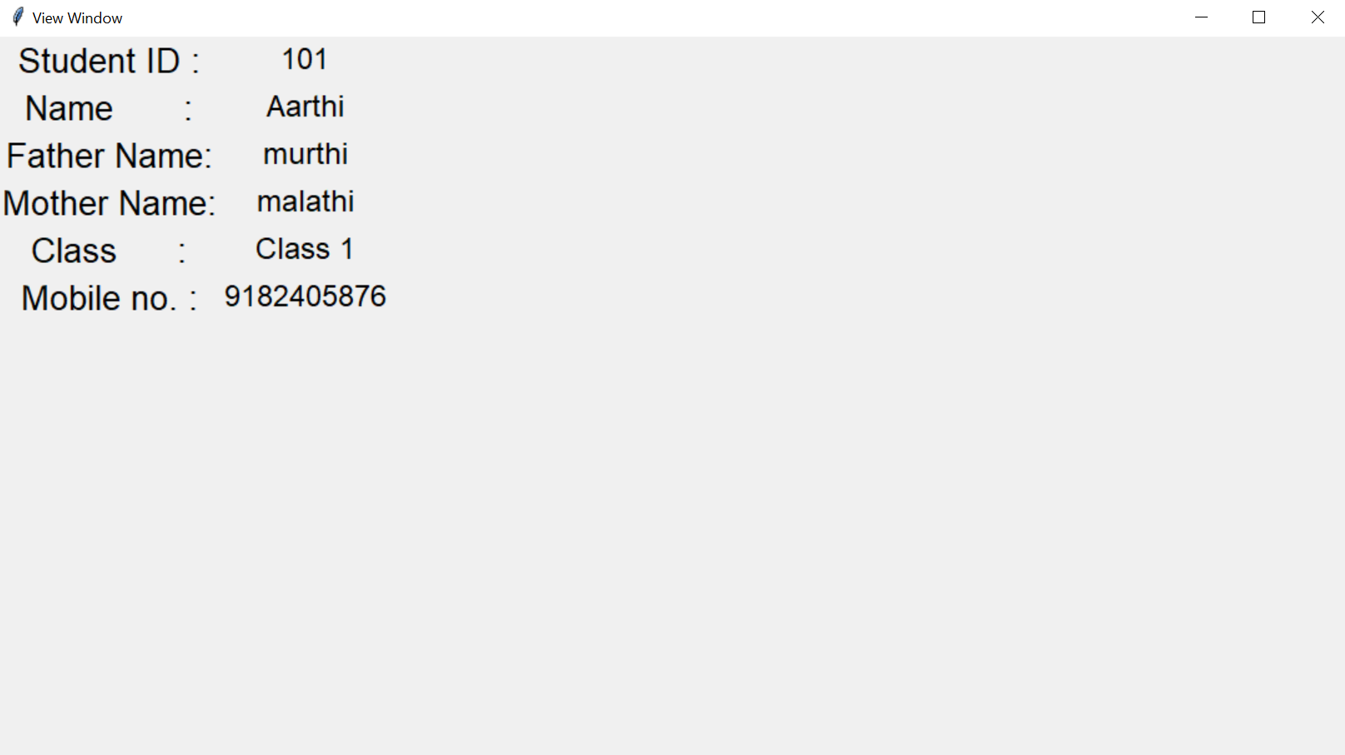
TEACHER: View Student Details
Fig 6.25:Teacher viewing student details
32
Fig 6.26:Student details

Slide 34
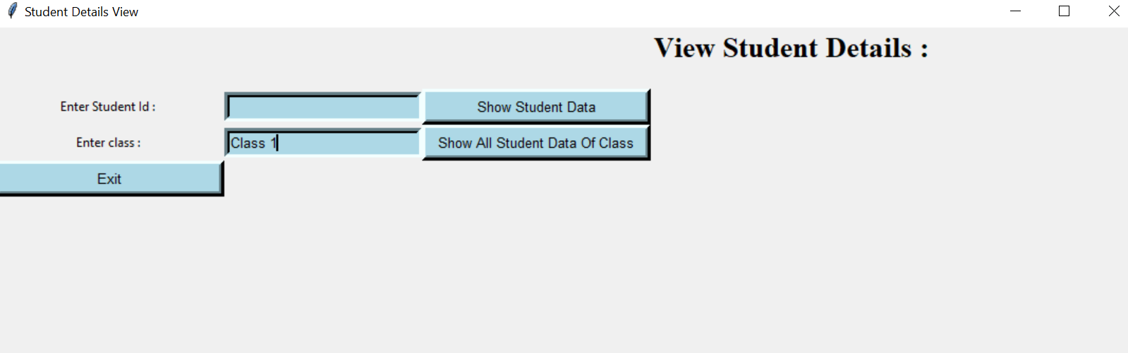
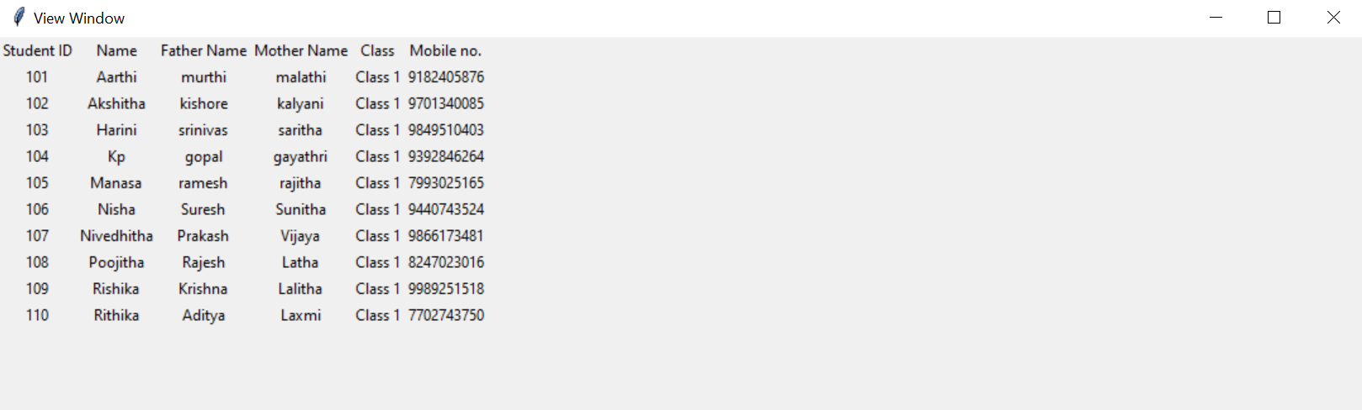
Continuation…..
Fig 6.27:Viewing student details
33
Fig 6.28:Student details belonging to same class

Slide 35
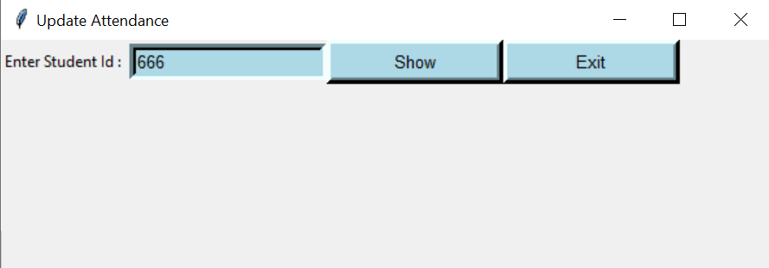
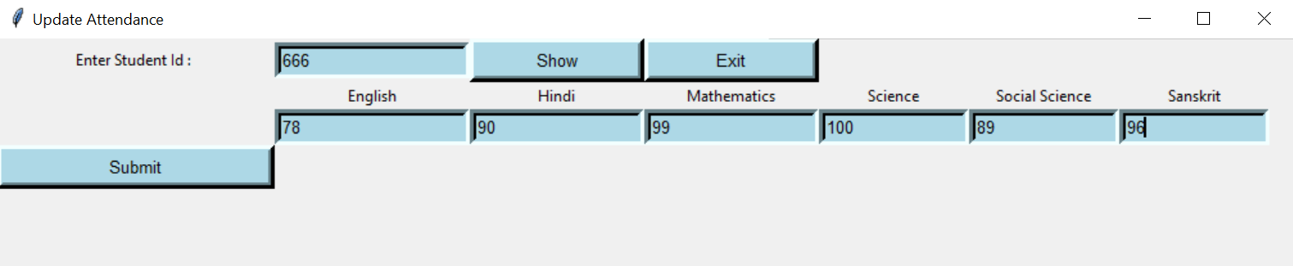
TEACHER: Update Student Attendance
Fig 6.29:Updating attendance
Fig 6.30:Entering attendance
34

Slide 36
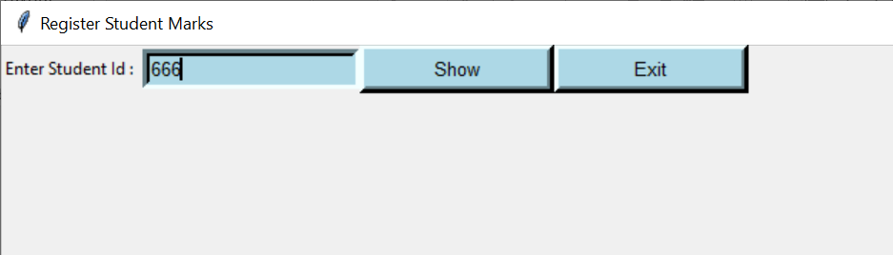
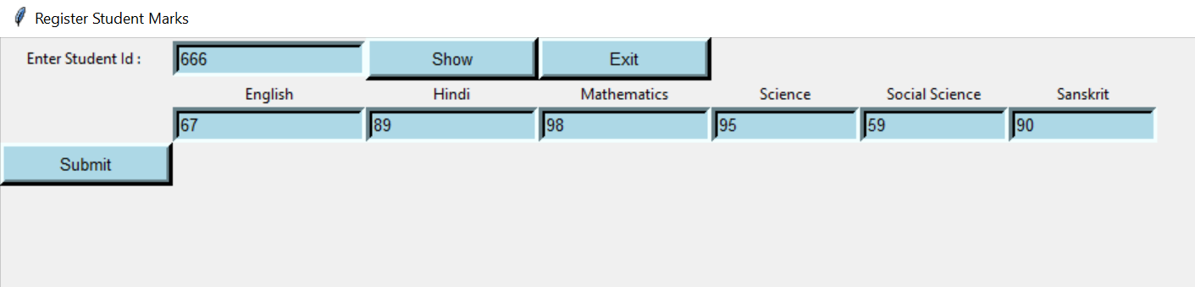
TEACHER: Update Student Marks
Fig 6.31:updating marks
Fig 6.32:Entering marks
35

Slide 37
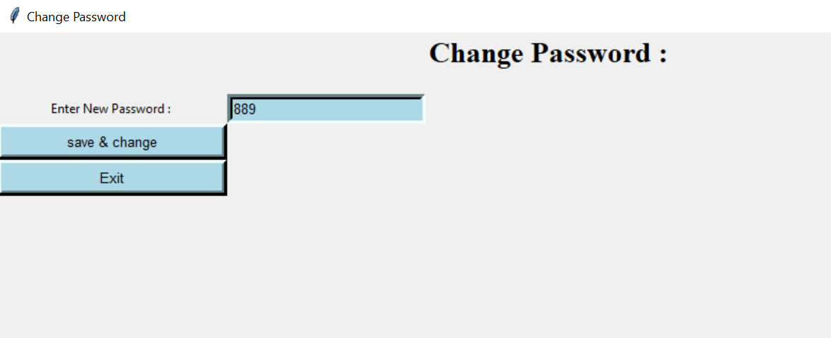
TEACHER: Change Password
Fig 6.34:Message of successful password change
Fig 6.33:Changing password window
36

Slide 38
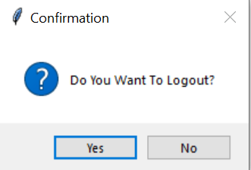
LOGOUT:
Fig 6.35:Logout confirmation message for all users
37

Slide 39
CONCLUSION
In recent years, with the pace of technological development, people have become more and more demanding in terms of quality of life, and the schools managers in recent years look to improve a performance in their schools to get the highest rate of knowledge and experience in their student.
The school management system is bringing a great difference in the lives of students, teachers, parents, and the admin. Good management offers better productivity and hence more progress towards development . It helps the school to achieve the target, reduce work, increase efficiency, eliminating error, and monitoring progress.
38

Slide 40
FUTURE SCOPE
Some ideas and features can be considered as a future work for this project. These features can be summarized in the following points:
Student – Enable student take exams Online , Enable the student take an online certification courses.
Teacher – Enable teacher to add notes for the respective subject.
Parent - Let parent concatenation with other parents , Let parent pay fee online
39

Slide 41
REFERENCES
http://dspace.up.edu.ps/jspui/bitstream/123456789/209/1/School%20Management%20System.pdf
https://www.techprofree.com/school-management-system-project-in-python/
https://www.sourcecodester.com/python/14520/school-management-system-project-python.html
https://core.ac.uk/download/pdf/84656452.pdf
40

Slide 42
THANK YOU

