Slide 1

Finance and Risk Analytics - Capstone Project BY – N V V Krishna Priya

Slide 2
Problem statement
In the recent past, the industry of wealth management has seen a lot of growth. Every individual or business actively searches for opportunities to get the maximum returns. However, in most of the cases, they either lack the skills to identify the right investment opportunity, or there is a shortage of time for finding these opportunities. Hence, this gave rise to the dedicated individuals who perform this task on behalf of the investors for a commission - Portfolio managers.
A portfolio manager makes investment decisions and carries out other related activities on behalf of vested investors. They work with a team of analysts and researchers, and their main objective is to realise the needs of the investor and suggest a suitable portfolio that meets all the expectations. They are responsible for establishing the best investment strategy, selecting appropriate investments along with the right allocation. However, in doing so, they face a lot of competition in the form of other portfolio managers and rival firms. Therefore, the portfolio manager has to use the available resources to provide the best solution to the investor.
Consider yourself working for an associate at an investment firm that manages accounts for private clients. Your role requires you to analyse a portfolio of stocks to provide consultation on investment management based on client’s requirement.

Slide 3
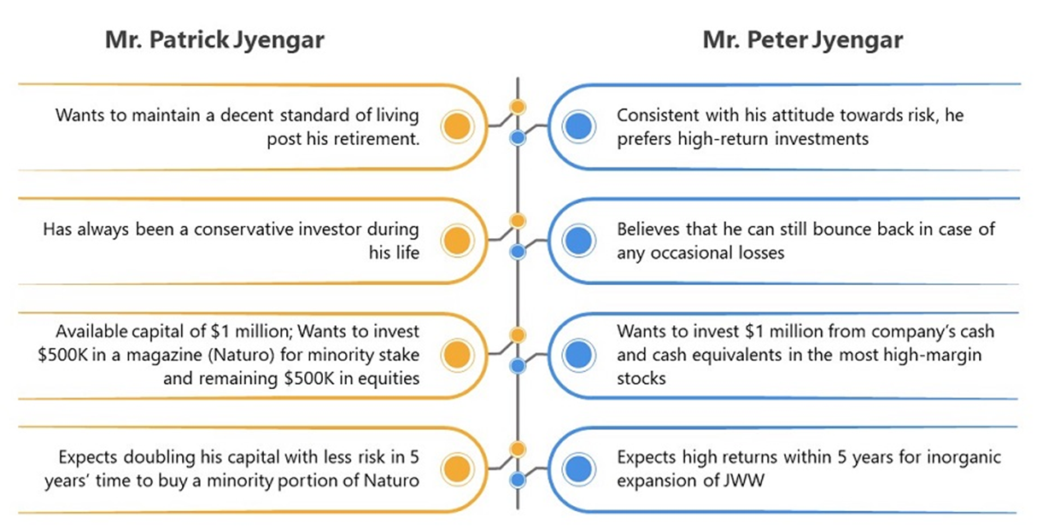
Executive Summary
The aim of this project is to select suitable stocks which suit their investor persona.
We are given a total number of 24 stocks, from which few stocks are selecting to fulfill their individual demands.

Slide 4
Stock selection and allocation
Based on Cumulative Return (%), annual risk (%), Sharpe Ratio, we will recommend the following stocks to the investors to generate better returns than the index, but also ensure that these stocks are relatively suitable for the investors. These include:
Mr Patrick Jyenger wants to maintain a decent standard of living post his retirement and expects doubling his capital with less risk in 5 years' time.
Mr Peter Jyenger is consistent with his attitude towards risk, he prefers high return investments. He wants to invest $1 million from company's cash and cash equivalents in the most high margin stocks. Expects high returns within 5 years.

Slide 5
Portfolio Description
Portfolio for Mr Patrick Jyenger:
Portfolio for Mr Peter Jyenger:
So, according to his investor persona, the below stocks with comparatively less risk would be a good pick which would be doubling his capital in 5 years' time.
A> Tech Stocks (Safer sector bet - This segment is very innovative, tech savvy and focusses a lot on automation. Also, very futuristic):
Google (50% allocation)
B> Pharma (Defensive or very safe sector - There is also constant demand for health care)
Johnson and Johnson (50% allocation)
So, according to his investor persona, the below stock with comparatively high margin would be a good pick which would be giving high returns on his capital in 5 years' time.
A> Tech Stocks (Safer sector bet - This segment is very innovative, tech savvy and focusses a lot on automation. Also, very futuristic):
Amazon (100% allocation)

Slide 6
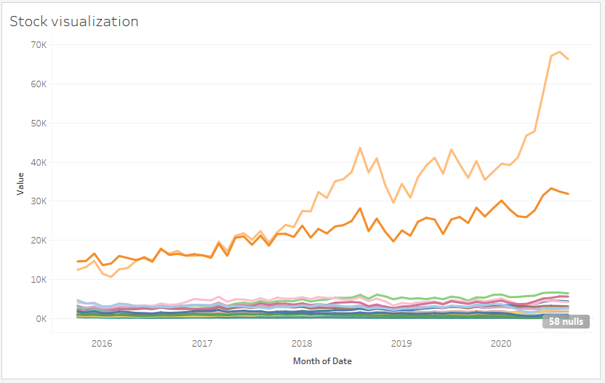
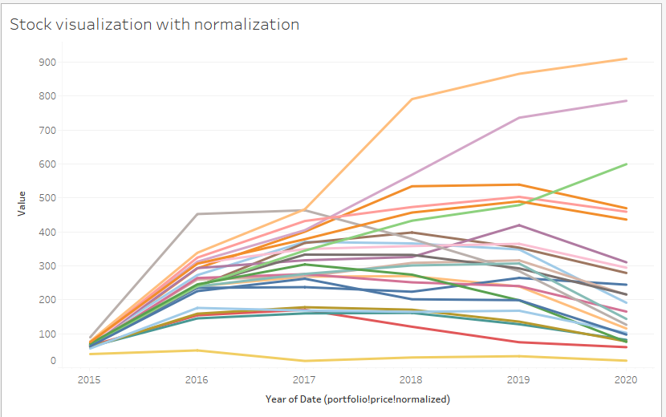
Stock visualization with and without normalization
We can see that from the stock visualization without normalization only Amazon and Google seem to be in the bullish trend.
After normalization we can see that Microsoft has taken the place of Google with Amazon and Microsoft in the leading trend.

Slide 7
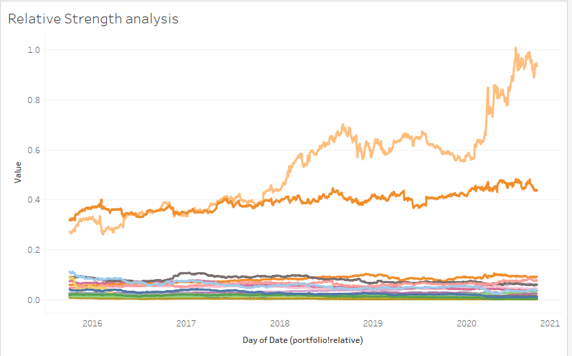
Relative strength analysis
Relative strength is a strategy used in momentum investing and in identifying value stocks. It focuses on investing in stocks or other investments that have performed well relative to the market as a whole or to a relevant benchmark.
From the visualization we can understand that Amazon and Google tops the list with high relative strength in accordance with SP500

Slide 8
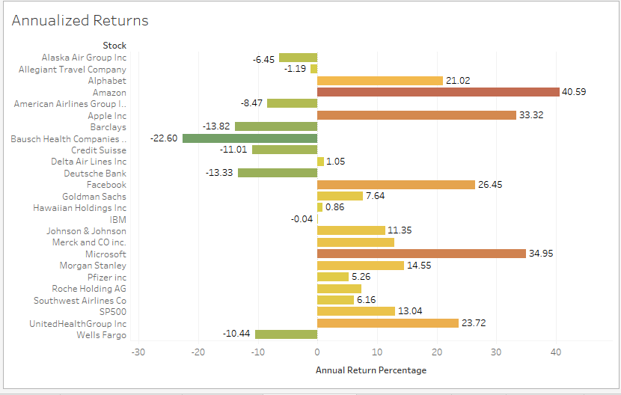
Annualized returns
An annualized total return is the average amount of money earned by an investment each year over a given time period.
We can see from the visualization that Amazon, Microsoft, Apple and Facebook which belong to the technology industry tops the list of stocks with Annualized returns greater than 25%.

Slide 9
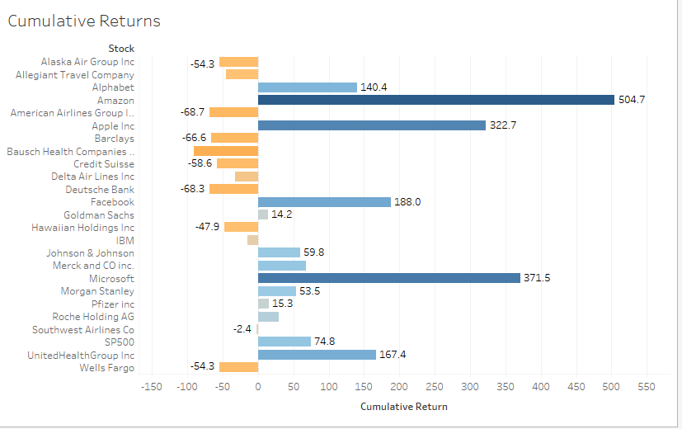
Cumulative Returns
The cumulative return is the total change in the investment price over a set time—an aggregate return, not an annualized one.
We can see from the visualization that Amazon, Microsoft, Apple and Facebook which belong to the technology industry tops the list of stocks with Cumulative returns greater than 180%.

Slide 10
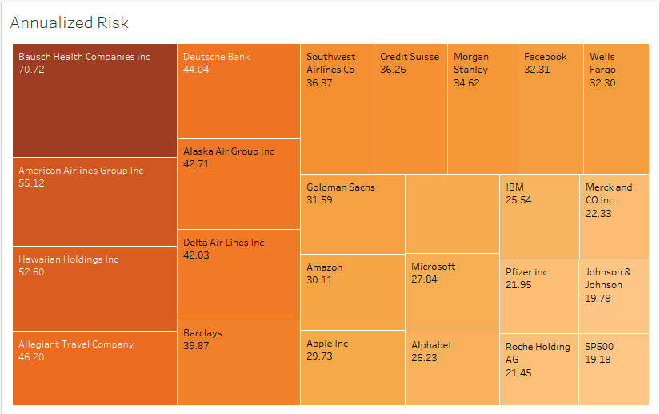
Annualized Risk
The volatility in the stock returns observed over a period of time normalized to one year
Bausch Health Companies inc(70.722112736), American Airlines Group Inc(55.123956562), Hawaiian Holdings Inc. (52.595000865) posses risk greater than 50%.

Slide 11
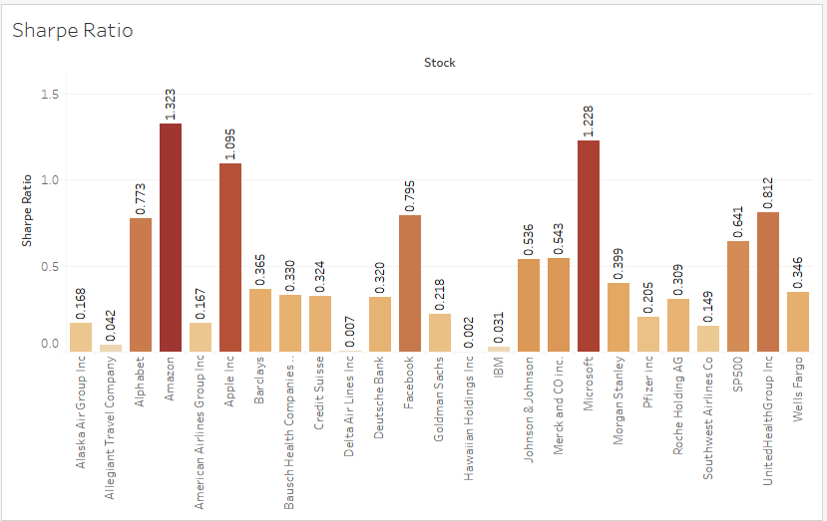
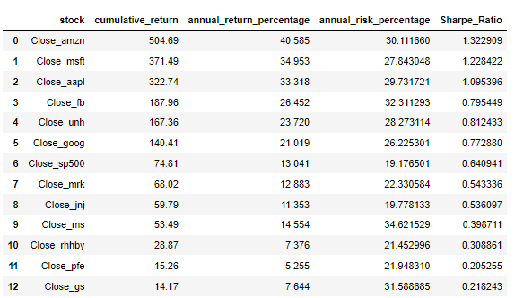
Sharpe Ratio
Sharpe ratio is the measure of risk-adjusted return of a financial portfolio. A portfolio with a higher Sharpe ratio is considered superior relative to its peers.
The stock selection would be based on the Sharpe ratio greater than 1 of the stocks.

Slide 12
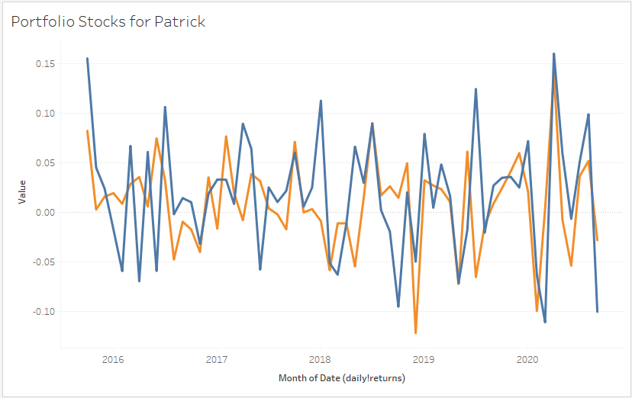
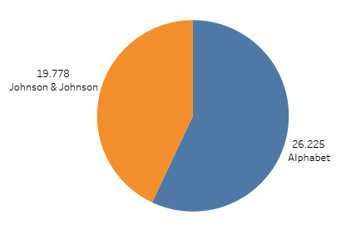
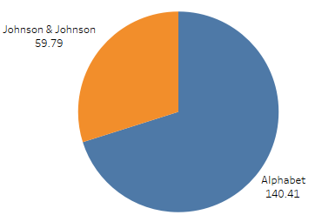

Portfolio Stocks for Mr Patrick Jyenger
For Mr Patrick Jyenger, we selected Jhonson & Jhonson and Alphabet as the combined Portfolio risk is 23% and Portfolio returns is 100% as required by the investor
The sharpe ratio for the combined stocks is greater than 1

Slide 13
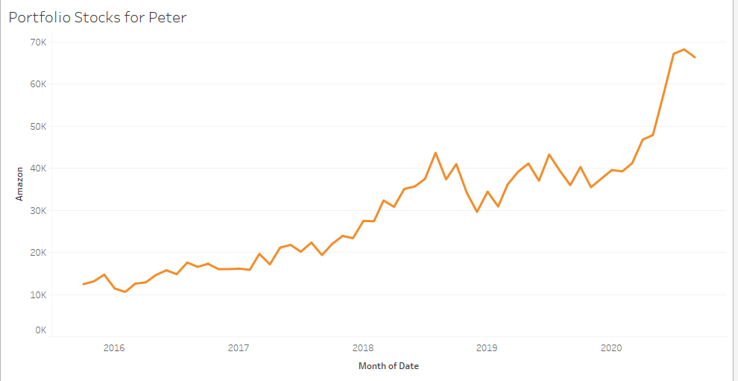
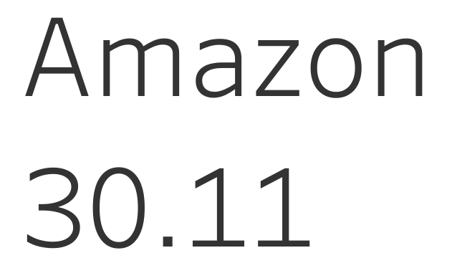
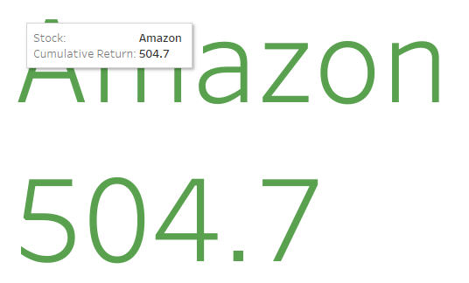


Portfolio Stocks for Mr Peter Jyenger
For Mr Patrick Jyenger, we selected Amazon as the Portfolio risk is 30% and Portfolio returns is 505% as required by the investor.
The sharpe ratio for the stock is greater than 1

Slide 14
THE END

