Slide 1



SUBMITTED BY
CORNERSTONE PROJECT BASED LEARNING
S.L.V.KRISHNA REDDY
25B11CS861
P. SURYA AKHIL
25B11CS717
STUDENT RESULT
SYSTEM
K.S.R.MOKSHAGNA
25B11CS453
K.VITESH KRISHNA
25B11CS483
Computer Science & Engineering (2026-2027)
UNDER THE GUIDANCE OF
Object Oriented Programming through C++
M Sushma Devi
Assistant Professor
Department of CSE
II Year – 3rd Semester
1 / 19

Slide 2

02 / PLANNING
Abstract
• The Student Result System is a menu-driven C++ application designed to calculate student academic results.
• The system accepts student details and subject marks as input and automatically calculates total marks, percentage, and grade.
• It provides a simple and organized way to enter, process, and display student results while reducing manual calculation errors.
• The project demonstrates the practical application of Object-Oriented Programming concepts such as classes, objects, encapsulation, constructors, and member functions.
The proposed system aims to make student result processing simple, accurate and modular.
Student Result System | Object Oriented Programming through C++
2 / 19

Slide 3

03 / PLANNING
Problem Definition
1
Manual result calculation involves repeated calculations and may lead to errors.
2
Calculating total, percentage, and grades for multiple students requires additional effort.
3
Students and faculty need a simple way to calculate and display academic results.
4
The project proposes a C++ based system to automate basic result processing.
5
The system should also validate marks and handle invalid inputs appropriately.
Student Result System | Object Oriented Programming through C++
3 / 19

Slide 4
04 / PLANNING
Objectives
1
Develop a simple and user-friendly C++ application for student result calculation.
5
Determine the appropriate grade based on student performance.
2
Store and process student information using classes and objects.
6
Display clear and meaningful student results.
3
Accept subject-wise marks and validate the entered values.
7
Apply OOP concepts such as encapsulation, constructors, and member functions.
4
Calculate total marks and percentage automatically.
8
Use modular functions to make the system easy to understand and maintain.
Student Result System | Object Oriented Programming through C++
4 / 19

Slide 5





05 / PLANNING
Modules / Functions
Module 1
Student Details and Marks Entry
Module 2
Input Validation
Module 3
Result Calculation
Module 4
Percentage and Grade Calculation
Module 5
Result Display
Student Result System | Object Oriented Programming through C++
5 / 19

Slide 6


06 / PLANNING
Inputs & Expected Outputs
Inputs
Expected Outputs
• Student Roll Number
• Student Details
• Subject-wise Marks
• Student Name
• Total Marks
• Section
• Percentage
• Number of Subjects
• Grade
• PASS / FAIL Status
• Subject Marks
• Formatted Student Result
Student Result System | Object Oriented Programming through C++
6 / 19

Slide 7
07 / PLANNING
Algorithm
Step 1
Start the program.
Step 2
Create a Student object.
Step 3
Read student details.
Step 4
Enter subject-wise marks.
Step 5
Validate each mark.
Step 6
Calculate total marks.
Step 7
Calculate percentage.
Step 8
Determine grade and PASS/FAIL status.
Step 9
Display the student result.
Step 10
End the program.
Student Result System | Object Oriented Programming through C++
7 / 19

Slide 8

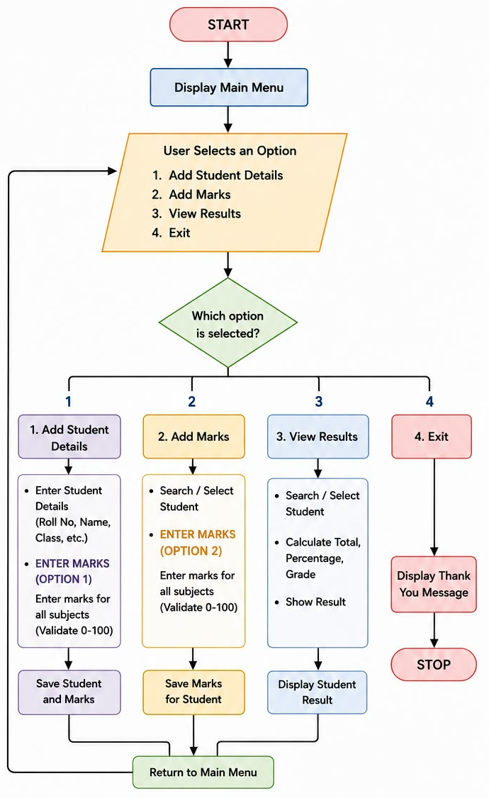
08 / PLANNING
Flowchart
Student Result System | Object Oriented Programming through C++
8 / 19

Slide 9


09 / IMPLEMENTATION
Class Used
The Student class represents one student's information.
CLASS DEFINITION
class Student
{
public:
string roll;
int subjects;
int marks[10];
string name;
string section;
void addDetails();
void addMarks();
void displayResult();
};
IT COMBINES
Student data
roll number, name, section, subjects and marks
Student operations
adding details, entering marks and displaying results
Student Result System | Object Oriented Programming through C++
9 / 19

Slide 10


10 / IMPLEMENTATION
Member Function
1. addDetails()
void addDetails(){
string input;
while (true)
{
cout << "\nEnter Roll Number (Maximum 10 characters): ";
cin >> roll;
if (!validRollNumber(roll))
{
cout << "\nInvalid roll number format!\n";
cout << "Roll number must contain only letters and numbers.\n";
cout << "Maximum length is 10 characters.\n";
cout << "Special characters and spaces are not allowed.\n";
}
else
{
roll = normalizeRoll(roll);
if (rollExists(roll))
{
cout << "\nRoll number already exists!\n";
cout << "Please enter another roll number.\n";
}
else
{
break;
}
}
}
Accepts and validates student details such as roll number, name, section, and number of subjects.
2. addMarks()
Accepts and validates marks for each subject and stores them in the marks array.
3. displayResult()
Calculates total, percentage, grade, and PASS/FAIL status, then displays the complete result.
Student Result System | Object Oriented Programming through C++
10 / 19

Slide 11
11 / IMPLEMENTATION
addMarks() & displayResult()
void Student::addMarks()
{
string input;
for (int i = 0; i < subjects; i++)
{
while (true)
{
cout << "Enter Marks for Subject "
<< i + 1 << " (0-100): ";
cin >> input;
if (!getValidInteger(input, marks[i]))
{
cout << "\nInvalid marks!\n";
cout << "Please enter a numeric value between 0 and 100.\n";
}
else if (marks[i] < 0 || marks[i] > 100)
{
cout << "\nInvalid marks!\n";
cout << "Marks must be between 0 and 100.\n";
}
else
{
break;
}
}
}
cout << "\nMarks entered successfully!\n";
}
void Student::displayResult()
{
int total = 0;
bool pass = true;
for (int i = 0; i < subjects; i++)
{
total += marks[i];
if (marks[i] < 40)
pass = false;
}
float percentage = (float)total / subjects;
string grade;
if (percentage >= 90)
grade = "A+";
else if (percentage >= 80)
grade = "A";
else if (percentage >= 70)
grade = "B";
else if (percentage >= 60)
grade = "C";
else if (percentage >= 50)
grade = "D";
else if (percentage >= 40)
grade = "E";
else
grade = "F";
if (percentage < 40)
pass = false;
Student Result System | Object Oriented Programming through C++
11 / 19

Slide 12
12 / OUTPUT
Output
CONSOLE MENU & INPUT
RESULT DISPLAYED
================================
STUDENT RESULT SYSTEM
================================
1. Add Student Details
2. Add Marks
3. View Results
4. Exit
Enter your choice: 1
Enter Roll Number (Maximum 10 characters): 101
Enter Name: Krishna Reddy
Enter Section (A-Z): A
Enter Number of Subjects (1-10): 5
Enter Marks for Subject 1 (0-100): 85
Enter Marks for Subject 2 (0-100): 76
Enter Marks for Subject 3 (0-100): 92
Enter Marks for Subject 4 (0-100): 68
Enter Marks for Subject 5 (0-100): 81
Marks entered successfully!
Enter your choice: 3
==============================================
STUDENT RESULT
==============================================
Roll Number : 101
Name : Krishna Reddy
Section : A
Number of Subjects: 5
----------------------------------------------
Subject Marks
----------------------------------------------
Subject 1 85
Subject 2 76
Subject 3 92
Subject 4 68
Subject 5 81
----------------------------------------------
Total : 402 / 500
Percentage : 80.40%
Grade : A
Result : PASS
==============================================
Student Result System | Object Oriented Programming through C++
12 / 19

Slide 13
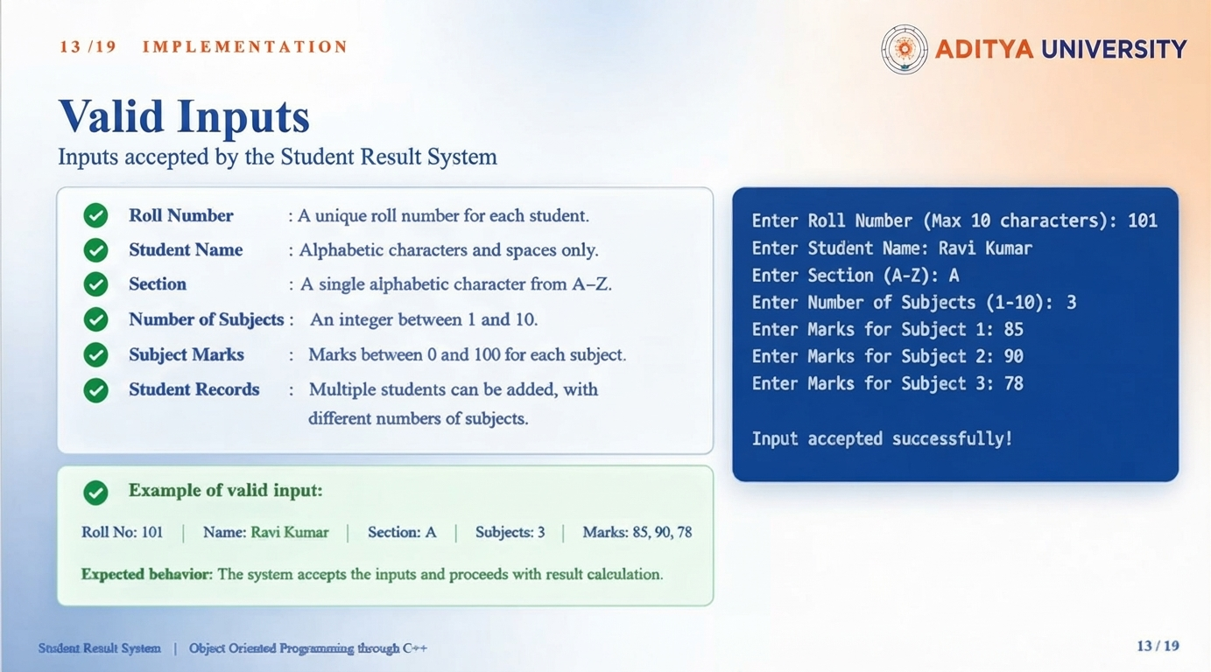


Slide 14
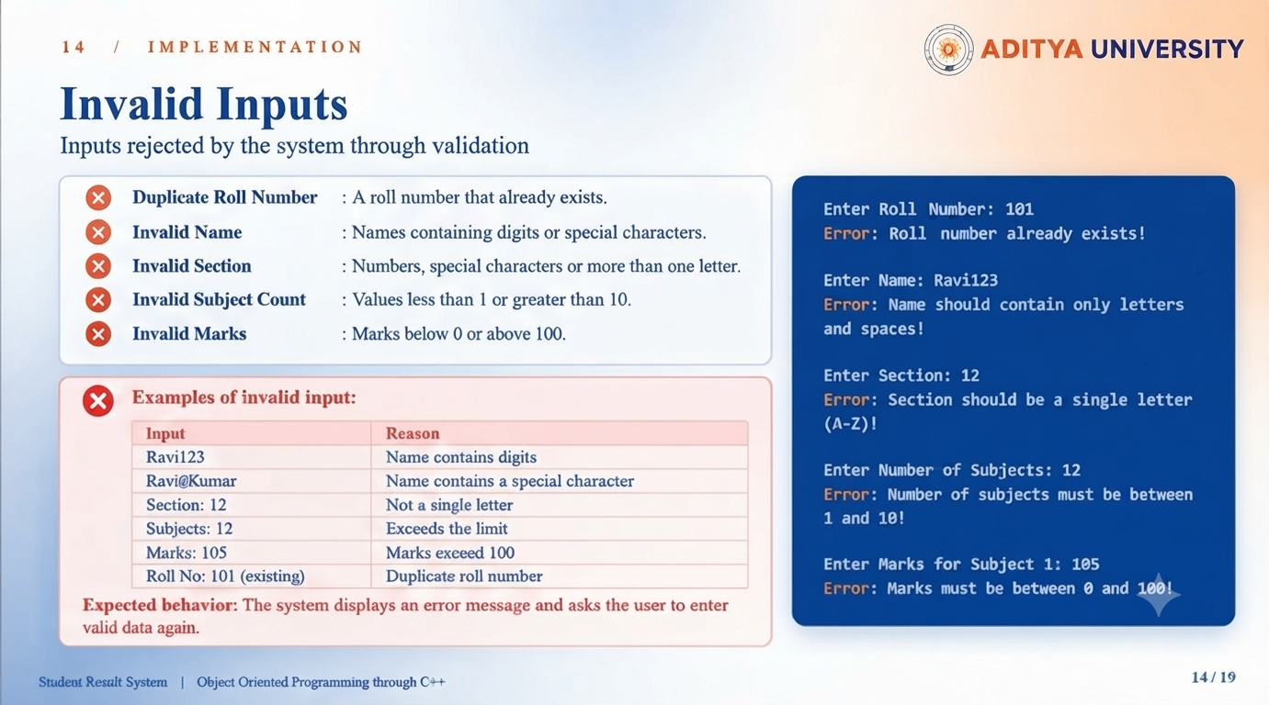

Slide 15
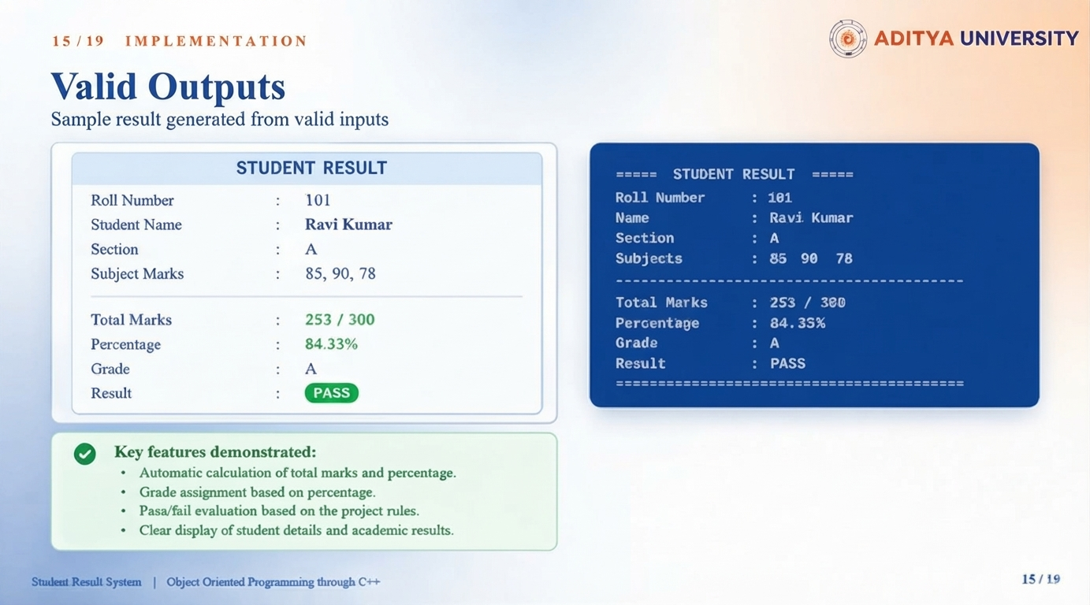

Slide 16




13 / IMPLEMENTATION
OOPs Concepts Used
1. Class
The Student class is used to group student data and related functions into a single unit.
2. Objects
Student students[100]; creates an array of Student objects to store details of multiple students.
3. Encapsulation
Student data members and their related member functions are grouped together inside the Student class.
4. Member Functions
addDetails(), addMarks(), and displayResult() perform operations on the data of each Student object.
5. Abstraction
Complex operations such as validation and result calculation are handled through functions, so the main program can simply call the required function.
Student Result System | Object Oriented Programming through C++
16 / 19

Slide 17

14 / TEAM
Team Member Contributions
S.L.V. KRISHNA REDDY
Project Lead, problem analysis, requirements, overall coordination, integration of modules.
Analysis & Design
P. SURYA AKHIL
Input & Validation Module — student details, marks entry, input validation, calculations and developing the application.
Implementation
K. S. R. MOKSHAGNA
Processing Module and coordinating in the implementation.
Implementation
K. V. KRISHNA
Output & Testing, Documentation.
Testing & Maintenance
Student Result System | Object Oriented Programming through C++
17 / 19

Slide 18

15 / FUTURE SCOPE
Future Scope
1
Store student records permanently using file handling or a database.
2
Add options to search, update and delete existing student records.
3
Generate class-wise reports, rank lists and subject-wise statistics.
4
Export results as printable report cards in PDF or spreadsheet format.
5
Develop a graphical (GUI) or web-based interface for easier use.
6
Provide secure login-based access for faculty, students and administrators.
CONCLUSION: A working, modular C++ application that calculates and displays student results accurately.
Student Result System | Object Oriented Programming through C++
18 / 19

Slide 19

THANK YOU
Student Result System
OBJECT ORIENTED PROGRAMMING THROUGH C++

