Slide 1
IBM University Engagement Project Submission
“Exploring the Power of Agentic AI with IBM Granite and LangFlow”

Slide 2

Project Tile – Smart Study Generator Agent
Domain of Project – Education
Student Name | Recent Passport Photo | Email ID | Mobile number [WhatsApp]
Krishna Hiteshbhai Rohit |  | krishnarohit127@gmail.com | 9773451240
Recommended font style and size: Font Style: Arial Font Size (Heading): 28
Font Size (Content): 20

Slide 3
Problem Statement No.13: Smart Study Generator Agent
The Challenge
Students today face an overwhelming flood of information—lecture notes, textbooks, research papers, YouTube tutorials, and online resources. This content is scattered, unorganized, and often not personalized to their learning pace or style. As a result, students struggle with finding the right study material, summarizing key concepts, and staying exam-ready. Traditional study tools only provide static notes or flashcards, failing to adapt dynamically to student needs. The challenge is to move beyond static resources toward an intelligent, adaptive study companion.
The Objective
Build an agentic AI-powered Smart Study Generator that personalizes and streamlines learning for students. The solution should:
Fuse Learning Resources: Aggregate content from class notes, textbooks, research articles, and online tutorials into structured, easy-to-digest study material.
Enable Multimodal Input: Allow students to upload notes, voice queries, or images (e.g., textbook pages), and generate concise summaaries, flashcards, or concept maps.
Create a Predictive & Agentic Layer: Recommend personalized study plans, highlight important topics based on syllabus or past exams, and provide predictive alerts (e.g., “Focus on Topic X—frequently asked in exams”).
Visualize Study Progress: Offer a real-time dashboard showing learning milestones, weak areas, practice quizzes, and performance forecasts.
Tech Stack (Mandatory)
IBM Langflow / IBM Orchestrate + IBM Models

Slide 4
Proposed Solution -
Proposed Solution: AI-Powered Smart Study Generator Agent
The proposed solution is an AI-powered Smart Study Generator Agent developed using IBM BOB, IBM Granite AI, and IBM Cloud concepts. The application helps students organize and understand their study materials through an intelligent and interactive learning platform.
Students can upload study materials such as PDF files, text documents, and images. The AI assistant provides concise summaries, answers questions, generates quizzes, creates flashcards, and recommends personalized study plans based on the uploaded content.
The application includes the following modules:
• Study Material Upload Module for uploading notes and documents.
• AI Chat Assistant for answering study-related questions.
• Quiz Generator for creating practice questions.
• Flashcard Generator for quick revision.
• Study Planner for preparing personalized schedules.
• Dashboard for displaying study progress and activity.
The solution provides a simple, responsive, and user-friendly interface that makes learning more organized, interactive, and efficient.

Slide 5
Technology Used
Technology Used
• IBM BOB – Used to generate the project structure, web pages, UI components, and application code.
• IBM Granite AI – Used as the AI model for answering questions, generating summaries, quizzes, and study recommendations.
• IBM Cloud – Provides the cloud environment for AI development and deployment concepts.
• HTML5 – Website structure.
• CSS3 – Responsive and modern user interface.
• JavaScript – Interactive functionality and user experience.

Slide 6
IBM BOB Components Used
IBM BOB Components Used
Content:
Chat Interface for AI-based interaction.
File Upload Component for uploading study materials.
IBM Granite AI integration concept for generating responses.
Quiz Generation Module.
Study Planner Module.
Dashboard Module for displaying study progress.
Navigation System connecting all pages.

Slide 7

Role of Agentic AI in the solution
Role of Agentic AI in Smart Study Generator
Agentic AI enables the Smart Study Generator to act as an intelligent learning assistant instead of a traditional study application. It understands user requests, analyzes uploaded study materials, and performs multiple educational tasks such as summarization, quiz generation, flashcard creation, and personalized study planning.
The AI adapts its responses according to student needs, making learning more interactive, efficient, and personalized. This improves productivity and helps students prepare more effectively for examinations.

Slide 8
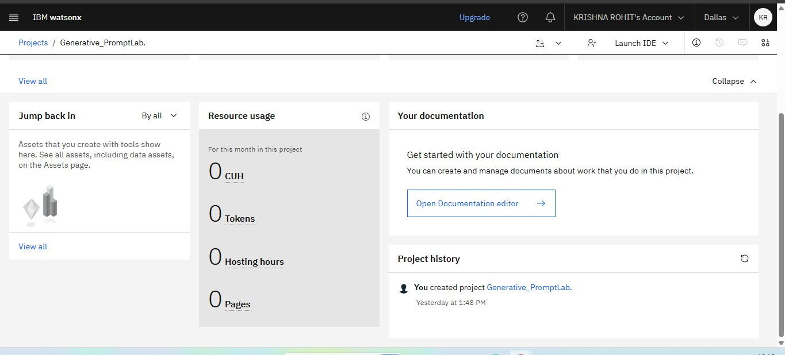
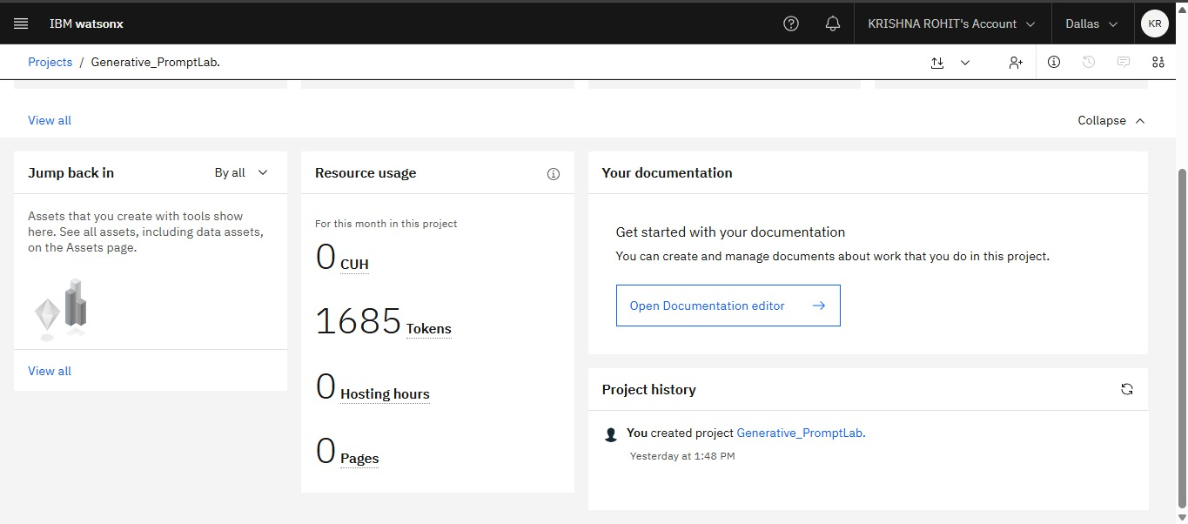
Token Usage
1685 token are used
Before Prompt
After the Prompt
·
·
·

Slide 9
Novelty and Uniqueness
Novelty and Uniqueness
• AI-powered study assistant.
• Upload and analyze study materials.
• Automatic quiz generation.
• Personalized study planning.
• Flashcard generation.
• Interactive AI chatbot.
• Simple and user-friendly interface.
• Built using IBM BOB and IBM Granite AI concepts.

Slide 10
Git Hub Link
https://github.com/KrishnaRohit12/Smart-Study-Generator-Agent
·
·
·

Slide 11
Future Scope
Itegration with IBM Watsonx services.
• Voice-based AI study assistant.
• OCR support for handwritten notes.
• Real-time collaboration between students.
• Multi-language support.
• Mobile application development.
• Cloud-based user accounts.
• Performance analytics using AI.
·
·
·

Slide 12
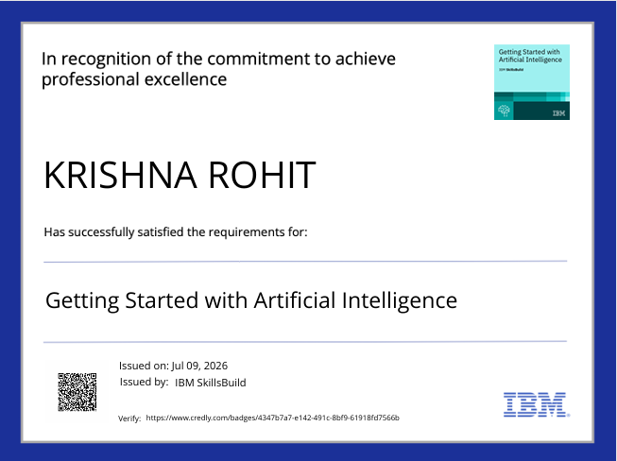
Certificates Earned:
Please add your credly certificate

Slide 13
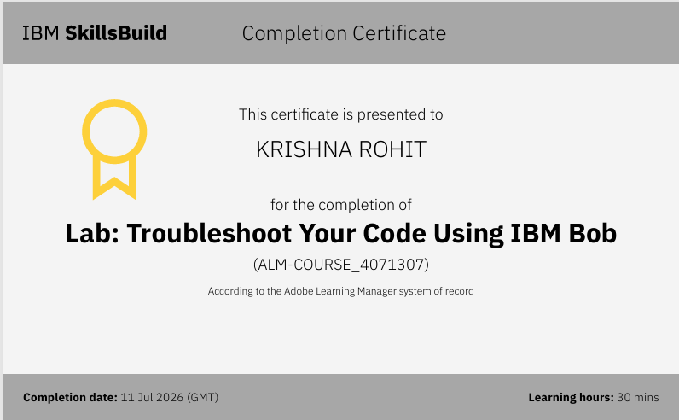
Certificates Earned:​
Add your IBM BOB Certificate

Slide 14


