Slide 1
Artemis Lunar Missions
Challenge : Lunar-Surface-Operations: Real-Time-Collaboration
Team Members :
B V G Krishna Sai

Slide 2
Logging becomes EFFECTIVE AND effortless
Allows the collaborators associated with the project to place their logs at one place . They retain the choice to either make the log available to all or selective few or to keep it to themselves. Public logs can be accessed by all the members from anywhere at anytime.
All the logs posted by the user is maintained in tabular form and can be filtered based on keywords and time.
Ability to upload different kinds of files as attachments into the log

Slide 3
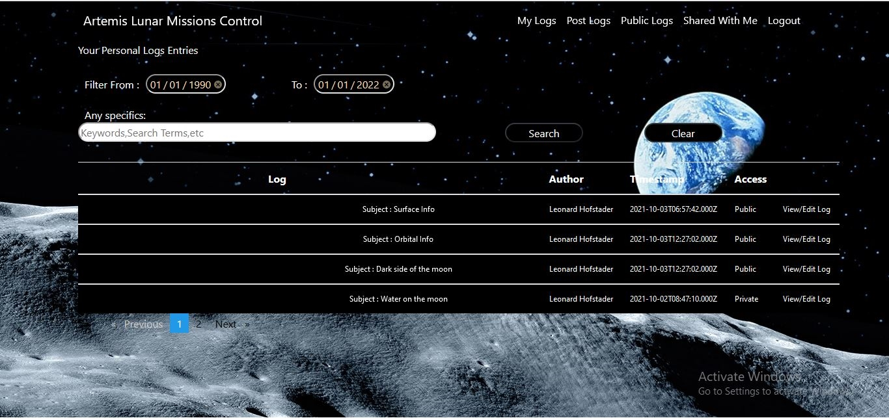
Want A taste of it?

Slide 4
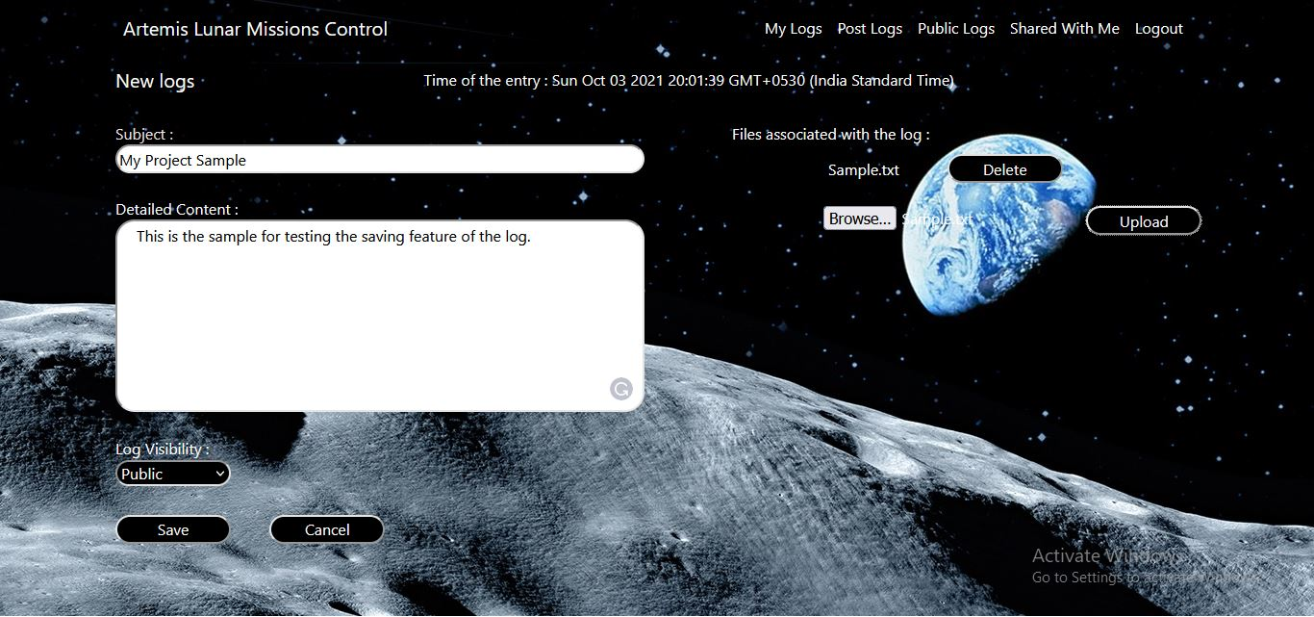
Logging becomes attractive

Slide 5
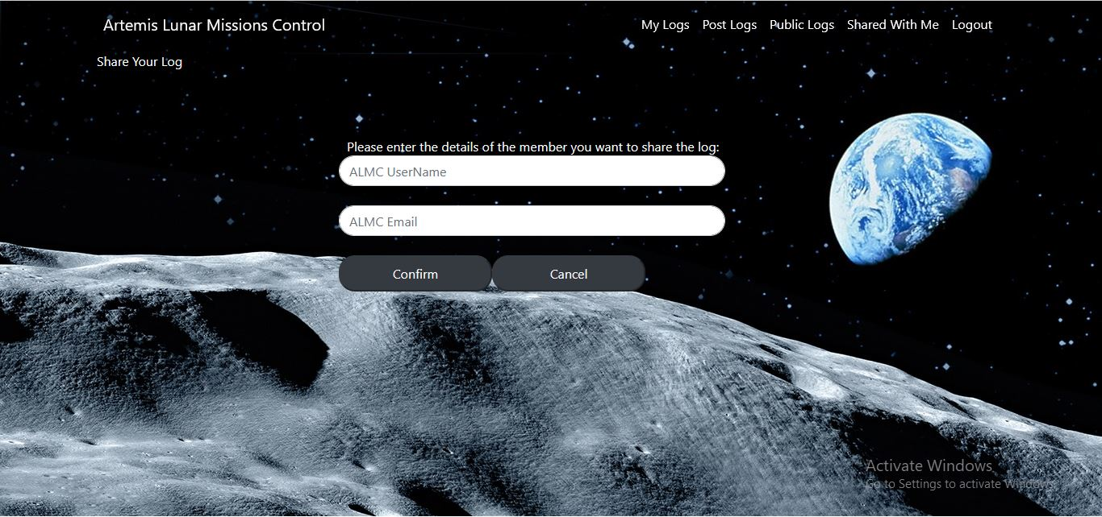
When Sharing leads to better prospects

Slide 6
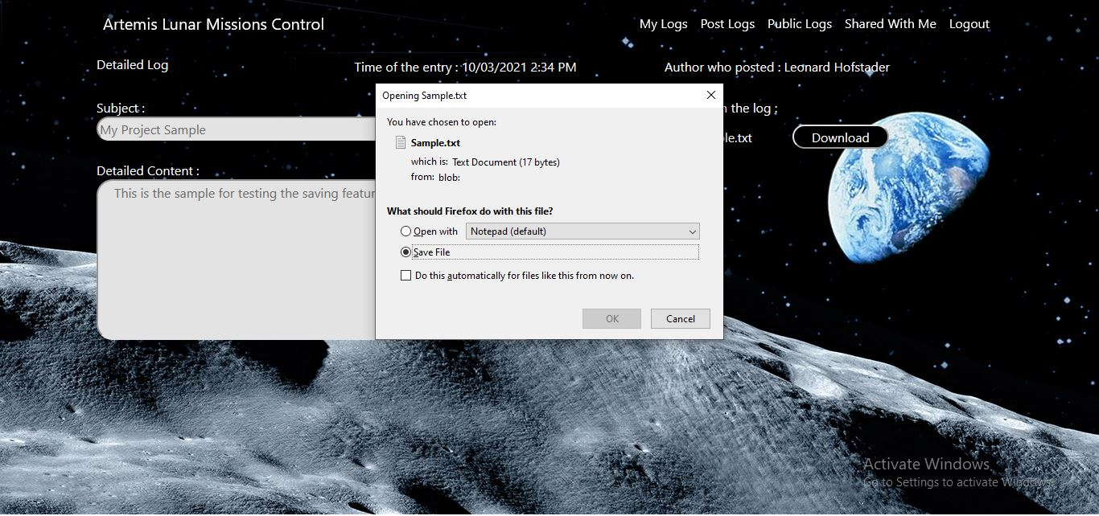
Downloading observation’s attachments

Slide 7
Future advancements
Well after what would have been delightful UI designs its time to talk about what could be made better.
There can be compare notes feature where people can compare their notes with others. This would mean directly comparing one notes with another if the subject is the same one.
Ability to view the images and video files put on the public logs directly
on the website itself without having the need to download them into our local systems

