Slide 1

CB.SC.U4AIE24138 - M. V. Mukesh CB.SC.U4AIE24144 - P. Varshitha CB.SC.U4AIE24165 - U. V. K. Sudeepthi
DIGITAL THERMOMETER USING ARDUINO UNO
Introduction to Electrical and Electronics Engineering(22AIE114) And User Interface Design(22AIE115) Project done by Group-18

Slide 2
Problem Statement
Conventional thermometers provide only manual and localized temperature readings, lacking automation, data storage, or real-time response capabilities.

Slide 3
Introduction
In the present era, live monitoring of the environment is gaining prominence in many fields like home automation, agriculture, health care, and industry. Basic thermometers only yield manual readings and not digital readings.
This is a low-cost, real-time temperature monitoring system based on an Arduino UNO microcontroller and an LM35 temperature sensor. The sensor senses the ambient temperature, which is processed by Arduino and displayed in digital form. This system can easily be extended to data logging, automation, or IoT applications.

Slide 4
Objectives
To design and implement a digital thermometer using an Arduino UNO and an LM35 temperature sensor that can measure, display, and can respond to temperature changes in real-time.

Slide 5
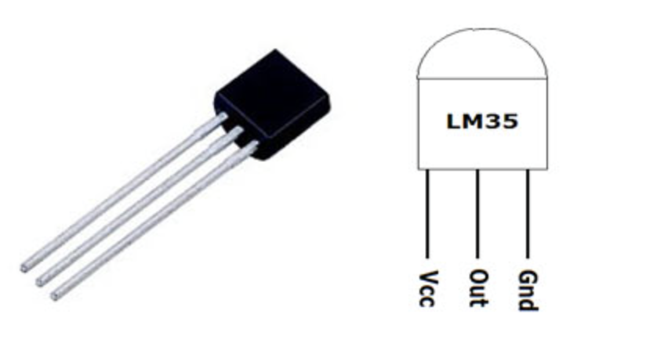
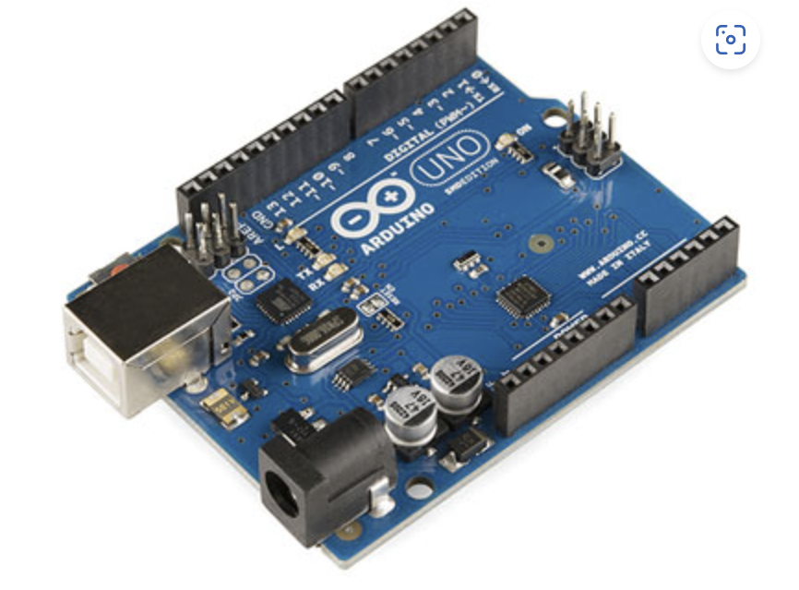

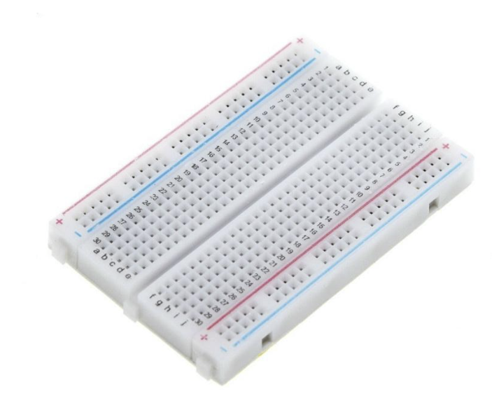
Components Required

Slide 6
Literature Review
S.No | Title | Year | Methodology
1. | Digital Thermometer using Arduino and LM35 Temperature Sensor | 2015 | Methodology for all these paper revolves around the part where it senses the temperature and display that in the LCD.
2. | Arduino Based Digital Thermometer | 2017
3. | DIY Digital Thermometer With Arduino | 2024

Slide 7
Research Gap
Accuracy in Varying Environmental Conditions
Battery Efficiency and Power Management

Slide 8
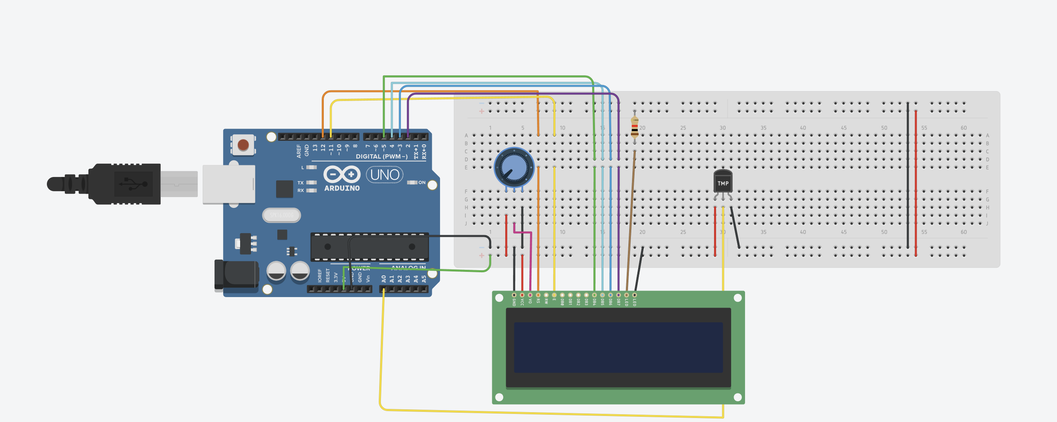
Block Diagram

Slide 9
Methodology
Component Selection
Arduino UNO: Acts as the central microcontroller for reading and processing sensor data.
LM35 Temperature Sensor: Analog sensor that outputs voltage linearly proportional to temperature (10 mV/°C).
9V Battery: Serves as a portable power source to ensure standalone operation.

Slide 10
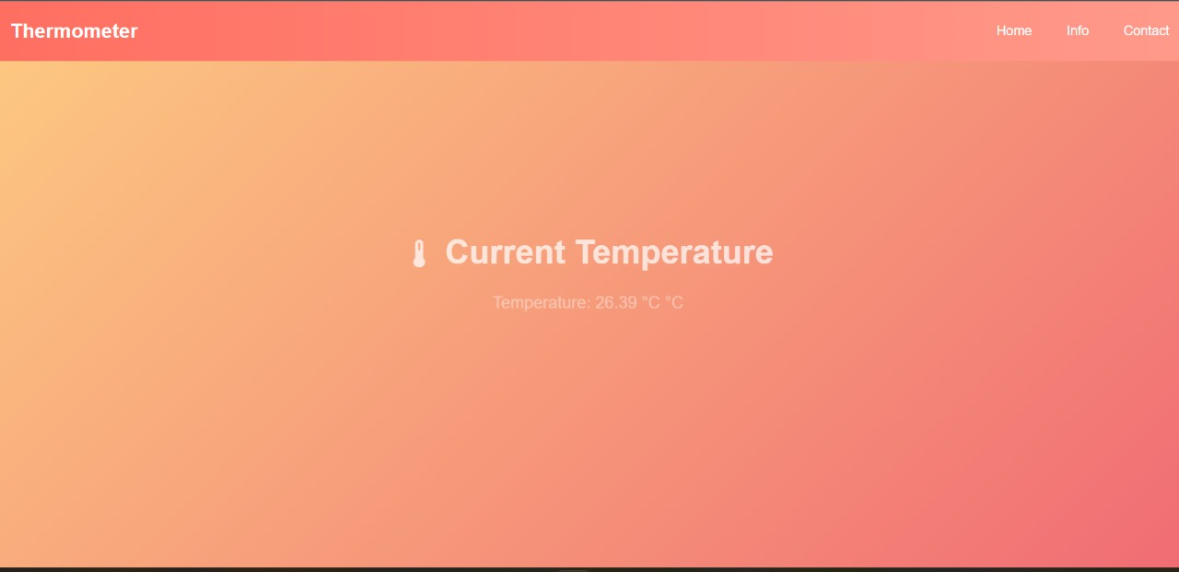
Results

Slide 11
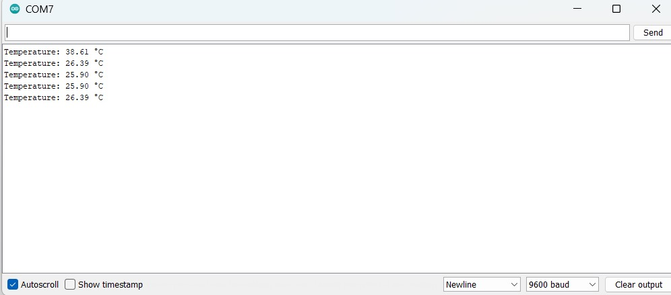

Slide 12
Conclusion
The combination of the Arduino UNO and LM35 sensor presents a cost-effective, accurate, and educational approach to digital temperature sensing.
Its simplicity makes it ideal for student projects, while its extendability opens doors for more complex real-time monitoring systems

Slide 13
Future Scope
Can extend this to “Home Automation System”.
Can extend this to “Automatic Watering System”.
Can connect to ESP32 in order to get live data using Wifi.
Can integrate with AI assistant to alarm you when the temperature exceeds a particular temperature or falls short of a particular temperature.

Slide 14
References
Ravi Teja , (June 24, 2024). Arduino Based Digital Thermometer. DIY Digital Thermometer with Arduino (Easy Project & Guide).
Ibrar Ayyub, (July 5, 2017). Arduino Based Digital Thermometer. Arduino Based Digital Thermometer – duino.
Saddam, (June 16, 2015). Digital Thermometer using Arduino and LM35 Temperature Sensor. Digital Thermometer Project using Arduino and LM35 Temperature Sensor.

Slide 15
Thankyou

