Slide 1
Bluestock Mutual Fund Analytics Platform
Capstone Project
Submitted By: Krishna Vamsi Bommireddy
Organization: Bluestock Fintech Pvt. Ltd.
Technologies: Python, SQLite, Tableau, Power BI, Pandas, NumPy
📷 Add dashboard cover screenshot

Slide 2
Problem Statement & Objectives
Problem Statement
Investors face difficulties in:
Comparing mutual funds
Understanding risk levels
Tracking performance
Monitoring SIP growth
Evaluating benchmarks
Objectives
Build ETL Pipeline
Create SQL Database
Perform EDA
Compute Risk Metrics
Build Dashboard
Analyze Investors
Benchmark Funds

Slide 3
Data Sources
Datasets Used
Fund Master (40 schemes)
NAV History (46,000+ rows)
AUM Data
SIP Inflows
Category Inflows
Folio Count
Scheme Performance
Investor Transactions
Portfolio Holdings
Benchmark Indices
Total Records
46K+ NAV Records
32K+ Transactions
5000 Investors

Slide 4
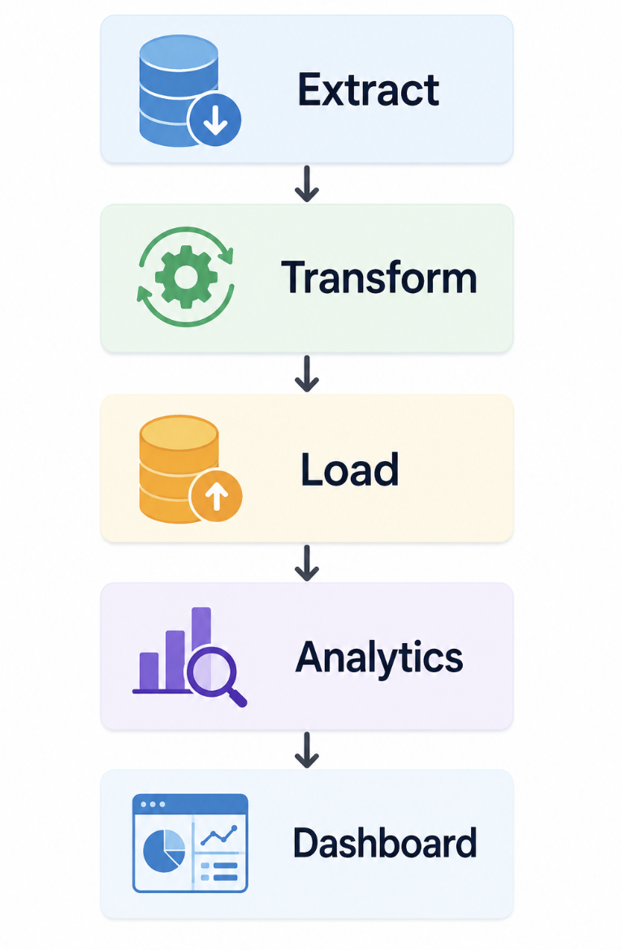
System Architecture
ETL Pipeline
Tools Used
Python
Pandas
SQLite
Tableau
Power BI

Slide 5
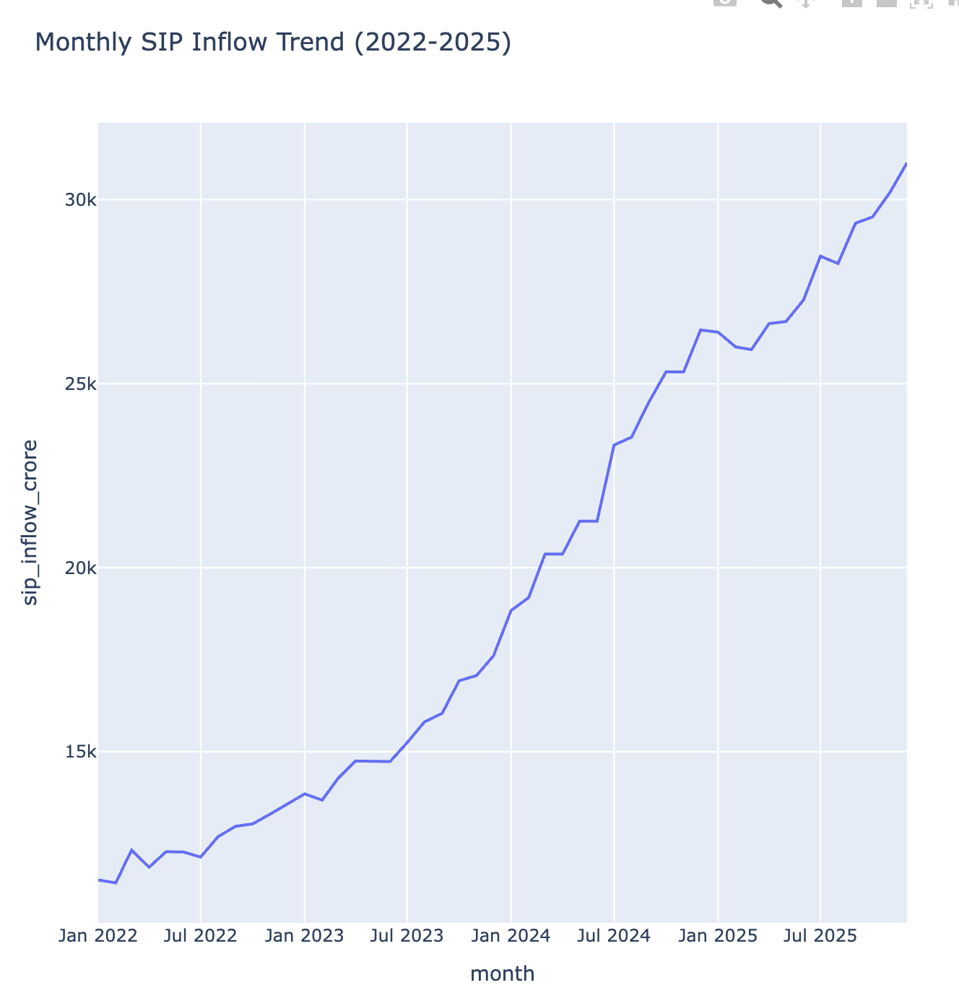
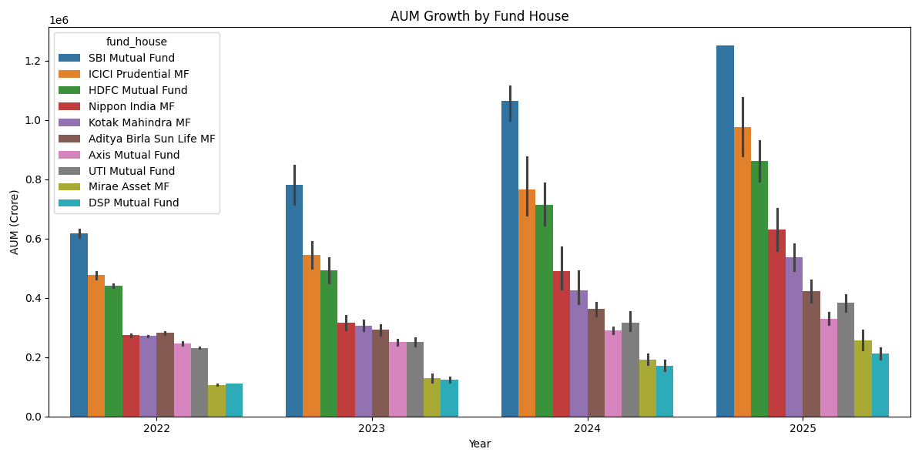
EDA Highlights (Part 1)
Industry Growth
Findings
Industry AUM crossed ₹81 Lakh Crore
SIP inflows reached ₹31,002 Crore
Folios increased from 13.26 Cr to 26.12 Cr

Slide 6
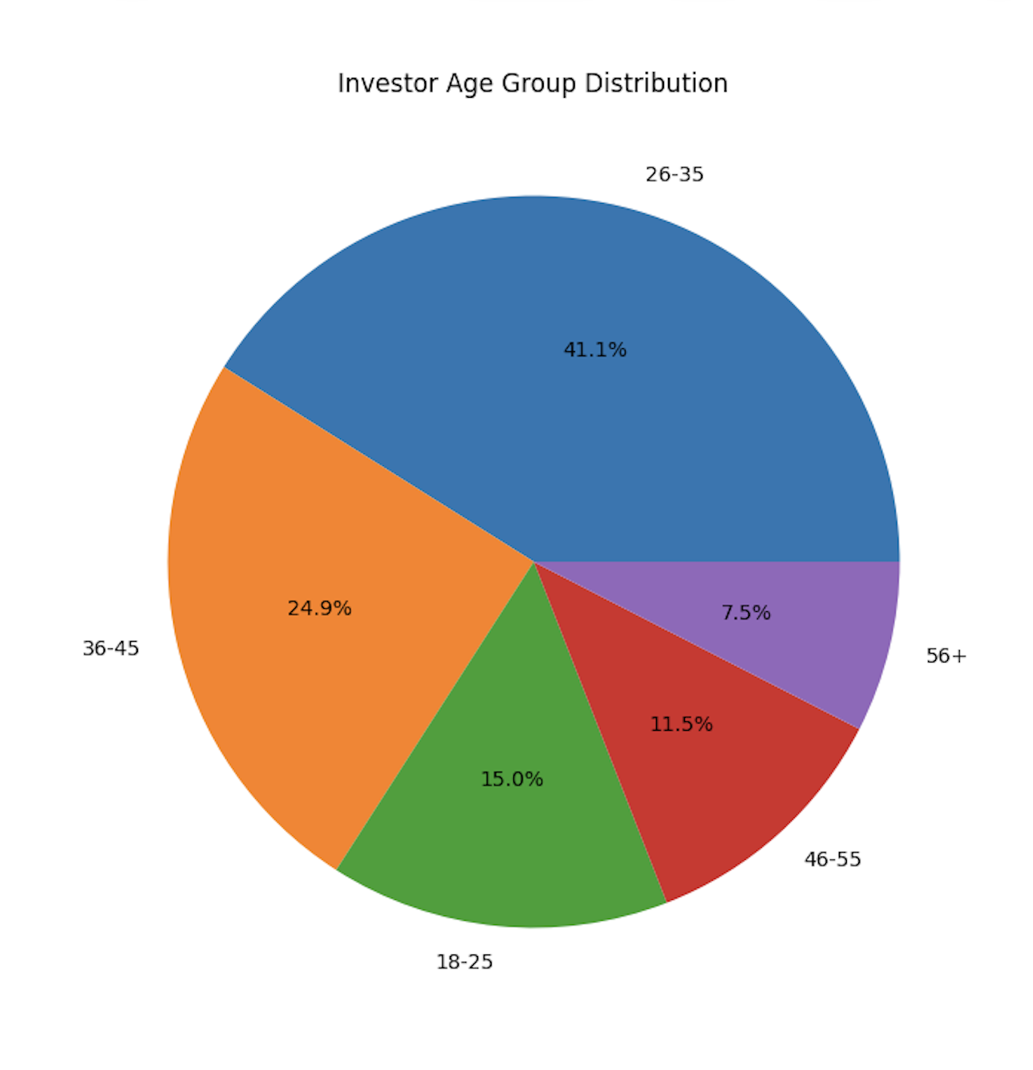
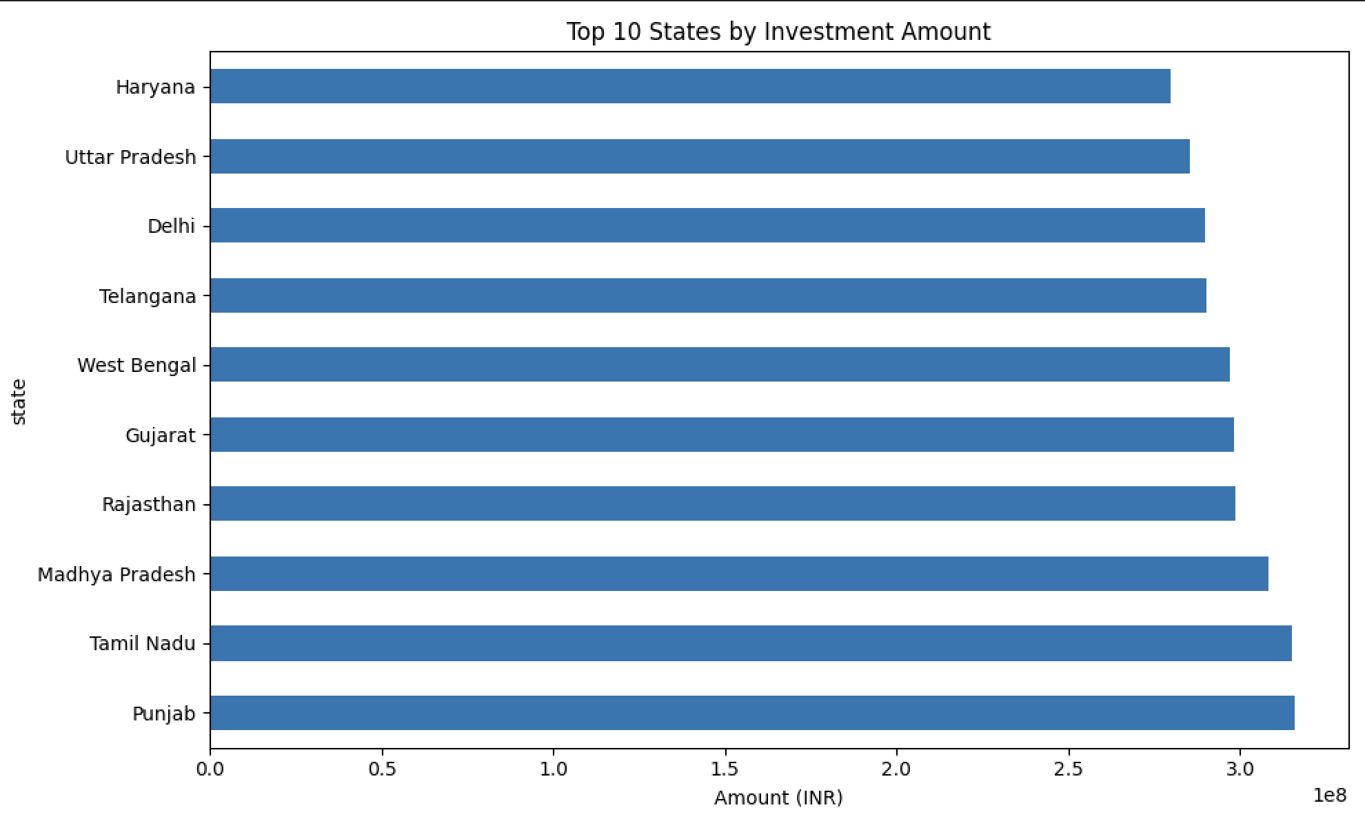
EDA Highlights (Part 2)
Investor Analytics
Findings
Age 25–35 dominates SIP participation
Tier-1 cities contribute most transactions
Maharashtra and Karnataka lead investment

Slide 7
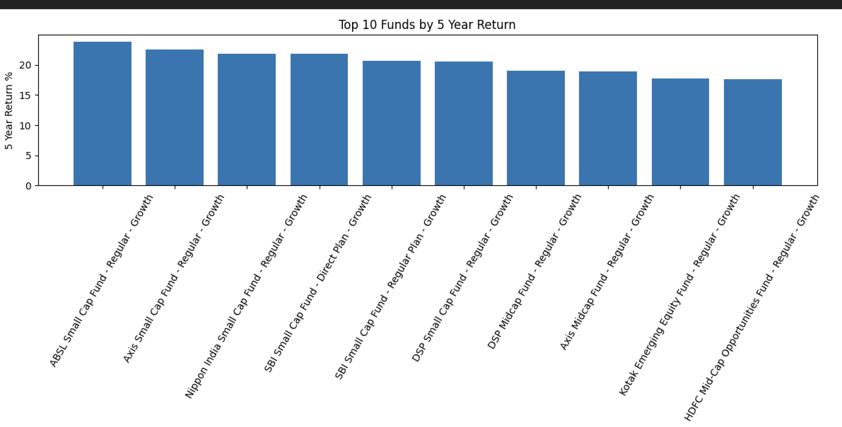
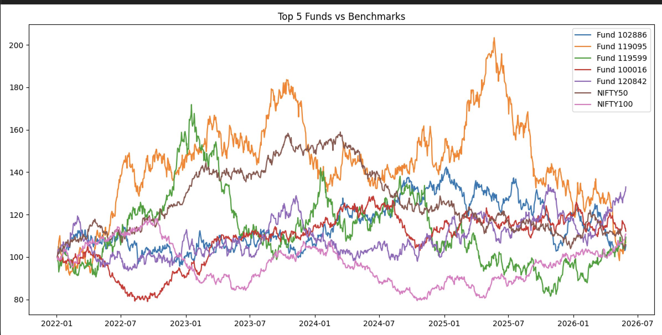
Performance Analytics (Part 1)
Metrics Calculated
CAGR
Sharpe Ratio
Sortino Ratio
Alpha
Beta
Standard Deviation
Key Finding
Mid-cap funds generated superior risk-adjusted returns.

Slide 8
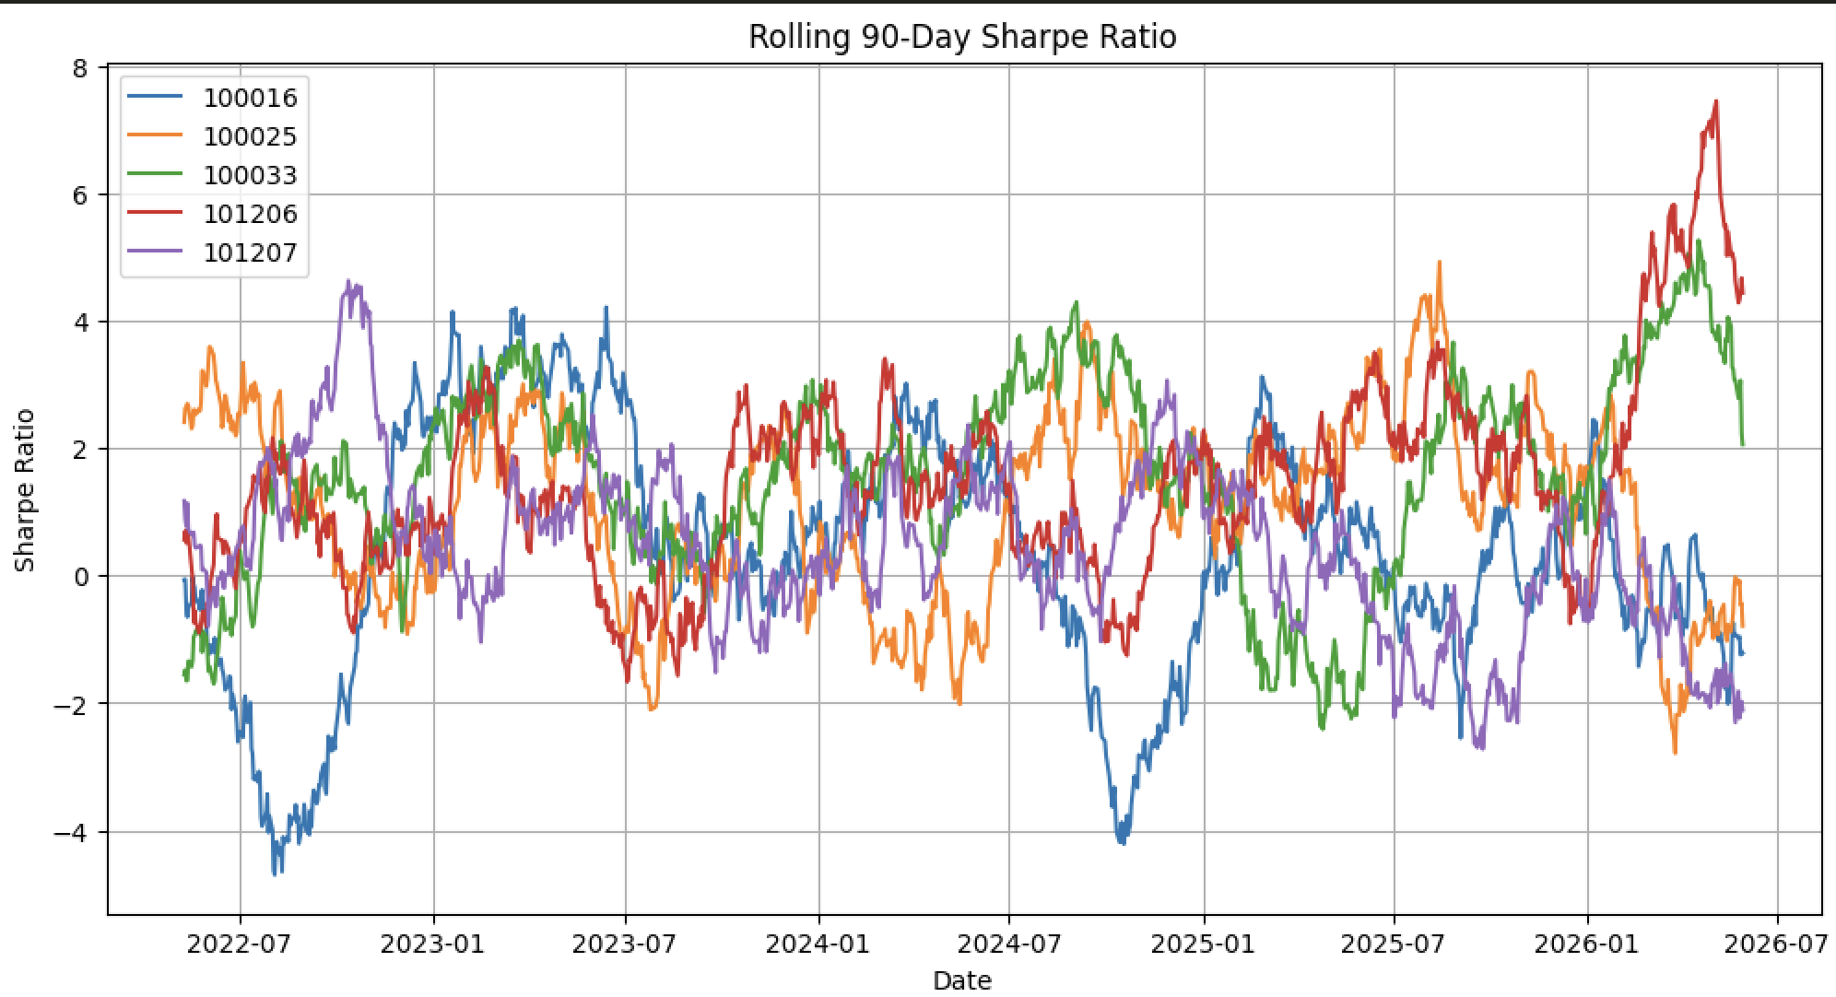
Performance Analytics (Part 2)
Risk Analysis
Metrics
VaR (95%)
CVaR (95%)
Maximum Drawdown
Rolling Sharpe Ratio
Key Finding
High-risk funds achieved highest Sharpe ratios.

Slide 9
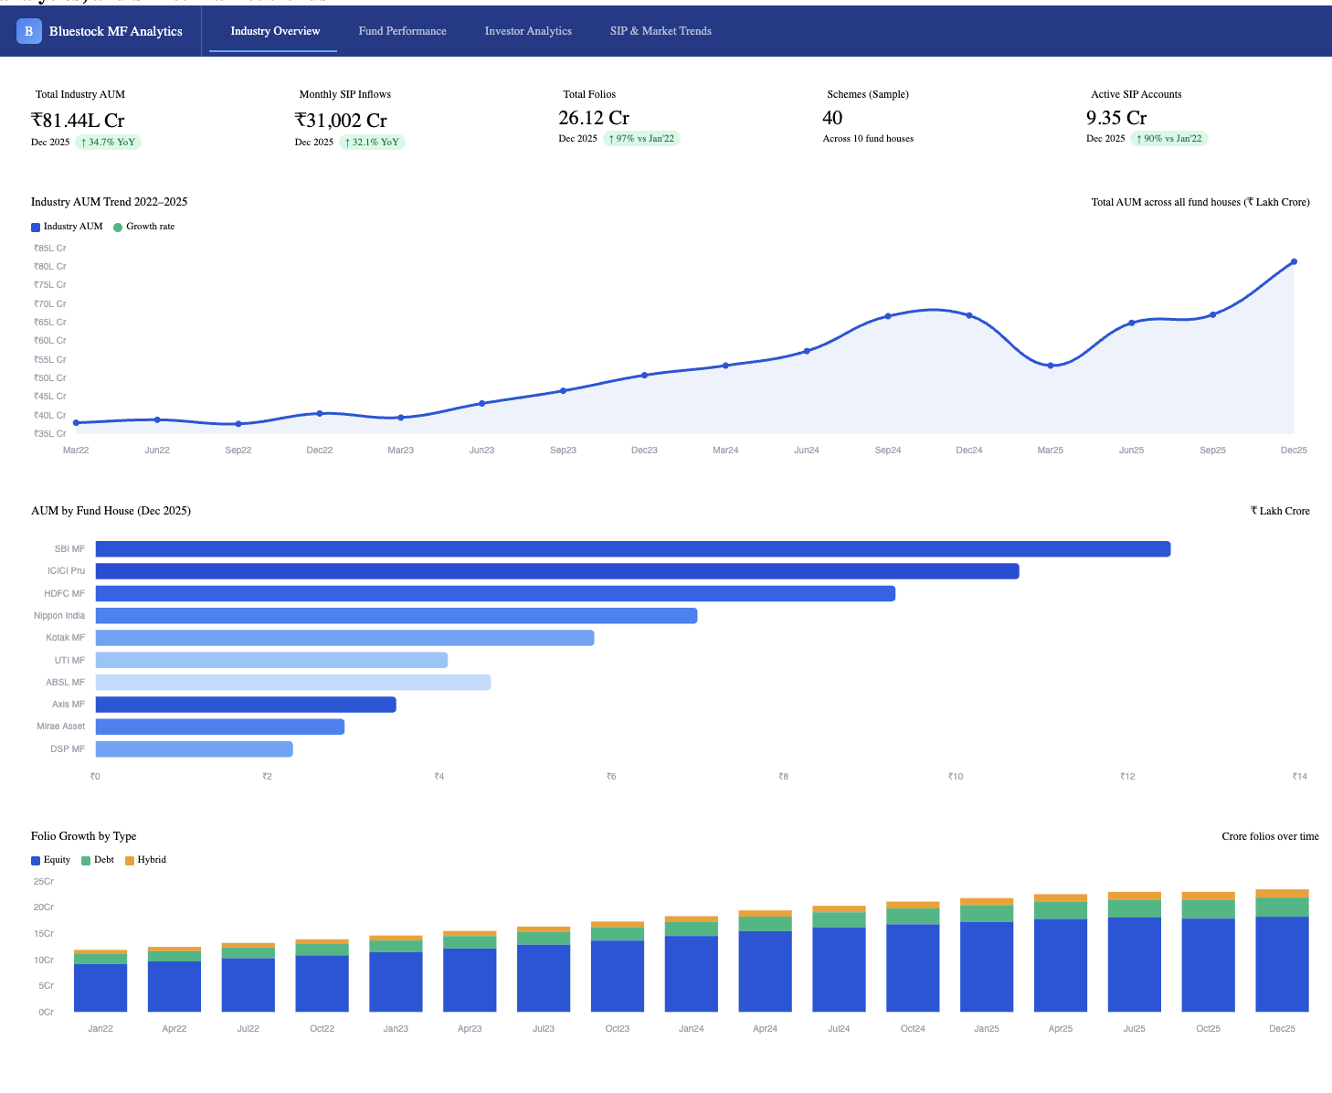
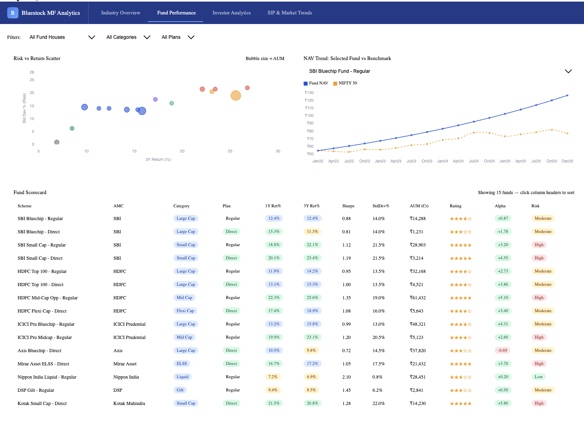
Dashboard Overview
Page 1
Industry Overview
AUM
SIP Inflows
Folios
AUM by AMC
Page 2
Fund Performance
Risk vs Return
Fund Scorecard
NAV vs Benchmark

Slide 10
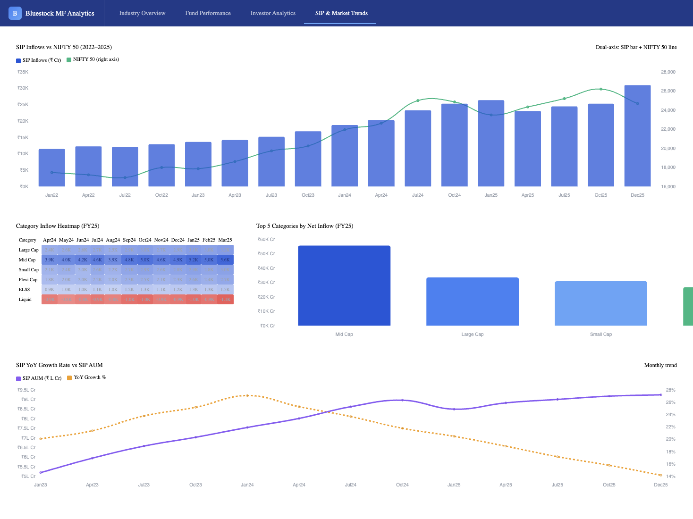
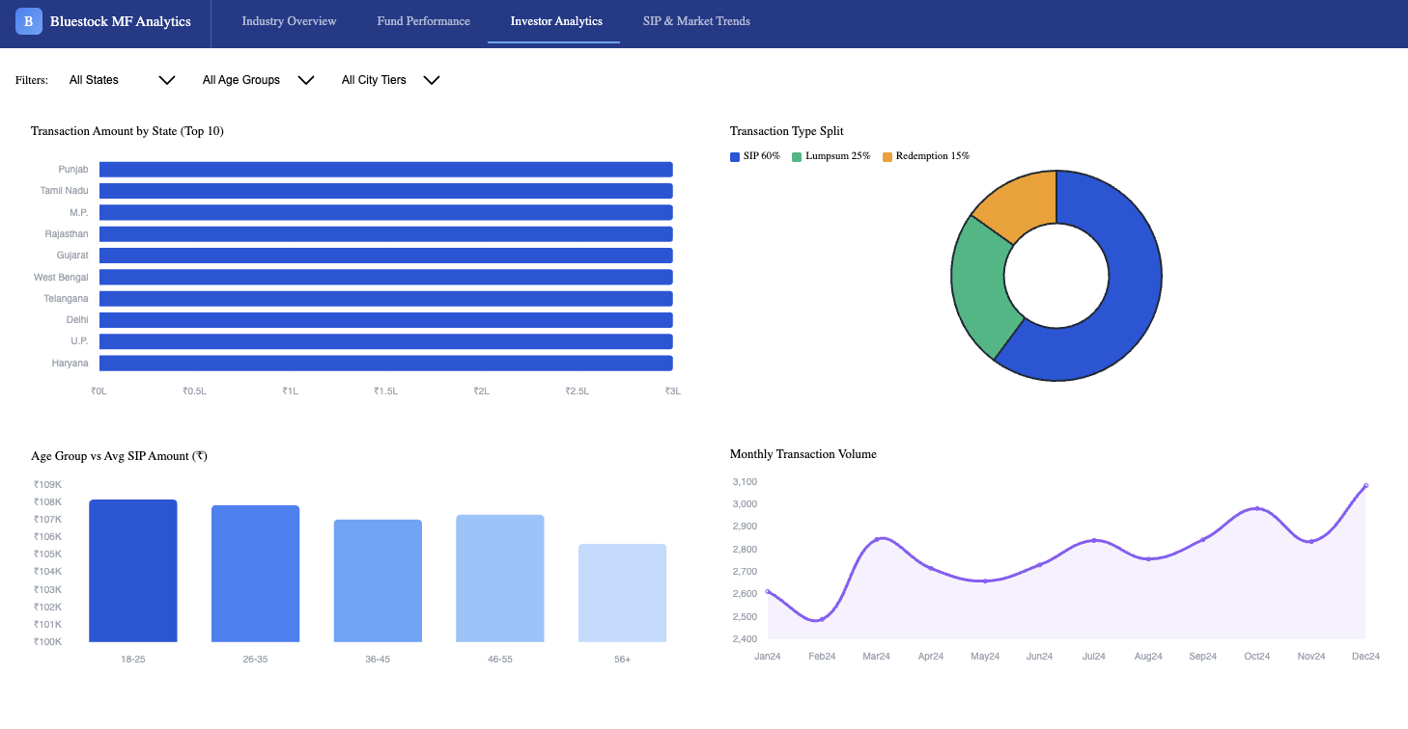
Dashboard Overview
Page 3
Investor Analytics
State Analysis
Transaction Analysis
Age Group Analysis
Page 4
SIP & Market Trends
SIP vs Nifty
Heatmap
Category Trends

Slide 11
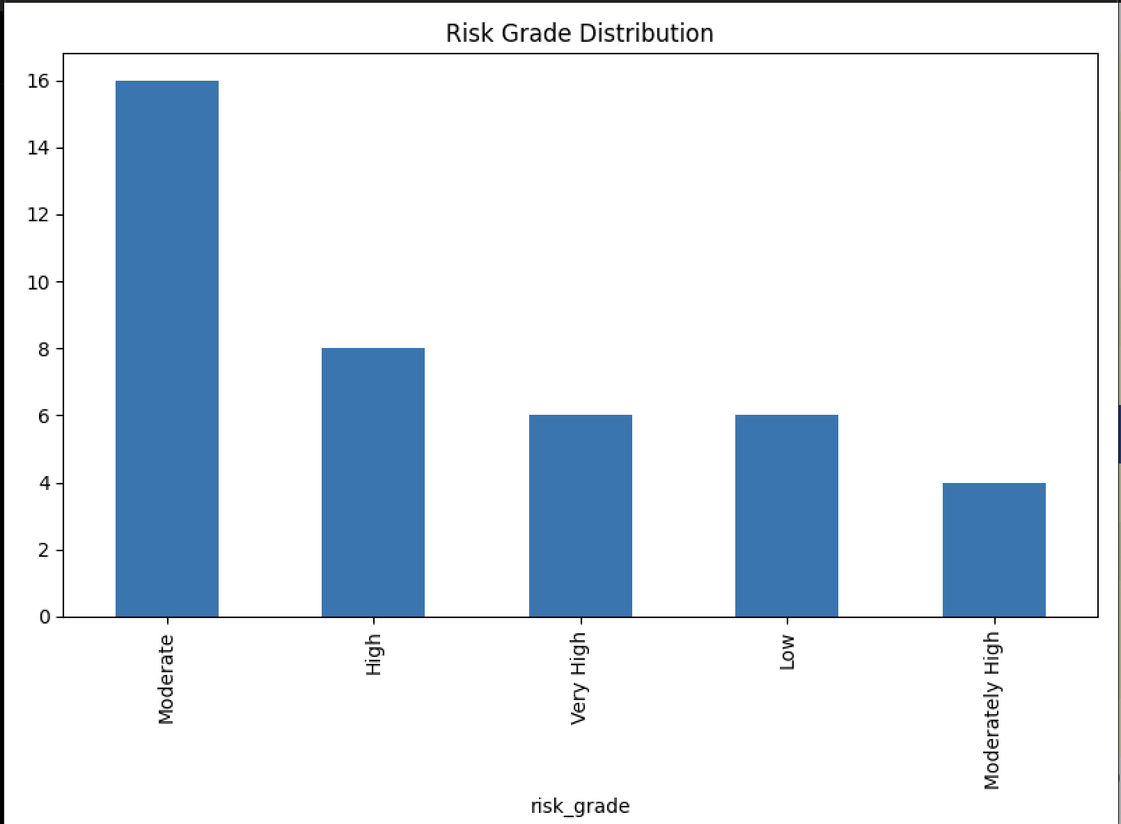
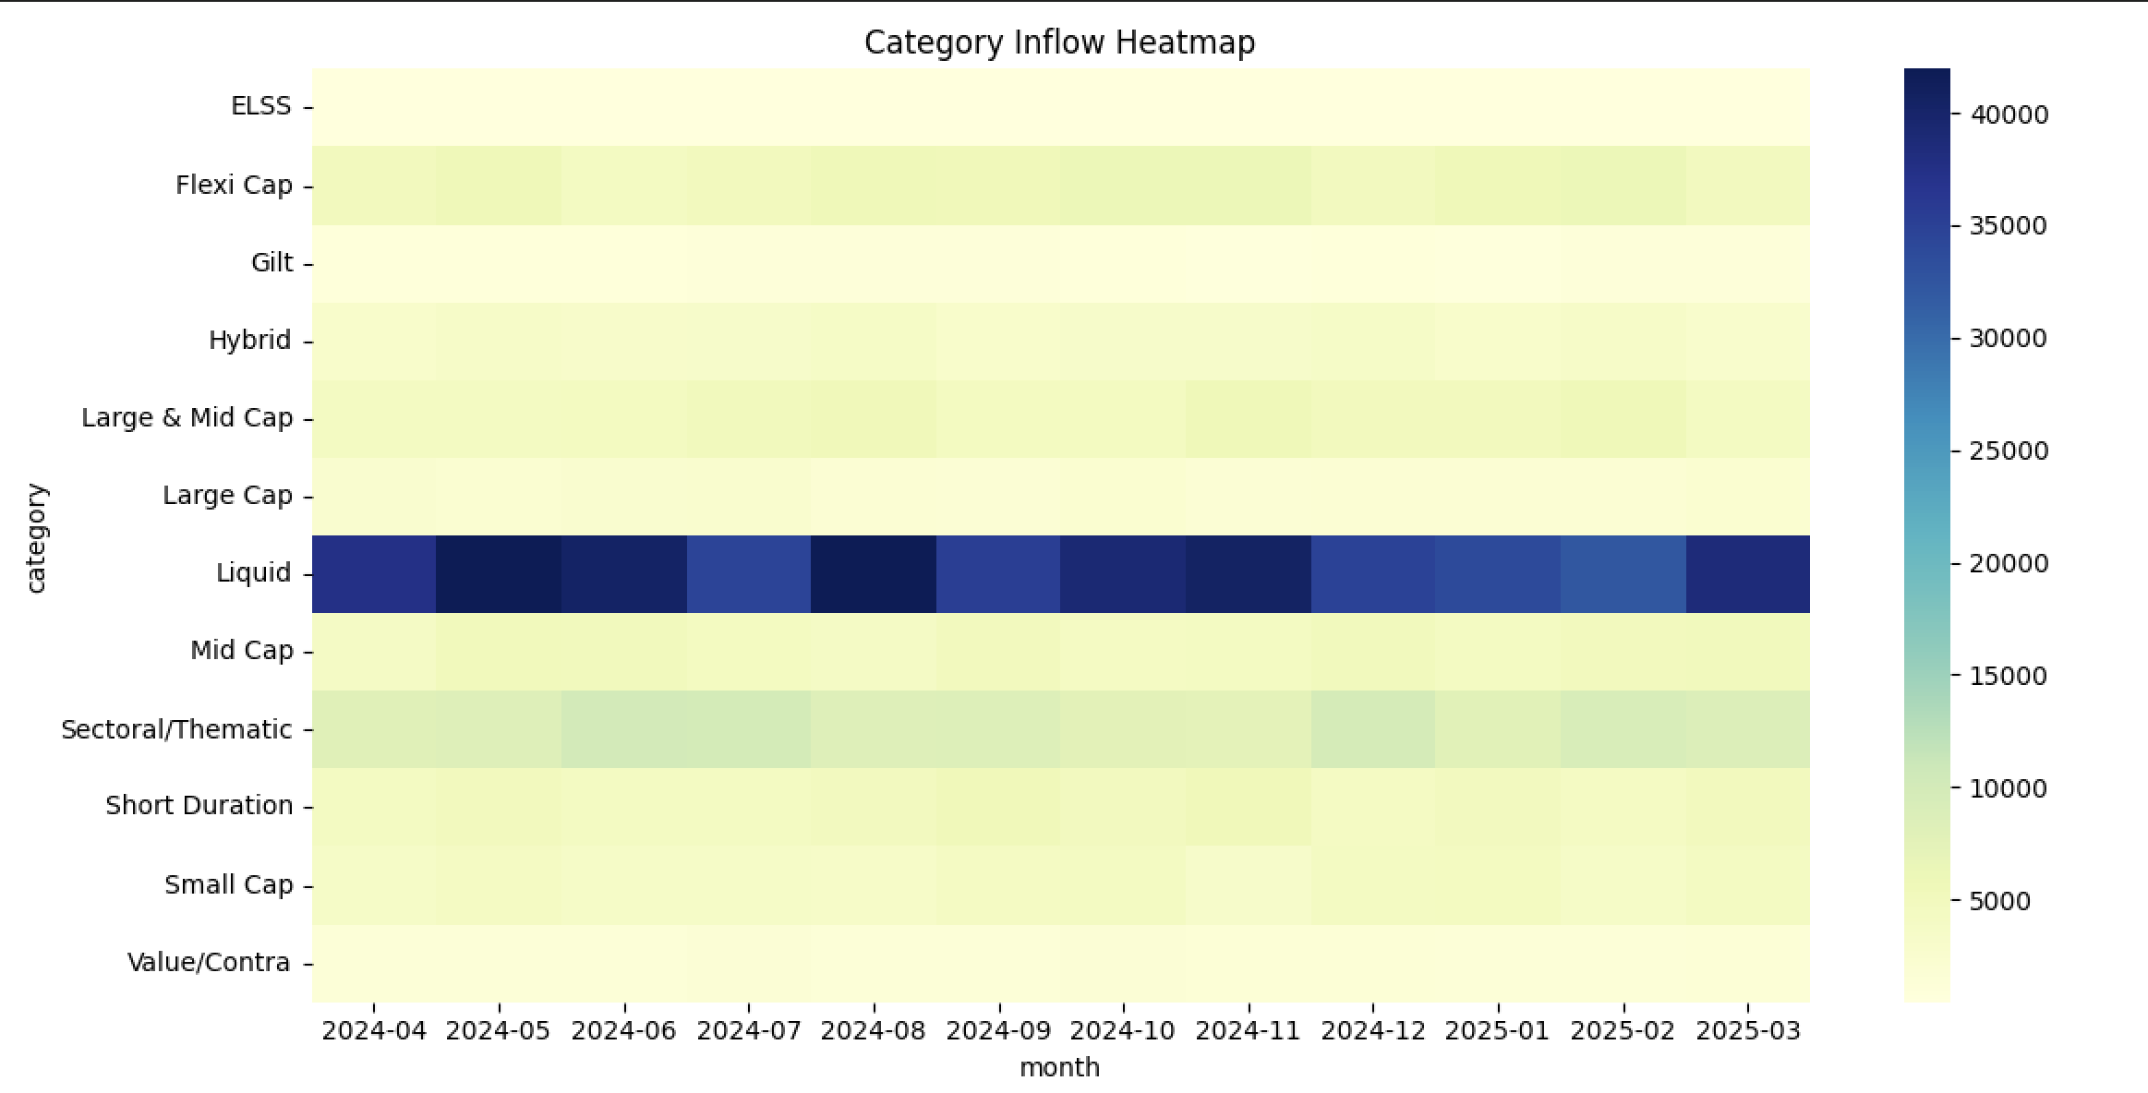
Key Findings & Achievements
Key Findings
Industry AUM exceeded ₹81L Cr
SIP inflows reached ₹31,002 Cr
Mid-cap funds outperformed large-cap funds
2024 investor cohort invested the most
Several SIP investors identified as At-Risk
Deliverables Completed
✅ ETL Pipeline
✅ SQLite Database
✅ EDA Notebook
✅ Performance Analytics
✅ Dashboard
✅ Advanced Analytics
✅ Final Report

Slide 12
Conclusion & Thank You
Conclusion
The project successfully delivered an end-to-end Mutual Fund Analytics Platform covering:
Data Engineering
Analytics
Risk Modelling
Dashboarding
Investor Insights
Future Enhancements
Streamlit App
Live NAV API
Monte Carlo Simulation
Portfolio Optimization
Thank You

