Slide 1
Game Controlling Hand Gloves
Discover the exciting world of game control using the power of Arduino Leonardo and custom-designed hand gloves.

Slide 2

Introduction to Hand Gesture Control
The Basics
Advantages
Hand gesture control allows users to interact with
technology using natural movements, offering intuitive
and immersive experiences. This technology is gaining traction in various fields, from gaming and robotics to healthcare and accessibility.
It eliminates the need for traditional input devices,
provides greater freedom of movement, and opens up new possibilities for interactive experiences.

Slide 3

Arduino Leonardo Capabilities
1. Built-in USB
ITnheteArrdfuaicnoeLeonardo is equipped with a built-in USB interface that allows it to communicate directly with a computer, simplifying the setup process.
2. Human Interface Device (HID)
The Leonardo supports HID,
allowing it to act as a keyboard, mouse, or gamepad, making it compatible with various gaming platforms.
3. Flexible Pin Configuration
The Leonardo offers a range of
digital and analog input/output pins, providing ample flexibility for connecting sensors and controlling actuators.
1
2
3

Slide 4
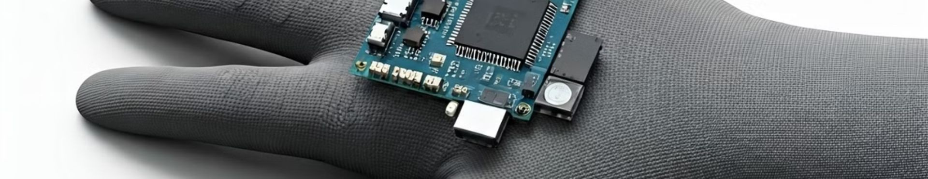

Designing the Hand Glove
^{H}Seªn^{r}so^{d}r S^{w}eleªcti^{r}on^{e}
Select appropriate sensors to
detect hand gestures, such as flex sensors, accelerometers, or even electromyography (EMG) sensors.
Glove Material
Choose a comfortable and durable material for the glove that allows for ease of movement and sensor integration. Consider materials like spandex, neoprene, or leather.
Circuit Design
Plan the circuitry to connect the sensors to the Arduino Leonardo, ensuring reliable signal transmission and power supply.

Slide 5
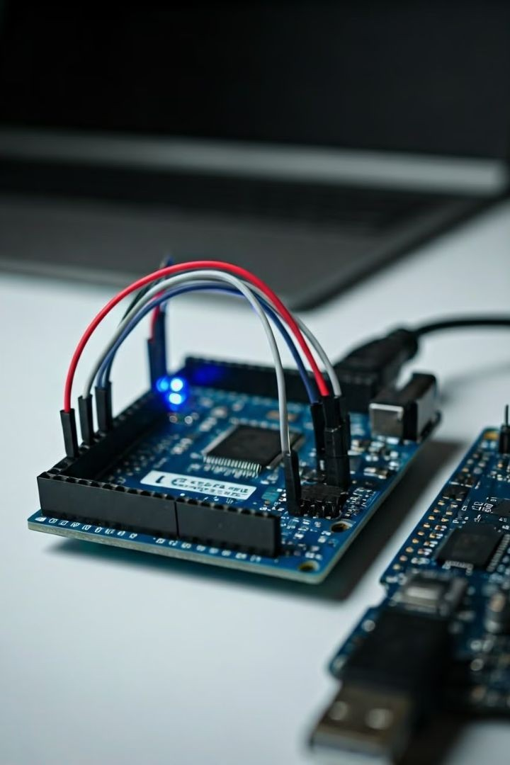



Integrating Sensors and Arduino Leonardo
Sensor Connection
Connect the sensors to the Arduino Leonardo using appropriate wiring techniques and pin assignments.
Code Libraries
Utilize libraries for specific sensor types to simplify data acquisition and processing.
Power Supply
Ensure a stable and reliable power supply for the Arduino Leonardo and the sensors, using batteries or a power adapter.

Slide 6

Developing the Control Software
Command Mapping
Map the recognized gestures to specific game commands, such as movement, actions, or special abilities.
Data Acquisition
Read sensor data from the connected sensors using the Arduino programming language.
1
2
3
Gesture Recognition
Develop algorithms to analyze the sensor data and identify different hand gestures.

Slide 7
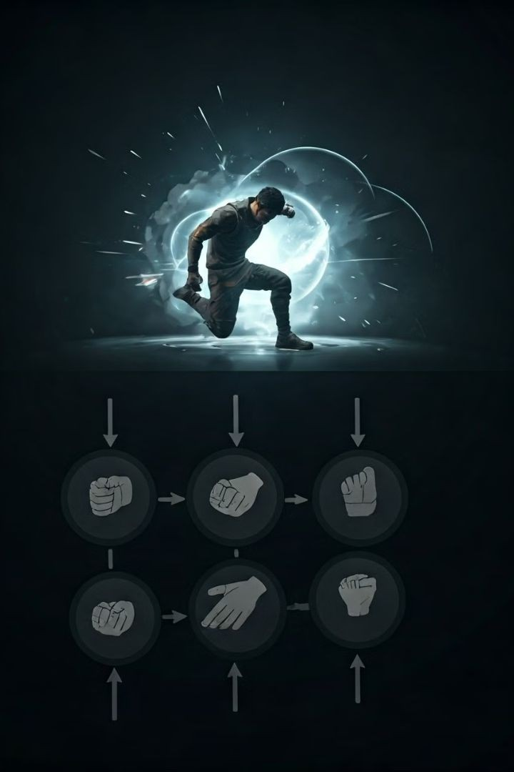

Mapping Hand Gestures to Game Commands
Fist
The fist gesture could be mapped to a punch, attack, or jump action.
Open Hand
An open hand could correspond to a block, shield, or defensive move.
Index Finger Pointing
Pointing could trigger a targeting mechanism or a special ability in the game.

Slide 8
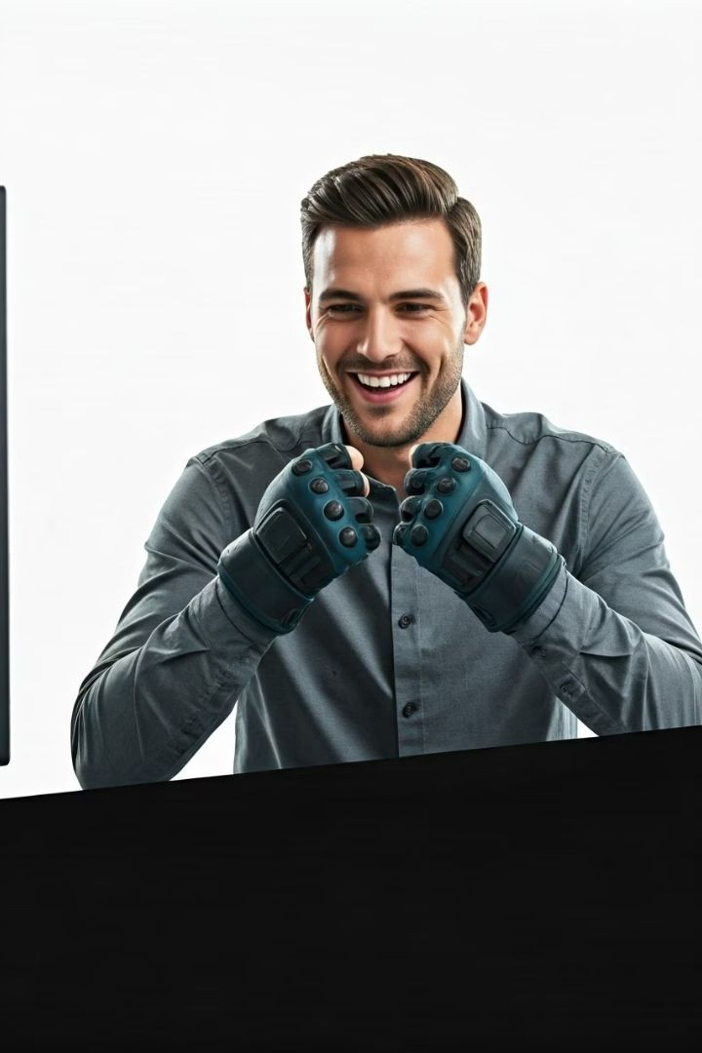
Demonstration and User Testing
1
Initial Testing
Test the functionality of the hand gloves and the control software in a controlled environment, adjusting the code and sensor calibration as needed.
2
User Feedback
Gather user feedback on the ease of use, responsiveness, and overall gaming experience.
3
Iterations and Refinement
Based on the feedback, refine the gesture mapping, control software, and hardware design to enhance the user experience.

Slide 9
Conclusion and Future Applications
Hand gesture control has the potential to revolutionize gaming, offering
immersive and intuitive experiences. Future applications include accessibility solutions, virtual reality, and augmented reality.

