Slide 1
Short Long Term Residential Load Forecasting Based On LSTM Recurrent Neural Network
By Gaurav Yadav (21075034) and K.V.K Varun (21075044)

Slide 2
Introduction
The current power system is shifting towards greater sustainability, but this is introducing additional complexity and uncertainty due to factors such as the growing use of renewables, electric vehicles, and fluctuating load demands in distribution grids.
By accurately forecasting loads, it becomes possible to utilize energy storage (ES) systems or intelligent demand response (DR) technologies in a flexible manner, which enables peak load shaving.
Deep learning has emerged as a highly active area of research across multiple fields. Unlike shallow learning, deep learning involves stacking multiple layers of neural networks and utilizing stochastic optimization to perform machine learning tasks.
Among deep learning methods, the long short-term memory (LSTM) recurrent neural network (RNN) has garnered significant attention in the area of sequence learning. Originally introduced by Hochreiter and Schmidhuber.
The paper aims to address the issues of short-term residential load forecasting by conducting an exploratory analysis of customer-wise data and evaluating the inconsistency in residential load profiles.
The paper aims to address the issues of short-term residential load forecasting by conducting an exploratory analysis of customer-wise data and evaluating the inconsistency in residential load profiles.
The paper then proposes a residential load forecasting framework based on LSTM and develops a conservative empirical optimization-based predictor.

Slide 3
Literature Review
In the field of short-term load forecasting, numerous studies have been conducted. For instance, Cao et al. utilized the autoregressive integrated moving average (ARIMA) model and a similar day technique for intraday load prediction.
They showed that ARIMA is more accurate in typical days, while the similar day method is more effective in unusual days.
Radial basis function (RBF) neural network had been used to address the short-term load forecasting. Yun et al. combine the RBF neural network with the adaptive neural fuzzy inference system (ANFIS) to adjust the prediction by taking account of the real-time electricity price.
Li et al. addressed the short-term day-ahead forecasting problem via a grid method combined with the back propagation (BP) and the RBF neural networks. The grid method is similar to the similar day method, but instead of grouping days with similar meteorological measurement, it groups load profiles according to location, nature and size of the loads. For each group, they trained a BP network and an RBF network to predict the day-ahead load demand.
Recently, k -nearest neighbour (KNN) algorithm had also seen some successful examples on load forecasting, whose dominant advantage is its efficiency.
This approach achieved the most accurate forecasting performance on system-level load forecasting, with mean absolute percentage error (MAPE) score as small as 0.419% on average.

Slide 4
Objective
The objective is to propose a deep learning-based approach, specifically using Long Short-Term Memory (LSTM) recurrent neural network, for short-term load forecasting of residential customers.
The paper aims to evaluate the performance of the proposed approach and compare it with other existing methods using metrics such as Mean Absolute Percentage Error (MAPE) and Root Mean Square Error (RMSE).
The paper presents a load forecasting framework for the difficult task of predicting individual residential load, using LSTM recurrent neural network, since LSTM has demonstrated its ability to understand long-term temporal relationships.
We also used different models like the GRU (Gated Recurrent Unit) and the Regression models like the polynomial regression, multiple linear regression, Lasso and Ridge regression.
We have used different evaluation metrics for comparing the results from all of this different models used in the report.

Slide 5
Proposed Approach
The ‘Household Power Consumption‘ dataset is a multivariate time series dataset that describes the electricity consumption for a single household over four years. The data was collected between December 2006 and November 2010 and observations of power consumption within the household were collected every minute.
LSTM Model:
The first layer is an LSTM layer with 200 units and an input shape of (X_train.shape[1], X_train.shape[2])
A dropout layer is added after the first LSTM layer to regularize the model and prevent overfitting. The dropout rate is set to 0.2, which means that 20% of the inputs to this layer will be randomly set to zero during training.
The second layer is another LSTM layer with 200 units that does not return sequences of outputs.
Another dropout layer is added after the second LSTM layer to further regularize the model. The dropout rate is set to 0.3.
The final layer is a dense layer with a single output unit, which is the predicted value.

Slide 6
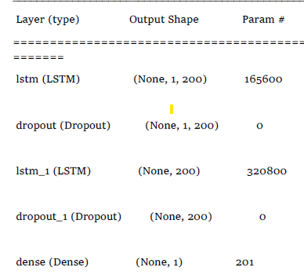
The LSTM model summary
GRU (Gated Recurrent Unit) model:
The Sequential function initializes a linear stack of layers. The first layer added to the model is a GRU layer with 75 units and return sequence is selected True, which means it returns the full sequence of outputs for each input time step. The input shape parameter defines the shape of the input data as a 3D tensor.

Slide 7
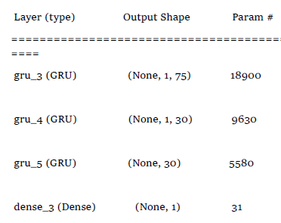
2. The next two layers are also GRU layers with 30 units each, and return sequences is True. The last layer is a Dense layer with one unit, which outputs the predicted value for the next time step.
3.The model is compiled using the mean absolute error (loss='mae') as the loss function and the Adam optimizer. The mean absolute error measures the absolute difference between the predicted and actual values, and is commonly used in regression problems.
The GRU model Summary:

Slide 8
The Regression Models:
Multiple Linear Regression:
‘linmodel’ class is defined with two parameters: df and target.
‘LinearRegression()’ is used to create a linear regression object.
‘reg.fit’ method is used to fit the linear regression model using the training data.
‘reg.predict’ method is used to predict the target variable using the testing data.
‘skm.mean_absolute_error, skm.mean_squared_error, skm.r2_score, and skm.explained_variance_score’ functions are used to calculate Mean Absolute Error (MAE), Root Mean Squared Error (RMSE), R-squared, and explained variance (EV) respectively.
In a similar way we build the other Regression models like the: -
Polynomial regression, Lasso Regression and Ridge Regression.

Slide 9


Results
We have compared the different models based on some evaluations metrics.
These are some common empirical methods like Mean Absolute Error (MAE), Root Mean Square Error (RMSE), R squared value (R^2).
Also represented the training and test loses.
For LSTM Model:
For GRU model:

Slide 10
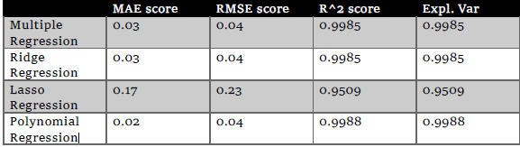
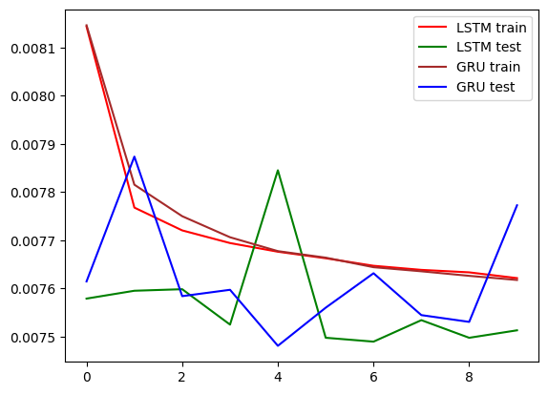
For the Regression models:
LSTM and GRU:

Slide 11
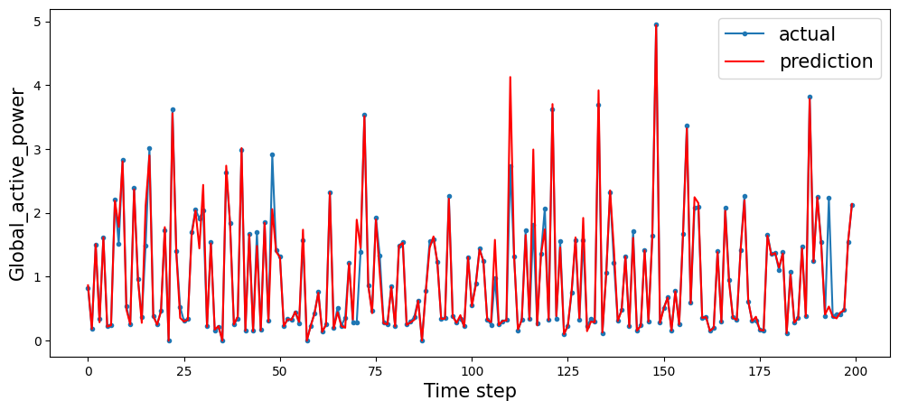
Forecast of the GRU model

Slide 12
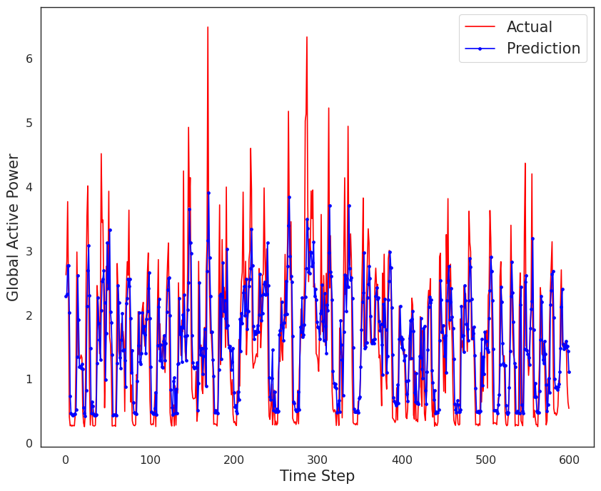
Forecast of the LSTM model

Slide 13
Conclusion
Daily consumption patterns exist at the system or substation level, but energy consumption in a single household is often unpredictable.
Based on the Practice Theory, which suggests that repetitive patterns reflect residents' lifestyles in energy consumption, the paper proposes an LSTM recurrent neural network-based framework for the challenging task of individual residential load forecasting. LSTM is chosen for this task because it can learn long-term temporal connections.
Multiple benchmarks are comprehensively tested and compared to the proposed LSTM load forecasting framework on a real-world dataset. We also tested different other models like the GRU model and the regression models. The GRU model is like the LSTM model with less complexity and only two gates are required to handle the information passing into the cell states.
We found that the GRU model is performing better than the other method after comparing the different evaluation metrices we applied and found. The inconsistency and unpredictability of the everyday usage of the electricity by individuals greatly effects the forecasting accuracy. So the higher the inconsistency the higher we need the demand of LSTM to perform the forecasting in place of the old backpropagation techniques.
For the future works we can tune the parameters more and this can further develop more accuracy in the forecasting of the values for different types of customers who have different style of livelihood and different patterns of living than the general.

