Slide 1
AI Assisted, Client-Aware, Closed Loop
RRM Plus
Arista Networks
Team 15

Slide 2
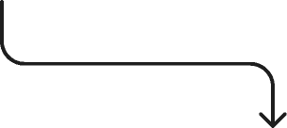
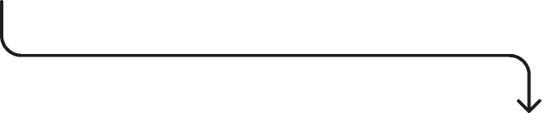
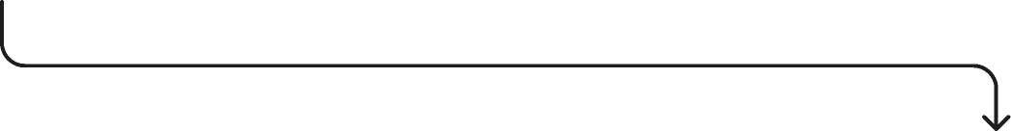
API: Sensing
RRM +
/client_view
/planner/propose
/planner/commit
/metrics
/sensing

Slide 3


API: Sensing
Channel Scan Scheduler
/sensing
Non-WiFi Classifier
Change Detection
Channel Scan Scheduler

Slide 4
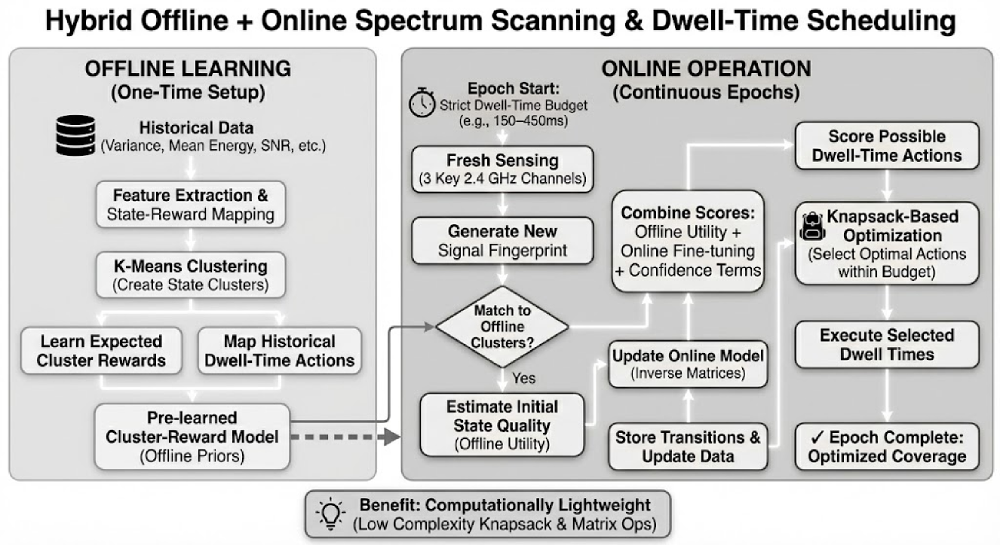

API: Sensing
Channel Scan Scheduler
Notes:
How is this method giving an edge over the other methods like UCB, ... ?

Slide 5
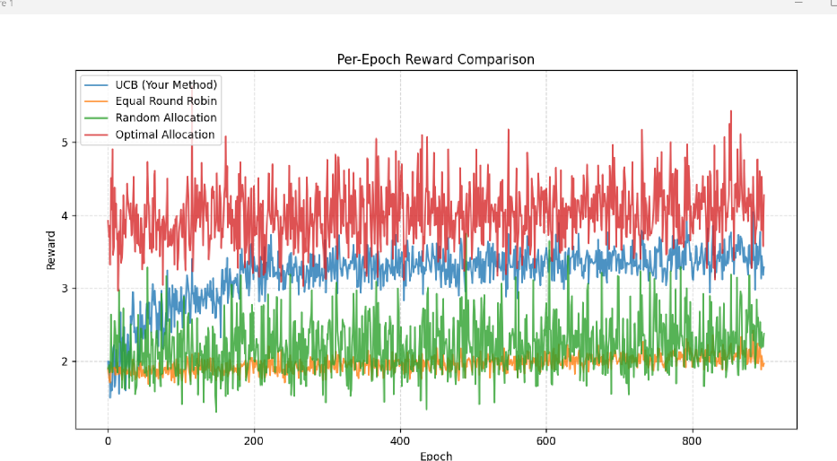
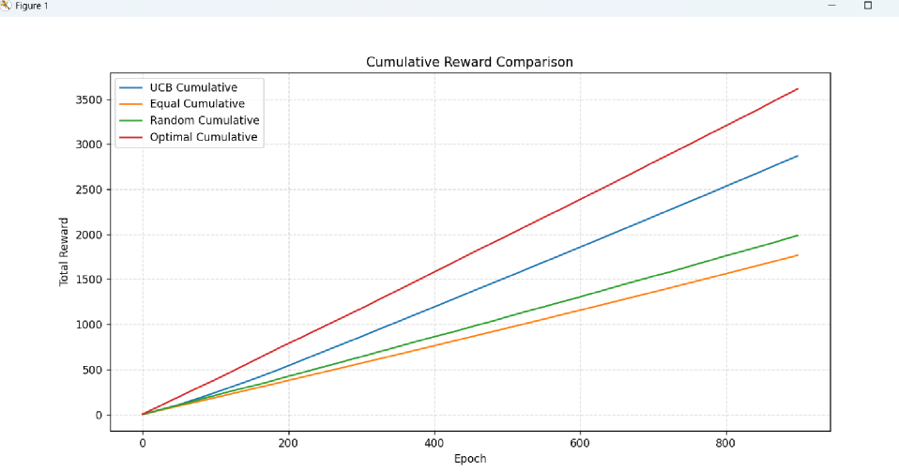
API: Sensing
Channel Scan Scheduler
Results

Slide 6

API: Sensing
Non-WiFi Classifier
/sensing
Channel Scan Scheduler
Change Detection
Non-WiFi Classifier

Slide 7
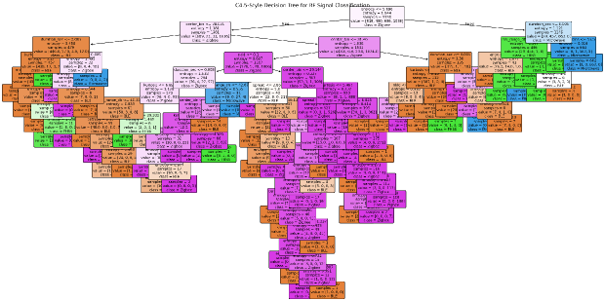
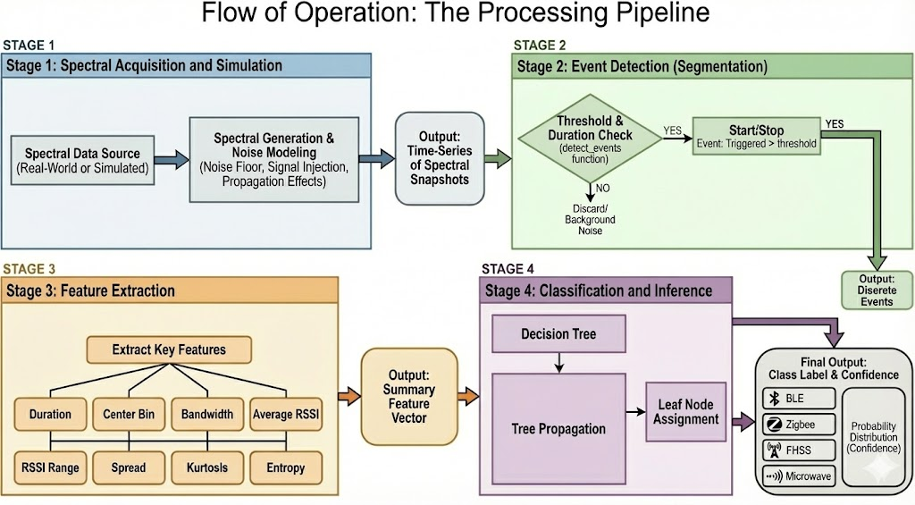
API: Sensing
●Decision Tree generated:
Non-WiFi Classifier
●Flow of operation:
A decision tree offers the following advantages, making it suitable for the requirements of the problem statement:
Speed: Inference in a decision tree is O(d), where d is the depth of the tree.
Interpretability: A Decision Tree is fully transparent.
To prevent overfitting, Cost Complexity Pruning was implemented. This technique introduces a penalty parameter (alpha) for the number of leaves.

Slide 8
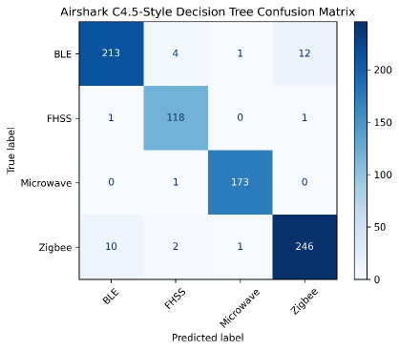
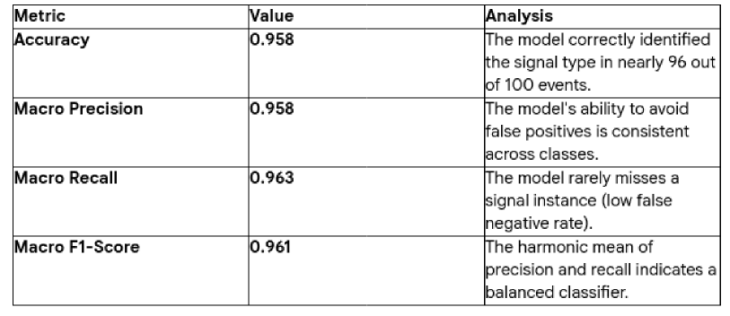
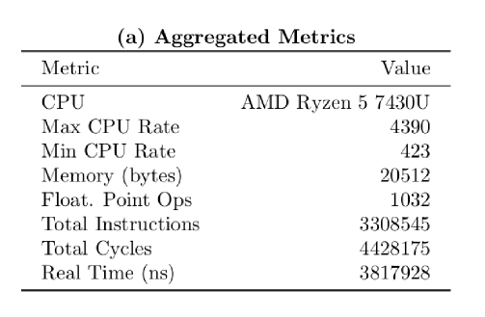
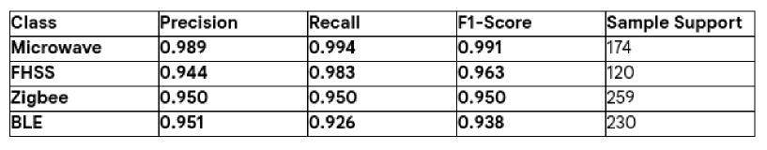
API: Sensing
Non-WiFi Classifier
● The system achieved an Overall Accuracy of 95.8% on the validation set. The overall results are displayed below:
● Memory Footprint: The trained tree structure consumes only kilobytes of RAM, making it much lighter than CNN or SVM models.
● Zero-Impact Serving: Because the processing is so fast, the additional radio can scan, process, and classify in real-time without consuming airtime that should be dedicated to clients.

Slide 9

API: Sensing
Change Detection
/sensing
Channel Scan Scheduler
Non-WiFi Classifier
Change Detection

Slide 10
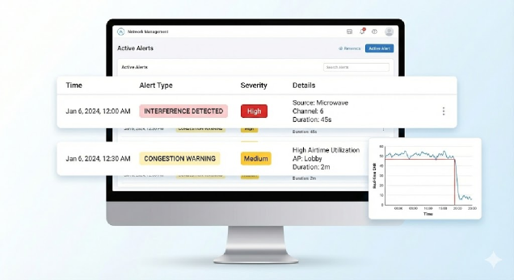
API: Sensing
Change Detection
Input Metrics:
CCA Busy% & Airtime: Measures channel utilization and contention levels.
Noise Floor: Tracks external, non-Wi-Fi interference power.
SNR: Monitors link quality and connection health.
Methodology (The Detection Algorithms)
EWMA (Recursive Smoothing): Filters high-frequency noise from the signal.
Used for: Congestion. Why: To ignore short traffic spikes and detect sustained loading.
CUSUM (Cumulative Sum): Tracks the accumulated deviation from the mean over time.
Used for: SNR. Why: Highly sensitive to sudden, persistent "step-drops" in link quality.
SPRT (Sequential Probability): Calculates the likelihood ratio between "Normal" and "Interfered" states.
Used for: Noise Floor. Why: Mathematically optimal for rapid interference confirmation.
Page-Hinkley Test: Monitors the cumulative difference to detect drift.
Used for: All Metrics. Why: To spot slow, gradual degradation over long periods.

Slide 11
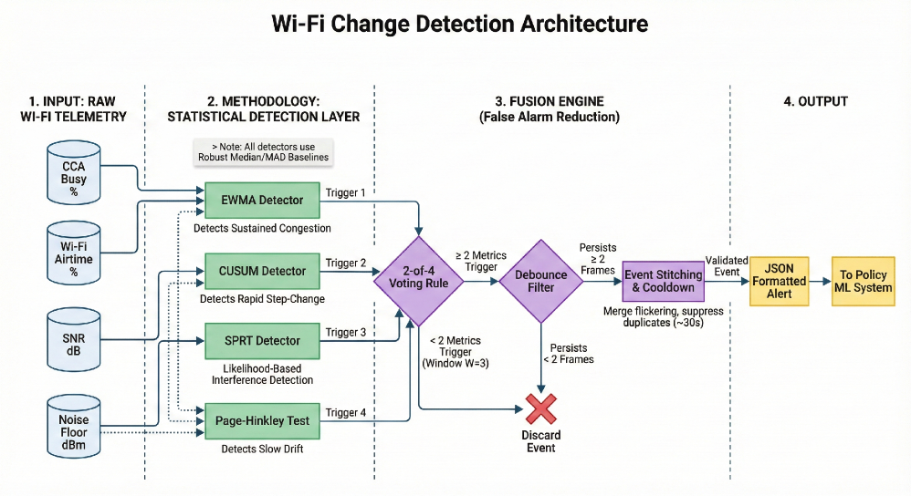
API: Sensing
Change Detection
Fusion Mechanism (False Alarm Reduction):
2-of-4 Voting: Requires at least 2 metrics to trigger within a 3-frame window to validate an event.
Debounce Filter: The alert condition must persist for 2 consecutive frames to rule out glitches.
Event Stitching: Merges rapid "flickering" detections into a single, continuous event.
Cooldown: Enforces a ~30-second suppression period after an alert to prevent system spam.

Slide 12
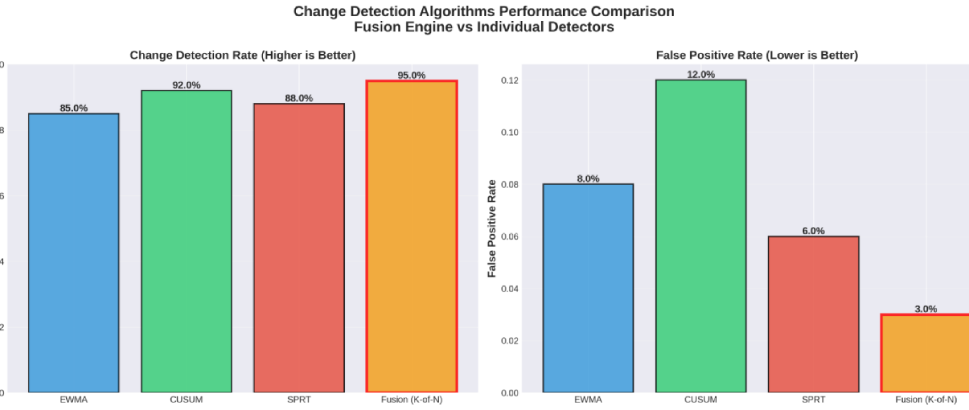

Slide 13

API: client_view
RRM +
/sensing
/planner/propose
/planner/commit
/metrics
/client_view

Slide 14

API: client_view
802.11k/v Roaming Assist
/client_view
802.11mc Interference Hotspots
Transport Layer QoE
802.11k/v Roaming Assist

Slide 15
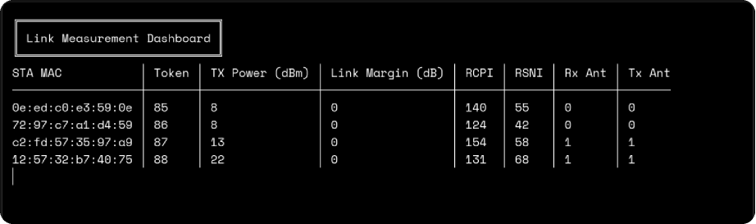
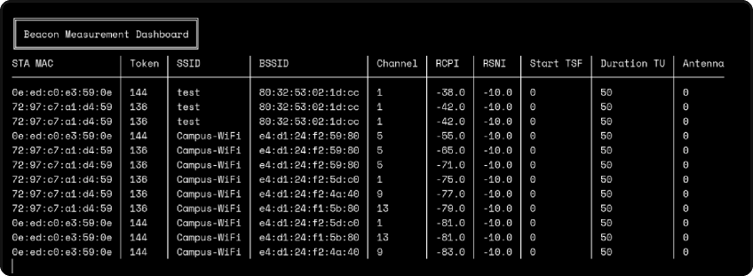
API: client_view
802.11k/v Roaming Assist
Data Acquisition and Storage
Link measurement scheduler (802.11k requests)
i) Sends standardized LM requests to stations.
ii) Collects RSSI, link margin, client TX power, and antenna configuration.
iii) Handles stale detection, asynchronous report parsing, and DB updates.
Beacon Measurement scheduler (802.11k beacon reports)
i) Issues beacon requests with operating class, channel, and duration parameters.
ii) Extracts RCPI, RSNI, channel utilization, station count, AP capabilities.
iii) Performs multi-cycle aggregation to stabilize noisy beacon data.

Slide 16
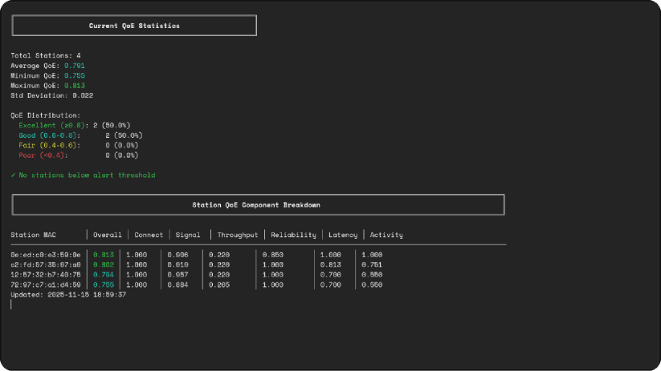
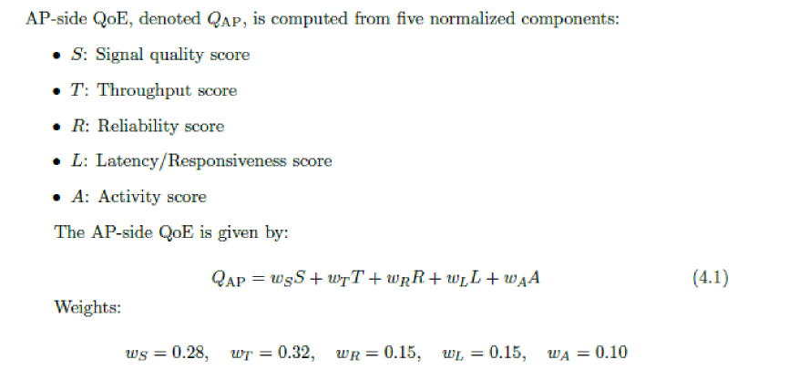
API: client_view
802.11k/v Roaming Assist
Client Quality of Experience
MAC layer QoE evaluation considers 5 factors -
i) Signal Quality (S): RSSI mapped linearly from –90→–30 dBm → [0,1].
ii) Throughput (T): geometric mean of TX/RX bitrates normalized to PHY rate.
iii) Reliability (R): composite metric from retry rate + FCS errors.
iv) Latency (L): inactivity time mapped to responsiveness scores.
v) Activity (A): frame count relative to reference load.
QoE updated every measurement cycle and stored with timestamped samples per action.

Slide 17
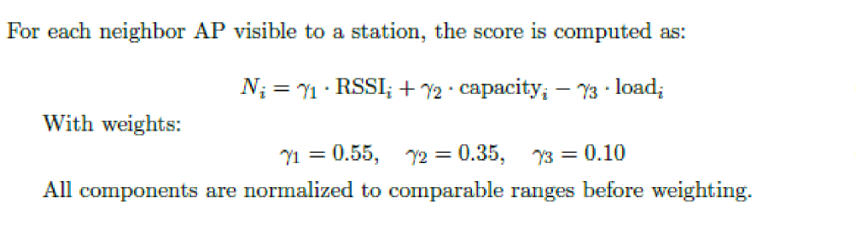
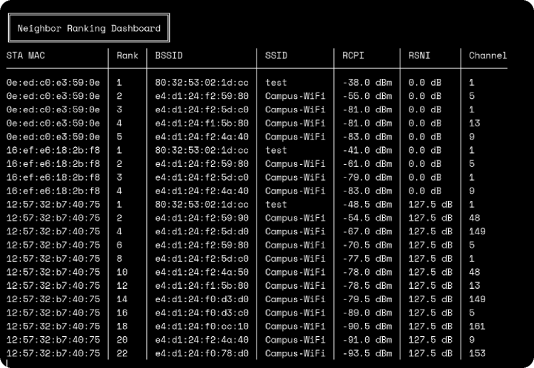
API: client_view
802.11k/v Roaming Assist
Neighbor Ranking Algorithm
Measurements are aggregated across multiple cycles per BSSID to smooth out noise, using averaged RSSI and load with the latest capability info before computing scores.
The neighbors are sorted by score and filtered with guardrails such as minimum RSSI, 5 GHz preference over 2.4 GHz when close, and same-SSID constraint, then stored as the ranked candidate list used by the steering engine.

Slide 18


API: client_view
802.11k/v Roaming Assist
/client_view
802.11k/v Roaming Assist
Transport Layer QoE
802.11mc Interference Hotspots

Slide 19
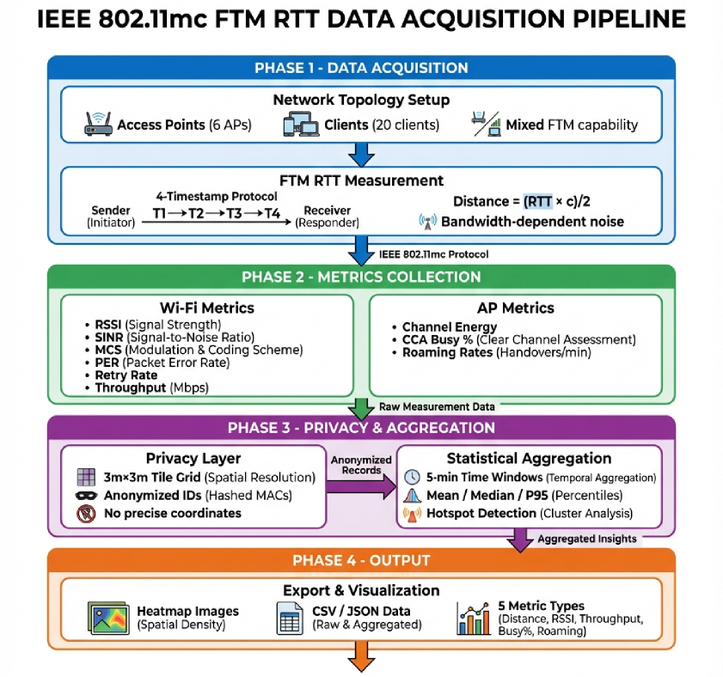
API: client_view
802.11mc Interference Hotspots
Data Acquisition
IEEE 802.11mc Wi-Fi RTT measures true time-of-flight distance to APs, independent of transmit power or antenna effects, unlike RSSI.
Each FTM report contains timestamp, logical AP ID, floor ID, distance, measurement uncertainty (stddev), quality flag, and a rotating session ID, with no MAC, BSSID, or coordinates stored to maintain privacy.

Slide 20
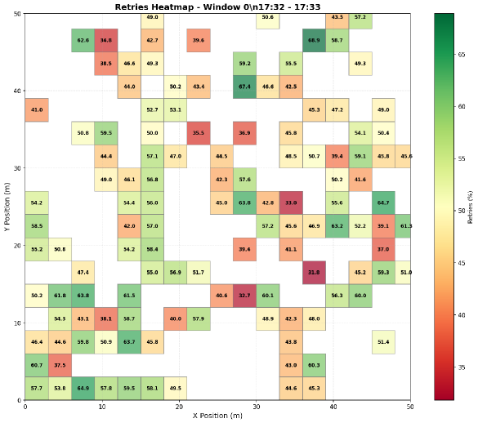
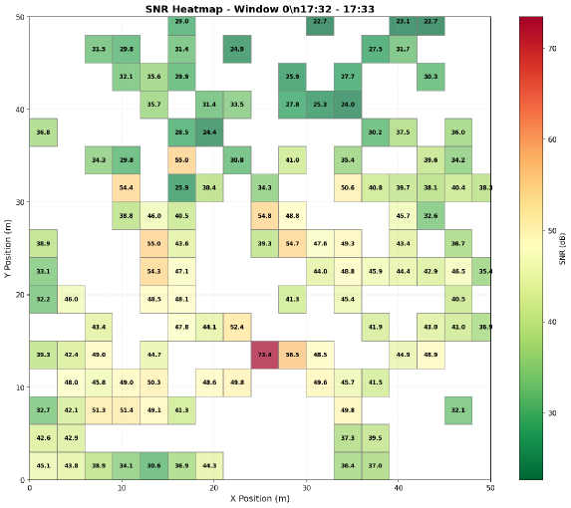
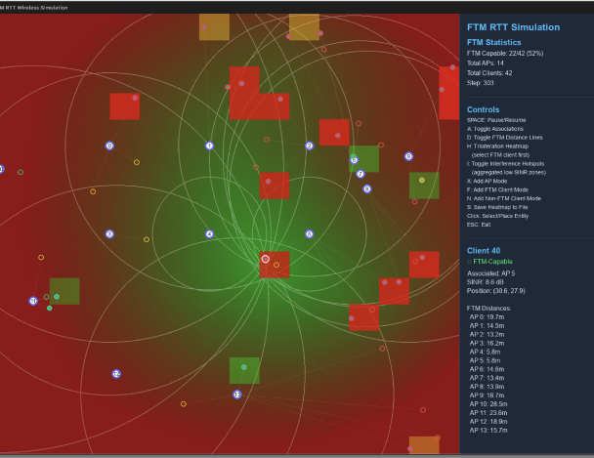
API: client_view
802.11mc Interference Hotspots
Interference Hotspots
RTT highlights interference hotspots because multipath and NLOS (Non-Line-Of-Sight) regions create large variance and higher distance uncertainty, while clean LOS areas produce tight and stable measurements.
Tile assignment is performed by comparing the measured distance with geometric AP-to-tile distances and selecting the tile where the difference falls within the uncertainty margin, and only the tile ID is stored.
Privacy is preserved through tile-level storage, five-minute aggregation windows, and hourly session-ID rotation, preventing position reconstruction while still supporting reliable RF and interference analytics.

Slide 21

API: client_view
Transport Layer QoE
/client_view
802.11k/v Roaming Assist
802.11mc Interference Hotspots
Transport Layer QoE

Slide 22
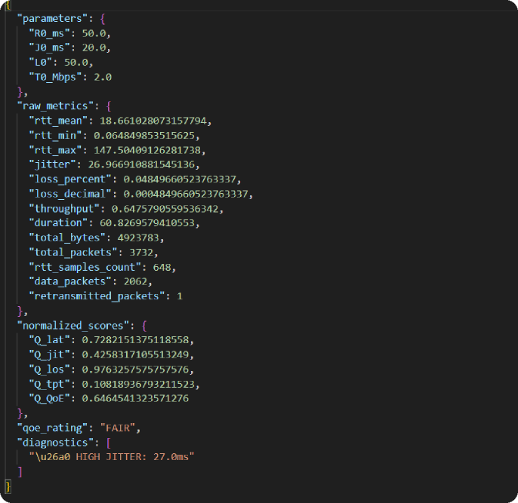
API: client_view
Transport Layer QoE
Data Acquisition
A lightweight TCP-level performance extractor monitors live traffic using tcpdump-based packet capture to observe real transport behaviour without modifying client devices.
Parsed packet streams provide RTT, jitter, packet loss, achieved throughput, and congestion characteristics.
Each measurement is timestamped and stored per station, allowing correlation with RF metrics, QoE history, and steering actions across the pipeline.

Slide 23
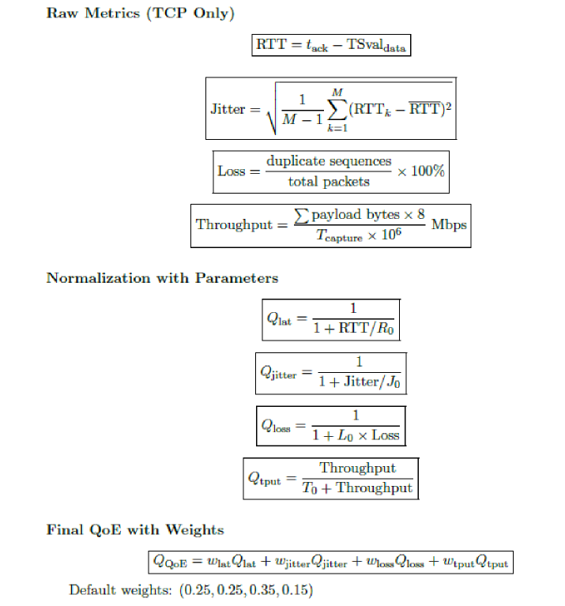
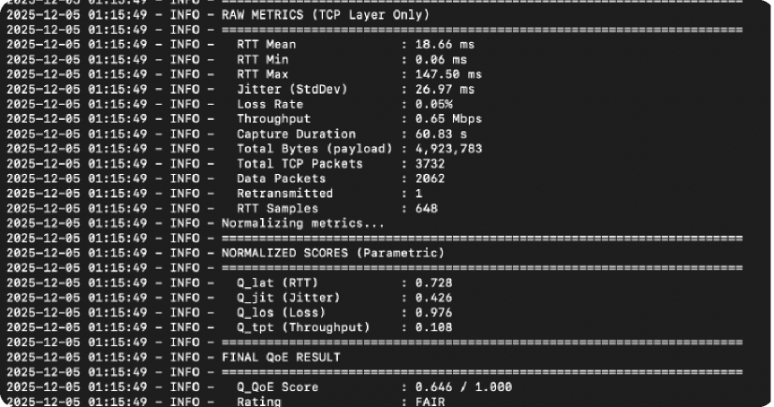
API: client_view
Transport Layer QoE
QoE Parameters
Transport QoE converts TCP latency, jitter, loss, and throughput into normalized 0–1 sub-scores representing true application performance.
Latency and jitter scores decrease smoothly with increasing delay, capturing congestion or path instability.
Packet loss contributes a strong penalty reflecting retransmissions and degraded flow quality.
Achieved throughput is normalized against an expected reference rate so improvements saturate and drops are reflected clearly.

Slide 24
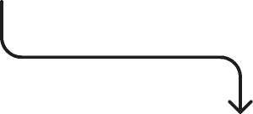
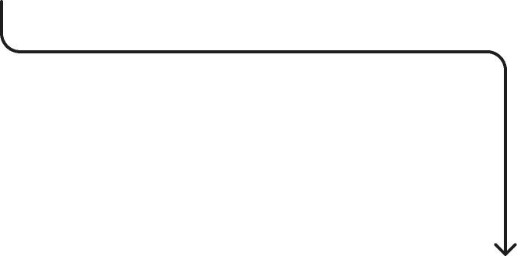
API: Planner-Propose
RRM +
/sensing
/client_view
/planner/commit
/metrics
/planner/propose

Slide 25



API: Planner-Propose
Policy Engine
/planner/propose
BO
Safe RL
Uplift Modelling
Policy Engine

Slide 26
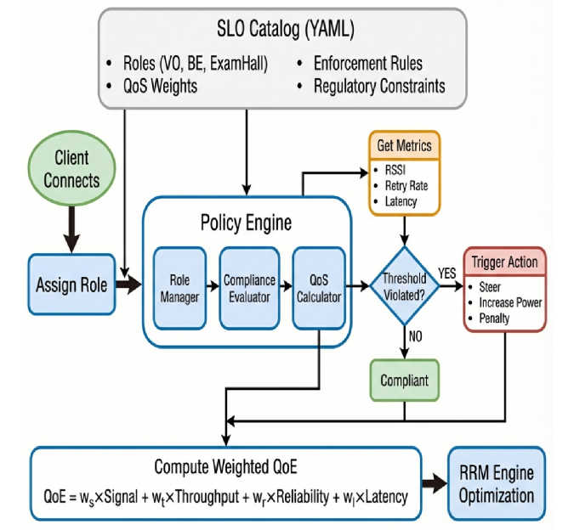
API: Planner-Propose
Policy Engine
Approach
We built the SLO Catalog around how real Wi-Fi behaves in dense, high-variance environments.
To make the system stable and predictable we made the following design choices:
Captured tail behavior using P95 for RSSI, SNR, PER, and Retry. Networks fail at the tail, not the average; a few bad clients can destabilize an entire BSS.
Used P50 for congestion metrics like Airtime and CCA. These fluctuate rapidly. P95 would trigger unnecessary changes and cause oscillations.
flowchart will come here
the overall policy engine flowchart
Normalized QoE components within true PHY boundaries according to the actual 802.11 operational limits and ensure meaningful scoring.
Introduced a penalty model to keep Safe-BO gradients stable and actions predictable.
Notes:
what is tail behaviour?
it means p95
Even if a network looks good “on average,” the 5% worst clients can completely determine the user experience

Slide 27

API: Planner-Propose
Bayesian Optimizer
/planner/propose
Policy Engine
Safe RL
Uplift Modelling
BO

Slide 28
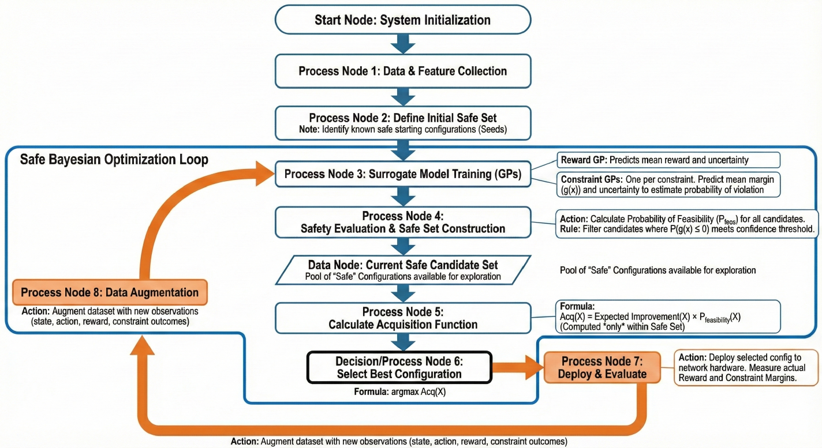
API: Planner-Propose
Bayesian Optimizer

Slide 29
API: Planner-Propose
Bayesian Optimizer
Approach
The Bayesian Optimizer uses Gaussian Process (GP) surrogates, and initial set of safe states and rewards based on QoS/SLO percentiles
We start off with a set of “safe” states that are configurations that do not violate the given constraints.
For reward and each constraint margin, we fit independent GPs by maximizing GP log marginal likelihood.
These GPs give a posterior distribution over each constraints for a new configuration that we use to compute the probability that the constraint will be violated.
Using this, for a given confidence level, we generate a safe set of candidate configurations and choose the one with the maximum Expected Improvement.
The Expected Improvement uses an exploration shift, given by the exploration parameter.
A higher exploration parameter raises the Expected Reward threshold which would mean that we give more importance to states that have a higher expected reward or higher uncertainty, and a lower exploration parameter would mean that we are exploiting known safe states because even a marginal improvement would be within the threshold.

Slide 30


API: Planner-Propose
Safe RL
/planner/propose
Policy Engine
BO
Uplift Modelling
Safe RL

Slide 31
API: Planner-Propose
Safe RL
We use 15 standardized metrics to capture the complete network state:
client_count
median_rssi
p95_retry_rate
p95_per
channel_utilization
avg_throughput
edge_p10_throughput
roaming_rate
The agent selects from a strictly defined set of 9 actions applied in real-time:
Tx Power (±2 dBm)
Increase/Decrease Channel Number (DFS-compliant channel switch).
Increase/Decrease Channel Width(Bandwidth switching) (20↔40↔80 MHz),
neighbor_ap_rssi
obss_pd_threshold
tx_power
noise_floor
channel_width
airtime_usage
cca_busy.
OBSS-PD (±4 dBm).
Stability: No-op (Do nothing).

Slide 32
API: Planner-Propose
Safe RL
Our objective isn't just speed it's reliable speed so the reward function is bounded and weighted sum of:
Performance Drivers (+):
  Edge Throughput (+35%)
  Mean Throughput (+15%) & RSSI Quality (+10%).
  Stability (+15%)
Stability Penalties (-):
  Retry Rate (-25%) & Packet Error Rate (-15%).
  Configuration Churn (-10%)
The Three-Tier Safety ensures that SafeRL never hallucinates a dangerous config, we use a 3-tier hierarchy:
Tier 1 (Hard Boundaries): Absolute regulatory limits. Violation = Immediate Prohibition.
Tier 2 (The Shield): A protective envelope
Tier 3 (Behavioral): Soft constraints that guide the agent via reward penalties rather than hard blocks.
Notes:
what is the shield for?

Slide 33
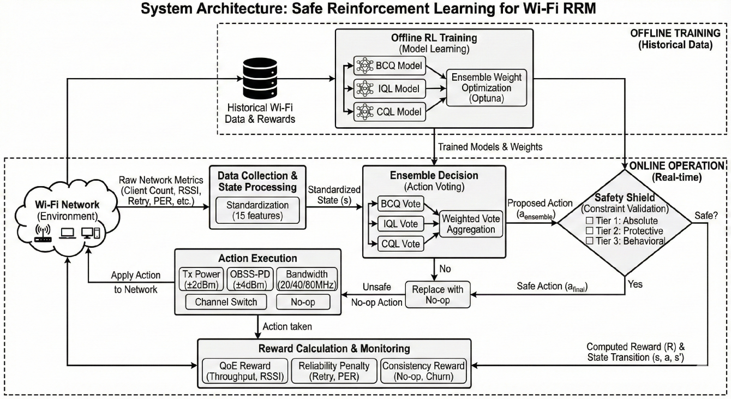
API: Planner-Propose
Safe RL

Slide 34
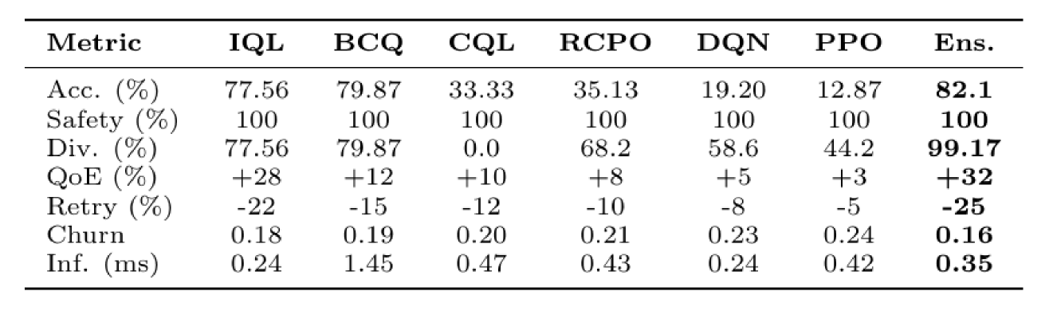
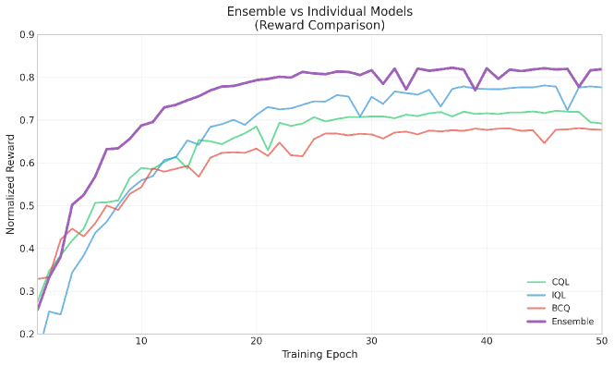
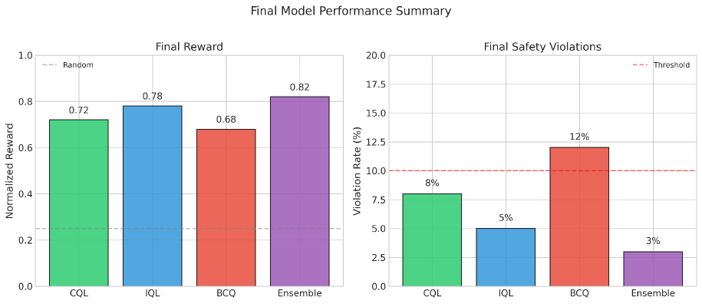
API: Planner-Propose
Safe RL
Model Comparision

Slide 35


API: Planner-Propose
Uplift Modelling
/planner/propose
Policy Engine
BO
Safe RL
Uplift Modelling

Slide 36
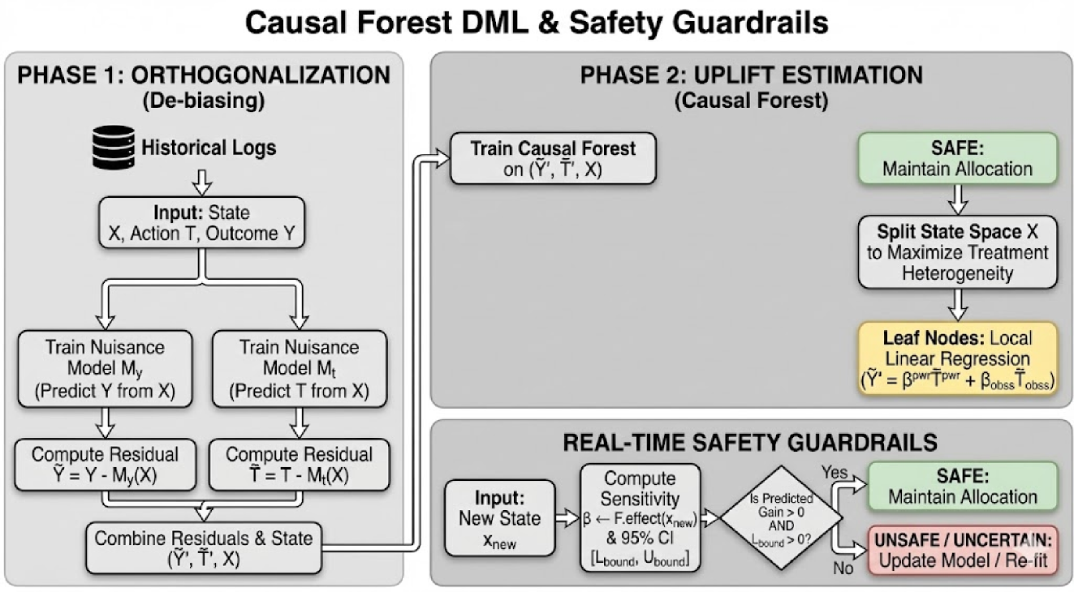
API: Planner-Propose
Uplift Modelling

Slide 37
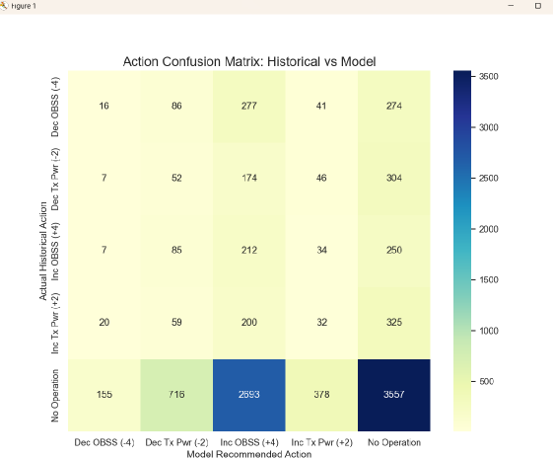
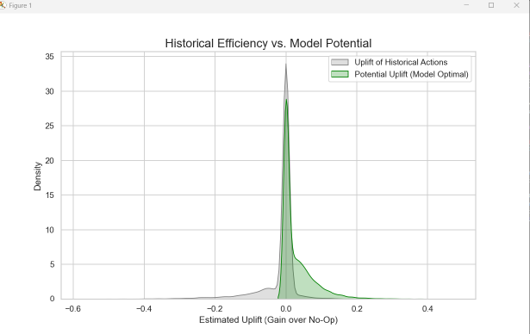
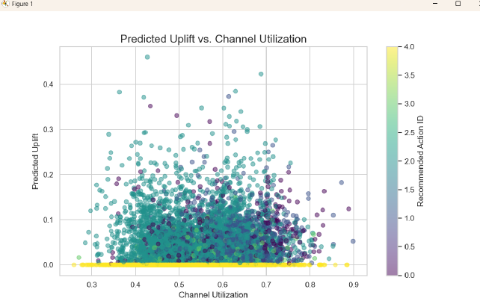
API: Sensing
Channel Scan Scheduler
Results
Notes:
Mention testing on small scale

Slide 38

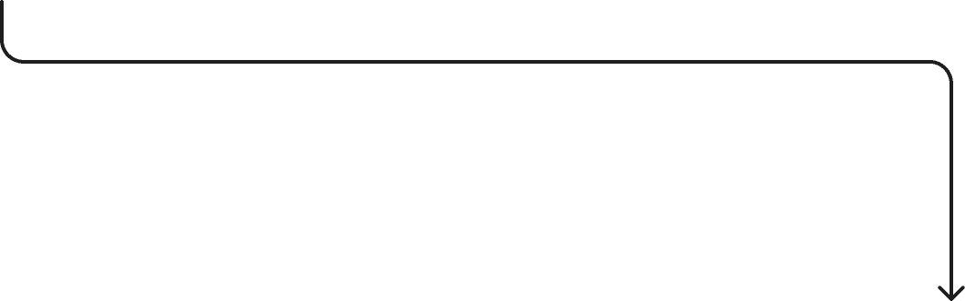
API: Planner-Commit
RRM +
/sensing
/client_view
/planner/propose
/metrics
/planner/commit

Slide 39


API: Planner-Commit
Guardrails
/planner/commit
Audit Trails
Rollback
Guardrails

Slide 40


API: Planner-Commit
Guardrails
Every recommended action passes through regulatory, role-based, system-level, and privacy/compliance checks before it can be applied. This includes:
Regulatory limits: EIRP caps, DFS requirements, AFC checks for 6 GHz, country-code enforcement, and channel availability rules.
Role constraints: allowable channel widths per role (e.g., the role ExamHallStrict locked to 20 MHz), power caps, and per-metric severity expectations from the SLO catalog.
System constraints: severity tiers (info → warning → critical), churn limits (<0.2 config changes/AP/day), safe-state prechecks, and rollback triggers.
Privacy & compliance constraints: ensuring opt-outs are honored, identifiers stay pseudonymized, and no action relies on restricted data.
Guardrails prevent the system from applying unsafe or non-compliant changes, even if optimizers try to. Only safe, justified, and audit-ready actions are allowed through.

Slide 41


API: Planner-Commit
Audit Trails
/planner/commit
Guardrails
Rollback
Audit Trails

Slide 42
API: Planner-Commit
Audit Trails
The audit trail serves as a complete, reconstructable explanation of every recommendation the system makes.
Example audit record
Every evaluation produces an append-only, cryptographically signed audit record that includes the full decision context:
pseudonymized identifiers (never raw MACs),
the percentiles and telemetry snapshot used in the evaluation,
QoE components, penalties, margins, and severity classification,
guardrail pass/fail results,
the recommended action or no-action decision,
the Safe-BO reward, and
a rollback token that links to the previous config state.
{
"id": "eval_87341",
"percentiles": { ... },
"qoe": 0.82,
"penalties": { "retry": 0.14 },
"action": "SteerClient",
"rollback_token": "prev_87230",
"signature": "HMAC(...)"
}
It also ensures the system is tamper-evident, privacy-preserving, and fully compliant with operational and regulatory requirements.

Slide 43


API: Planner-Commit
Rollback
/planner/commit
Guardrails
Audit Trails
Rollback

Slide 44

API: Planner-Commit
Rollback Mechanism
Every configuration change generated by the Policy Engine is paired with a rollback token that captures the previous state, its QoE evaluation, penalties, margins, and guardrail results at the moment it was applied.
If the new configuration reduces QoE, increases violation severity, or fails any guardrail, the rollback token is activated. The system immediately restores the last known “good” configuration, ensuring stability and continuity.
Evaluate live state QoE change Penalties trend Constraint margins Guardrail checks BO reward direction
Stable state n
Apply action (new configuration)
Healthy
Stable state n+1
Degraded or unsafe
Apply Rollback

Slide 45


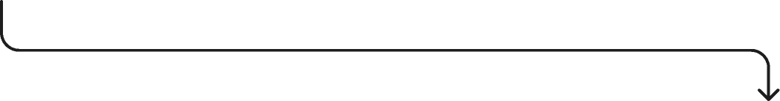
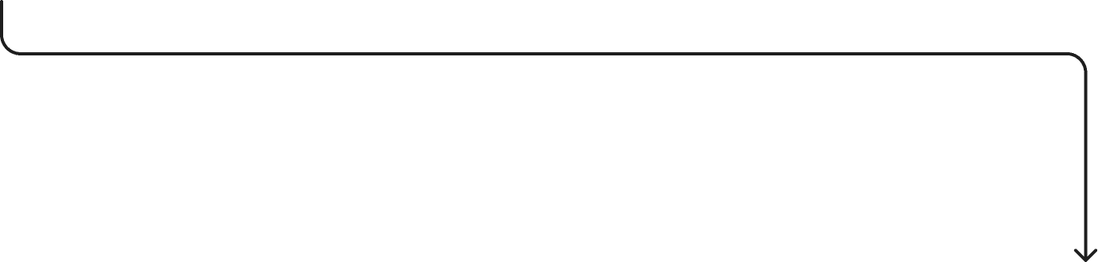
API: Metrics
RRM+
/sensing
/client_view
/planner/propose
/planner/commit
/metrics

Slide 46

API: Metrics
Storage and Privacy
/metrics
Data-Retention Policy
Storage & Privacy

Slide 47
API: Metrics
Storage and Privacy
How the system handles identifiers
How data is secured
All device identifiers are pseudonymized before storage, MACs are normalized and transformed using HMAC-SHA256 with a site-specific secret key.
Opt-out devices are filtered at ingestion: their telemetry is excluded from per-device logs and percentiles, and only aggregate counters may include them.
All stored data like telemetry, audit records, percentile aggregates, and BO outputs is protected with encryption at rest (AES-256) and TLS 1.2+ in transit.
Access is controlled through strict RBAC, ensuring only the minimal set of internal components can read telemetry or audit logs.
Evaluator and policy-engine actions always operate on pseudonyms, never PII.

Slide 48

API: Metrics
Data-Retention Policy
/metrics
Storage & Privacy
Data-Retention Policy

Slide 49
API: Metrics
Data-Retention Policy
Retention policy
Purge policy
Each data category has a strictly defined retention period aligned to its operational purpose.
Raw telemetry is kept only for the short window required to compute percentiles and QoE.
Aggregated percentiles are retained longer to enable trend analysis and maintain Safe-BO model stability.
Audit logs are stored for extended periods to preserve a complete accountability record of all automated decisions.
Pseudonymization keys are rotated on a fixed schedule, and retired keys are securely invalidated.
Automated purge processes remove data as soon as its retention window expires, on a daily or monthly schedule depending on the category.
All purge actions are themselves recorded and signed to maintain full transparency.
Devices that have opted out are excluded from per-device storage entirely and never retained beyond coarse aggregate statistics.

Slide 50
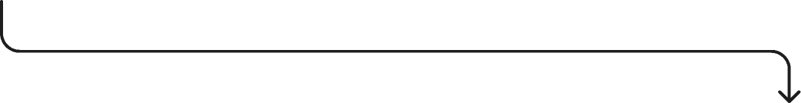
RRM+ Architecture
RRM +
/sensing
/client_view
/planner/propose
/planner/commit
/metrics

Slide 51


RRM+ Architecture
RRM +
On-AP Controller
Cloud Controller
Site-Planner

Slide 52
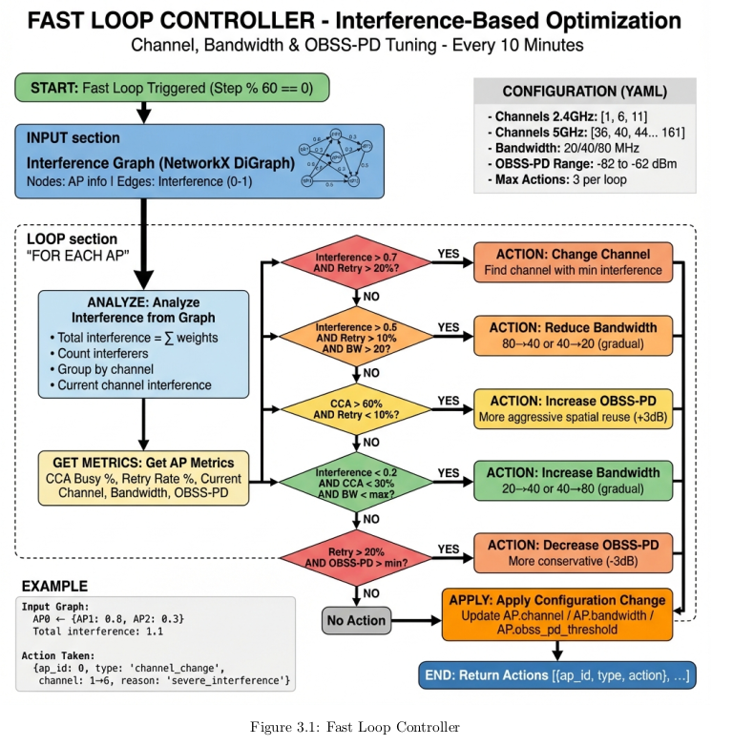
RRM+ Architecture
On-AP Controller (Fast-Loop Controller)
● Purpose:
What the Fast Loop Is:
  A scheduled (every 10 minutes) interference-aware optimizer for Wi-Fi AP configuration.
  Operates between the Event Loop (seconds) and Slow Loop (days).
  Designed for incremental, safe, client-aware improvements, not disruptive changes.
● Design Principles:
  Do no harm: strict cooldowns, change budgets, hysteresis thresholds.
  Small, reversible steps for stability (bandwidth ±1 step, OBSS-PD ±3 dB, channel change only when significant).
● Fast Loop Approach:
A. Interference Graph–Driven Optimization:
  Builds a Directed Interference Graph every cycle using:
  Additional-radio RSSI, FFT, non-Wi-Fi signatures.
  Client telemetry (802.11k/v) to capture hidden links and actual client SINR impact.
  Each AP's interference score = weighted sum of all interfering neighbors.
B. MAPE Cycle (Monitor → Analyze → Plan → Execute)
Every 10-minute cycle:
  Monitor: ingest latest sensing, retry rates, CCA busy %, channel info.
  Analyze: compute total interference, per-channel interference, call decision rules.
  Plan: choose safest corrective action via priority logic.
  Execute: apply via ConfigEngine, log HMAC audit + rollback token.

Slide 53
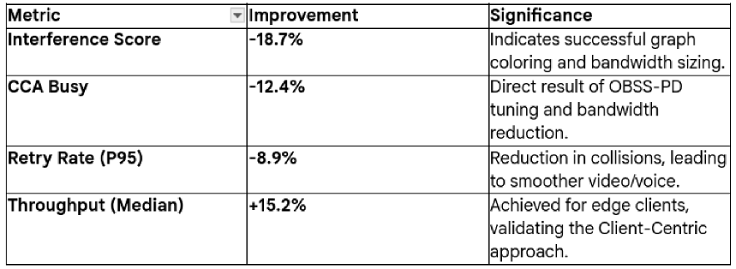
RRM+ Architecture
On-AP Controller (Fast-Loop Controller)
● The system demonstrated measurable improvements across all target metrics:
● Compliance with Configuration Guardrails:
Regulatory: Defaults to safe non_dfs channels and strictly caps 2.4 GHz bandwidth at 20 MHz.
Standards: Restricts spatial reuse (OBSS-PD) thresholds to the valid IEEE 802.11ax range of -82 dBm to -62 dBm.
Stability: Prevents thrashing by enforcing a 10-minute cooldown per AP.
SLA: Triggers Auto-Rollback if retry rates increase by >10% or throughput decreases by >20%.
● Activity Profile: Over 4,320 cycles, the system executed 5,904 changes. The breakdown of actions validates the multi-priority logic:
  58% Bandwidth Adjustments: Proving that bandwidth is the most flexible lever.
  26% OBSS-PD Tuning: Proving the value of spatial reuse.
  15% Channel Changes: Proving that disruptive changes are minimized.
● Success Rate: 94.3% of actions resulted in positive metric improvement, validating the predictive accuracy of the interference graph.

Slide 54

RRM+ Architecture
RRM +
On-AP Controller
Cloud Controller
Site-Planner

Slide 55
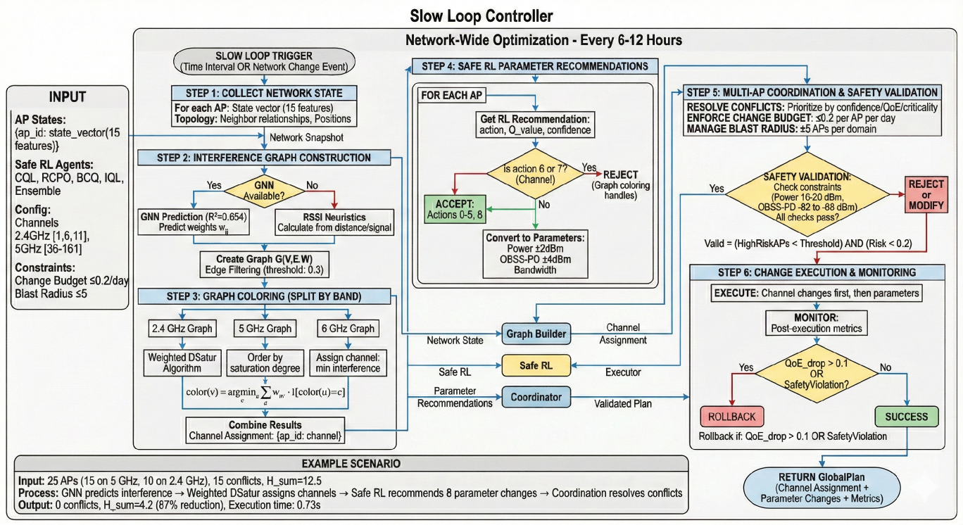
RRM+ Architecture
Cloud Controller (Slow Loop Part)

Slide 56


RRM+ Architecture
RRM +
On-AP Controller
Cloud Controller
Site-Planner

Slide 57
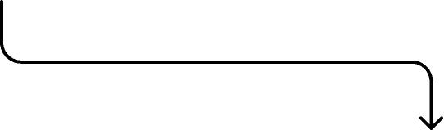
RRM+ Architecture
Site-Planner
Site-Planner
Planner and BSS Coloring
Interference Graph (GNN)

Slide 58
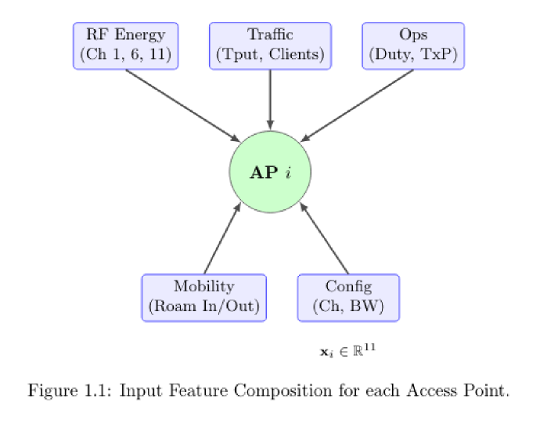
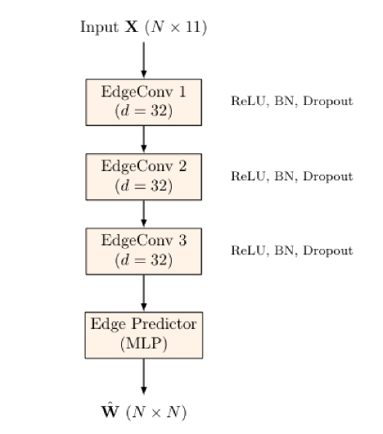
RRM+ Architecture
Site-Planner
Interference Graph (GNN)
Architecture
Input Features

Slide 59



RRM+ Architecture
Site-Planner
Interference Graph (GNN)
Training and Results

Slide 60

RRM+ Architecture
Site-Planner
Site-Planner
Interference Graph (GNN)
Planner and BSS Coloring

Slide 61

RRM+ Architecture
Site-Planner
Planner and BSS Coloring

Slide 62

RRM+ Architecture
Site-Planner
Planner and BSS Coloring

Slide 63

RRM+ Architecture
Site-Planner
Planner and BSS Coloring

Slide 64

Pilot Site Report
(Simulation Environment)

Slide 65






Pilot Site Report
(from 3 days simulation logs)
Site A: Dense Office
with-rrm
without-rrm
Throughput Distribution
Events Injection

Slide 66


Pilot Site Report
(from 3 days simulation logs)
Statistics Comparision
With RRM+
Without RRM+
Improvement rates:
  P95 retry rate: 18.2%
  Avg. throughput: 10.04%
  P95 QoE: 7.9%

Slide 67






Pilot Site Report
(from 3 days simulation logs)
Site B: Education
with-rrm
without-rrm
Throughput Distribution
Events Injection

Slide 68


Pilot Site Report
(from 3 days simulation logs)
Statistics Comparision
With RRM+
Without RRM+
Improvement rates:
  P95 retry rate: 18.3%
  Avg. throughput: 17.22%
  P95 QoE: 10.9%

Slide 69
Limitations
The Slow Loop’s graph coloring algorithm and global planner remain theoretical proposals without full simulation validation.
Safe RL and causal uplift models were trained exclusively on synthetic data generated from physics-based models rather than production network traces, as real-world datasets were unavailable.
Similarly, the non-Wi-Fi interference classifier relies on code-generated training data adhering to IEEE 802.15 specifications for Zigbee, BLE, and FHSS signatures.
The extent of simulation is limited and the simulation doesn’t fully implement the multi AP coordination and graph planner.

Slide 70
Thanks

