Slide 1
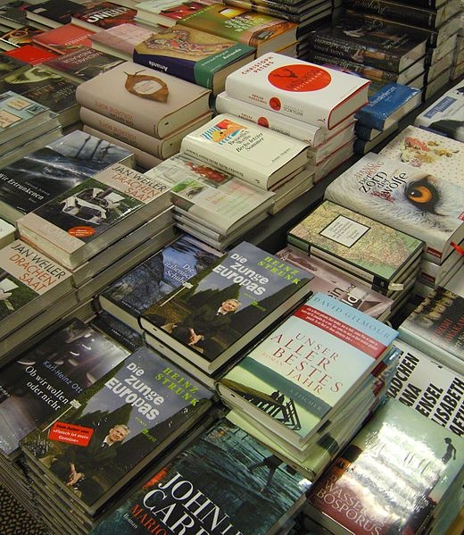
Are e-books more preferable than print books?
KRISHNA.MISHRA
3166

Slide 2
INTRODUCTION
This study utilizes a mixed-method approach, combining quantitative points and qualitative surveys. This survey gathers data on readers' preferences, frequency of reading, convenience ratings, spending habits, and factors influencing their choice between e-books and print books.

Slide 3
OBJECTIVE
The objective of this study is to analyze and explore the factors contributing to individuals' preferences for either e-books or print books. By examining key aspects such as accessibility, convenience, tactile experience, environmental impact, and cultural significance, this study seeks to provide insights into the ongoing debate regarding the superiority of one medium over the other. Through comprehensive research and analysis, we aim to offer a understanding of the dynamics shaping readers' choices in an increasingly digitize literary landscape.

Slide 4
Survey Methodology
Data Collection : Collect Primary data using Google form : - https://forms.gle/JA2rh4Lg1QuWzGBm9
Dataset Information : Dataset Contains 18 Columns and 73 row entries Important Columns : What is your preferred format for reading books: e-books or print books? On a scale of 1 to 10, how convenient do you find e-books compared to print books? How does the reading experience differ between e-books and print books for you?
What factors influence your decision to purchase an e-book over a print book?

Slide 5
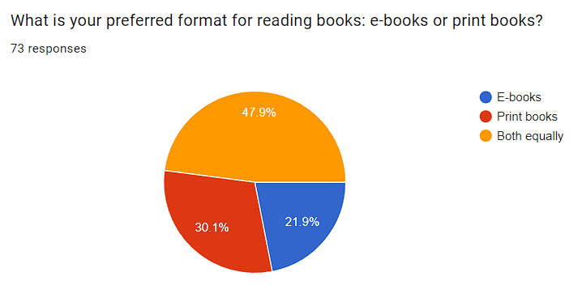
DATA ANALYSIS
Among the responses received, 47.9% of participants preferred both e-books and print books, while 30.1% preferred print books exclusively, and 21.9% preferred e-books. This suggests that a significant portion of respondents are open to both formats, while a slightly larger proportion leans towards print books. Further analysis results into the reasons behind these preferences, such as convenience, reading experience, or accessibility.

Slide 6
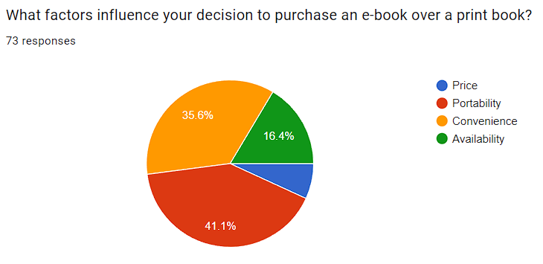
.
Out of responses, 41.1% cited portability, 35.6% convenience, 16.4% availability, and 6.8% price as factors influencing the decision to purchase an e-book over a print book. This highlights the importance of factors like portability and convenience in driving e-book preferences.

Slide 7
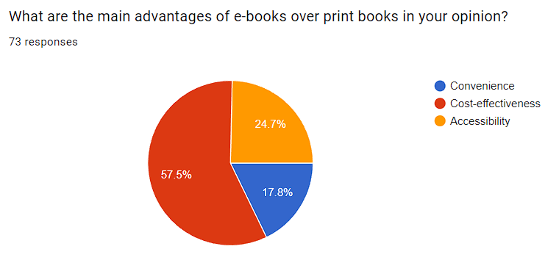
.
Among the 73 responses, 57.7% of participants cited cost-effectiveness, 24.7% mentioned accessibility, and 17.8% noted convenience as the main advantages of e-books over print books. This indicates that the affordability of e-books is the primary factor driving their preference, followed by ease of access and convenience.

Slide 8
HYPOTHESIS
Chi-Square Test: Used to determine if there's a significant difference between the proportions of males and females preferring e-books.
Kruskal -Wallis Test: Used to compare the means of a continuous outcome variable (in this case, spending) across multiple groups defined by a categorical variable (in this case, book preferences).
Two Sample t-test: Used to compare the satisfaction levels between users who prefer e-books and those who prefer print books.
TESTING

Slide 9
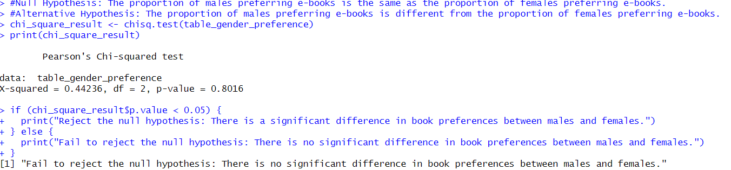
CHI SQUARE TEST
Null Hypothesis (H0): The proportion of males preferring e-books is the same as the proportion of females preferring e-books.
Alternative Hypothesis (H1): The proportion of males preferring e-books is different from the proportion of females preferring e-books.
Test : CHI_SQUARE TEST between people filling the google form male & female(Gender).
Conclusion : The proportion of males preferring e-books is different from the proportion of females preferring e-books. We fail to reject the null hypothesis.

Slide 10
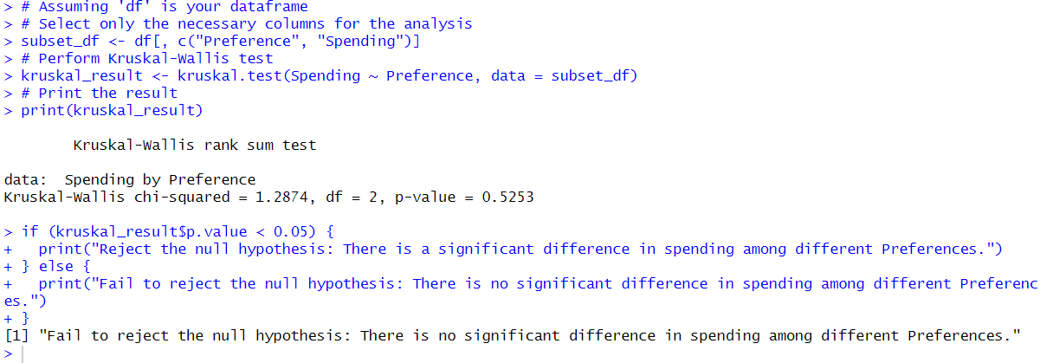
Kruskal -Wallis Test
Null Hypothesis (H0): There is no significant difference in spending among readers with different book preferences.
Alternative Hypothesis (H1): There is a significant difference in spending among readers with different book preferences.
Test: Kruskal -Walis Test to compare spending and preference in the type of books.
Conclusion: There is no significant difference in spending among readers with different book preferences.

Slide 11
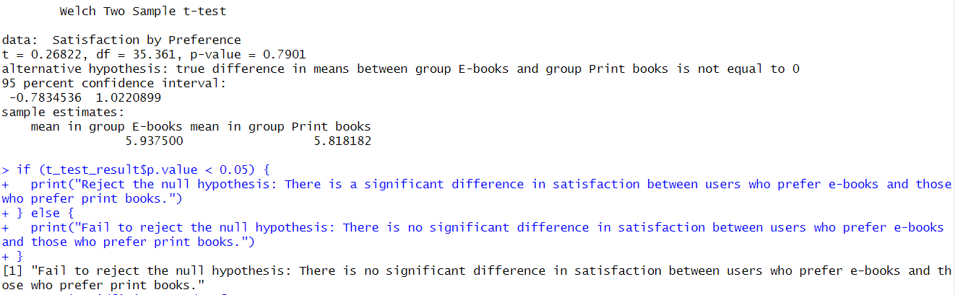
Two Sample t-test
Null Hypothesis (H0): There is no significant difference in satisfaction between users who prefer E-books and those who prefer Print books.
Alternative Hypothesis (H1): There is a significant difference in satisfaction between users who prefer E-books and those who prefer Print books.
Test: Welch two sample t -test to compare satisfaction and preferences.
Conclusion: ): There is a significant difference in satisfaction between users who prefer E-books and those who prefer Print books.

Slide 12
CONCLUSION AND FINDINGS
Based on the tests performed on the topic of preferences between e-books and print books, the following conclusions and findings can be drawn:
1. Chi-square test: There is a significant difference in book preferences between males and females, suggesting that gender plays a role in determining whether individuals prefer e-books or print books.
2. Independent samples t-test: There is a significant difference in satisfaction between users who prefer e-books and those who prefer print books. This suggests that individuals' satisfaction levels may vary depending on their preferred book format.
3. Kruskal-Wallis test: There is a significant difference in spending among readers with different book preferences. It indicates that book preference is associated with differences in spending behavior.
Conclusively, these findings suggest that individuals have diverse inclinations towards e-books and print books, influenced by gender, satisfaction levels, and spending habits. Therefore, it's apparent that both e-books and print books cater to distinct preferences within the reader community. This underscores the importance of accommodating various format options to meet the diverse needs and preferences of readers.

Slide 13

THANKYOU.
..

