Slide 1

Vehicle Number Plate Detection
Name : KRISHNAA S
CT/DT Number : DT20184774185
College Name : Nandha Engineering College, Erode.
Youtube Link : https://youtu.be/jT0Lv_FeoyA

Slide 2
PROBLEM STATEMENT
Identify the license plate in the image and do an OCR to extract the characters from the detected license plate.
Category: Object detection & OCR.

Slide 3
UNDERSTANDING
Vehicle number plate detection is an image processing technology which uses number plate to identify the vehicle.
The developed system first detects the number plate of the vehicle and recognizes the text characters with the help of OCR.

Slide 4
REQUIREMENTS
PLATFORM : Windows, macOS and Linux.
IDE : PyCharm.
LANGUAGE: Python.
LIBRARIES : json, urllib, cv2, Numpy, pandas, pytesseract.

Slide 5
PyCharm
PyCharm is an integrated development environment (IDE) used in computer programming.
It provides code analysis, a graphical debugger, an integrated unit tester, integration with version control systems.

Slide 6
Python
Python is an interpreted, high-level, general-purpose programming language.
The biggest strength of the Python is large library which can be used for the following
Machine Learning
GUI Applications
Multimedia
Image processing
Web scraping
Text processing and many more.

Slide 7
LIBRARIES USED…
Json : JSON (JavaScript Object Notation) is a popular data format used for representing structured data. It's common to transmit and receive data between a server and web application in JSON format.
Urllib : urllib is a Python module for fetching URLs (Uniform Resource Locators). It offers a very simple interface, in the form of the url open function.

Slide 8
LIBRARIES USED…
OpenCV : OpenCV-Python is a library of Python bindings designed to solve computer vision problems.
Pytesseract : Python-tesseract is an optical character recognition (OCR) tool for python. That is, it will recognize and “read” the text embedded in images.

Slide 9
LIBRARIES USED…
NumPy : NumPy is a general-purpose array-processing package. It provides a high-performance multidimensional array object, and tools for working with these arrays.
Pandas : Pandas is a software library written for the Python programming language for data manipulation and analysis.

Slide 10
MODULES
Importing and Reading the given dataset.
Object Detection (OpenCV).
Object Character Recognition (PyTesseract).
Data retrieving.

Slide 11
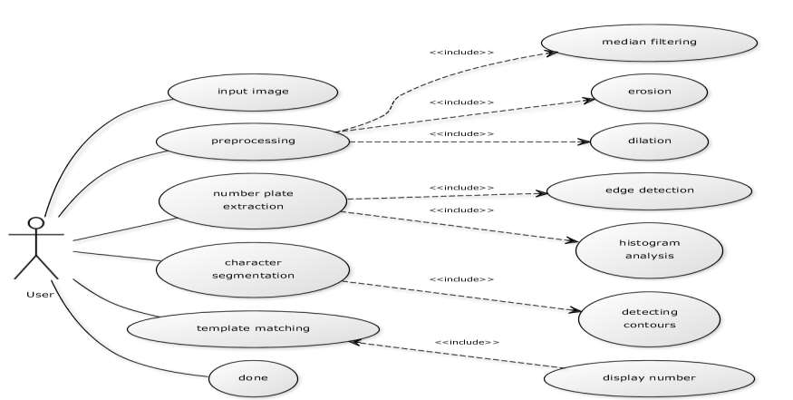
USE CASE MODEL

Slide 12
WORK FLOW
INPUT IMAGE
PREPROCESSING
NUMBER PLATE EXTRACTION
CHARACTER RECOGNITION
OUTPUT TEXT

Slide 13
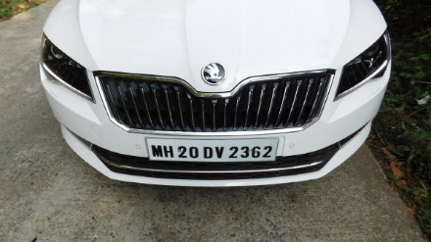
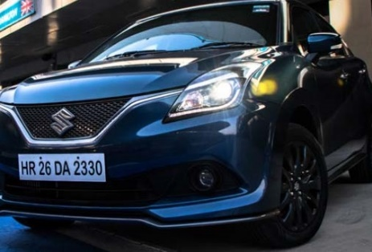
SAMPLE INPUTS

Slide 14
OUTPUT
MH 20 DV 2362
HR 26 DA 2330

Slide 15

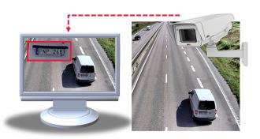
PROS
The detection and reading of license plates is a kind of intelligent system and it is considerable in different aspects which includes.
Law enforcement.
Parking.
Access Control.
Tolling.

Slide 16
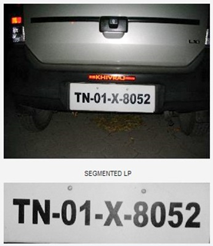
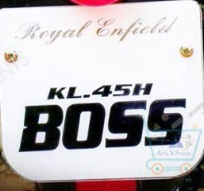
CONS
Returns the exact text only when the number plate is contained with the standard text format.
Inappropriate text format of the number plate is difficult to recognize.

Slide 17
FUTURE DEVELOPMENT
The process of vehicle number plate detection requires a very high degree of accuracy.
We have achieved an accuracy of 98% by optimizing various parameters, for homeland security an accuracy of 100% cannot be compromised with.
To achieve this, further optimization is required. Also, the issues like stains, smudges, blurred regions & different font style and sizes are need to be taken care of this work can be further extended to minimize the errors due to image capturing.

Slide 18

THANK U…..

