Slide 1
ECOLOOP BUILDING AGENTS
Problem: Static HVAC schedules
Solution: Guardrailed local control
Theme: Smart automation
Category: Software
Team: Krishnaa Nair — EcoLoop
Repository: honeywell-hackathon
Notes:
[Sources]
- Project repository: https://github.com/Krishnaanair/honeywell-hackathon
- Project brief: docs/presentation-content.md

Slide 2
LOCAL CHOICE. SAFE CONTROL.
The model proposes; the safety layer decides
Sense: 15-minute telemetry becomes compact zone and building state.
Choose: qwen3:8b uses real MCP tools to select a scored candidate.
Act: validation clamps or rejects; only safe setpoints reach the next callback.
Notes:
[Sources]
- Project architecture: docs/architecture.md
- Control policy and candidate limits: docs/control-policy.md
- MCP Python SDK: https://github.com/modelcontextprotocol/python-sdk

Slide 3
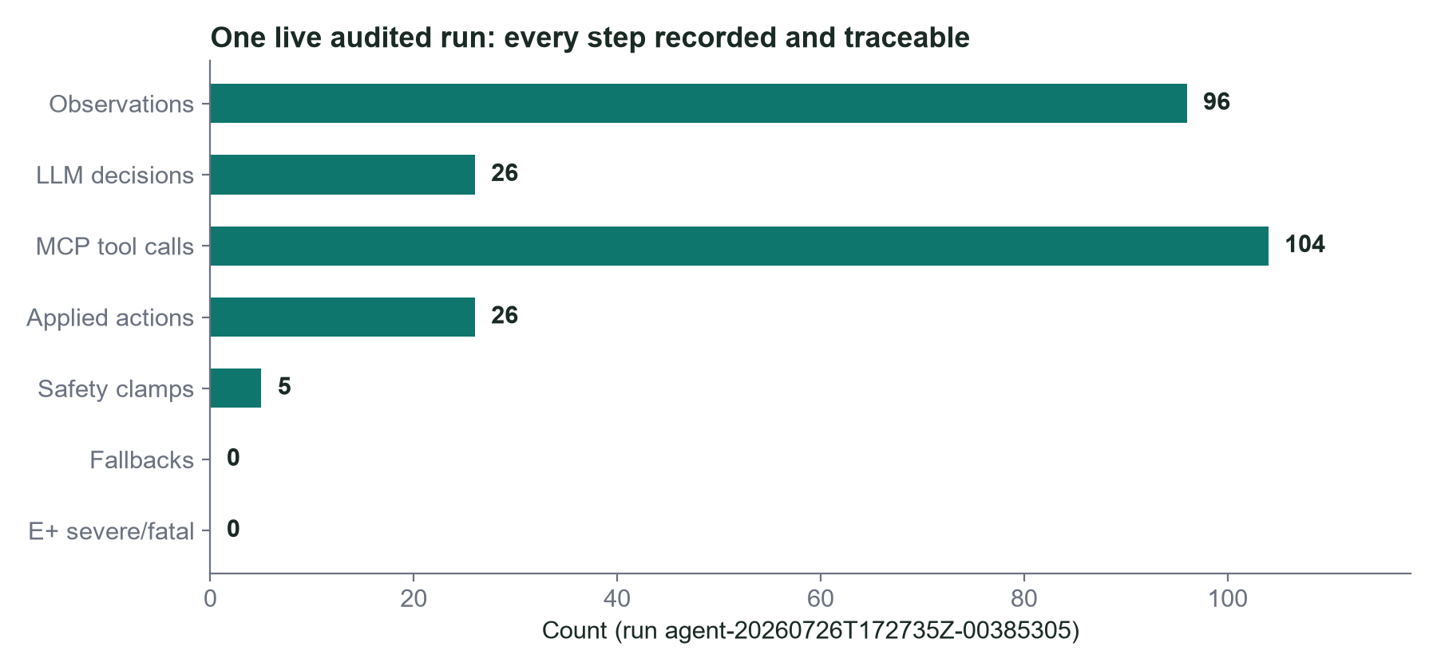
ONE AUDITABLE LOOP, END TO END
Control: EnergyPlus 26.1 → SQLite WAL → MCP stdio → local Ollama → safety validator → thermostat schedules.
Evidence: every proposal, clamp, action and later response is durable; EnergyPlus outputs verify energy, peak and comfort.
Notes:
[Sources]
- EnergyPlus 26.1 Data Exchange API: https://energyplus.readthedocs.io/en/v26.1.0/datatransfer_8h.html
- MCP Python SDK and FastMCP: https://github.com/modelcontextprotocol/python-sdk
- Ollama tool calling: https://docs.ollama.com/capabilities/tool-calling
- Project architecture: docs/architecture.md

Slide 4
SAFETY FAILS CLOSED
Feasible now: official five-zone heat-pump model, discovered capabilities and no cloud key.
Failure-safe: stale or unsupported actions are rejected; timeout uses bounded fallback; repeated failures open the breaker.
Honest scaling: matched inputs gate claims; BACnet/MQTT deployment requires commissioning and site safeties.
Notes:
[Sources]
- Project control policy: docs/control-policy.md
- Evaluation methodology: docs/methodology.md
- Known deployment boundaries: docs/limitations.md

Slide 5
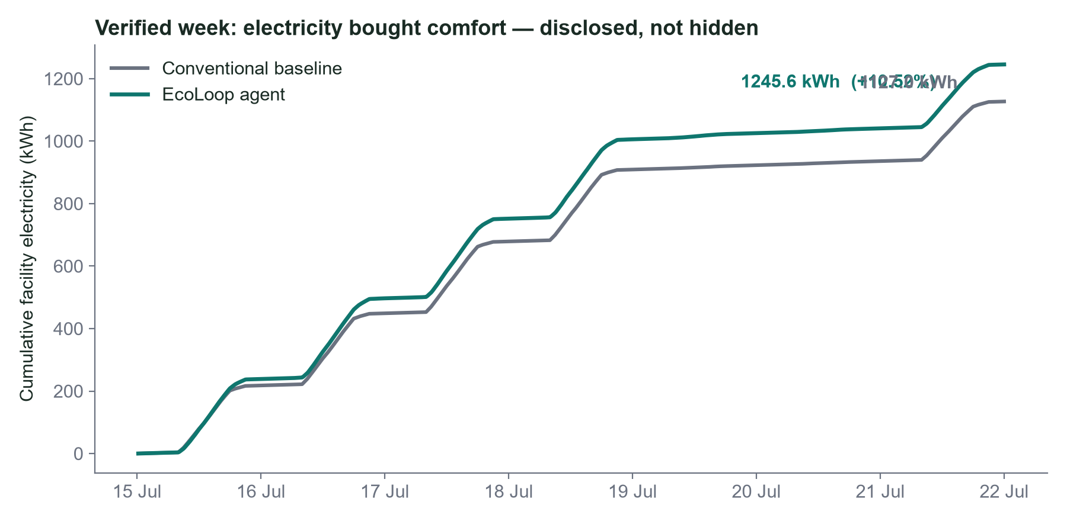
EVIDENCE BEFORE CLAIMS
Electricity 1,126.96 → 1,245.56 kWh: 10.52% higher (saving -10.52%).
Comfort compliance 67.77% → 90.31%: +22.54 pp; PMV compliance 94.62% → 97.46%.
HVAC 461.79 → 580.39 kWh; peak 23.01 → 24.23 kW (5.32% higher).
Audit: 170 decisions | 0 timeout attempts | 11 fallbacks.
Notes:
[Sources]
- Verified comparison artifact: results\comparison.json
- Comparison SHA-256: 7fcf6609940d43641b3f53642f3ba46572d716278611dc389571fdace14ec1da
- Baseline run: baseline-20260726T105124Z-4adce000
- Agent run: agent-20260726T130255Z-65de6a32
- Electricity saving: 100 * (baseline - agent) / baseline = -10.524230747996784%
- Comfort compliance change: (100 - agent violation) - (100 - baseline violation) = 22.538461538461533 percentage points
- Evaluation method and publication gate: docs/methodology.md; docs/results.md

Slide 6
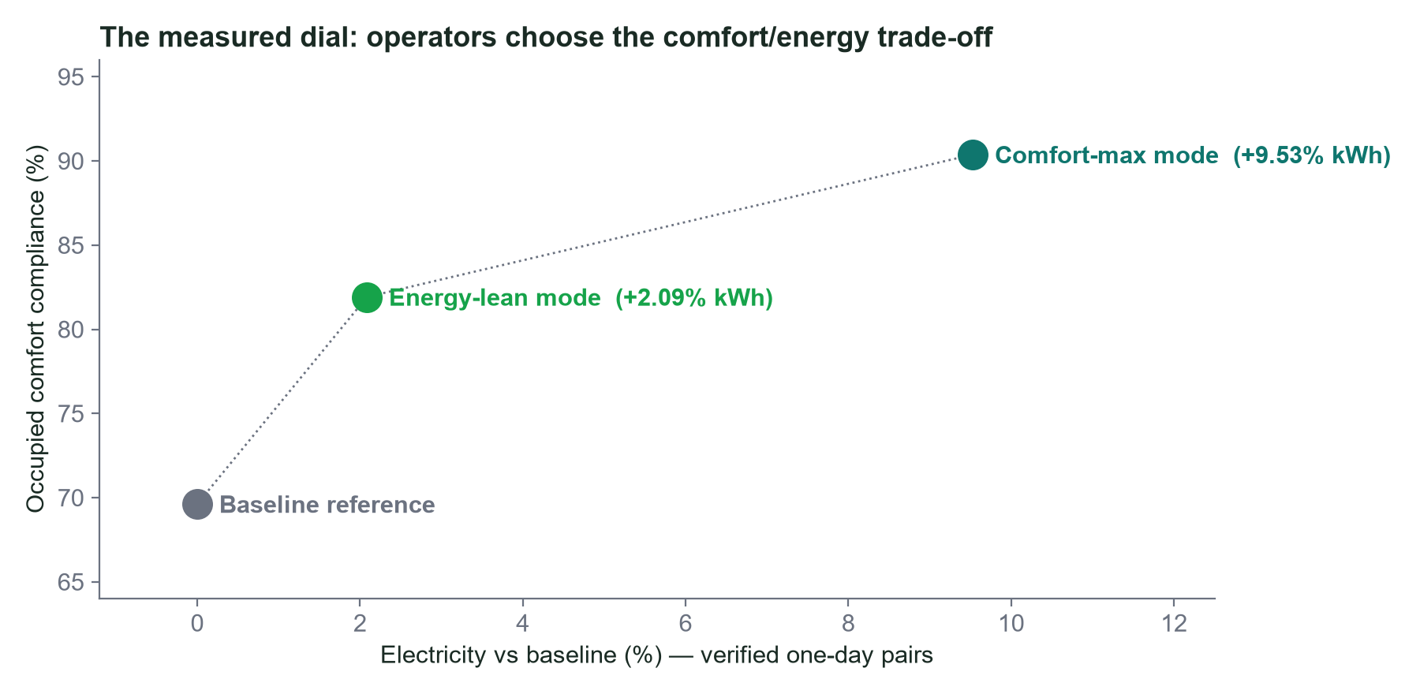
THE MEASURED COMFORT/ENERGY DIAL
Two verified one-day operating points, one policy dial:
Comfort-max: +9.53% kWh, compliance 69.6% → 90.4% (violations third).
Energy-lean: +2.09% kWh, compliance 69.6% → 81.9%, zero fallbacks.
Replays reproduce both retained runs digit-for-digit (170/170 actions).
Notes:
[Sources]
- Comfort-max pair: baseline-20260726T151534Z-df519672 / agent-20260726T151601Z-4f076a27 (runs/agent-.../export/comparison.json)
- Energy-lean pair: baseline-20260726T180508Z-48166652 / agent-20260726T180544Z-ea3913ad (verified comparison, 2026-07-26)
- Replay proofs: replay-20260726T165649Z-6ff9f492, replay-20260726T171617Z-5ffa3497 (metrics digit-identical to sources)
- Electricity change = 100 * (agent - baseline) / baseline; compliance from occupied zone telemetry (22-26 C operative)
- Full validation record: docs/audit/FINAL_TEST_REPORT.md and docs/audit/INDEPENDENT_FINAL_AUDIT.md

Slide 7
LIMITS DEFINE THE NEXT STEP
Foundation: official EnergyPlus 26.1 Runtime API, MCP Python SDK/FastMCP and Ollama tool calling.
Evidence boundary: Chicago TMY3, one reference heat-pump building and configured PMV assumptions; CO2 is unavailable.
Next: push the measured dial below baseline energy at the comfort boundary, then commission a BACnet/MQTT adapter with site-level safeties.
Notes:
[Sources]
- EnergyPlus 26.1 API: https://energyplus.readthedocs.io/en/v26.1.0/datatransfer_8h.html
- EnergyPlus 26.1 release: https://github.com/NatLabRockies/EnergyPlus/releases/tag/v26.1.0
- MCP Python SDK: https://github.com/modelcontextprotocol/python-sdk
- Ollama tool calling: https://docs.ollama.com/capabilities/tool-calling
- Project methodology and limitations: docs/methodology.md; docs/limitations.md

