Slide 1
Python Tutorial for Beginners

Slide 2
#1
We will the Python IDLE in this tutorial.
The language that the computer understands is Binary Code i.e, 0 and 1.
We use a programming language to write code, which is neither a binary language nor English.
Programming language has its own protocols and grammar which we use.
We will write code in a programming language say Python and then it will convert into a binary format that the computer will understand.
We can perform several operations using Python language.

Slide 3
#2
Starting with operations like Addition, Subtraction, Multiplication, and Division.
We do addition, subtraction and multiplication with integer values, and then it gives us answers also in integer data type.
But when performing division with integer values then it gives us an answer in float data type.
Float stands for Floating Point Representation.
When we divide two integer values then it might be possible that the answer can in decimal.
e.g., 5/2 = 2.5

Slide 4
#2
As the interpreter wants to give you an exact answer for the division also, it will return it in float.
If you want to get only the quotient part or the integer part of the answer and want to neglect the decimal value, it can be done with the help of (//).
// (double slash) is used for division when you want to return only an integer value in the answer.
// is also called Integer Division or Floor Division.
We can multiple operations in a single statement as well.
We need to follow the proper syntax for the programming language.
If we apply an operation but do not give operands, then it will give an error.
8+9- = Error

Slide 5
#2
We can also apply BODMASS rules of mathematics to perform operations.
Double asterisks (**) is used to find the power of a number.
number ** power = 2**3 = 2*2*2 To get the remainder, we use the modulus operator (%).

Slide 6
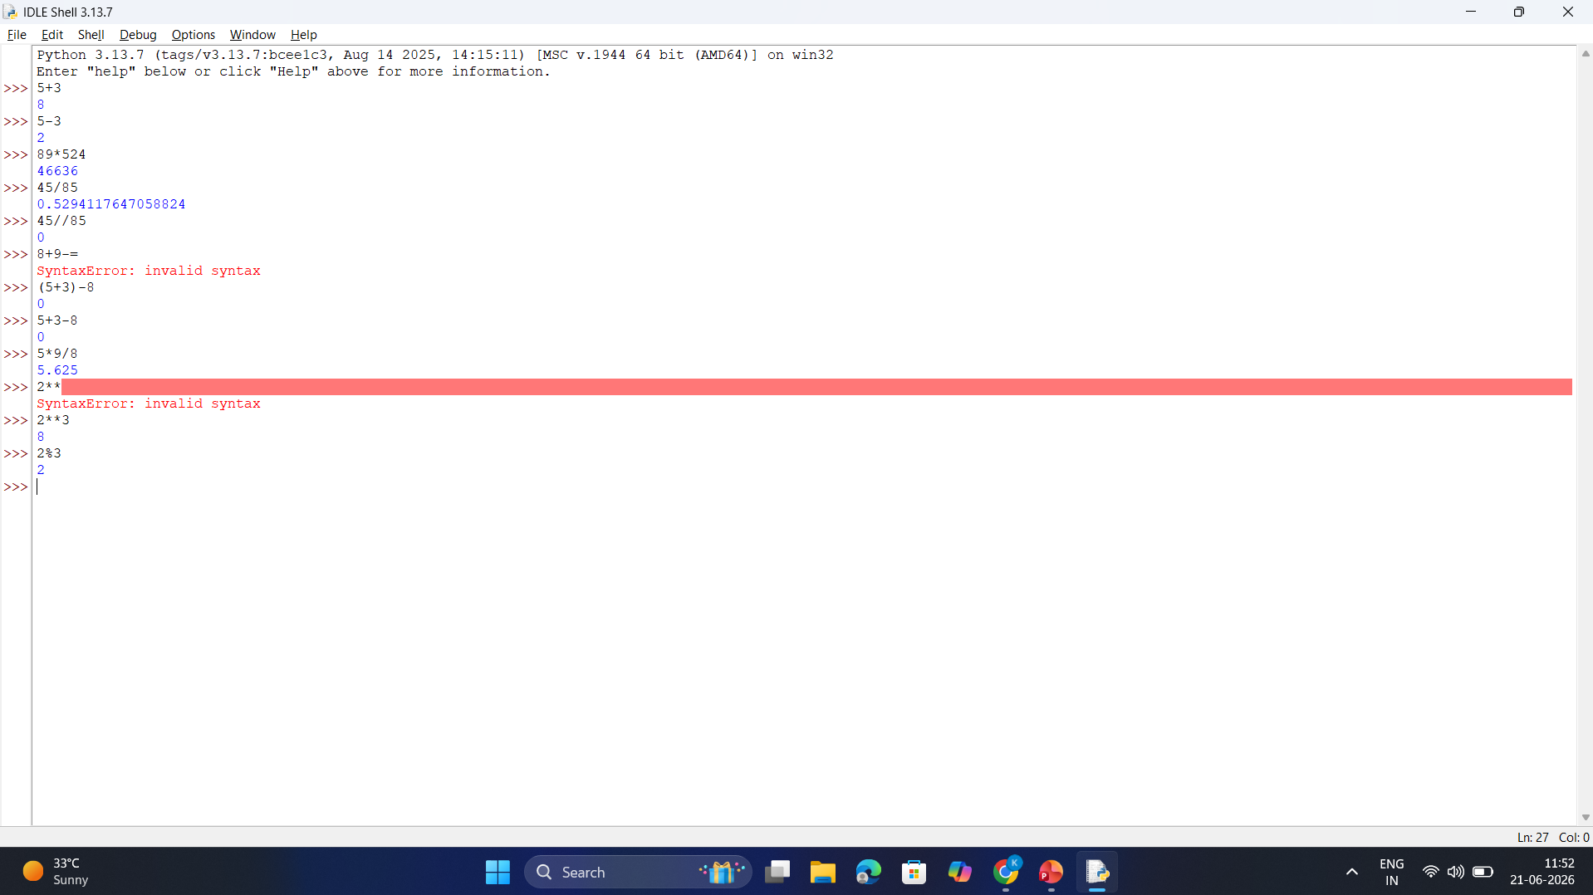

Slide 7
#3
String is a combination of characters like "Youtube", "Camera", "Telusko", "Python", etc., all are strings.
Whenever we use strings, we need to use double quotes(" ") or single quotes(' ') with it in python.
If you back-slash(\) to tell the python to ignore the special meaning of that double and single quotes.
If you use a back-slash before a single or double quotes then the quote is also treated as a simple character.

Slide 8
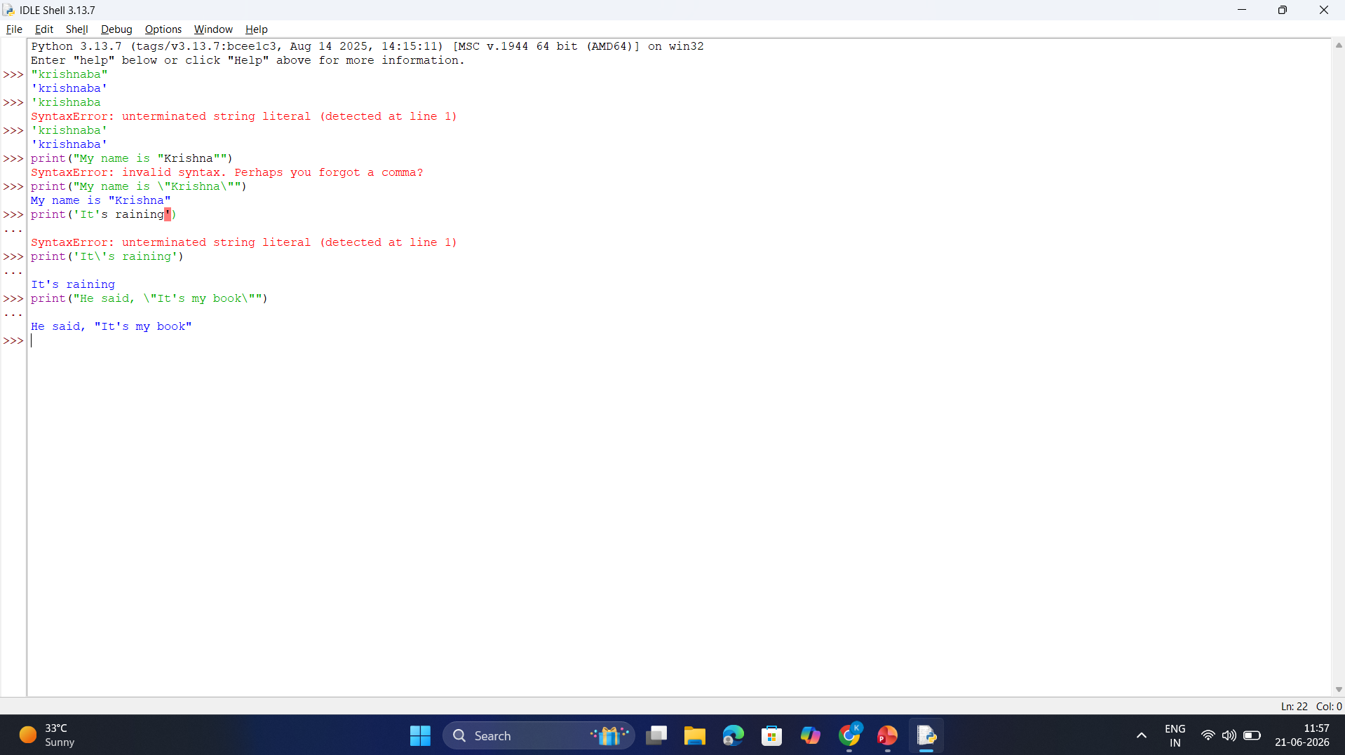

Slide 9
#4
Function is a set of tasks that can be done. We need to call functions. There are several functions in Python like the print() function.
Round brackets are used with a function to pass a parameter in it.
We can define our own functions as well.

Slide 11
#5
Concatenation is used to combine two things like we can convert two strings into one using concatenation.
Concatenation is done using the (+) operator.
e.g., 'navin' + 'navin’
Repetition is used to print a single value multiple times like we can print a string like "Navin" multiple times.
Repetition is done using the (*) operator.
e.g., 'navin' * 3

Slide 12
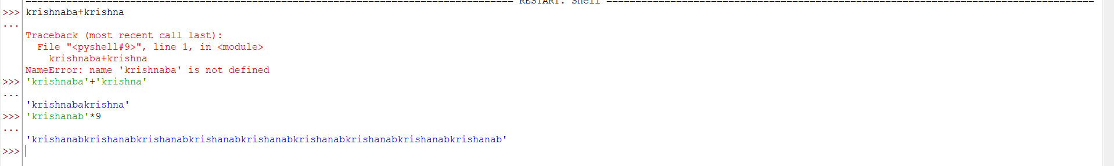

Slide 13
#6
(\n) has a special meaning in Python. It is used to enter a new line.
To print the original string or to neglect the meaning of \n, we have to use a Raw String.
Raw string is a string that returns it as it is without making any changes to it.
We have to specify (r) before the quote to print the same string that is present inside the quotes.

Slide 14
