Slide 1
#4

Slide 2
#4
Variable: It is a container where we can put our value
e.g
x=2 #here x is variable and 2 is value
x+3
5
y=3
Note:If I want to use output of previous operation so we use underscore (_)
_+y
8 # previous output 5 and y is 3

Slide 3
#4
Use String as a variable:
Strings in python are surrounded by either single quotation marks, or double quotation marks.
e.g "shiva" ,'shiva’
Assign String to a Variable:
Assigning a string to a variable is done with the variable name followed by an equal sign and the string:
name='shiva’
Name
shiva

Slide 4
#4
Slicing String:
we can return a range of characters by using the slice syntax.
Specify the start index and the end index, separated by a colon, to return a part of the string.
Get the characters from position 2 to position 5 (not included):
name='youtube’
name[2:5]
'utu'

Slide 5
#4
Slice From the Start:
name[:5] #from starting to index 5 (exclude)
'youtu’
Slice To the End:
name[2:] #from 2nd index to end
'utube’

Slide 6
#4
Negative Indexing:
0 1 2 3 4 5 6 #positive indexing
y o u t u b e
-7 -6 -5 -4 -3 -2 -1 #Negative indexing
name[-1]
'e’
name[:-1]
'youtub’

Slide 7
#4
name[:]
‘youtube’
name [:0]
‘’
name[-5:-2]
'utu’
Concatenate String:
name+ ' telusko’
'youtube telusko'

Slide 8
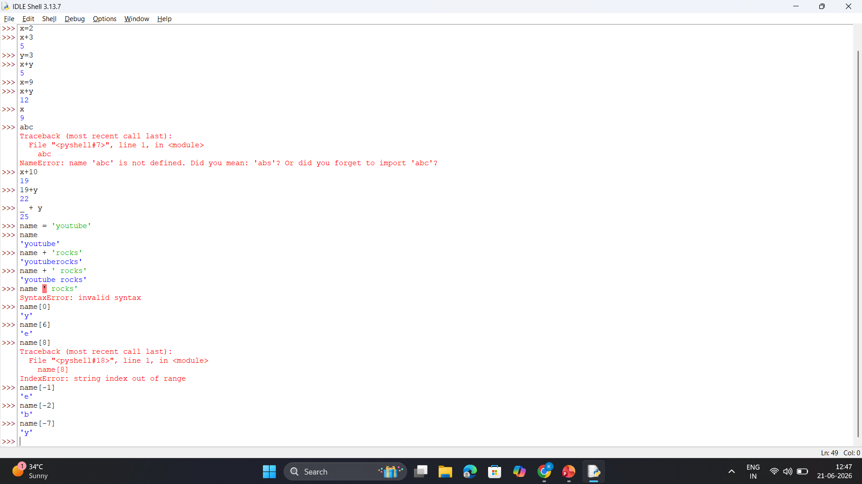

Slide 9
