Slide 1
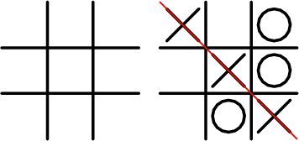
Tic Tac Toe Using MiniMax algorithm
by:
Krishna Chaitanya Pureti

Slide 2
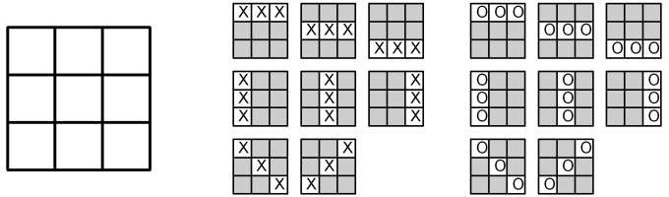
Functionality
Winning Combinations in game:

Slide 3
Algorithm Chosen
Mini-Max Algorithm
To find a path from the starting position to a goal position.
Calculate all possible game states by examining all opposing moves.
Determine the next move against best play [opponent].
Basically we tried to maximize our win and opponent tries to minimize their loss.

Slide 4
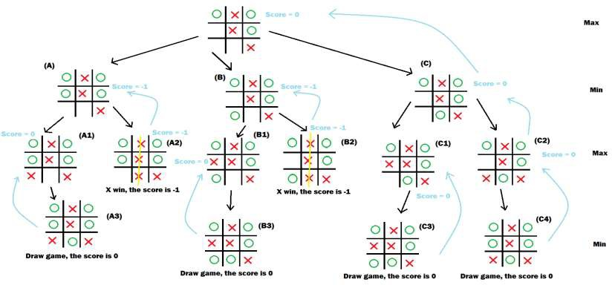
Game tree of Tic Tac Toe

Slide 5
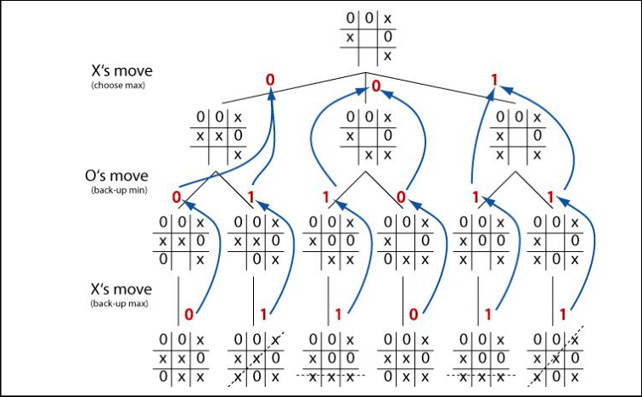
Other example of Game Tree

Slide 6
Algorithm
Step 1: START
Step 2: Check winning move for system (X). If there is such move, take it and go to Step 7. Else go to Step 3.
Step 3: Check wining move for user (O). It there is such move, then block the
player and go to Step 7. Else go to Step 4.
Step 4: If there are corner spaces (i.e. 1, 3, 7, 9), take it and go to Step 7. Else go to Step 5.
Step 5: If there is center position, take it and go to step 7. Else go to Step 6.
Step 6: If there are side positions (i.e. 2,4,6,8), take it and go to Step 7. Else go to step 8. (Since there are no spaces left to move.)
Step 7: Ask user to take a move and go to step 2.

Slide 7
Algorithm
Step 8: Check system move (X) is in a vertical/horizontal/diagonal form. If it is there the system will win. And go to step 11. Else go to step 9.
Step 9: Check user’s move (O) is in a vertical/horizontal/diagonal form. If
it is there the system will lose. And go to step 11. Else go to step 10.
Step 10: Game is draw and go to step 11:
Step 11: END

