Slide 1
WALMART SALES FORECASTING
Krishna Chinya
Arpitha Somayaji
Srinivas Venkatesh
Arvind Madugolkar Vithal

Slide 2
Introduction
Super store, Walmart has a huge impact on their sales during markdown events like the Super Bowl,President’s day and other holidays like Black Friday, Christmas,etc. The reason being there are several promotional offers preceding these holidays. Therefore, there is a necessity to analyze the sales data set of the MegaStore Walmart, during markdown events in order to plan more efficient strategies for improving sales

Slide 3
Data Exploration
<Features>
·Store - the store number
·Date - the week
·Temperature - average temperature in the region
·Fuel Price - cost of fuel in the region
·MarkDown1-5 - data is only available after Nov 2011,
·CPI - the consumer price index
·Unemployment - the unemployment rate
·IsHoliday - whether the week is a special holiday week
<Feature> provided parameters may affect weekly sales, but did not provide weekly sales.
<Train>
Store - the store number
·Dept - the department number
·Date - the week
·Weekly Sales - sales for the given department in the given store
·IsHoliday - whether the week is a special holiday week
<Train> provided sales data of 45 stores with up to 99 departments in more than 421,000 records, and didn’t sum each store’s weekly sales up.

Slide 4
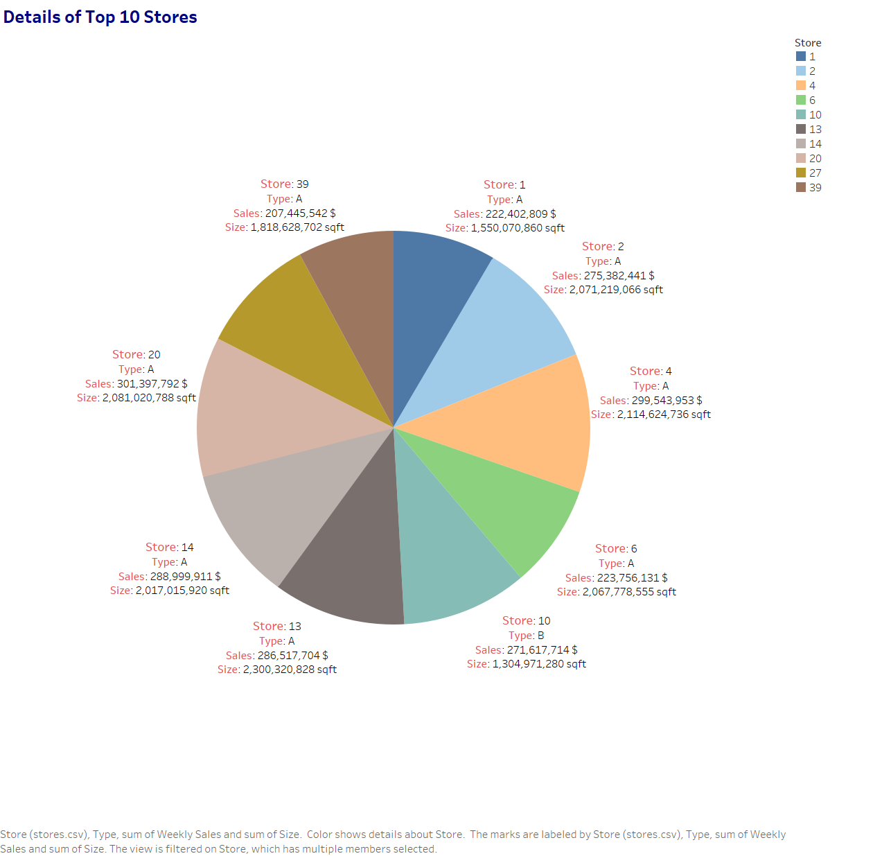
Exploratory Analysis
The above chart shows the top 10 stores in terms of sales revenue and their percentage contribution to the total sales generated between them. Store 20 was the highest contributor with a total of 301 Million. These 10 stores accounted for 39% of the revenue generated by the given 45 stores.
We have used Tableau to perform the analysis.

Slide 5
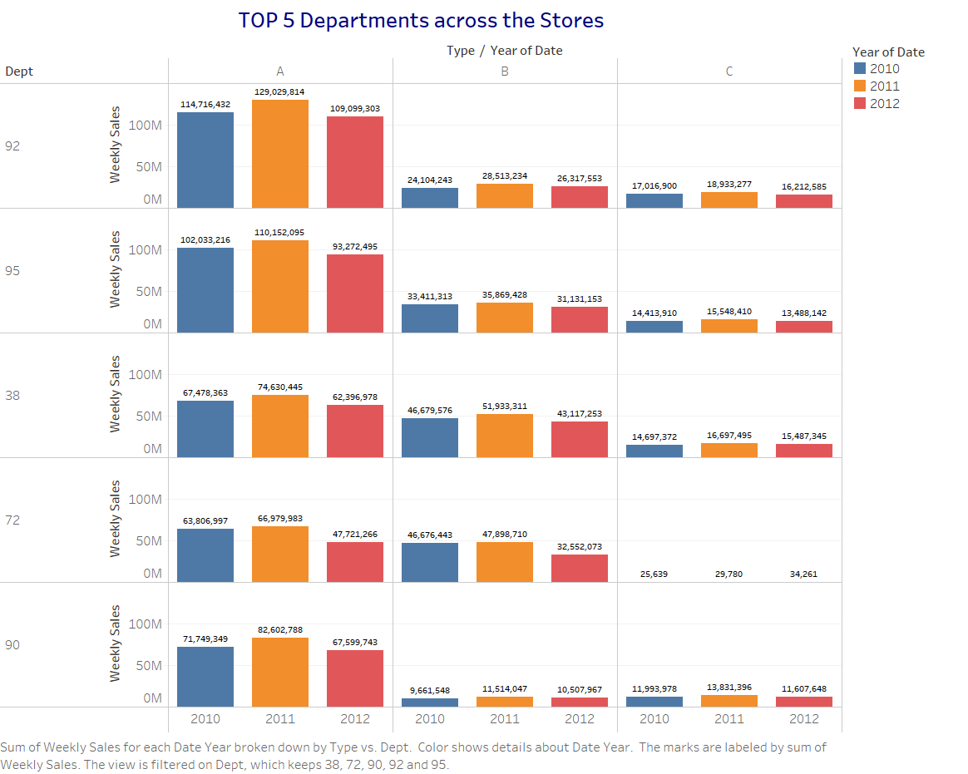
Continued. . . .
The above figure shows the top 5 departments across the 3 store types namely A,B & C. Store type A fetched the most sales whereas Store type C fetched the least sales.
We can see that Department 92 belonging to Store type A ranks the Highest in sales during period of 2010 through 2013.
Store Number | Cumulative Weekly Sales($)
92 | 483,943,342
95 | 449,320,163
38 | 393,118,137
72 | 305,725,152
90 | 291,068,469

Slide 6
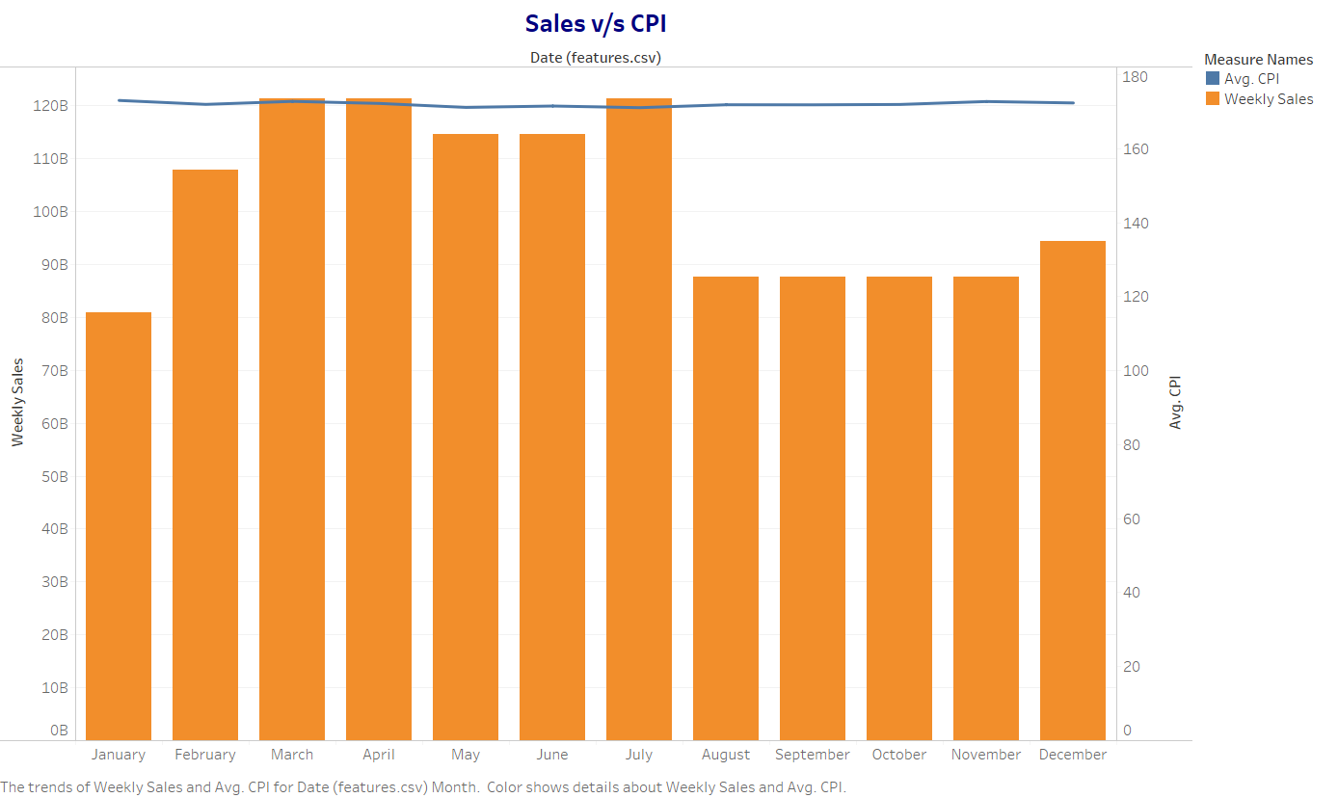
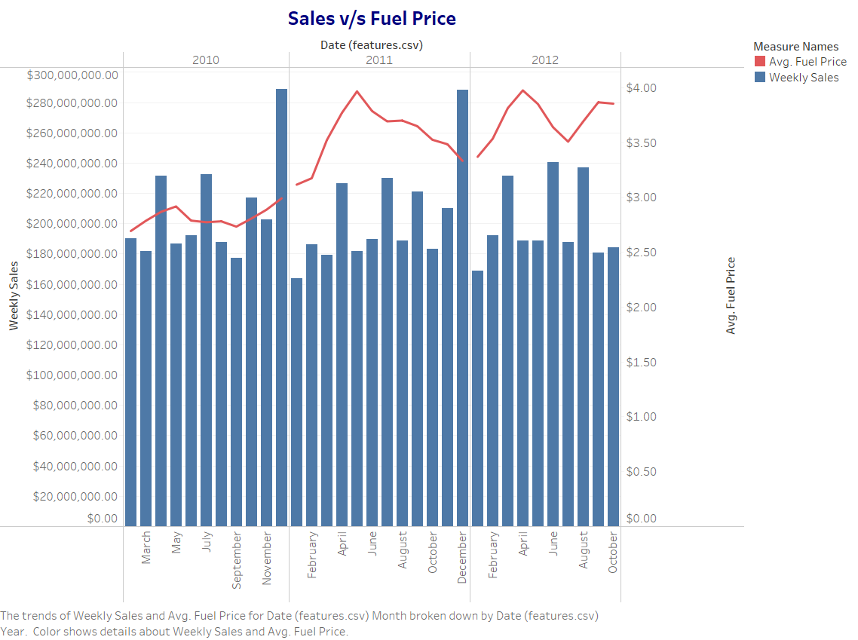
No strong relationships were clear from visualizing the weekly sales data with respect to the CPI and the fuel price during that week.

Slide 7
Data Preparation: Merging, Cleaning, and Transforming the Data
We are merging train.csv and features.csv based on Store numbers and Date.
From the Merged Data, we are removing records dated from Jan 2011 to November 2011, since the markdowns(1-5) in features.csv for this period is unavailable.
For the remainder of Merged Data, we found missing values in Markdown(1-5) columns. We are filling these missing values with mean grouped by store and department.
Test.csv consists of Store, Department and Date columns dated from November 2012 to August 2013.
Only for the computation of accuracy score, we are dividing the train data in 70:30 ratio.
Notes:
We have data from 2011 Jan to 2013 August

Slide 8
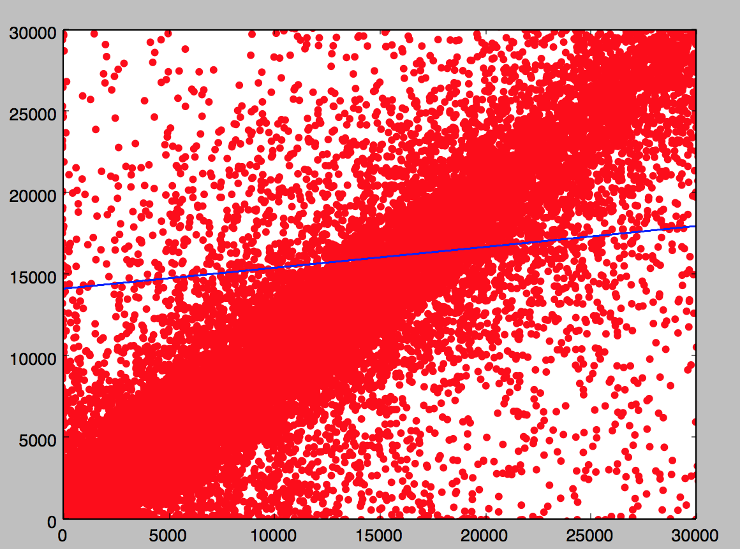
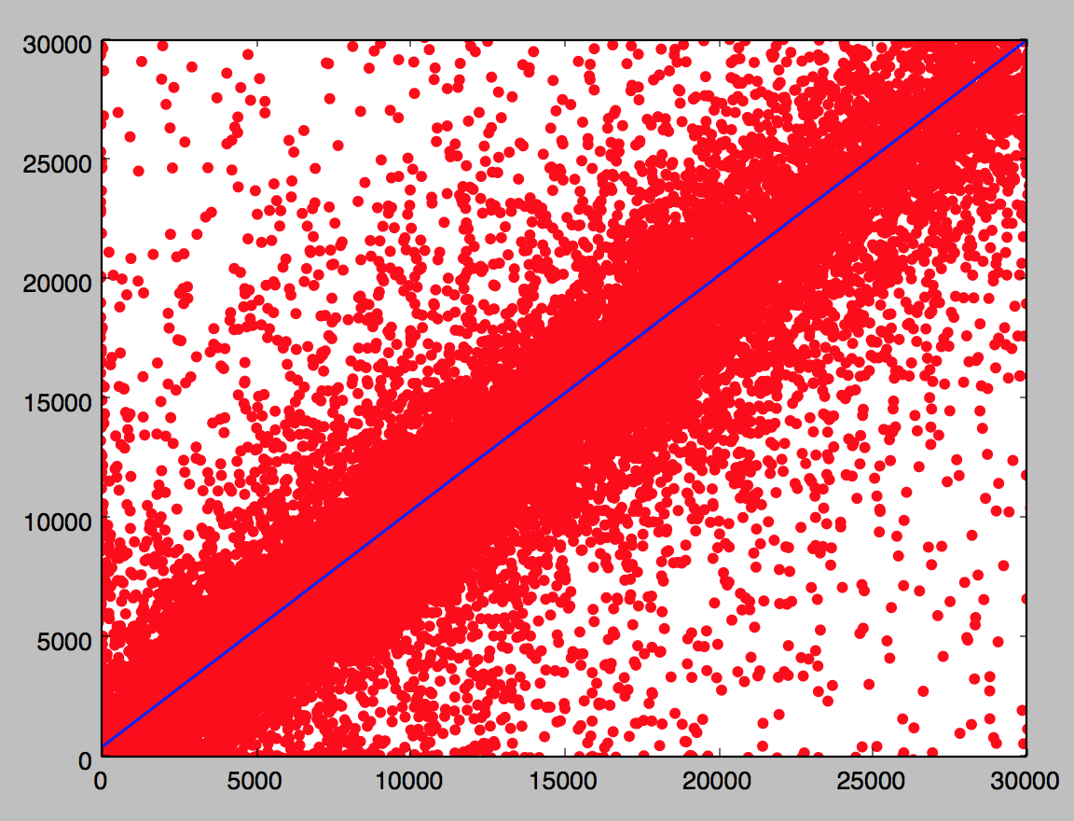
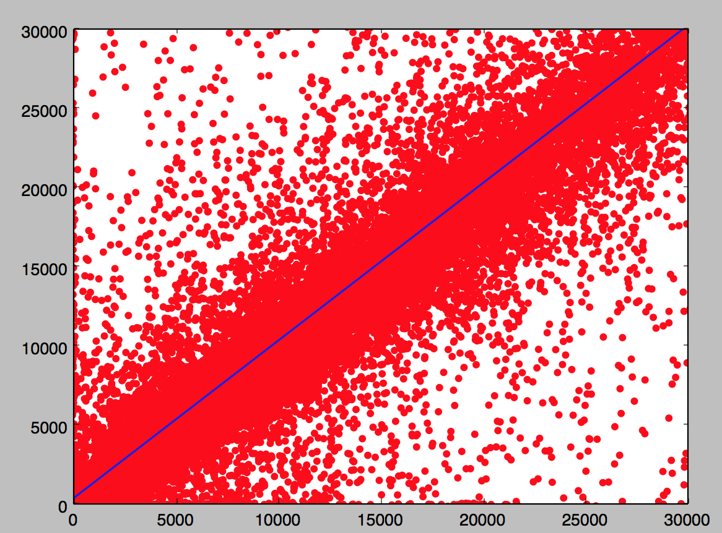
Supervised Modelling
 | Linear Regression | Random Forest Regressors | Extra Trees Regressors.
R2 | -5.43 | 0.86 | 0.87
Mean Log Square error | 0.91 | 0.67 | 0.65

Slide 9
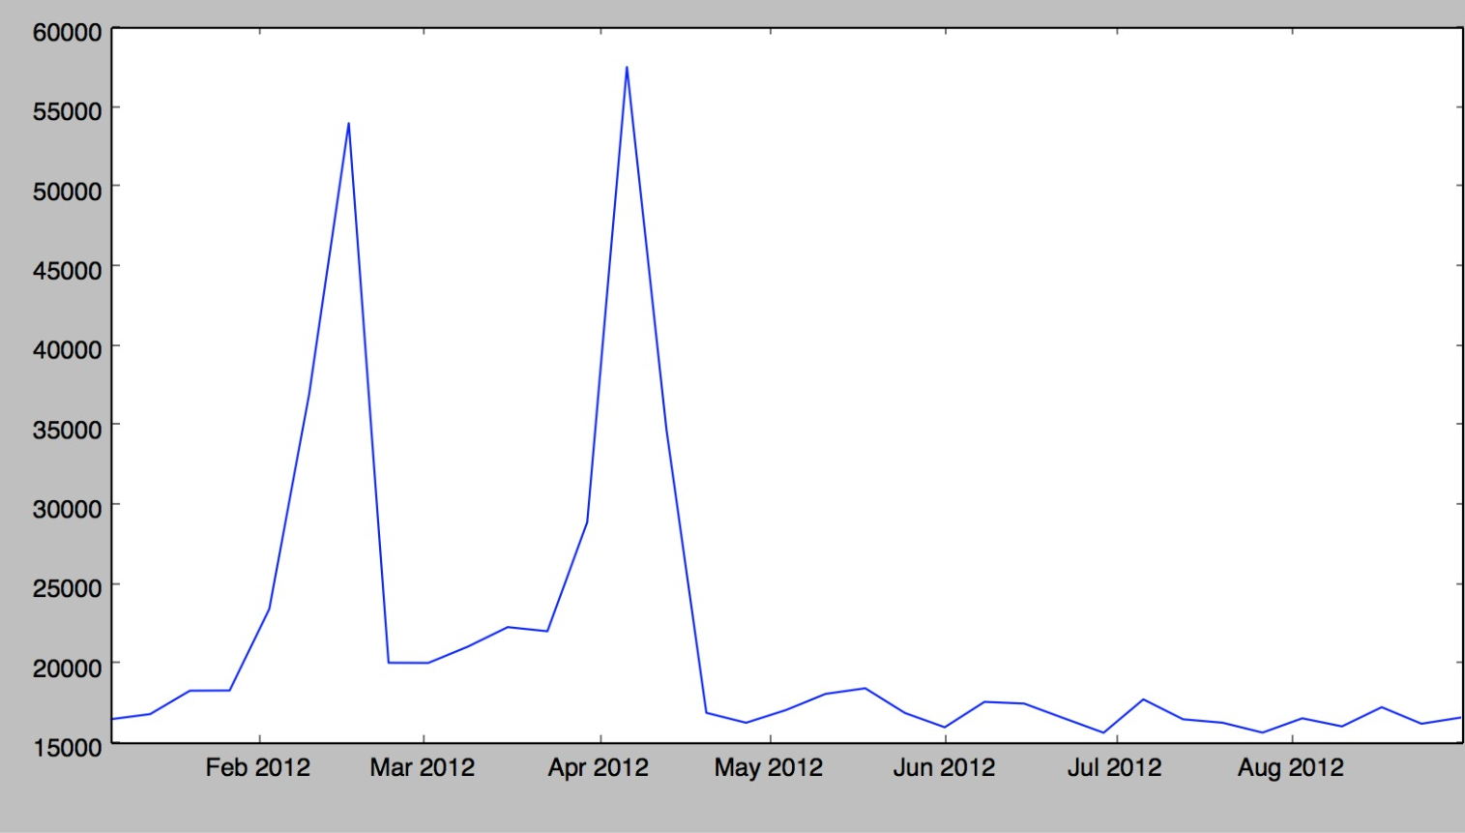
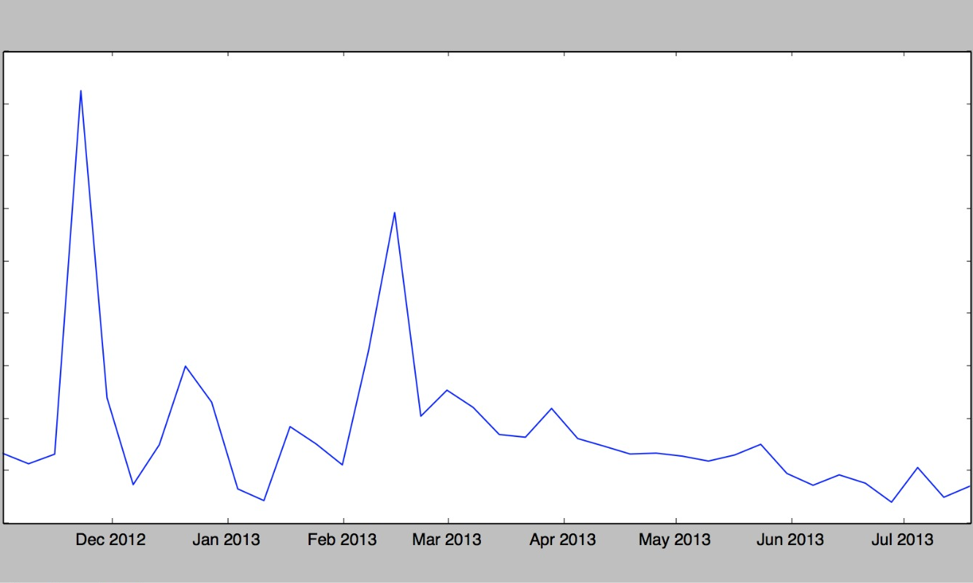
Sales Trend Analysis on Modeled Data
Train Data Sales Analysis
Test Data Sales Analysis

Slide 10
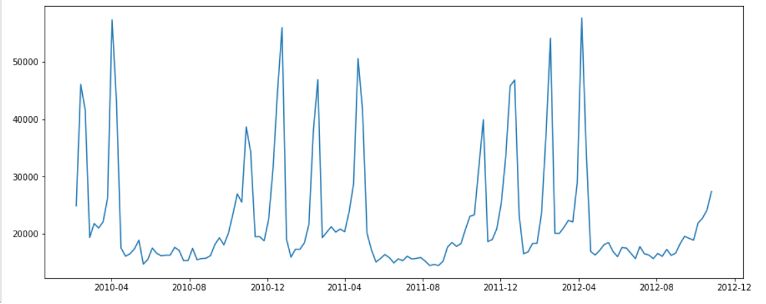
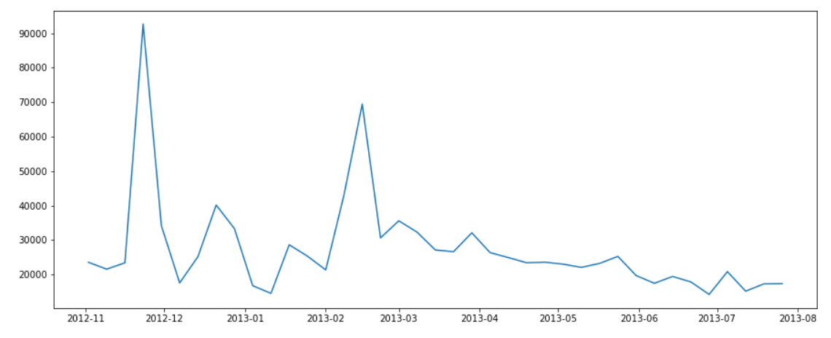
Sales Trend Analysis for Store 1 and Department 1

Slide 11
Conclusion and Improvements
Which model performs well and provides better accuracy and why ?

