Slide 1
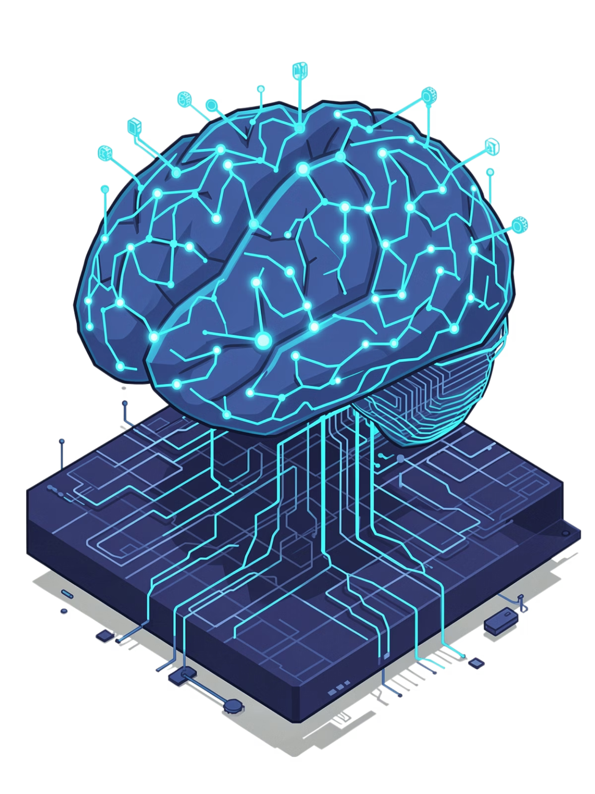
NeuralPath
The AI-Powered Learning Revolution
Transforming education through highly personalized, intelligent, and interactive learning experiences powered by cutting-edge artificial intelligence.

Slide 2

The Problem with Traditional Learning
One-Size-Fits-All Doesn't Work
Traditional education follows a rigid, linear path that ignores individual learning styles, paces, and prior knowledge.
Unengaging, static content causes learner fatigue
No personalized guidance or adaptive support
High dropout rates in online courses
Advanced learners waste time on basics

Slide 3

Introducing NeuralPath
The ultimate solution combining intelligent algorithms with adaptive learning to deliver dynamic, personalized educational experiences.
Dynamic Learning Paths
AI-Powered Classroom
AI-generated roadmaps tailored to your unique learning journey
24/7 instant tutoring with specialized AI tools
Gamified Experience
Stay motivated with XP, achievements, and streaks

Slide 4
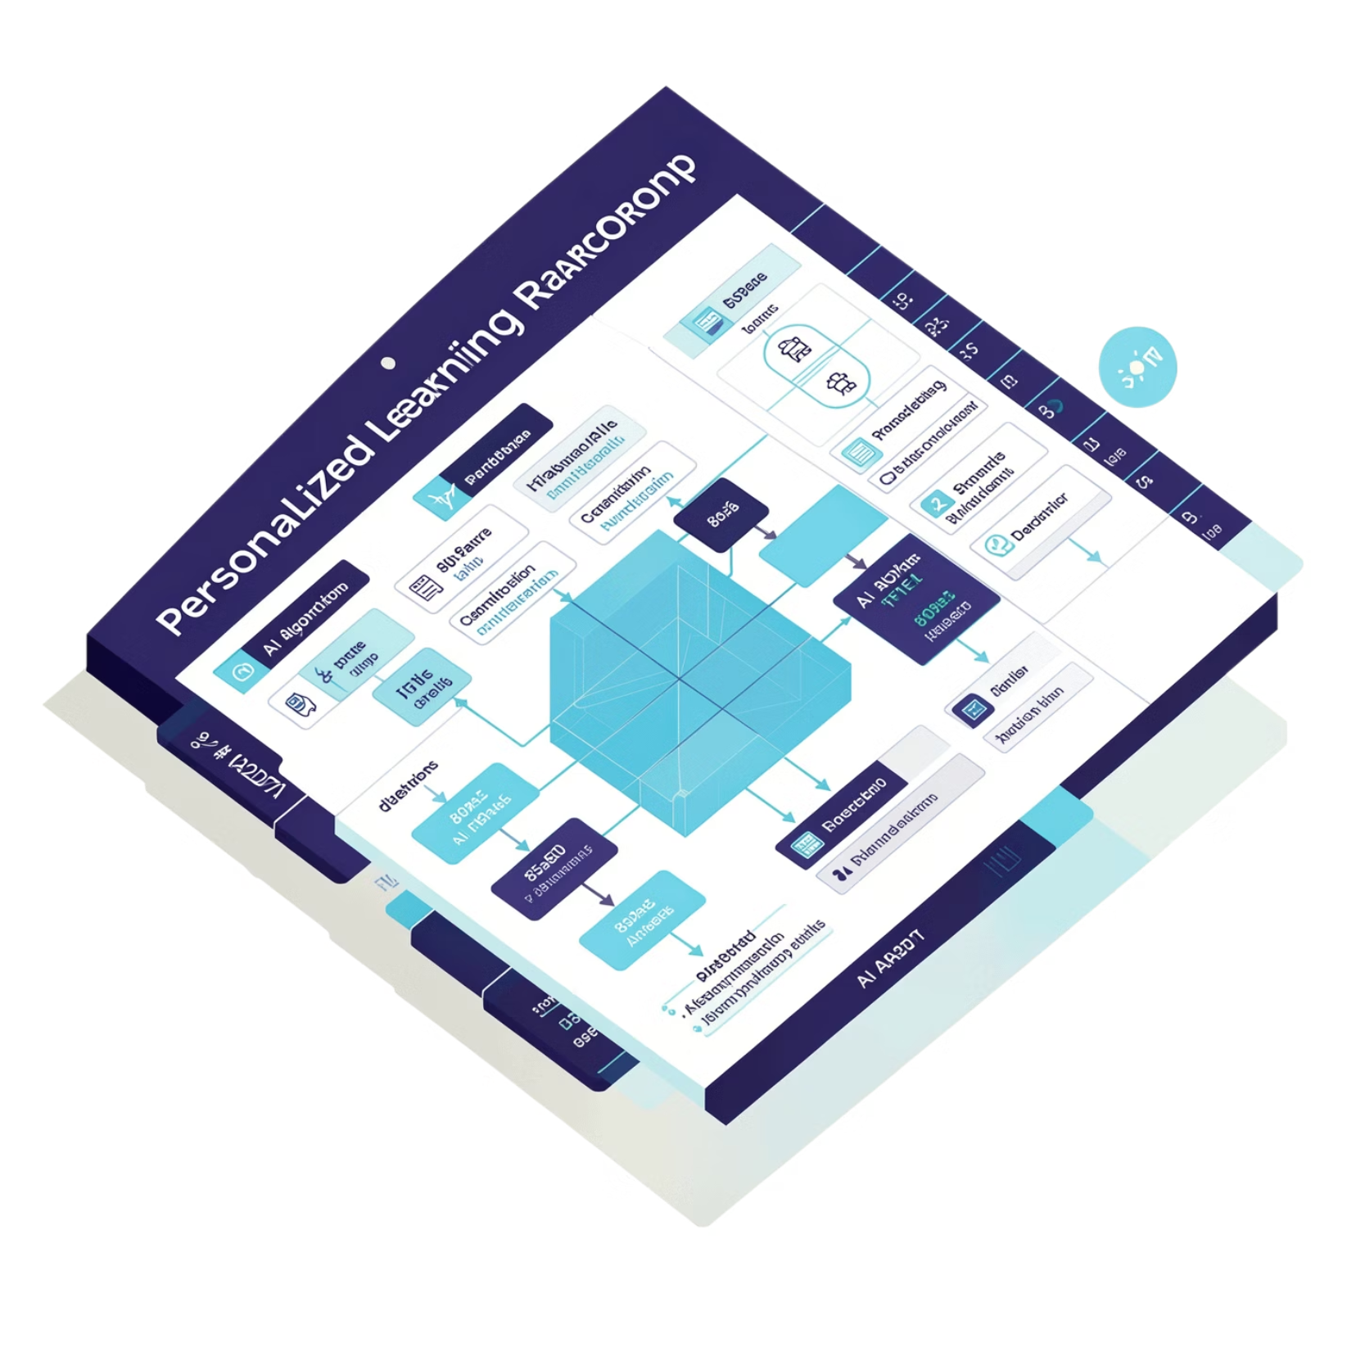
AI-Powered Personalized Learning Paths
Intelligent Roadmaps, Built for You
NeuralPath starts with a comprehensive assessment quiz that analyzes your knowledge level, learning style, and goals.
The platform then generates a dynamic, step-by-step learning roadmap that evolves as you progress.
Adaptive Trimming
Skips foundational steps for advanced learners, saving time and maintaining engagement with appropriately challenging content.

Slide 5
The AI Classroom
Powered by NVIDIA NIM (openai/gpt-oss-120b) with 9 specialized AI tools for instant, 24/7 tutoring
AI Teacher
Quiz Generator
Personalized explanations and guidance
Custom assessments tailored to your level
Homework Solver
Study Assistant
Step-by-step problem solving
Concept summaries and key insights
Q&A Bot
Goal Tracker
Instant answers to any question
Progress monitoring and milestone setting

Slide 6
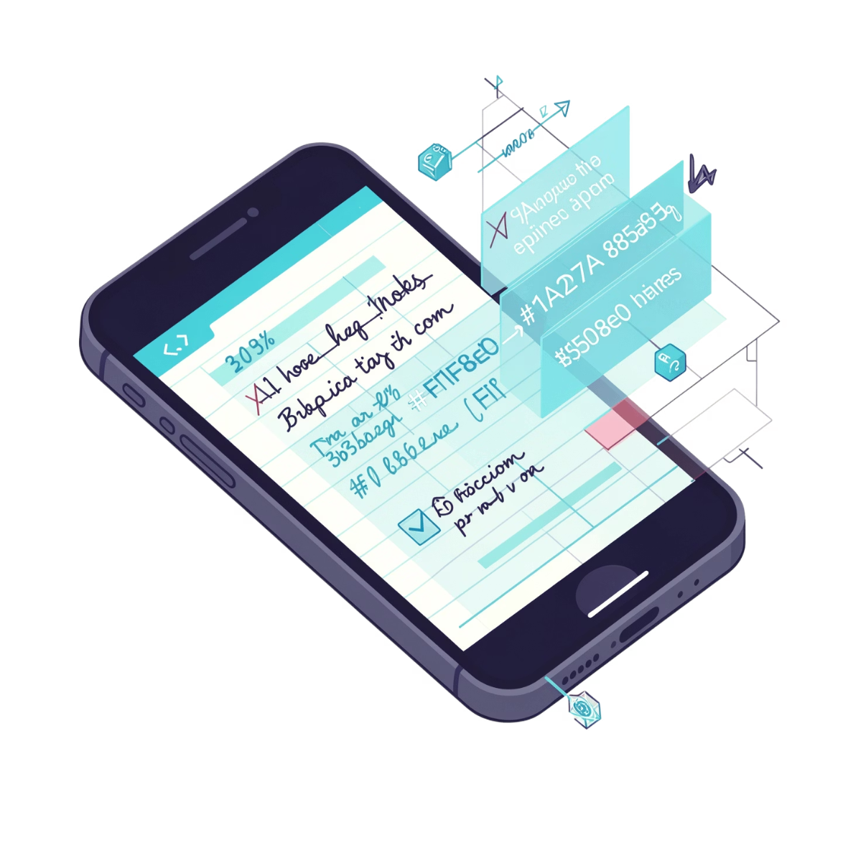



Smart Notes & Automated Study Tools
From Notes to Mastery
Upload PDFs or images of your notes, and NeuralPath uses advanced OCR (Optical Character Recognition) to automatically read and process your content.
Instant Processing
OCR technology reads text from any format
Interactive Flashcards
Generate spaced-repetition cards automatically
Conceptual Mindmaps
Visualize connections between ideas

Slide 7
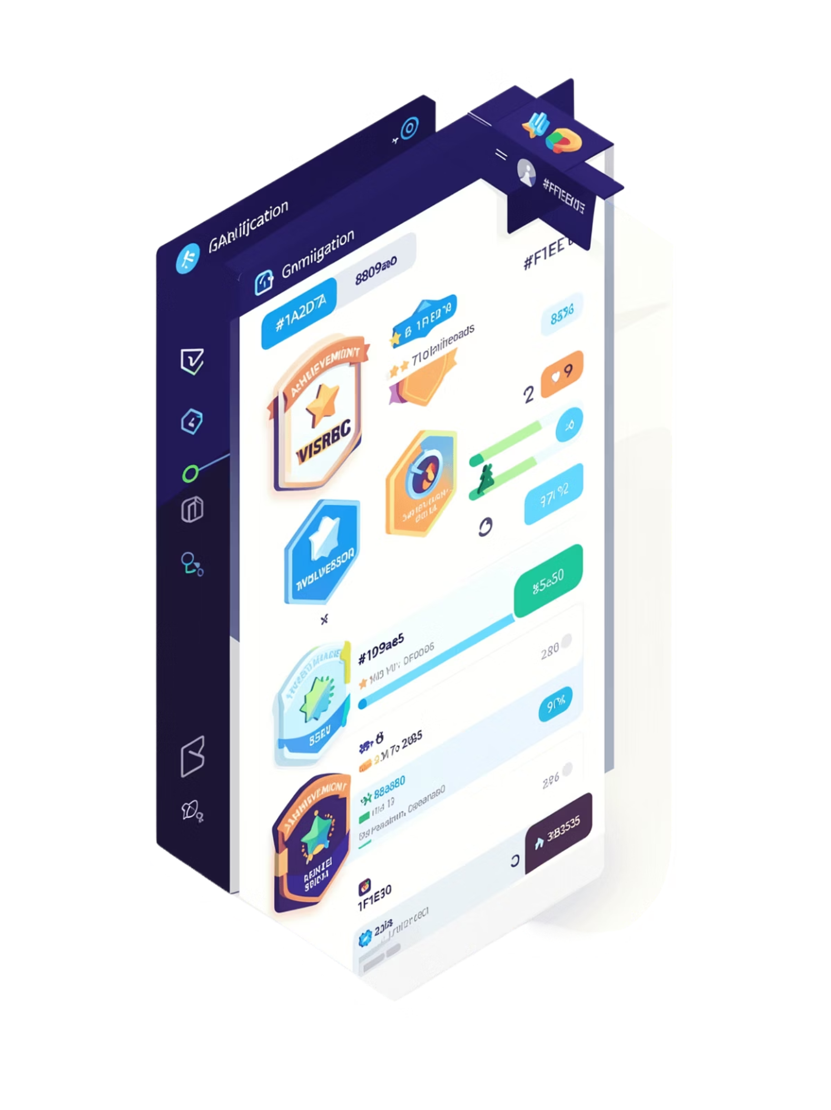
Gamification & Progression
Combat learner fatigue with an engaging gamified experience designed to keep you motivated
01
02
Earn Experience Points
Unlock Achievements
Accumulate XP for every learning step completed, building your knowledge level
Collect badges and rewards for milestones, creating a sense of accomplishment
03
Maintain Daily Streaks
Build consistency with streak tracking that encourages regular learning habits

Slide 8
Social Hub & Course Catalog
Real-Time Peers Hub
Secure Course Catalog
Connect with learners who share your interests and goals. Collaborate on projects, discuss concepts, and learn from diverse perspectives in real-time.
Explore and enroll in courses with seamless, secure payments powered by Razorpay. Access premium content with confidence.
Interest-based matching algorithm
Group study sessions
Peer feedback and support
Interactive course browsing
Secure payment processing
Progress tracking

Slide 9
Technology Stack
Modern, Scalable Architecture Built for Performance
Frontend Excellence
Backend Power
Security First
React 18 with Vite for blazing-fast development, Tailwind CSS for modern styling, Framer Motion for smooth micro-animations, and Recharts for data visualization
Node.js with Express for robust server-side operations, MongoDB for flexible data storage, creating a scalable MERN stack foundation
Google SSO (OAuth 2.0) for seamless authentication and JWT session tokens for secure, encrypted user sessions

Slide 10

Join the Learning Revolution
NeuralPath is not just a learning management system—it's an intelligent, adaptive educational ecosystem designed to make learning faster, smarter, and highly engaging.
References & Core Technologies
NVIDIA NIM (openai/gpt-oss-120b)
MERN Stack (MongoDB, Express, React, Node)
Tesseract.js (server-side OCR)
Razorpay Payment API
Google Auth Library (OAuth 2.0)
Let's Transform Education Together

