Slide 1
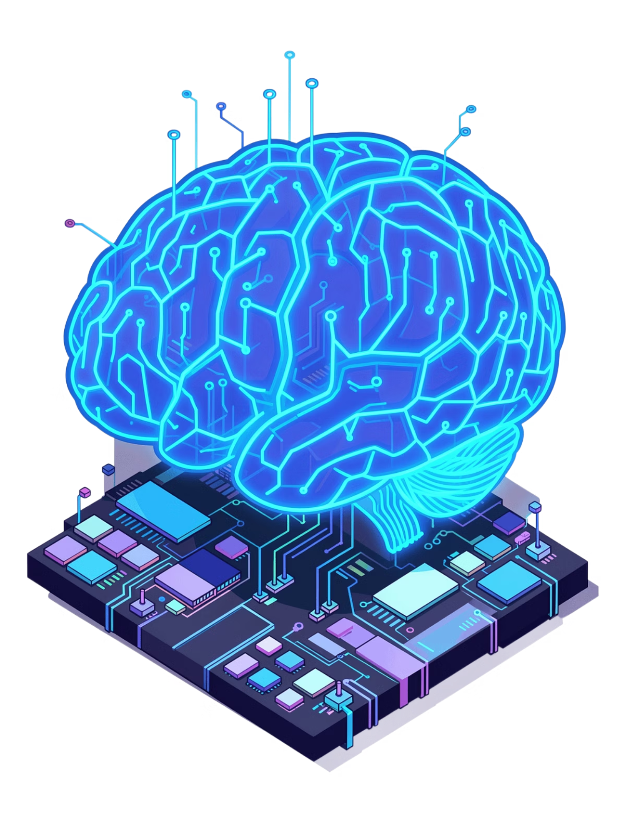
NeuralPath: The AI-Powered Learning Revolution
Personalized, Gamified, and Intelligent Education for the Modern Learner

Slide 2

Why Traditional Learning is Broken
One-Size-Fits-All
High Dropout Rates
Rigid curriculums ignore individual learning paces and unique interests
Generic content leads to disengagement and abandoned courses
No Personalization
Static materials fail to adapt to evolving skill levels and goals

Slide 3
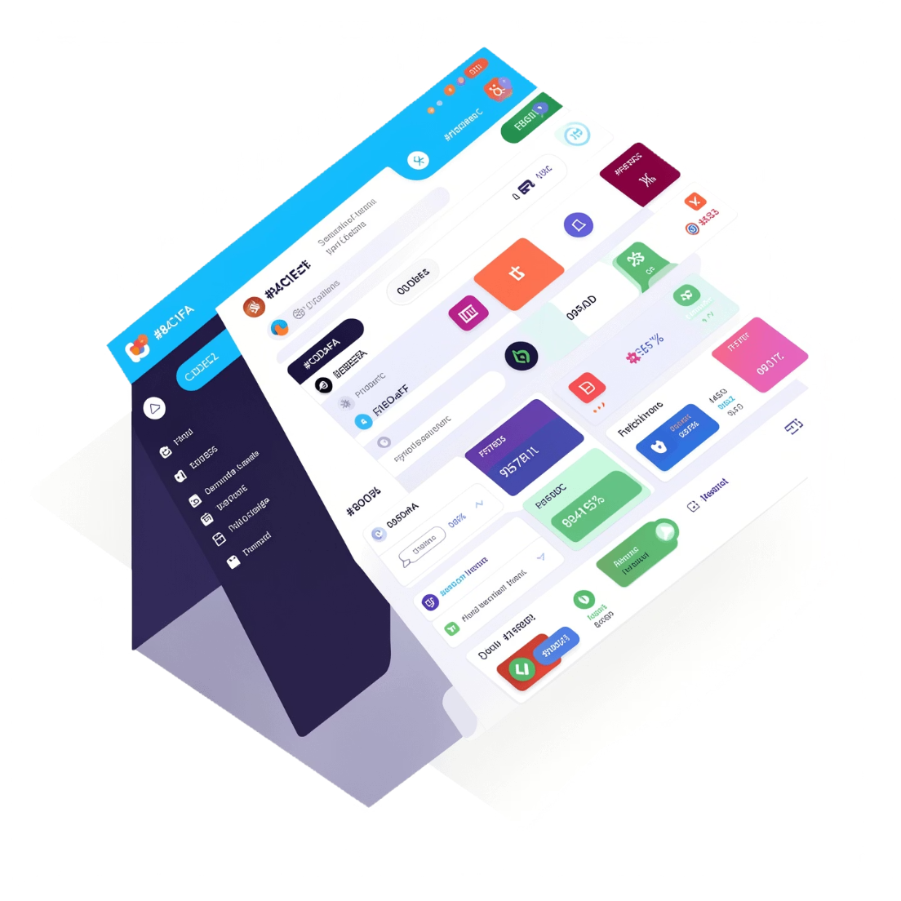
Introducing NeuralPath
NeuralPath is a MERN-stack platform that transforms how learners engage with education. By leveraging cutting-edge AI, we create custom learning roadmaps and automated study tools that adapt to each user's unique journey.
Our intelligent system assesses skill levels, identifies learning gaps, and generates step-by-step paths from beginner to advanced mastery—all while keeping users engaged through gamification and real-time progress tracking.

Slide 4
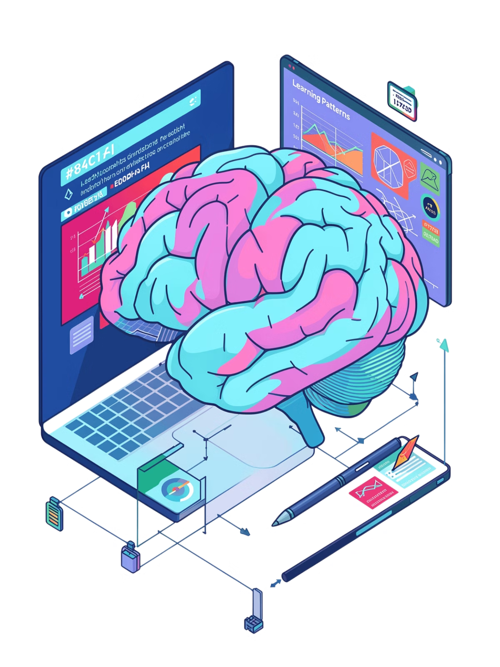



AI-Powered Learning Paths
Assessment Quiz
Diagnostic evaluation identifies current skill levels and interests
Dynamic Roadmap
AI generates personalized, step-by-step learning paths tailored to your goals
Progression System
Seamlessly advance from Beginner through Intermediate to Advanced mastery

Slide 5
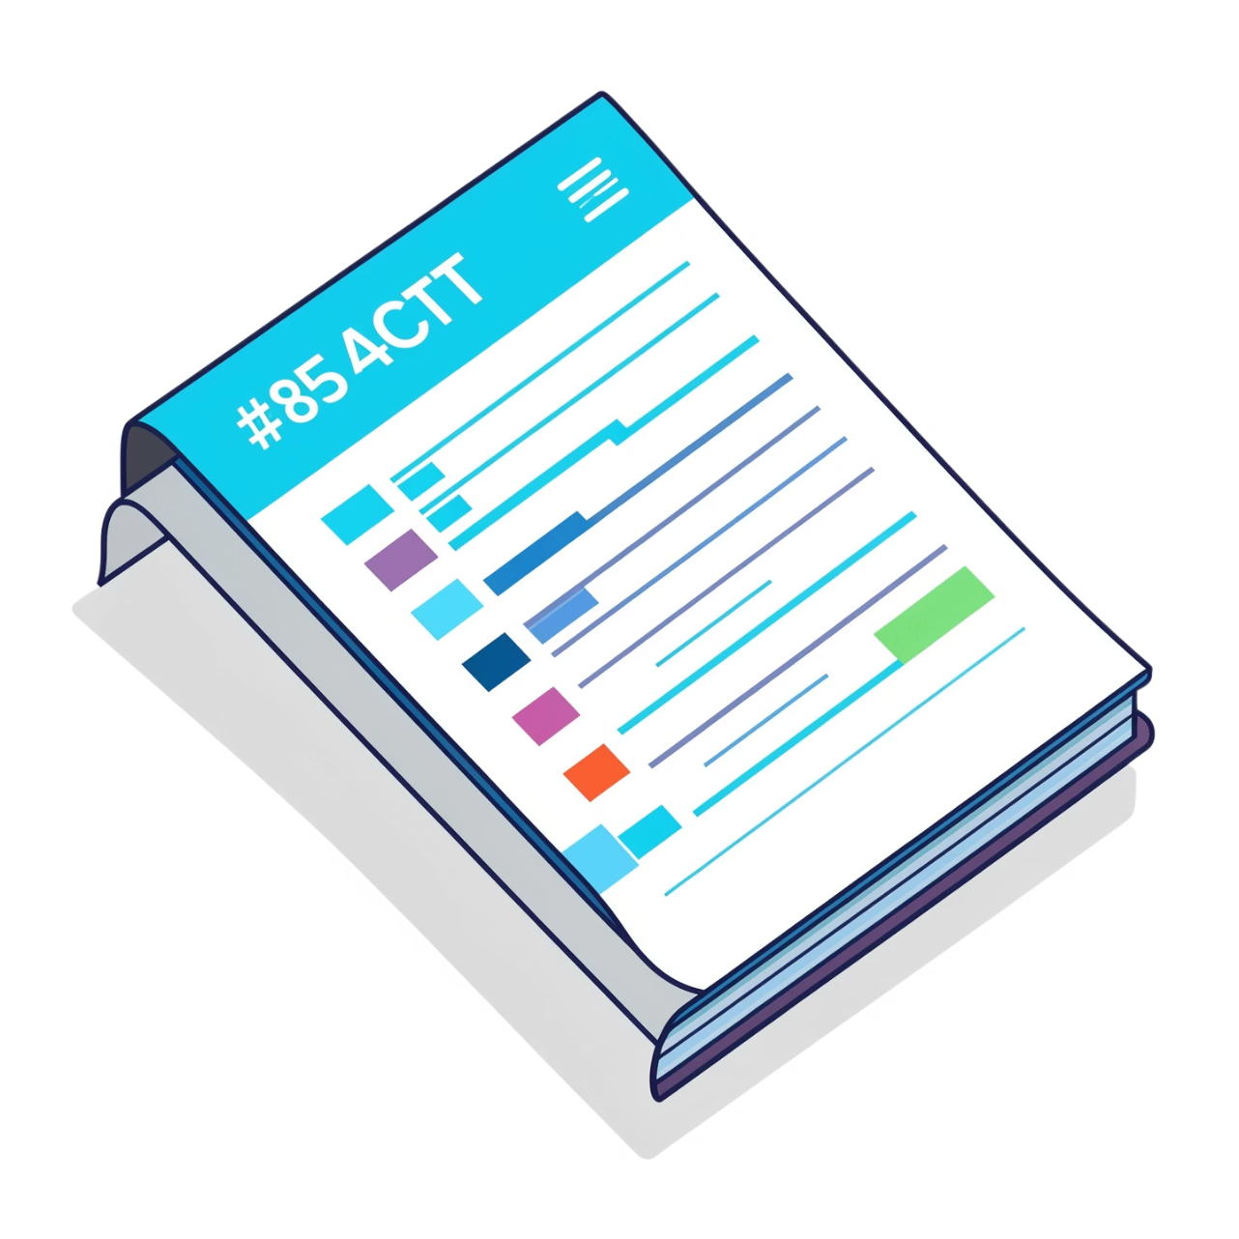
Smart Notes: From Static to Interactive
Intelligent OCR Technology
Our platform uses Tesseract.js to convert PDFs and images into dynamic study tools. Upload your materials and watch as NeuralPath automatically transforms them into interactive flashcards and mindmaps.
PDF and image file support
Automated text extraction
Visual mindmap generation
Interactive flashcard creation

Slide 6

Gamification & Engagement
Experience Points
Earn XP for completing lessons, quizzes, and milestones. Level up your learner profile as you progress through your journey.
Daily Streaks
Maintain consistency with streak tracking that rewards consecutive days of learning. Build momentum with visual streak displays.
Unlockable Achievements
Celebrate milestones with badges and achievements that recognize your dedication and mastery across different skill domains.

Slide 7

Interactive Dashboard
Real-Time Progress Charts
Weekly Activity Tracking
Recharts visualizations show completion rates, skill progression, and learning velocity with interactive data displays
Detailed breakdown of study hours, content engagement, and goal achievement across seven-day periods
Skill Level Visualizations
Intuitive indicators show competency levels across different topics, helping you identify strengths and areas for improvement

Slide 8
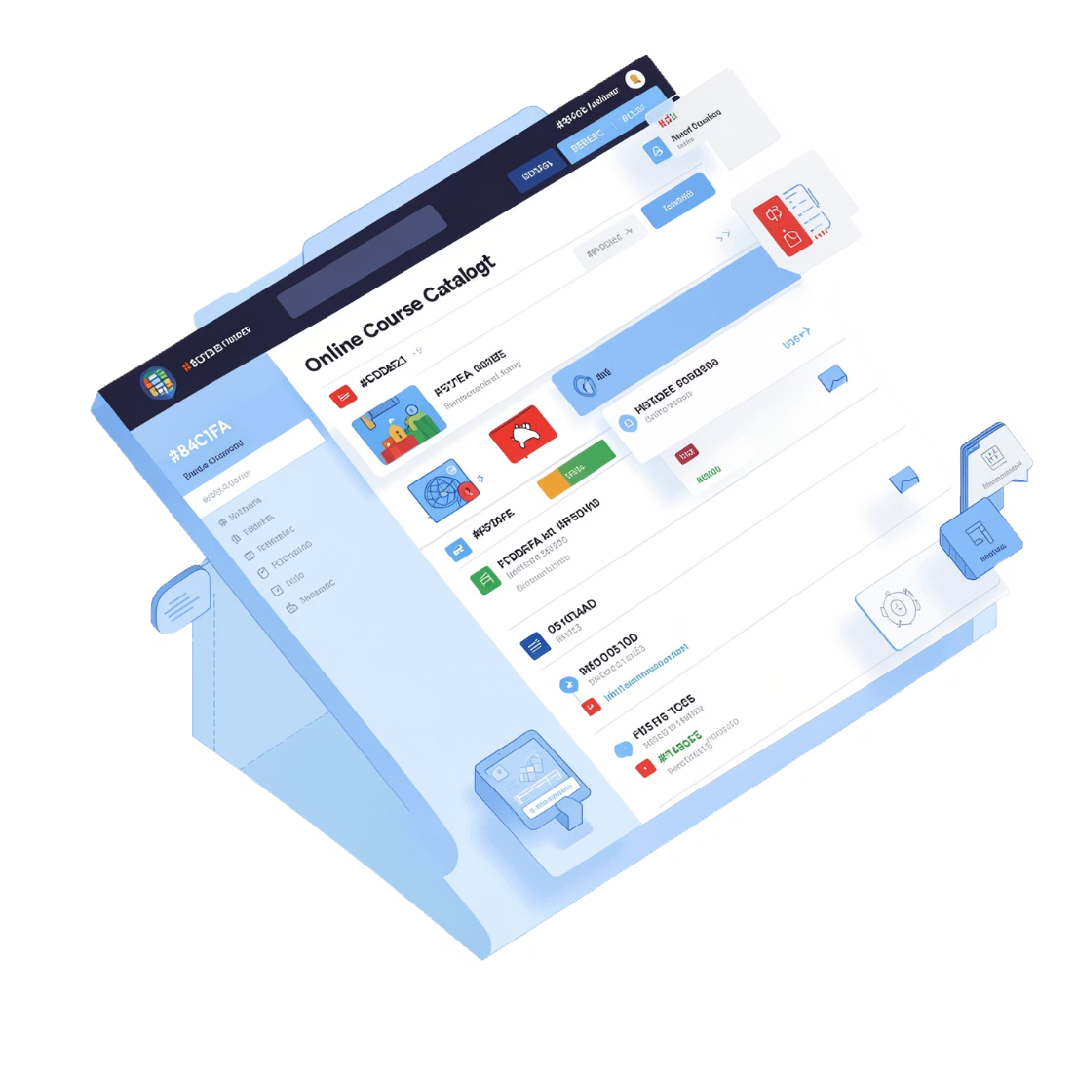
Course Catalog & Social Hub
Secure Course Marketplace
Browse and purchase premium courses through Razorpay integration, ensuring secure transactions for educational content.
Peers Hub
Connect with like-minded learners, share insights, and build your professional network within our community platform.

Slide 9
Modern Tech Stack
MongoDB
Express.js
Flexible NoSQL database for storing user profiles, learning paths, and course content
Backend framework handling API routes, middleware, and server-side logic
React
Node.js
Component-based frontend library creating responsive, interactive user interfaces
Server runtime enabling scalable backend services and real-time features
Vite: Lightning-fast development server and build tool
Tailwind CSS: Utility-first styling for consistent, modern UI
Framer Motion: Smooth animations and interactive transitions

Slide 10
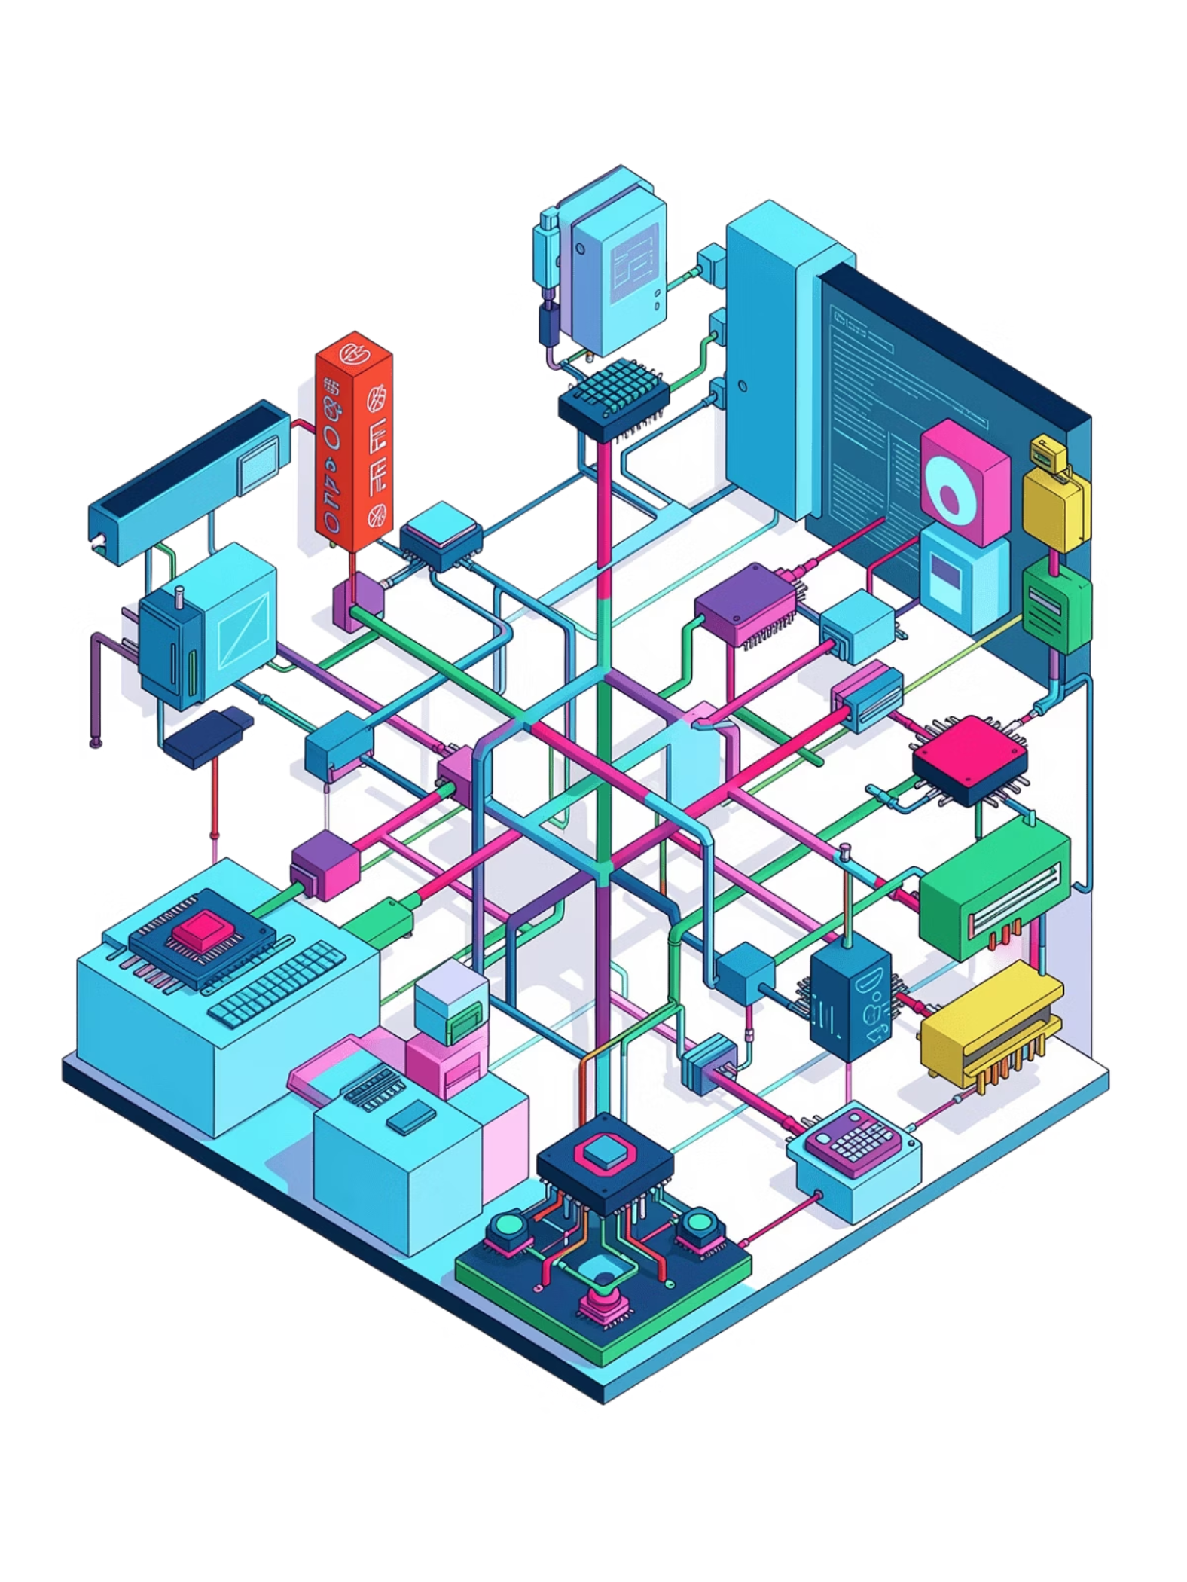
The Intelligence Behind NeuralPath
01
02
Adaptive Path Generation
TF-IDF Mindmap Extraction
Machine learning algorithms analyze user behavior to dynamically adjust learning trajectories and content recommendations
Term frequency-inverse document frequency analysis identifies key concepts and relationships within source materials
03
Heuristic Flashcard Parsing
Rule-based systems transform extracted content into optimized flashcards using spaced repetition principles

