Slide 1
AccessPath AI
“Don’t just test a website. Test whether a real person can actually complete the task.”
• Main Objective – Task-Level Accessibility & Usability Testing with Live AI Browser Agent
• Hackathon – HackIIITD 2026 — Indraprastha Institute of Information Technology Delhi (IIIT-D)
• Track / Theme – AI Browser Agents & Public Infrastructure Usability (TinyFish Powered)
• PS Category – Software / Web Accessibility / Autonomous Testing
• Team Name (Registered on portal) – [Team Name Placeholder]
• Team Members – [Member 1, Member 2, Member 3, Member 4 Placeholder]

Slide 2
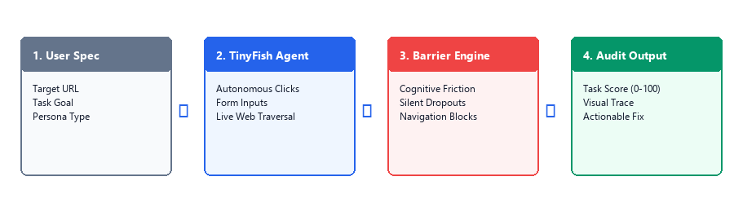
1
SECTION 01
Idea / Approach Detail
Problem
> Websites often pass technical accessibility checklists yet remain completely unusable for real people. While static scanners verify HTML tags and contrast, they cannot verify whether a real person can complete end-to-end tasks like submitting a scholarship or uploading required documents.
> Organizations need an automated, task-first testing platform that detects where and why users get stuck across dynamic forms, mobile viewports, and regional languages.
Solution
> AccessPath AI deploys a live AI browser agent to autonomously attempt real tasks on live portals from diverse user perspectives (mobile-first, Hindi-speaking, low digital-literacy).
> When a user encounters a friction point or unrecoverable barrier, the system captures step evidence, computes a Task Success Score (0–100), and provides actionable engineering fixes.
What Makes It Different
> Task-First Usability Over Static Compliance
Unlike static WCAG scanners that inspect code in isolation, AccessPath AI evaluates the complete multi-step journey on the live website.
> Persona-Aware Execution: Define ➔ Execute ➔ Detect ➔ Improve
Simulates realistic personas (device constraints, language hurdles, low literacy) to uncover hidden UX dead ends that traditional linters completely miss.
Section 01 of 08

Slide 3
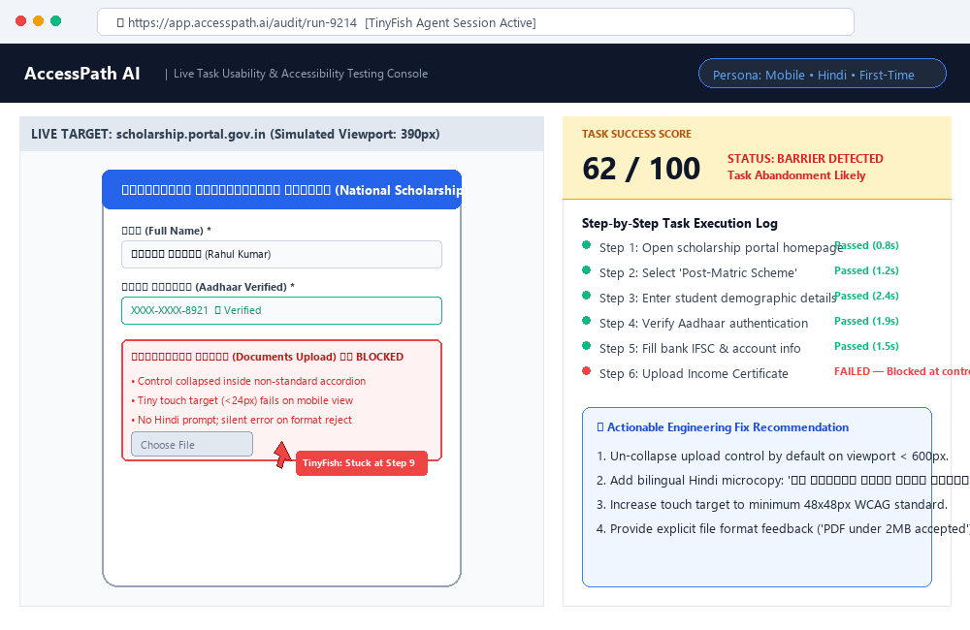
2
SECTION 02
Technical Approach
PROCESS & ARCHITECTURAL PIPELINE:
➢ 1. Test Specification Layer: Accepts Target URL, Goal Task ('Apply for Scholarship'), and User Persona profile (Mobile, Hindi, First-Time User).
➢ 2. Live Web Agent Layer (TinyFish): Spawns autonomous browser session executing real clicks, input typing, dropdown selects, and dynamic modal navigation.
➢ 3. Observation & Barrier Detection: Monitors execution telemetry, detecting DOM dead ends, cognitive friction, confusing controls, and silent form rejections.
➢ 4. Audit & Diagnostic Engine: Computes Task Success Score (0-100), captures failure screenshots, and outputs engineering remediation guidance.
User Input ➔ TinyFish Agent ➔ Live Portal ➔ Friction Detection ➔ Task Score & Fix
Prototype :
TECH STACK:
Web Agent: TinyFish Web Agent API • Frontend: React.js + TypeScript + TailwindCSS • Backend: Python + FastAPI • Analysis: Vision LLM Reasoner
Section 02 of 08

Slide 4
3
SECTION 03
Impact and Benefits
Social & Citizen Impact
> Equitable Public Services: Ensures students and rural citizens can successfully complete scholarship, pension, and welfare applications without agent exploitation.
> Overcoming Digital Literacy Barriers: Detects UI jargon and language hurdles that cause first-time users to abandon critical government portals.
> Assistive Dignity: Verifies functional completion for screen-reader and mobile users beyond surface-level tag compliance.
Economic & Operational Impact
> Dramatically Cheaper Usability Audits: Automates multi-persona user testing that traditionally costs thousands of dollars and weeks of manual user research.
> Reduced Support Desk Ticket Volume: Eliminating submission drop-offs cuts grievance tickets, helpline congestion, and manual document re-submissions.
> Increased Form Completion Rates: Organizations capture higher digital service adoption and revenue throughput across public and commercial portals.
Target Sectors & Deployment
> Government Public Portals: National & State scholarship portals, Direct Benefit Transfer (DBT), ration card and revenue services.
> Universities & Colleges: Admissions, entrance test registration, fee payment, and examination portals.
> Banking & FinTech: Digital KYC onboarding, micro-credit applications, insurance claim submission flows.
> Healthcare & Telemedicine: Appointment booking, diagnostic report retrieval, and health scheme registrations.
Section 03 of 08

Slide 5
4
SECTION 04
TinyFish Integration & Technical Feasibility
Potential Challenges
➢ Dynamic Client-Rendered SPAs & Popups
Modern portals rely heavily on React/Vue, asynchronous validation, modal popups, and anti-bot checks that break basic headless scrapers.
➢ Subjective Cognitive Usability vs Bugs
Distinguishing between a broken HTML element and a confusing UX layout (e.g. buried upload button) requires reasoning, not just DOM parsing.
➢ Execution Latency & Site Flakiness
Live multi-step web browsing can encounter slow government servers, dynamic reloads, or temporary network timeouts.
Mitigation & TinyFish Division
➢ TinyFish as Web Interaction Layer
TinyFish serves as the autonomous 'eyes and hands'—handling live browser control, DOM interactions, resilient retries, and multi-page flows seamlessly.
➢ AccessPath as Cognitive Analysis Layer
AccessPath evaluates task intent, scores cognitive friction, and explains exactly why the user journey failed with visual evidence.
➢ Graceful Degradation & Step Checkpoints
System records deterministic telemetry at each step; if a live network stall occurs, prior completed steps remain cached and auditable.
TINYFISH WEB AGENT • COGNITIVE BARRIER DETECTION • FAIL-SOFT AUDIT ARCHITECTURE
Section 04 of 08

Slide 6
5
SECTION 05
Research and References
1. World Wide Web Consortium (W3C), “Web Content Accessibility Guidelines (WCAG) 2.2,” W3C Recommendation, Oct 2023.
https://www.w3.org/TR/WCAG22/
2. Ministry of Electronics and Information Technology (MeitY), Govt. of India, “Guidelines for Indian Government Websites (GIGW 3.0),” 2023.
https://guidelines.gov.in/
3. WebAIM, “The WebAIM Million: An annual accessibility analysis of the top 1,000,000 home pages,” WebAIM Research Report, 2024.
https://webaim.org/projects/million/
4. Zhou S. et al., “WebArena: A Realistic Web Environment for Building Autonomous Agents,” International Conference on Learning Representations (ICLR), 2024.
https://arxiv.org/abs/2307.13854
5. Gur I. et al., “A Real-World WebAgent with Planning, Long Context Understanding, and HTML Pruning,” Advances in Neural Information Processing Systems (NeurIPS), 2023.
https://arxiv.org/abs/2307.12856
6. Power C. et al., “Guidelines Are Only Half of the Story: How Accessibility Guidelines Fail People with Disabilities,” ACM CHI Conference on Human Factors in Computing Systems, 2012.
https://dl.acm.org/doi/10.1145/2207676.2207736
7. National e-Governance Division (NeGD), “Digital India Usability and Citizen Interface Standards,” MeitY, 2022.
https://www.digitalindia.gov.in/
Section 05 of 08

Slide 7
6
SECTION 06
Solution Summary
Problem
➔
Websites can be technically compliant under static WCAG rules and yet remain impossible for citizens to use. Static code checkers only inspect isolated syntax tags, missing end-to-end user friction, mobile viewport traps, and Hindi language barriers on real portals.
Proposed Solution
➔
AccessPath AI pairs a live AI browser agent (powered by TinyFish) with task-level cognitive diagnostics. It tests live websites from specific user persona perspectives, executing the full workflow to verify whether a real person can actually achieve their goal.
Novelty / USP
➔
Task-first outcome testing rather than page-level checklists. Provides persona-aware simulation, live web multi-step execution, and an objective Task Success Score (0-100) with visual evidence and engineering remediation.
Feasibility
➔
Feasible 24-hour hackathon prototype combining TinyFish Web Agent API for autonomous browsing, React/Tailwind for the audit console, and Python/LLM reasoning for barrier scoring and recommendations.
Impact
➔
CITIZEN ACCESS: Enables students and rural users to complete critical welfare and scholarship forms.
ORGANIZATIONAL EFFICIENCY: Lowers usability testing costs and prevents grievance ticket backlogs.
OUTCOME ACCOUNTABILITY: Moves web accessibility evaluation from passive checklists to proven task completion.
Section 06 of 08

Slide 8
7
SECTION 07
The Big Idea: Accessibility Measured by Outcomes
“Traditional Testing Asks: ‘Does the website pass a code checklist?’
AccessPath AI Asks: ‘Can a real human being actually complete the task?’”
AccessPath AI helps organizations build websites that people can actually use — not just websites that pass a checklist.
SUBMISSION & TEAM DETAILS
• Hackathon Event: HackIIITD 2026 — IIIT Delhi (TinyFish Web Agent Track)
• Project Name: AccessPath AI
• Team Name (Registered): ___________________________ [Space for Team Name]
• Team Leader: ___________________________ [Name, Email / Contact]
• Team Members: 1. ___________________________________
2. ___________________________________
3. ___________________________________
• GitHub Repository: https://github.com/___________________ [Prototype Repo]
Section 07 of 08

