Slide 1
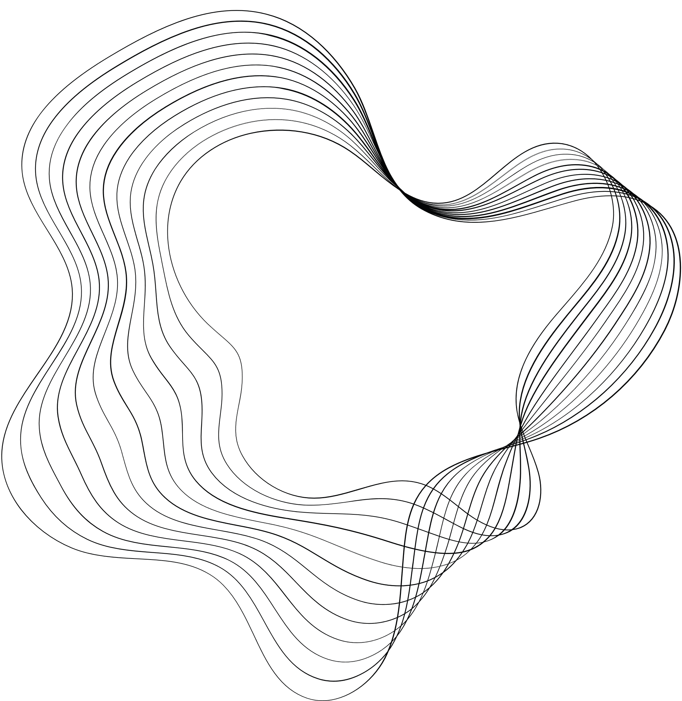

INSE 6250
Modeling and Verification of an Insurance
Purchase Website Using Uppaal
Submitted By:
Supriya Avala – 40258501
Bhanu Teja Kakarla – 40256174
Kunati Bala Krishna Yadav – 40292128
Naveen Rayapudi – 40291526
Submitted To
DR. JAMAL BENTAHAR

Slide 2
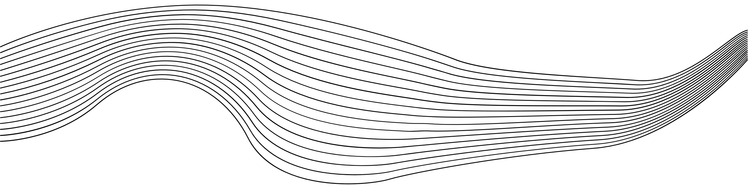
CONTENT
01
INTRODUCTION
02
ABOUT TOOL
03
MODEL
04
SYSTEM REQUIREMENTS
05
PROJECT
06
PROJECT DEMO

Slide 3

INTRODUCTION
Model Checking
Model checking is an automated technique for verifying that a system model satisfies specified properties, such as safety and liveness, by exhaustively exploring all possible states and transitions.
It uses temporal logic to specify and check properties, ensuring that systems meet required behaviors over time, such as "eventually" or "always" conditions.

Slide 4
Modeling & Verification
System modeling is putting a system's behavior and structure into an abstract representation. Diagrams or formal languages are frequently used to depict the system's elements and interactions.
Visualization: Through simulation of many scenarios and configurations, it aids in the design of systems and the analysis of their behavior, performance, and correctness prior to implementation.
Correctness Assurance: Verification is the process of ensuring that a system or component meets its specifications and performs its intended functions correctly, typically through methods like testing, inspection, or formal verification.
Error Detection: It aims to identify and correct errors or inconsistencies in the system design or implementation, ensuring that all specified requirements and constraints are satisfied.

Slide 5



UPPAAL
Users can examine system behavior under timing restrictions and make sure the system satisfies performance and safety criteria by utilizing UPPAAL, a tool for modeling and validating real-time systems using timed automata.
Key Features include automated model checking for verifying temporal properties, simulation capabilities and extensions for optimizing real-time strategies and performance analysis.

Slide 6



SYSTEM REQUIREMENTS
TOOL
MODEL
Modeling capability
Simulation support
Performance analysis
Insurance Selection
Login approach
Policy Management

Slide 7
PROJECT
Modeling and Verification of an Insurance Purchase Website Using Uppaal
View Insurance Plans
Purchase desired Insurance (medical, car, etc.,)
Managing Profile
Payments
Claims Handling

Slide 8
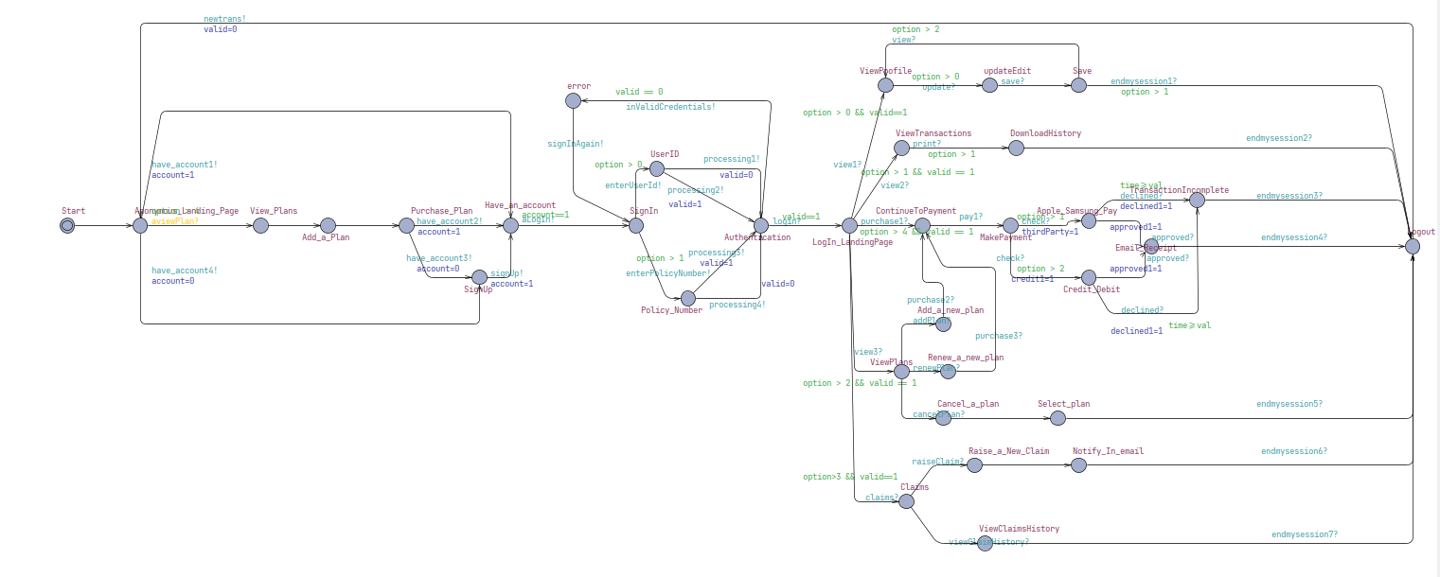
SERVER MODEL

Slide 9
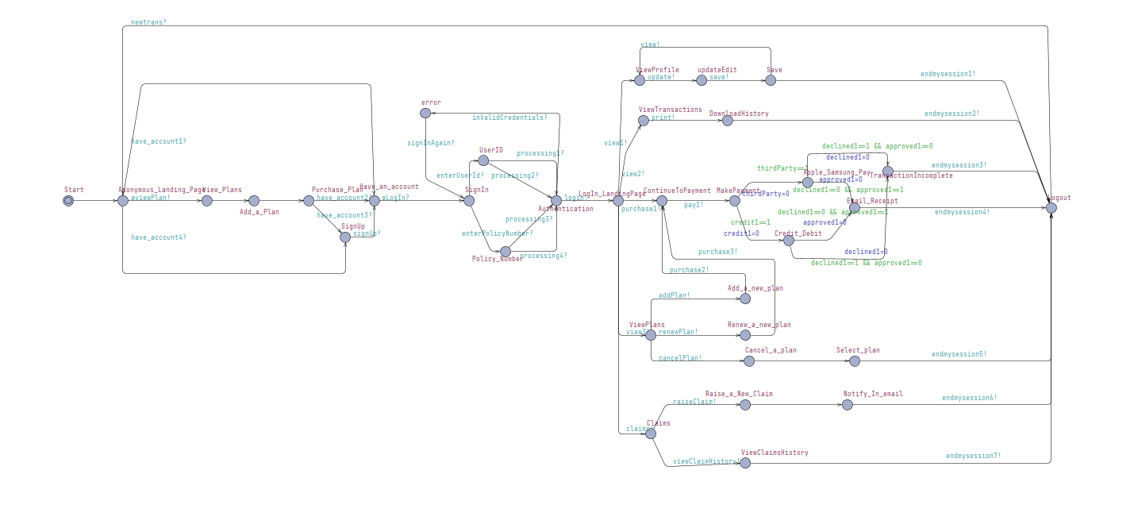
USER MODEL

Slide 10
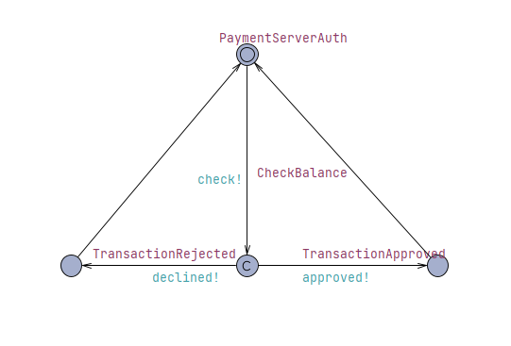
PAYMENT SYSTEM MODEL

Slide 11

CONCEPT
Users can view the plans on the default home page and would require to own an account to purchase any plans
User must enter their email or policy number to login the site.
Secure authentication takes place for each login.
Users can choose a plan that is suitable for their requirement and claim it.
They can also add new/re-new the old and cancel the plans
Existing users can add a plan to purchase and process the payment.

Slide 12
CONCEPT
Users can raise a new claim and would be notified in the email.
Users can also view claim history records.
Accepted payment types are Credit/Debit and Apple/Samsung pay.
In case of failed payments, the page returns to payment procedures.
New and Existing users will be able to view transaction history and update the profile & Save.
After every purchase made, the client will receive an E-mail receipt.

Slide 13
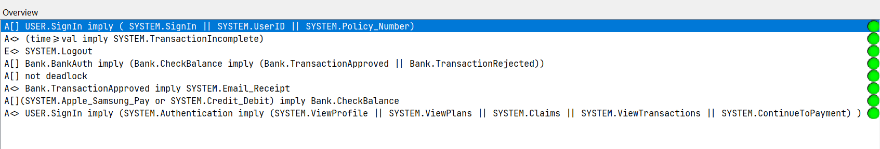
Verification Results

Slide 14

THANK YOU

