Slide 1







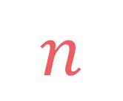

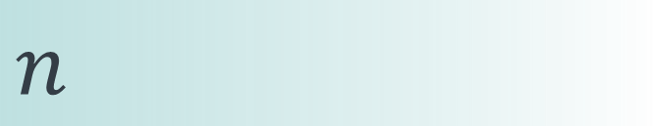

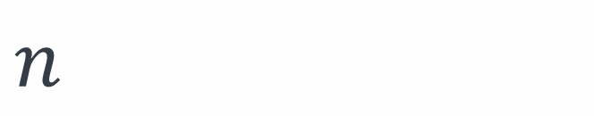
left
[4, 5, 1, 7, 2, 6, 3, 8]
no margin
Space complexity:
$$O(n)$$
list
list
list
list
mid
no margin
"string"
4 | 5 | 1 | 7 | 2 | 6 | 3 | 8
Space complexity:
$$O(n)$$
5
5
$
5
rec(n)
$$n$$
5
$$n$$
$$⇒$$
$$n$$
Time complexity:
$$O(n)$$
text
text
 |  |  | a
$$n$$
text
text
no margin
no margin
no margin
no margin
no margin
no margin
no margin
no margin

Slide 2
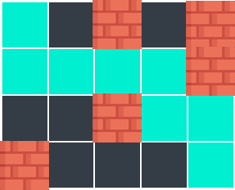
Paths in matrix

Slide 3

$$matrix\left[i\right]\left[j\right]∈\left\{0, 1\right\} \\ \left|matrix\right|≥1 \\ \left|matrix\left[i\right]\right|≥1$$
Given a matrix where a cell has the value of 1 if it's a wall and 0 if not, find the number of ways to go from the top-left cell to the bottom-right cell, knowing that it's not possible to pass from a wall and we can only go to the right or to the bottom

Slide 4


$$matrix\left[i\right]\left[j\right]∈\left\{0, 1\right\} \\ \left|matrix\right|≥1 \\ \left|matrix\left[i\right]\right|≥1$$
Given a matrix where a cell has the value of 1 if it's a wall and 0 if not, find the number of ways to go from the top-left cell to the bottom-right cell, knowing that it's not possible to pass from a wall and we can only go to the right or to the bottom
input:
matrix = [ [0, 0, 1, 0, 1], [0, 0, 0, 0, 1], [0, 0, 1, 0, 0], [1, 0, 0, 0, 0] ]
output: 7
explanation:

Slide 7
paths
(0,0)
paths
(1,0)
paths
(0,1)

Slide 8
paths
(i,j)
to the bottom
to the right
paths
(i+1,j)
paths
(i,j+1)

Slide 9
paths
(i+1,j)
+
paths
(i,j+1)

Slide 10
$$i=n \text{or} j=m \text{or} matrix\left[i\right]\left[j\right]==0→0$$

Slide 11
$$i=n \text{or} j=m \text{or} matrix\left[i\right]\left[j\right]==0→0$$
$$i=n−1 \text{and} j=m−1→1$$

Slide 12
def paths(matrix, i=0, j=0): n, m = len(matrix), len(matrix[0]) if i == n or j == m or matrix[i][j] == 1: return 0 elif i == n-1 and j == m-1: return 1 else: return paths(matrix, i+1, j) + paths(matrix, i, j+1)

Slide 13
def paths(matrix, i=0, j=0): n, m = len(matrix), len(matrix[0]) if i == n or j == m or matrix[i][j] == 1: return 0 elif i == n-1 and j == m-1: return 1 else: return paths(matrix, i+1, j) + paths(matrix, i, j+1)

Slide 14
def paths(matrix, i=0, j=0): n, m = len(matrix), len(matrix[0]) if i == n or j == m or matrix[i][j] == 1: return 0 elif i == n-1 and j == m-1: return 1 else: return paths(matrix, i+1, j) + paths(matrix, i, j+1)

Slide 15
def paths(matrix, i=0, j=0): n, m = len(matrix), len(matrix[0]) if i == n or j == m or matrix[i][j] == 1: return 0 elif i == n-1 and j == m-1: return 1 else: return paths(matrix, i+1, j) + paths(matrix, i, j+1)

Slide 16
def paths(matrix, i=0, j=0): n, m = len(matrix), len(matrix[0]) if i == n or j == m or matrix[i][j] == 1: return 0 elif i == n-1 and j == m-1: return 1 else: return paths(matrix, i+1, j) + paths(matrix, i, j+1)

Slide 17
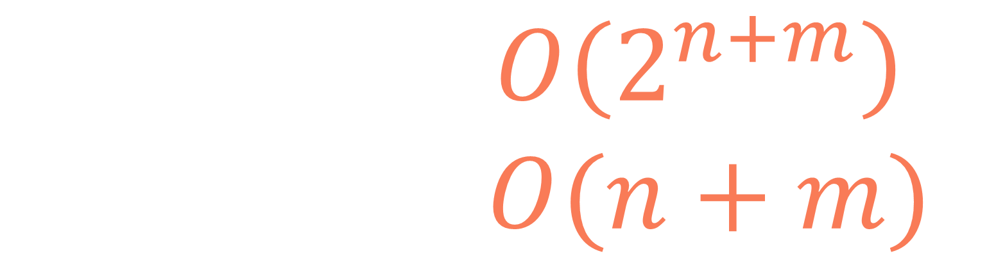
$$T\left(n,m\right)=O\left(2^{n+m}\right) \\ S\left(n,m\right)=O(n+m)$$

Slide 18
input:
matrix = [ [0, 0, 1, 0, 1], [0, 0, 0, 0, 1], [0, 0, 1, 0, 0], [1, 0, 0, 0, 0] ]
paths
(0,0)
paths
(1,0)
paths
(0,1)
paths
(2,0)
paths
(1,1)
paths
(1,1)
paths
(0,2)
paths
(3,0)
paths
(2,1)
paths
(2,1)
paths
(1,2)
paths
(2,1)
paths
(1,2)
.
.
.
.
.
.
.
.
.
.
.
.
.
.
.
.
.
.

Slide 19
input:
matrix = [ [0, 0, 1, 0, 1], [0, 0, 0, 0, 1], [0, 0, 1, 0, 0], [1, 0, 0, 0, 0] ]
paths
(0,0)
paths
(0,1)
paths
(0,2)
paths
(1,0)
paths
(1,1)
paths
(1,2)
paths
(1,3)
paths
(1,4)
paths
(2,0)
paths
(2,1)
paths
(2,2)
paths
(2,3)
paths
(2,4)
paths
(2,5)
paths
(3,0)
paths
(3,1)
paths
(3,2)
paths
(3,3)
paths
(3,4)
paths
(4,1)
paths
(4,2)
paths
(4,3)

Slide 20
input:
matrix = [ [0, 0, 1, 0, 1], [0, 0, 0, 0, 1], [0, 0, 1, 0, 0], [1, 0, 0, 0, 0] ]
paths
(0,0)
paths
(0,1)
paths
(0,2)
paths
(1,0)
paths
(1,1)
paths
(1,2)
paths
(1,3)
paths
(1,4)
paths
(2,0)
paths
(2,1)
paths
(2,2)
paths
(2,3)
paths
(2,4)
paths
(2,5)
paths
(3,0)
paths
(3,1)
paths
(3,2)
paths
(3,3)
paths
(3,4)
paths
(4,1)
paths
(4,2)
paths
(4,3)

Slide 21
def paths(matrix, i=0, j=0): n, m = len(matrix), len(matrix[0]) if i == n or j == m or matrix[i][j] == 1: return 0 elif i == n-1 and j == m-1: return 1 else: return paths(matrix, i+1, j) + paths(matrix, i, j+1)

Slide 22
def paths(matrix, i=0, j=0): n, m = len(matrix), len(matrix[0]) if i == n or j == m or matrix[i][j] == 1: return 0 elif i == n-1 and j == m-1: return 1 else: return paths(matrix, i+1, j) + paths(matrix, i, j+1)
i changes
j changes

Slide 23
1
def paths(matrix, i=0, j=0, lookup=None): lookup = {} if lookup is None else lookup n, m = len(matrix), len(matrix[0]) if (i, j) in lookup: return lookup[(i, j)] if i == n or j == m or matrix[i][j] == 1: return 0 elif i == n-1 and j == m-1: return 1 else: lookup[(i, j)] = paths(matrix, i+1, j, lookup)
+ paths(matrix, i, j+1, lookup) return lookup[(i, j)]
2
3
4

Slide 24





$$i∈\{0,1,…,n−1\}$$
$$j∈\{0,1,…,m−1\}$$
$$n$$
$$m$$
$$(i,j)∈\{\left(0,0\right),\left(0,1\right),\left(1,0\right),…,(n−1,m−1)\}$$
$$nm$$

Slide 25
$$i∈\{0,1,…,n−1\}$$
$$j∈\{0,1,…,m−1\}$$
$$n$$
$$m$$
$$(i,j)∈\{\left(0,0\right),\left(0,1\right),\left(1,0\right),…,(n−1,m−1)\}$$
$$nm$$
$$T\left(n,m\right)=nm∗O\left(1\right)=O(nm)$$

Slide 26
$$S(n,m)=O\left(n+m\right)+O(nm)=O(nm)$$
call stack size
lookup table size

Slide 27


$$i∈\{0,1,…,n−1\}$$
$$j∈\{0,1,…,m−1\}$$
$$n$$
$$m$$
$$m$$
$$n$$

Slide 28
$$i∈\{0,1,…,n−1\}$$
$$j∈\{0,1,…,m−1\}$$
$$n$$
$$m$$
$$m$$
$$n$$

Slide 29
$$i∈\{0,1,…,n−1\}$$
$$j∈\{0,1,…,m−1\}$$
$$n$$
$$m$$
$$m$$
$$n$$

Slide 30
$$i∈\{0,1,…,n−1\}$$
$$j∈\{0,1,…,m−1\}$$
$$n$$
$$m$$
$$m$$
$$n$$

Slide 31


$$i∈\{0,1,…,n−1\}$$
$$j∈\{0,1,…,m−1\}$$
$$n$$
$$m$$
$$m$$
dp[i][j] should represent the number of ways of going from the top-left cell to the cell (i,j)
$$n$$

Slide 32
input:
dp

Slide 33
input:
dp
1

Slide 34
input:
dp
1
1

Slide 35
input:
dp
wall
1
1
0

Slide 36
input:
dp
1
1
0
0

Slide 37
input:
dp
wall
1
1
0
0
0

Slide 38
input:
dp
1
1
0
0
0
1

Slide 39
input:
dp
1
1
0
0
0
1
1

Slide 40
input:
dp
1
1
0
0
0
1
1
0
wall

Slide 41
input:
dp
1
1
0
0
0
1
1
0
dp[i][j] = dp[i-1][j] + dp[i][j-1] if matrix[i][j] == 0 else 0

Slide 42
input:
dp
1
1
0
0
0
1
2
1
0
dp[i][j] = dp[i-1][j] + dp[i][j-1] if matrix[i][j] == 0 else 0

Slide 43
input:
dp
1
1
0
0
0
1
2
2
1
0
dp[i][j] = dp[i-1][j] + dp[i][j-1] if matrix[i][j] == 0 else 0

Slide 44
input:
dp
1
1
0
0
0
1
2
2
2
1
0
dp[i][j] = dp[i-1][j] + dp[i][j-1] if matrix[i][j] == 0 else 0

Slide 45
input:
dp
1
1
0
0
0
1
2
2
2
0
1
0
dp[i][j] = dp[i-1][j] + dp[i][j-1] if matrix[i][j] == 0 else 0

Slide 46
input:
dp
1
1
0
0
0
1
2
2
2
0
1
3
0
dp[i][j] = dp[i-1][j] + dp[i][j-1] if matrix[i][j] == 0 else 0

Slide 47
input:
dp
1
1
0
0
0
1
2
2
2
0
1
3
0
0
dp[i][j] = dp[i-1][j] + dp[i][j-1] if matrix[i][j] == 0 else 0

Slide 48
input:
dp
1
1
0
0
0
1
2
2
2
0
1
3
0
2
0
dp[i][j] = dp[i-1][j] + dp[i][j-1] if matrix[i][j] == 0 else 0

Slide 49
input:
dp
1
1
0
0
0
1
2
2
2
0
1
3
0
2
2
0
dp[i][j] = dp[i-1][j] + dp[i][j-1] if matrix[i][j] == 0 else 0

Slide 50
input:
dp
1
1
0
0
0
1
2
2
2
0
1
3
0
2
2
0
3
dp[i][j] = dp[i-1][j] + dp[i][j-1] if matrix[i][j] == 0 else 0

Slide 51
input:
dp
1
1
0
0
0
1
2
2
2
0
1
3
0
2
2
0
3
3
dp[i][j] = dp[i-1][j] + dp[i][j-1] if matrix[i][j] == 0 else 0

Slide 52
input:
dp
1
1
0
0
0
1
2
2
2
0
1
3
0
2
2
0
3
3
5
dp[i][j] = dp[i-1][j] + dp[i][j-1] if matrix[i][j] == 0 else 0

Slide 53
input:
dp
1
1
0
0
0
1
2
2
2
0
1
3
0
2
2
0
3
3
5
7
dp[i][j] = dp[i-1][j] + dp[i][j-1] if matrix[i][j] == 0 else 0

Slide 54
input:
dp
1
1
0
0
0
1
2
2
2
0
1
3
0
2
2
0
3
3
5
7
dp[i][j] = dp[i-1][j] + dp[i][j-1] if matrix[i][j] == 0 else 0

Slide 55
def paths(matrix): n, m = len(matrix), len(matrix[0]) dp = [([0]*m) for i in range(n)] dp[0][0] = 1 if (matrix[0][0] == 0) else 0 for j in range(1, m): dp[0][j] = dp[0][j-1] if matrix[0][j] == 0 else 0 for i in range(1, n): dp[i][0] = dp[i-1][0] if matrix[i][0] == 0 else 0 for i in range(1, n): for j in range(1, m): dp[i][j] = dp[i-1][j] + dp[i][j-1] if matrix[i][j] == 0 else 0 return dp[n-1][m-1]

Slide 56
def paths(matrix): n, m = len(matrix), len(matrix[0]) dp = [([0]*m) for i in range(n)] dp[0][0] = 1 if (matrix[0][0] == 0) else 0 for j in range(1, m): dp[0][j] = dp[0][j-1] if matrix[0][j] == 0 else 0 for i in range(1, n): dp[i][0] = dp[i-1][0] if matrix[i][0] == 0 else 0 for i in range(1, n): for j in range(1, m): dp[i][j] = dp[i-1][j] + dp[i][j-1] if matrix[i][j] == 0 else 0 return dp[n-1][m-1]

Slide 57
def paths(matrix): n, m = len(matrix), len(matrix[0]) dp = [([0]*m) for i in range(n)] dp[0][0] = 1 if (matrix[0][0] == 0) else 0 for j in range(1, m): dp[0][j] = dp[0][j-1] if matrix[0][j] == 0 else 0 for i in range(1, n): dp[i][0] = dp[i-1][0] if matrix[i][0] == 0 else 0 for i in range(1, n): for j in range(1, m): dp[i][j] = dp[i-1][j] + dp[i][j-1] if matrix[i][j] == 0 else 0 return dp[n-1][m-1]

Slide 58
def paths(matrix): n, m = len(matrix), len(matrix[0]) dp = [([0]*m) for i in range(n)] dp[0][0] = 1 if (matrix[0][0] == 0) else 0 for j in range(1, m): dp[0][j] = dp[0][j-1] if matrix[0][j] == 0 else 0 for i in range(1, n): dp[i][0] = dp[i-1][0] if matrix[i][0] == 0 else 0 for i in range(1, n): for j in range(1, m): dp[i][j] = dp[i-1][j] + dp[i][j-1] if matrix[i][j] == 0 else 0 return dp[n-1][m-1]

Slide 59
def paths(matrix): n, m = len(matrix), len(matrix[0]) dp = [([0]*m) for i in range(n)] dp[0][0] = 1 if (matrix[0][0] == 0) else 0 for j in range(1, m): dp[0][j] = dp[0][j-1] if matrix[0][j] == 0 else 0 for i in range(1, n): dp[i][0] = dp[i-1][0] if matrix[i][0] == 0 else 0 for i in range(1, n): for j in range(1, m): dp[i][j] = dp[i-1][j] + dp[i][j-1] if matrix[i][j] == 0 else 0 return dp[n-1][m-1]

Slide 60
def paths(matrix): n, m = len(matrix), len(matrix[0]) dp = [([0]*m) for i in range(n)] dp[0][0] = 1 if (matrix[0][0] == 0) else 0 for j in range(1, m): dp[0][j] = dp[0][j-1] if matrix[0][j] == 0 else 0 for i in range(1, n): dp[i][0] = dp[i-1][0] if matrix[i][0] == 0 else 0 for i in range(1, n): for j in range(1, m): dp[i][j] = dp[i-1][j] + dp[i][j-1] if matrix[i][j] == 0 else 0 return dp[n-1][m-1]

Slide 61
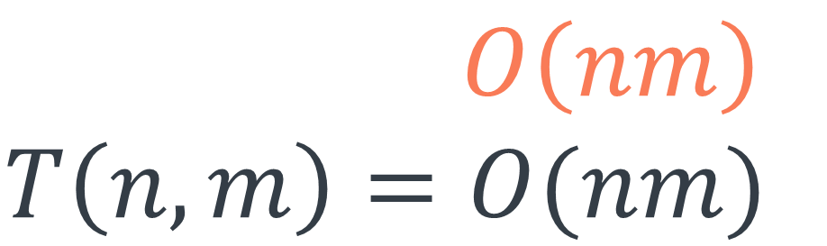
def paths(matrix): n, m = len(matrix), len(matrix[0]) dp = [([0]*m) for i in range(n)] dp[0][0] = 1 if (matrix[0][0] == 0) else 0 for j in range(1, m): dp[0][j] = dp[0][j-1] if matrix[0][j] == 0 else 0 for i in range(1, n): dp[i][0] = dp[i-1][0] if matrix[i][0] == 0 else 0 for i in range(1, n): for j in range(1, m): dp[i][j] = dp[i-1][j] + dp[i][j-1] if matrix[i][j] == 0 else 0 return dp[n-1][m-1]
$$S\left(n,m\right)=O\left(nm\right) \\ T\left(n,m\right)=O(nm)$$

Slide 62
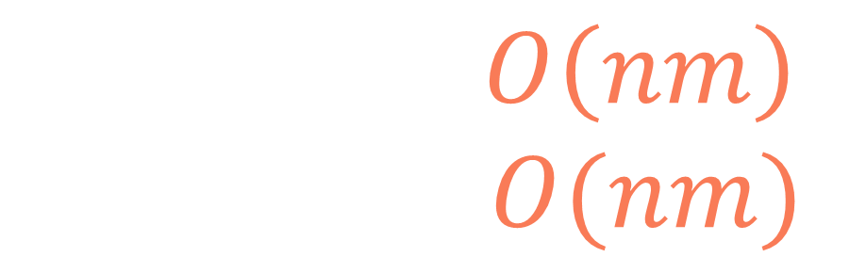
def paths(matrix): n, m = len(matrix), len(matrix[0]) dp = [([0]*m) for i in range(n)] dp[0][0] = 1 if (matrix[0][0] == 0) else 0 for j in range(1, m): dp[0][j] = dp[0][j-1] if matrix[0][j] == 0 else 0 for i in range(1, n): dp[i][0] = dp[i-1][0] if matrix[i][0] == 0 else 0 for i in range(1, n): for j in range(1, m): dp[i][j] = dp[i-1][j] + dp[i][j-1] if matrix[i][j] == 0 else 0 return dp[n-1][m-1]
$$S\left(n,m\right)=O\left(nm\right) \\ T\left(n,m\right)=O(nm)$$

Slide 63
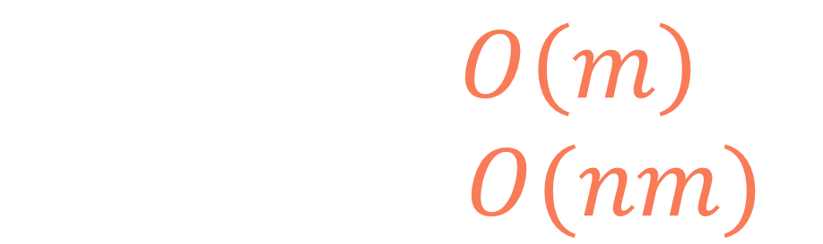
def paths(matrix): n, m = len(matrix), len(matrix[0]) prev_dp = [0]*m dp = [0]*m prev_dp[0] = 1 if (matrix[0][0] == 0) else 0 for j in range(1, m): prev_dp[j] = prev_dp[j-1] if matrix[0][j] == 0 else 0 for i in range(1, n): dp[0] = prev_dp[0] if matrix[i][0] == 0 else 0 for j in range(1, m): dp[j] = prev_dp[j] + dp[j-1] if matrix[i][j] == 0 else 0 prev_dp = dp dp = [0]*m return prev_dp[m-1]
$$S\left(n,m\right)=O\left(m\right) \\ T\left(n,m\right)=O(nm)$$

Slide 64
Paths in matrix

