Slide 1







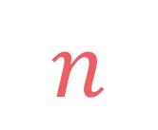

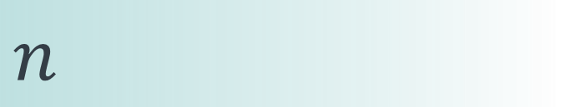

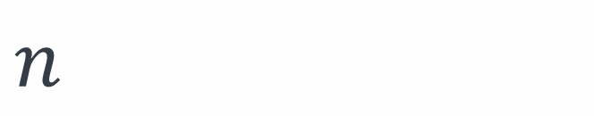
left
[4, 5, 1, 7, 2, 6, 3, 8]
no margin
Space complexity:
$$O(n)$$
list
list
list
list
mid
no margin
"string"
4 | 5 | 1 | 7 | 2 | 6 | 3 | 8
Space complexity:
$$O(n)$$
5
5
$
5
rec(n)
$$n$$
5
$$n$$
$$⇒$$
$$n$$
Time complexity:
$$O(n)$$
text
text
 |  |  | a
$$n$$
text
text
no margin
no margin
no margin
no margin
no margin
no margin
no margin
no margin

Slide 2

Subset
sum

Slide 3

$$arr\left[i\right]≥1 \\ k≥1$$
Given an array of strictly positive integers arr and a strictly positive integer k, count the number of subsets that sum up to k

Slide 4
$$arr\left[i\right]≥1 \\ k≥1$$
Given an array of strictly positive integers arr and a strictly positive integer k, count the number of subsets that sum up to k
input:
arr = [1, 2, 3, 1, 4],
k = 6
output: 4
explanation: we have 4 subsets that sum up to 6:
[1, 2, 3], [1, 1, 4], [2, 3, 1], and [2, 4]

Slide 5
knapsack(k, i)
knapsack
(k-weights[i], i+1)
knapsack(k, i+1)

Slide 6
knapsack(k, i)
knapsack
(k-weights[i], i+1)
knapsack(k, i+1)

Slide 7
subsets(k, i)
subsets
(k-arr[i], i+1)
subsets(k, i+1)

Slide 8
subsets(k, i)
subsets
(k-arr[i], i+1)
subsets(k, i+1)

Slide 9

when we take arr[i] in our subset
$$subsets\left(k,i\right)=subsets\left(k−arr\left[i\right],i+1\right)$$ $+subsets(k, i+1)$
when we don't take arr[i]

Slide 10



$$k=0→1$$
$$i=|arr|→0$$
$$k<0→0$$

Slide 11







$$1$$
$$if k=0$$
$$0$$
$$subsets\left(k,i\right)=$$
$$if i=\left|arr\right| or k<0$$
$$subsets\left(k−arr\left[i\right],i+1\right) \\ +subsets(k, i+1)$$
$$otherwise$$

Slide 12
input:
arr = [1, 2, 3, 1, 4],
k = 6
[2, 4]
wouldn't count if we swap base cases

Slide 13







def subsets(arr, k, i=0): if k == 0: return 1 elif i == len(arr) or k < 0: return 0 else: return subsets(arr, k-arr[i], i+1) + subsets(arr, k, i+1)
$$1$$
$$if k=0$$
$$subsets\left(k,i\right)=$$
$$0$$
$$if i=\left|arr\right| or k<0$$
$$subsets\left(k−arr\left[i\right],i+1\right) \\ +subsets(k, i+1)$$
$$otherwise$$

Slide 14
def subsets(arr, k, i=0): if k == 0: return 1 elif i == len(arr) or k < 0: return 0 else: return subsets(arr, k-arr[i], i+1) + subsets(arr, k, i+1)
$$1$$
$$if k=0$$
$$subsets\left(k,i\right)=$$
$$0$$
$$if i=\left|arr\right| or k<0$$
$$subsets\left(k−arr\left[i\right],i+1\right) \\ +subsets(k, i+1)$$
$$otherwise$$

Slide 15
def subsets(arr, k, i=0): if k == 0: return 1 elif i == len(arr) or k < 0: return 0 else: return subsets(arr, k-arr[i], i+1) + subsets(arr, k, i+1)
subsets(k, 0)
subsets(k, 1)
.
.
.
subsets(k, n)

Slide 16
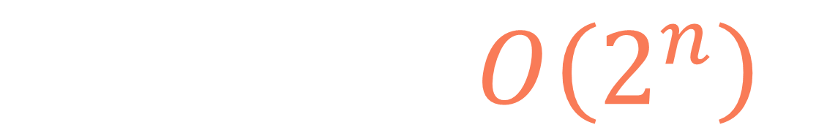
def subsets(arr, k, i=0): if k == 0: return 1 elif i == len(arr) or k < 0: return 0 else: return subsets(arr, k-arr[i], i+1) + subsets(arr, k, i+1)
subsets(k, 0)
subsets(k, 1)
.
.
.
$$T(n,k)=O\left(2^{n}\right)$$
subsets(k, n)

Slide 17

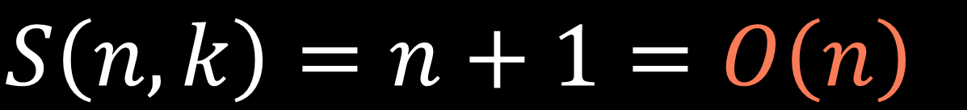
subsets(k,n)
.
.
.
$$n+1$$
subsets(k,1)
$$S\left(n,k\right)=n+1=O\left(n\right)$$
subsets(k,0)

Slide 18
input:
arr = [1, 2, 3, 1, 4],
k = 6
s(6,0)
s(6,1)
s(5,1)
s(6,2)
s(5,2)
s(4,2)
s(3,2)
s(6,3)
s(5,3)
s(4,3)
s(3,3)
s(2,3)
s(1,3)
s(0,3)
s(6,4)
s(5,4)
s(4,4)
s(3,4)
s(2,4)
s(1,4)
s(0,4)
s(6,5)
s(5,5)
s(4,5)
s(3,5)
s(2,5)
s(1,5)
s(0,5)
s(-1,5)
s(-2,5)
s(-3,5)

Slide 19
input:
arr = [1, 2, 3, 1, 4],
k = 6
s(6,0)
s(6,1)
s(5,1)
s(6,2)
s(5,2)
s(4,2)
s(3,2)
s(6,3)
s(5,3)
s(4,3)
s(3,3)
s(2,3)
s(1,3)
s(0,3)
s(6,4)
s(5,4)
s(4,4)
s(3,4)
s(2,4)
s(1,4)
s(0,4)
s(6,5)
s(5,5)
s(4,5)
s(3,5)
s(2,5)
s(1,5)
s(0,5)
s(-1,5)
s(-2,5)
s(-3,5)

Slide 20
1
2
def subsets(arr, k, i=0, lookup=None): lookup = {} if lookup is None else lookup if (i, k) in lookup: return lookup[(i, k)] if k == 0: return 1 elif i == len(arr) or k < 0: return 0 else: lookup[(i, k)] = subsets(arr, k-arr[i], i+1, lookup)
+ subsets(arr, k, i+1, lookup) return lookup[(i, k)]
3
4

Slide 21


$$i∈\{0,1,…,n−1\}$$
$$k∈\{k_{0},k_{0}−1,…,0\}$$
$$(k,i)∈\{{(k}_{0},0),(k_{0},1),…,(0,0)\}$$

Slide 22
$$i∈\{0,1,…,n−1\}$$
$$k∈\{k_{0},k_{0}−1,…,0\}$$
$$(k,i)∈\{{(k}_{0},0),(k_{0},1),…,(0,0)\}$$
$$T\left(n,k\right)=n∗\left(k+1\right)∗O\left(1\right)=O(nk)$$

Slide 23
$$S\left(n,k\right)=O\left(n\right)+O\left(nk\right)=O(nk)$$
call stack size
lookup table size

Slide 24






$$i∈\{0,1,…,n−1\}$$
$$k∈\{k_{0},k_{0}−1,…,0\}$$
$$n$$
$$k+1$$
$$k+1$$
$$n$$

Slide 25


$$k+1$$
$$n$$
dp[n-1][k] represents the number of subsets that sum up to k in the part of arr from 0 to n-1 inclusive

Slide 26
$$k+1$$
$$n$$
dp[i][j] represents the number of subsets that sum up to j in the part of arr from 0 to i inclusive

Slide 27
input:
arr = [1, 2, 3, 1, 4],
k = 6
0
1
2
3
4
5
6
0
1
2
3
4

Slide 28
input:
arr = [1, 2, 3, 1, 4],
k = 6
0
1
2
3
4
5
6
1
1
0
1
2
3
4

Slide 29
arr = [1, 2, 3, 1],
k = 6
[1, 2, 3]
and
[2, 3, 1]
if we don't take the last element
arr = [1, 2, 3, 1, 4],
k = 6
if we don't take the last element, dp[i][j] is dp[i-1][j]

Slide 30
arr = [1, 2, 3, 1],
k = 6
[1, 2, 3]
and
[2, 3, 1]
if we don't take the last element
arr = [1, 2, 3, 1, 4],
k = 6
arr = [1, 2, 3, 1],
k = 2
[1, 1]
and
[2]
if we take the last element
if we don't take the last element, dp[i][j] is dp[i-1][j]
if we take the last element, dp[i][j] is dp[i-1][j-arr[i]]

Slide 31

arr = [1, 2, 3, 1],
k = 6
[1, 2, 3]
and
[2, 3, 1]
if we don't take the last element
arr = [1, 2, 3, 1, 4],
k = 6
arr = [1, 2, 3, 1],
k = 2
[1, 1]
and
[2]
if we take the last element
if we don't take the last element, dp[i][j] is dp[i-1][j]
if we take the last element, dp[i][j] is dp[i-1][j-arr[i]]
we want to get subsets of both cases,
so dp[i][j] is dp[i-1][j] + dp[i-1][j-arr[i]] (if j-arr[i] $≥$ 0)

Slide 32
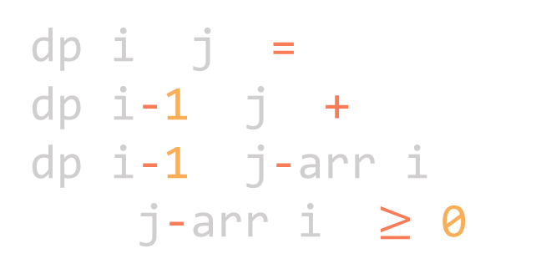
input:
arr = [1, 2, 3, 1, 4],
k = 6
0
1
2
3
4
5
6
1
1
0
0
0
0
0
0
1
2
3
dp[i][j] =
dp[i-1][j] +
dp[i-1][j-arr[i]]
(if j-arr[i] $≥$ 0)
4

Slide 33
j-arr[i]
j
input:
arr = [1, 2, 3, 1, 4],
k = 6
0
1
2
3
4
5
6
1
1
0
0
0
0
0
0
1
1
2
3
dp[i][j] =
dp[i-1][j] +
dp[i-1][j-arr[i]]
(if j-arr[i] $≥$ 0)
4

Slide 34
input:
arr = [1, 2, 3, 1, 4],
k = 6
j-arr[i]
j
0
1
2
3
4
5
6
1
1
0
0
0
0
0
0
1
1
1
2
3
dp[i][j] =
dp[i-1][j] +
dp[i-1][j-arr[i]]
(if j-arr[i] $≥$ 0)
4

Slide 35
input:
arr = [1, 2, 3, 1, 4],
k = 6
j-arr[i]
j
0
1
2
3
4
5
6
1
1
0
0
0
0
0
0
1
1
1
1
2
3
dp[i][j] =
dp[i-1][j] +
dp[i-1][j-arr[i]]
(if j-arr[i] $≥$ 0)
4

Slide 36
input:
arr = [1, 2, 3, 1, 4],
k = 6
j-arr[i]
j
0
1
2
3
4
5
6
1
1
0
0
0
0
0
0
1
1
1
1
1
2
3
dp[i][j] =
dp[i-1][j] +
dp[i-1][j-arr[i]]
(if j-arr[i] $≥$ 0)
4

Slide 37
input:
arr = [1, 2, 3, 1, 4],
k = 6
j-arr[i]
j
0
1
2
3
4
5
6
1
1
0
0
0
0
0
0
1
1
1
1
0
1
2
3
dp[i][j] =
dp[i-1][j] +
dp[i-1][j-arr[i]]
(if j-arr[i] $≥$ 0)
4

Slide 38
input:
arr = [1, 2, 3, 1, 4],
k = 6
j-arr[i]
j
0
1
2
3
4
5
6
1
1
0
0
0
0
0
0
1
1
1
1
0
0
1
2
3
dp[i][j] =
dp[i-1][j] +
dp[i-1][j-arr[i]]
(if j-arr[i] $≥$ 0)
4

Slide 39
input:
arr = [1, 2, 3, 1, 4],
k = 6
j-arr[i]
j
0
1
2
3
4
5
6
1
1
0
0
0
0
0
0
1
1
1
1
0
0
0
1
2
3
dp[i][j] =
dp[i-1][j] +
dp[i-1][j-arr[i]]
(if j-arr[i] $≥$ 0)
4

Slide 40
j-arr[i]
j
input:
arr = [1, 2, 3, 1, 4],
k = 6
0
1
2
3
4
5
6
1
1
0
0
0
0
0
0
1
1
1
1
0
0
0
1
1
2
3
dp[i][j] =
dp[i-1][j] +
dp[i-1][j-arr[i]]
(if j-arr[i] $≥$ 0)
4

Slide 41
j-arr[i]
j
input:
arr = [1, 2, 3, 1, 4],
k = 6
0
1
2
3
4
5
6
1
1
0
0
0
0
0
0
1
1
1
1
0
0
0
1
1
1
2
3
dp[i][j] =
dp[i-1][j] +
dp[i-1][j-arr[i]]
(if j-arr[i] $≥$ 0)
4

Slide 42
input:
arr = [1, 2, 3, 1, 4],
k = 6
j-arr[i]
j
0
1
2
3
4
5
6
1
1
0
0
0
0
0
0
1
1
1
1
0
0
0
1
1
1
1
2
3
dp[i][j] =
dp[i-1][j] +
dp[i-1][j-arr[i]]
(if j-arr[i] $≥$ 0)
4

Slide 43
input:
arr = [1, 2, 3, 1, 4],
k = 6
j-arr[i]
j
0
1
2
3
4
5
6
1
1
0
0
0
0
0
0
1
1
1
1
0
0
0
1
1
1
1
2
2
3
dp[i][j] =
dp[i-1][j] +
dp[i-1][j-arr[i]]
(if j-arr[i] $≥$ 0)
4

Slide 44
input:
arr = [1, 2, 3, 1, 4],
k = 6
j-arr[i]
j
0
1
2
3
4
5
6
1
1
0
0
0
0
0
0
1
1
1
1
0
0
0
1
1
1
1
2
1
2
3
dp[i][j] =
dp[i-1][j] +
dp[i-1][j-arr[i]]
(if j-arr[i] $≥$ 0)
4

Slide 45
input:
arr = [1, 2, 3, 1, 4],
k = 6
j-arr[i]
j
0
1
2
3
4
5
6
1
1
0
0
0
0
0
0
1
1
1
1
0
0
0
1
1
1
1
2
1
1
2
3
dp[i][j] =
dp[i-1][j] +
dp[i-1][j-arr[i]]
(if j-arr[i] $≥$ 0)
4

Slide 46
input:
arr = [1, 2, 3, 1, 4],
k = 6
j-arr[i]
j
0
1
2
3
4
5
6
1
1
0
0
0
0
0
0
1
1
1
1
0
0
0
1
1
1
1
2
1
1
1
2
3
dp[i][j] =
dp[i-1][j] +
dp[i-1][j-arr[i]]
(if j-arr[i] $≥$ 0)
4

Slide 47
input:
arr = [1, 2, 3, 1, 4],
k = 6
j-arr[i]
j
0
1
2
3
4
5
6
1
1
0
0
0
0
0
0
1
1
1
1
0
0
0
1
1
1
1
2
1
1
1
2
1
3
dp[i][j] =
dp[i-1][j] +
dp[i-1][j-arr[i]]
(if j-arr[i] $≥$ 0)
4

Slide 48
input:
arr = [1, 2, 3, 1, 4],
k = 6
j-arr[i]
j
0
1
2
3
4
5
6
1
1
0
0
0
0
0
0
1
1
1
1
0
0
0
1
1
1
1
2
1
1
1
2
1
2
3
dp[i][j] =
dp[i-1][j] +
dp[i-1][j-arr[i]]
(if j-arr[i] $≥$ 0)
4

Slide 49
input:
arr = [1, 2, 3, 1, 4],
k = 6
j-arr[i]
j
0
1
2
3
4
5
6
1
1
0
0
0
0
0
0
1
1
1
1
0
0
0
1
1
1
1
2
1
1
1
2
1
2
2
3
dp[i][j] =
dp[i-1][j] +
dp[i-1][j-arr[i]]
(if j-arr[i] $≥$ 0)
4

Slide 50
input:
arr = [1, 2, 3, 1, 4],
k = 6
j-arr[i]
j
0
1
2
3
4
5
6
1
1
0
0
0
0
0
0
1
1
1
1
0
0
0
1
1
1
1
2
1
1
1
2
1
2
2
3
3
dp[i][j] =
dp[i-1][j] +
dp[i-1][j-arr[i]]
(if j-arr[i] $≥$ 0)
4

Slide 51
input:
arr = [1, 2, 3, 1, 4],
k = 6
j-arr[i]
j
0
1
2
3
4
5
6
1
1
0
0
0
0
0
0
1
1
1
1
0
0
0
1
1
1
1
2
1
1
1
2
1
2
2
3
3
3
dp[i][j] =
dp[i-1][j] +
dp[i-1][j-arr[i]]
(if j-arr[i] $≥$ 0)
4

Slide 52
input:
arr = [1, 2, 3, 1, 4],
k = 6
j-arr[i]
j
0
1
2
3
4
5
6
1
1
0
0
0
0
0
0
1
1
1
1
0
0
0
1
1
1
1
2
1
1
1
2
1
2
2
3
3
2
3
dp[i][j] =
dp[i-1][j] +
dp[i-1][j-arr[i]]
(if j-arr[i] $≥$ 0)
4

Slide 53
input:
arr = [1, 2, 3, 1, 4],
k = 6
j-arr[i]
j
0
1
2
3
4
5
6
1
1
0
0
0
0
0
0
1
1
1
1
0
0
0
1
1
1
1
2
1
1
1
2
1
2
2
3
3
2
2
3
dp[i][j] =
dp[i-1][j] +
dp[i-1][j-arr[i]]
(if j-arr[i] $≥$ 0)
4

Slide 54
j-arr[i]
j
input:
arr = [1, 2, 3, 1, 4],
k = 6
0
1
2
3
4
5
6
1
1
0
0
0
0
0
0
1
1
1
1
0
0
0
1
1
1
1
2
1
1
1
2
1
2
2
3
3
2
2
3
dp[i][j] =
dp[i-1][j] +
dp[i-1][j-arr[i]]
(if j-arr[i] $≥$ 0)
1
4

Slide 55
j-arr[i]
j
input:
arr = [1, 2, 3, 1, 4],
k = 6
0
1
2
3
4
5
6
1
1
0
0
0
0
0
0
1
1
1
1
0
0
0
1
1
1
1
2
1
1
1
2
1
2
2
3
3
2
2
3
dp[i][j] =
dp[i-1][j] +
dp[i-1][j-arr[i]]
(if j-arr[i] $≥$ 0)
1
2
4

Slide 56
j-arr[i]
j
input:
arr = [1, 2, 3, 1, 4],
k = 6
0
1
2
3
4
5
6
1
1
0
0
0
0
0
0
1
1
1
1
0
0
0
1
1
1
1
2
1
1
1
2
1
2
2
3
3
2
2
3
dp[i][j] =
dp[i-1][j] +
dp[i-1][j-arr[i]]
(if j-arr[i] $≥$ 0)
1
2
2
4

Slide 57
input:
arr = [1, 2, 3, 1, 4],
k = 6
j-arr[i]
j
0
1
2
3
4
5
6
1
1
0
0
0
0
0
0
1
1
1
1
0
0
0
1
1
1
1
2
1
1
1
2
1
2
2
3
3
2
2
3
dp[i][j] =
dp[i-1][j] +
dp[i-1][j-arr[i]]
(if j-arr[i] $≥$ 0)
1
2
2
3
4

Slide 58
input:
arr = [1, 2, 3, 1, 4],
k = 6
j-arr[i]
j
0
1
2
3
4
5
6
1
1
0
0
0
0
0
0
1
1
1
1
0
0
0
1
1
1
1
2
1
1
1
2
1
2
2
3
3
2
2
3
dp[i][j] =
dp[i-1][j] +
dp[i-1][j-arr[i]]
(if j-arr[i] $≥$ 0)
1
2
2
3
4
4

Slide 59
input:
arr = [1, 2, 3, 1, 4],
k = 6
j-arr[i]
j
0
1
2
3
4
5
6
1
1
0
0
0
0
0
0
1
1
1
1
0
0
0
1
1
1
1
2
1
1
1
2
1
2
2
3
3
2
2
3
dp[i][j] =
dp[i-1][j] +
dp[i-1][j-arr[i]]
(if j-arr[i] $≥$ 0)
1
2
2
3
4
4
4

Slide 60
input:
arr = [1, 2, 3, 1, 4],
k = 6
j-arr[i]
j
0
1
2
3
4
5
6
1
1
0
0
0
0
0
0
1
1
1
1
0
0
0
1
1
1
1
2
1
1
1
2
1
2
2
3
3
2
2
3
dp[i][j] =
dp[i-1][j] +
dp[i-1][j-arr[i]]
(if j-arr[i] $≥$ 0)
1
2
2
3
4
4
4
4

Slide 61
input:
arr = [1, 2, 3, 1, 4],
k = 6
0
1
2
3
4
5
6
1
1
0
0
0
0
0
0
1
1
1
1
0
0
0
1
1
1
1
2
1
1
1
2
1
2
2
3
3
2
2
3
dp[i][j] =
dp[i-1][j] +
dp[i-1][j-arr[i]]
(if j-arr[i] $≥$ 0)
1
2
2
3
4
4
4
4

Slide 62
def subsets(arr, k): n = len(arr) if k > sum(arr) or n == 0: return 0 dp = [[0]*(k+1) for i in range(n)] dp[0][0] = 1
if arr[0] <= k: dp[0][arr[0]] = 1 for i in range(1, n): for j in range(k + 1): dp[i][j] = dp[i-1][j]
+ (dp[i-1][j-arr[i]] if j-arr[i] >= 0 else 0) return dp[n-1][k]
4

Slide 63
def subsets(arr, k): n = len(arr) if k > sum(arr) or n == 0: return 0 dp = [[0]*(k+1) for i in range(n)] dp[0][0] = 1
if arr[0] <= k: dp[0][arr[0]] = 1 for i in range(1, n): for j in range(k + 1): dp[i][j] = dp[i-1][j]
+ (dp[i-1][j-arr[i]] if j-arr[i] >= 0 else 0) return dp[n-1][k]
4

Slide 64
def subsets(arr, k): n = len(arr) if k > sum(arr) or n == 0: return 0 dp = [[0]*(k+1) for i in range(n)] dp[0][0] = 1
if arr[0] <= k: dp[0][arr[0]] = 1 for i in range(1, n): for j in range(k + 1): dp[i][j] = dp[i-1][j]
+ (dp[i-1][j-arr[i]] if j-arr[i] >= 0 else 0) return dp[n-1][k]
4

Slide 65
def subsets(arr, k): n = len(arr) if k > sum(arr) or n == 0: return 0 dp = [[0]*(k+1) for i in range(n)] dp[0][0] = 1
if arr[0] <= k: dp[0][arr[0]] = 1 for i in range(1, n): for j in range(k + 1): dp[i][j] = dp[i-1][j]
+ (dp[i-1][j-arr[i]] if j-arr[i] >= 0 else 0) return dp[n-1][k]
4

Slide 66
def subsets(arr, k): n = len(arr) if k > sum(arr) or n == 0: return 0 dp = [[0]*(k+1) for i in range(n)] dp[0][0] = 1
if arr[0] <= k: dp[0][arr[0]] = 1 for i in range(1, n): for j in range(k + 1): dp[i][j] = dp[i-1][j]
+ (dp[i-1][j-arr[i]] if j-arr[i] >= 0 else 0) return dp[n-1][k]
4

Slide 67
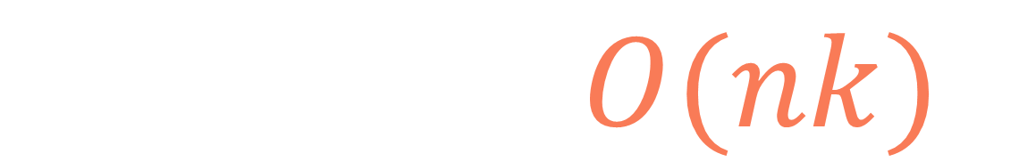
def subsets(arr, k): n = len(arr) if k > sum(arr) or n == 0: return 0 dp = [[0]*(k+1) for i in range(n)] dp[0][0] = 1
if arr[0] <= k: dp[0][arr[0]] = 1 for i in range(1, n): for j in range(k + 1): dp[i][j] = dp[i-1][j]
+ (dp[i-1][j-arr[i]] if j-arr[i] >= 0 else 0) return dp[n-1][k]
$$T\left(n,k\right)=O(nk)$$
4

Slide 68

def subsets(arr, k): n = len(arr) if k > sum(arr) or n == 0: return 0 dp = [[0]*(k+1) for i in range(n)] dp[0][0] = 1
if arr[0] <= k: dp[0][arr[0]] = 1 for i in range(1, n): for j in range(k + 1): dp[i][j] = dp[i-1][j]
+ (dp[i-1][j-arr[i]] if j-arr[i] >= 0 else 0) return dp[n-1][k]
$$S\left(n,k\right)=O(nk)$$
4

Slide 69
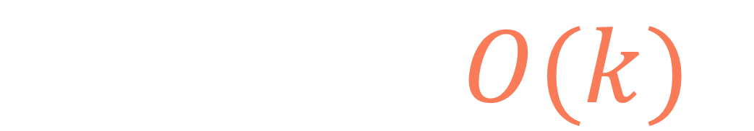
def subsets(arr, k): n = len(arr) if k > sum(arr) or n == 0: return 0 prev_dp = [0]*(k+1) dp = [0]*(k+1) prev_dp[0] = 1 if arr[0] <= k: prev_dp[arr[0]] = 1 for i in range(1, n): for j in range(k+1): dp[j] = prev_dp[j] + (prev_dp[j-arr[i]] if j-arr[i] >= 0 else 0) prev_dp = dp dp = [0]*(k+1) return prev_dp[k]
$$S\left(n,k\right)=O(k)$$
4

Slide 70
input:
arr = [1, 2, 3, 1, 4],
k = 6
s(6,0)
s(6,1)
s(5,1)
s(6,2)
s(5,2)
s(4,2)
s(3,2)
s(6,3)
s(5,3)
s(4,3)
s(3,3)
s(2,3)
s(1,3)
s(0,3)
s(6,4)
s(5,4)
s(4,4)
s(3,4)
s(2,4)
s(1,4)
s(0,4)
s(6,5)
s(5,5)
s(4,5)
s(3,5)
s(2,5)
s(1,5)
s(0,5)
s(-1,5)
s(-2,5)
s(-3,5)

Slide 71
Subset
sum

