Slide 1







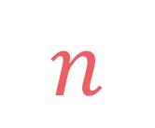

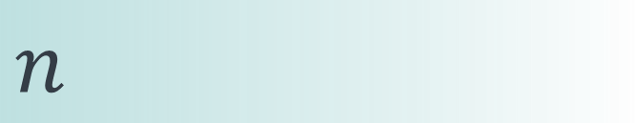

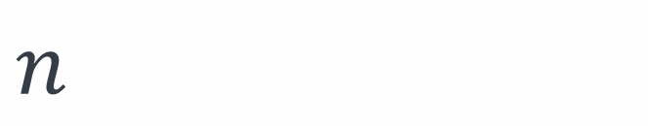
left
[4, 5, 1, 7, 2, 6, 3, 8]
no margin
Space complexity:
$$O(n)$$
list
list
list
list
mid
no margin
"string"
4 | 5 | 1 | 7 | 2 | 6 | 3 | 8
Space complexity:
$$O(n)$$
5
5
$
5
rec(n)
$$n$$
5
$$n$$
$$⇒$$
$$n$$
Time complexity:
$$O(n)$$
text
text
 |  |  | a
$$n$$
text
text
no margin
no margin
no margin
no margin
no margin
no margin
no margin
no margin

Slide 2


House robber

Slide 4


Slide 6

5
5
5
5
5
5
5
5 + 5 + 5 + 5 = 20
maximum possible amount

Slide 7

2
10
3
6
8
1
7
2 + 3 + 8 +7 = 20
not maximum possible amount
we can make 25 with 10 + 8 + 7

Slide 8
house index
rob(0)
doesn't steal
steals
rob(2)
rob(1)

Slide 9
$$rob\left(i\right)=max⁡(arr\left[i\right]+rob\left(i+2\right), rob\left(i+1\right))$$

Slide 10





$$0$$
$$if i≥|arr|$$
$$rob\left(i\right)=$$
$$max⁡(arr\left[i\right]+rob\left(i+2\right),$$
$rob\left(i+1\right))$
$$otherwise$$

Slide 11





def rob(arr, i=0): if i >= len(arr): return 0 else: return max(arr[i]+rob(arr, i+2),
rob(arr, i+1))
$$0$$
$$if i≥|arr|$$
$$rob\left(i\right)=$$
$$max⁡(arr\left[i\right]+rob\left(i+2\right),$$
$rob\left(i+1\right))$
$$otherwise$$

Slide 12
rob(0)
rob(2)
rob(1)
rob(4)
rob(3)
rob(3)
rob(2)
rob(6)
rob(5)
rob(5)
rob(4)
rob(5)
rob(4)
rob(4)
rob(3)
.
.
.
.
.
.
.
.
.
.
.
.
.
.
.
.
.
.
.
.
.
.
.
.

Slide 13

$$T\left(n\right)=T\left(n−1\right)+T\left(n−2\right)+O\left(1\right) \\ T\left(n\right)=O(φ^{n})$$

Slide 14

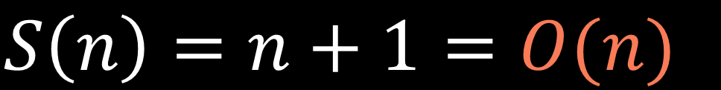
rob(n)
.
.
.
$$S\left(n\right)=n+1=O(n)$$
rob(2)
$$n+1$$
rob(1)
rob(0)

Slide 15
rob(0)
rob(1)
rob(2)
rob(3)
rob(4)
rob(5)
rob(6)
rob(7)
arr = [4, 10, 5, 2, 3, 7]

Slide 16
1
def rob(arr, i=0, lookup=None): lookup = {} if lookup is None else lookup if i in lookup: return lookup[i] if i >= len(arr): return 0 else: lookup[i] = max(arr[i]+rob(arr, i+2, lookup), rob(arr, i+1, lookup)) return lookup[i]
2
3
4

Slide 17


$$i∈\{0,1,…,n,n+1\}$$
$$n+2$$

Slide 18
$$i∈\{0,1,…,n,n+1\}$$
$$n+2$$
$$T\left(n\right)=\left(n+2\right)∗O\left(1\right)=O(n)$$

Slide 19
$$S\left(n\right)=O\left(n\right)+O(n)=O(n)$$
call stack size
lookup table size

Slide 20

arr = [4, 8, 12, 1, 2, 10, 3, 6, 8]
$$n$$

Slide 21

arr = [4, 8, 12, 1, 2, 10, 3, 6, 8]
4
dp[0]
dp[1]
dp[2]
dp[3]
dp[4]
dp[5]
dp[6]
dp[7]
dp[8]
$$dp\left[0\right]=arr\left[0\right]=4$$

Slide 22
arr = [4, 8, 12, 1, 2, 10, 3, 6, 8]
4
8
dp[0]
dp[1]
dp[2]
dp[3]
dp[4]
dp[5]
dp[6]
dp[7]
dp[8]

Slide 23
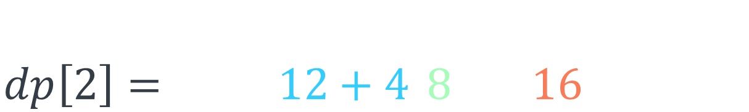
arr = [4, 8, 12, 1, 2, 10, 3, 6, 8]
4
8
16
dp[0]
dp[1]
dp[2]
dp[3]
dp[4]
dp[5]
dp[6]
dp[7]
dp[8]
$$dp\left[2\right]=\max\left(arr\left[2\right]+dp\left[0\right], dp\left[1\right]\right) \\ dp\left[2\right]=\max\left(12+4, 8\right)=16$$

Slide 24
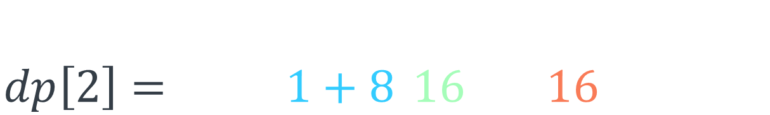
arr = [4, 8, 12, 1, 2, 10, 3, 6, 8]
4
8
16
16
dp[0]
dp[1]
dp[2]
dp[3]
dp[4]
dp[5]
dp[6]
dp[7]
dp[8]
$$dp\left[3\right]=\max\left(arr\left[3\right]+dp\left[1\right], dp\left[2\right]\right) \\ dp\left[2\right]=\max\left(1+8, 16\right)=16$$

Slide 25
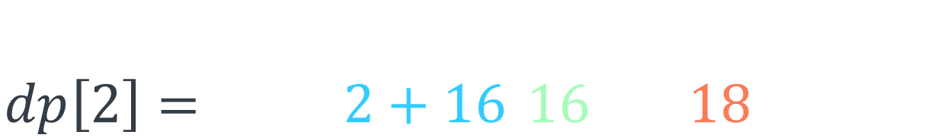
arr = [4, 8, 12, 1, 2, 10, 3, 6, 8]
4
8
16
16
18
dp[0]
dp[1]
dp[2]
dp[3]
dp[4]
dp[5]
dp[6]
dp[7]
dp[8]
$$dp\left[4\right]=\max\left(arr\left[4\right]+dp\left[2\right], dp\left[3\right]\right) \\ dp\left[2\right]=\max\left(2+16, 16\right)=18$$

Slide 26
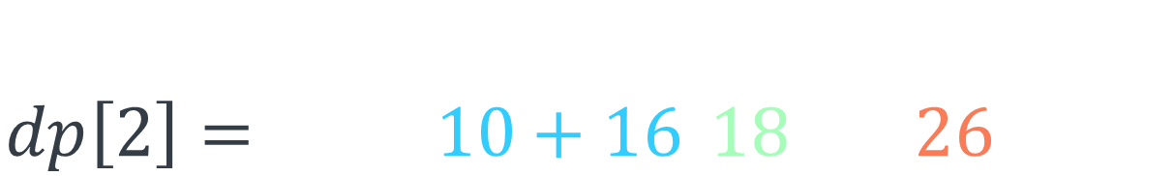
arr = [4, 8, 12, 1, 2, 10, 3, 6, 8]
4
8
16
16
18
26
dp[0]
dp[1]
dp[2]
dp[3]
dp[4]
dp[5]
dp[6]
dp[7]
dp[8]
$$dp\left[5\right]=\max\left(arr\left[5\right]+dp\left[3\right], dp\left[4\right]\right) \\ dp\left[2\right]=\max\left(10+16, 18\right)=26$$

Slide 27
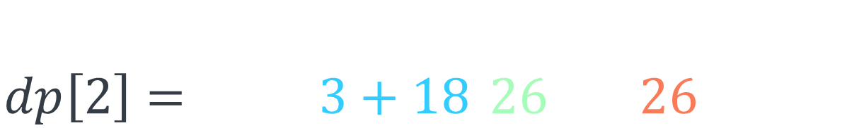
arr = [4, 8, 12, 1, 2, 10, 3, 6, 8]
4
8
16
16
18
26
26
dp[0]
dp[1]
dp[2]
dp[3]
dp[4]
dp[5]
dp[6]
dp[7]
dp[8]
$$dp\left[6\right]=\max\left(arr\left[6\right]+dp\left[4\right], dp\left[5\right]\right) \\ dp\left[2\right]=\max\left(3+18, 26\right)=26$$

Slide 28
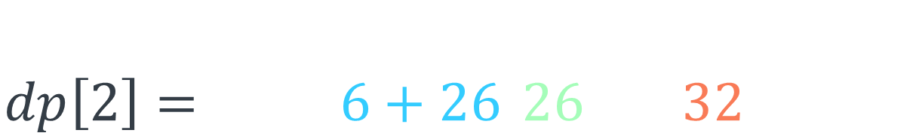
arr = [4, 8, 12, 1, 2, 10, 3, 6, 8]
4
8
16
16
18
26
26
32
dp[0]
dp[1]
dp[2]
dp[3]
dp[4]
dp[5]
dp[6]
dp[7]
dp[8]
$$dp\left[7\right]=\max\left(arr\left[7\right]+dp\left[5\right], dp\left[6\right]\right) \\ dp\left[2\right]=\max\left(6+26, 26\right)=32$$

Slide 29
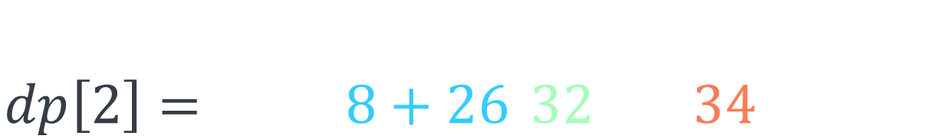
arr = [4, 8, 12, 1, 2, 10, 3, 6, 8]
4
8
16
16
18
26
26
32
34
dp[0]
dp[1]
dp[2]
dp[3]
dp[4]
dp[5]
dp[6]
dp[7]
dp[8]
$$dp\left[8\right]=\max\left(arr\left[8\right]+dp\left[6\right], dp\left[7\right]\right) \\ dp\left[2\right]=\max\left(8+26, 32\right)=34$$

Slide 30
arr = [4, 8, 12, 1, 2, 10, 3, 6, 8]
4
8
16
16
18
26
26
32
34
dp[0]
dp[1]
dp[2]
dp[3]
dp[4]
dp[5]
dp[6]
dp[7]
dp[8]

Slide 31
def rob(arr): n = len(arr) if n == 1: return arr[0] dp = [0]*n dp[0] = arr[0] dp[1] = max(arr[0], arr[1]) for i in range(2, n): dp[i] = max(dp[i-1], arr[i]+dp[i-2]) return dp[n-1]

Slide 32
def rob(arr): n = len(arr) if n == 1: return arr[0] dp = [0]*n dp[0] = arr[0] dp[1] = max(arr[0], arr[1]) for i in range(2, n): dp[i] = max(dp[i-1], arr[i]+dp[i-2]) return dp[n-1]

Slide 33
def rob(arr): n = len(arr) if n == 1: return arr[0] dp = [0]*n dp[0] = arr[0] dp[1] = max(arr[0], arr[1]) for i in range(2, n): dp[i] = max(dp[i-1], arr[i]+dp[i-2]) return dp[n-1]

Slide 34
def rob(arr): n = len(arr) if n == 1: return arr[0] dp = [0]*n dp[0] = arr[0] dp[1] = max(arr[0], arr[1]) for i in range(2, n): dp[i] = max(dp[i-1], arr[i]+dp[i-2]) return dp[n-1]

Slide 35
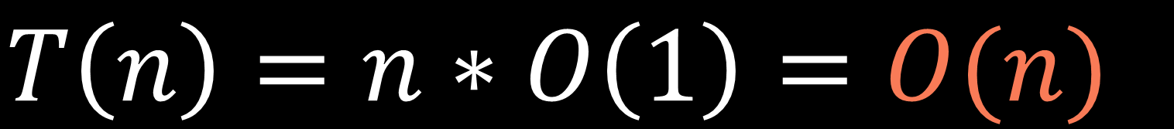
$$T\left(n\right)=n∗O\left(1\right)=O(n)$$

Slide 36
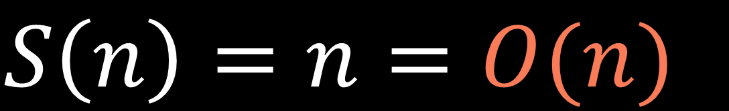
$$S\left(n\right)=n=O(n)$$

Slide 37
def rob(arr): n = len(arr) if n == 1: return arr[0] before_prev_dp = arr[0] prev_dp = max(arr[0], arr[1]) for i in range(2, n): dp = max(prev_dp, arr[i]+before_prev_dp) before_prev_dp = prev_dp prev_dp = dp return prev_dp

Slide 38

def rob(arr): n = len(arr) if n == 1: return arr[0] before_prev_dp = arr[0] prev_dp = max(arr[0], arr[1]) for i in range(2, n): dp = max(prev_dp, arr[i]+before_prev_dp) before_prev_dp = prev_dp prev_dp = dp return prev_dp
$$S\left(n\right)=O(1)$$

