Slide 1







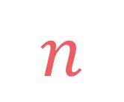

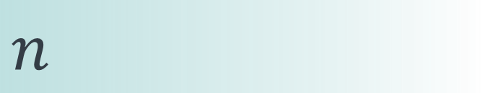

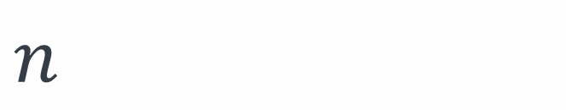
left
[4, 5, 1, 7, 2, 6, 3, 8]
no margin
Space complexity:
$$O(n)$$
list
list
list
list
mid
no margin
"string"
4 | 5 | 1 | 7 | 2 | 6 | 3 | 8
Space complexity:
$$O(n)$$
5
5
$
5
rec(n)
$$n$$
5
$$n$$
$$⇒$$
$$n$$
Time complexity:
$$O(n)$$
text
text
 |  |  | a
$$n$$
text
text
no margin
no margin
no margin
no margin
no margin
no margin
no margin
no margin

Slide 2
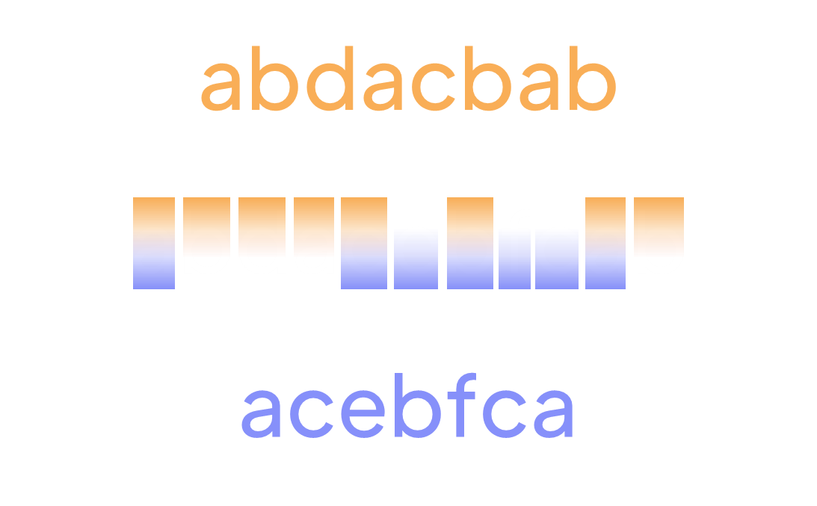
Shortest common supersequence

Slide 3
A subsequence of a string is a subset of its characters,
that are not necessarily adjacent but have to be in the right order
rain
is a subsequence of
programming

Slide 4
A subsequence of a string is a subset of its characters,
that are not necessarily adjacent but have to be in the right order
rain
is a subsequence of
is a supersequence of
programming

Slide 5

Given two strings $s1$ and $s2$, find the length of their shortest common supersequence

Slide 6

Given two strings $s1$ and $s2$, find the length of their shortest common supersequence
input:
s1 = "abdacbab"
s2 = "acebfca"
output: 11
explanation: the scs of s1 and s2 is "abdacebfcab", its length is 11
abdacbab
abdacebfcab
acebfca

Slide 7
abdacbab
abdacbab
acebfca
acebfca

Slide 8
abdacbab
acebfca
abdacbab
a
b
d
a
c
b
a
b
acebfca
a
c
e
b
f
c
a

Slide 9
abdacbab
acebfca
abdacbab
acebfca
a
b
a
d
a
c
c
e
b
f
b
a
c
b
a

Slide 10
abdacbab
acebfca
abdacbab
acebfca
a
b
d
a
c
e
b
f
c
a
b

Slide 11

$$scs\left(\text{"}\text{ab}","\text{cd}\text{"}\right)→\text{"}\text{abcd}"$$

Slide 12

$$scs\left(\text{"}\text{ab}","\text{cd}\text{"}\right)→\text{"}\text{abcd}"$$
$$scs\left(\text{"}\text{ab}","\text{bc}\text{"}\right)→\text{"}\text{abc}"$$

Slide 13
input:
s1 = "abecd"
s2 = "afcbd"
abecd
s1:
afcbd
s2:

Slide 14
input:
s1 = "abecd"
s2 = "afcbd"
abecd
s1:
Error
afcbd
s2 is not a subsequence of scs
s2:
afbecd
scs:

Slide 15
input:
s1 = "abecd"
s2 = "afcbd"
Error
abecd
s1 is not a subsequence of scs
s1:
afcbd
s2:
afcebd
scs:

Slide 16
"abdacbab"
"acebfca"
Longest common subsequence

Slide 17
input:
s1 = "abecd"
s2 = "afcbd"
$$lcs\left(\text{"}\text{abecd}","\text{afcbd}\text{"}\right)→\text{"}\text{abd}"$$
abecd
s1:
afcbd
s2:

Slide 18
input:
s1 = "abecd"
s2 = "afcbd"
$$lcs\left(\text{"}\text{abecd}","\text{afcbd}\text{"}\right)→\text{"}\text{abd}"$$
abecd
s1:
afcbd
s2:
afcbecd
scs:

Slide 19
input:
s1 = "abdacbab"
s2 = "acebfca"
$$lcs\left(\text{"}\text{abdacbab}","\text{acebfca}\text{"}\right)→\text{"}\text{acba}"$$
abdacbab
s1:
acebfca
s2:

Slide 20
input:
s1 = "abdacbab"
s2 = "acebfca"
$$lcs\left(\text{"}\text{abdacbab}","\text{acebfca}\text{"}\right)→\text{"}\text{acba}"$$
abdacbab
s1:
acebfca
s2:
abdacebfcab
scs:

Slide 21
$$\left|scs\left(s1,s2\right)\right|=\left|s1\right|+\left|s2\right|−|lcs\left(s1,s2\right)|$$

Slide 22
def scs(s1, s2): return len(s1) + len(s2) - lcs(s1, s2)

Slide 23
input:
s1 = "abdacbab"
s2 = "acebfca"
abdacbab
s1:
acebfca
s2:
scs:
scs(0,0)

Slide 24
input:
s1 = "abdacbab"
s2 = "acebfca"
abdacbab
s1:
acebfca
s2:
scs:
a
scs(0,0)
scs(1,1)

Slide 25
input:
s1 = "abdacbab"
s2 = "acebfca"
abdacbab
s1:
acebfca
s2:
scs:
a
scs(0,0)
scs(1,1)

Slide 26
input:
s1 = "abdacbab"
s2 = "acebfca"
abdacbab
s1:
acebfca
s2:

Slide 27
input:
s1 = "abdacbab"
s2 = "acebfca"
abdacbab
s1:
acebfca
s2:

Slide 28
input:
s1 = "abdacbab"
s2 = "acebfca"
abdacbab
s1:
acebfca
s2:
scs:
a
scs(0,0)
scs(1,1)
scs(2,1)
scs(1,2)

Slide 29








$$0$$
$$if i=\left|s_{1}\right|$$
$$0$$
$$if j=|s_{2}|$$
$$lcs\left(i,j\right)=$$
$$1+lcs(i+1,j+1)$$
$$if s_{1}\left[i\right]=s_{2}[j]$$
$$max⁡(lcs\left(i+1,j\right),lcs\left(i,j+1\right))$$
$$otherwise$$

Slide 30

$$lcs\left("", s\right)→""$$
Example: lcs of "" and "abc" is ""

Slide 31

$$scs\left("", s\right)→s$$
Example: scs of "" and "abc" is "abc"

Slide 32
$$i=\left|s1\right|→scs\left(s1,s2\right)=len\left(s2\right)−j$$
i
abdacbab
s1:
acebfca
s2:
j

Slide 33
$$i=\left|s1\right|→scs\left(s1,s2\right)=len\left(s2\right)−j$$
i
abdacbab
s1:
acebfca
s2:
j
$$j=\left|s2\right|→scs\left(s1,s2\right)=len\left(s1\right)−i$$
i
abdacbab
s1:
acebfca
s2:
j

Slide 34








$$\left|s_{2}\right|−j$$
$$if i=\left|s_{1}\right|$$
$$\left|s_{1}\right|−i$$
$$if j=|s_{2}|$$
$$scs\left(i,j\right)=$$
$$1+scs(i+1,j+1)$$
$$if s_{1}\left[i\right]=s_{2}[j]$$
$$1+min⁡(scs\left(i+1,j\right),scs\left(i,j+1\right))$$
$$otherwise$$

Slide 35









def scs(s1, s2, i=0, j=0): if i == len(s1): return len(s2)-j elif j == len(s2): return len(s1)-i elif s1[i] == s2[j]: return 1 + scs(s1, s2, i+1, j+1) else: return 1 + min(scs(s1, s2, i+1, j), scs(s1, s2, i, j+1))
lcs:
$$\left|s_{2}\right|−j$$
$$if i=\left|s_{1}\right|$$
scs:
$$\left|s_{1}\right|−i$$
$$if j=|s_{2}|$$
$$scs\left(i,j\right)=$$
$$1+scs(i+1,j+1)$$
$$if s_{1}\left[i\right]=s_{2}[j]$$
$$1+min⁡(scs\left(i+1,j\right),scs\left(i,j+1\right))$$
$$otherwise$$

Slide 36














$$0$$
$$if i=\left|s_{1}\right|$$
lcs:
$$0$$
$$if j=|s_{2}|$$
$$lcs\left(i,j\right)=$$
$$1+lcs(i+1,j+1)$$
$$if s_{1}\left[i\right]=s_{2}[j]$$
$$max⁡(lcs\left(i+1,j\right),lcs\left(i,j+1\right))$$
$$otherwise$$
$$\left|s_{2}\right|−j$$
$$if i=\left|s_{1}\right|$$
scs:
$$\left|s_{1}\right|−i$$
$$if j=|s_{2}|$$
$$scs\left(i,j\right)=$$
$$1+scs(i+1,j+1)$$
$$if s_{1}\left[i\right]=s_{2}[j]$$
$$1+min⁡(scs\left(i+1,j\right),scs\left(i,j+1\right))$$
$$otherwise$$

Slide 37






$$0$$
$$if i=\left|s_{1}\right|$$
lcs:
$$0$$
$$if j=|s_{2}|$$
$$lcs\left(i,j\right)=$$
$$1+lcs(i+1,j+1)$$
$$if s_{1}\left[i\right]=s_{2}[j]$$
$$max⁡(lcs\left(i+1,j\right),lcs\left(i,j+1\right))$$
$$otherwise$$
$$\left|s_{2}\right|−j$$
$$if i=\left|s_{1}\right|$$
scs:
$$\left|s_{1}\right|−i$$
$$if j=|s_{2}|$$
$$scs\left(i,j\right)=$$
$$1+scs(i+1,j+1)$$
$$if s_{1}\left[i\right]=s_{2}[j]$$
$$1+min⁡(scs\left(i+1,j\right),scs\left(i,j+1\right))$$
$$otherwise$$

Slide 38
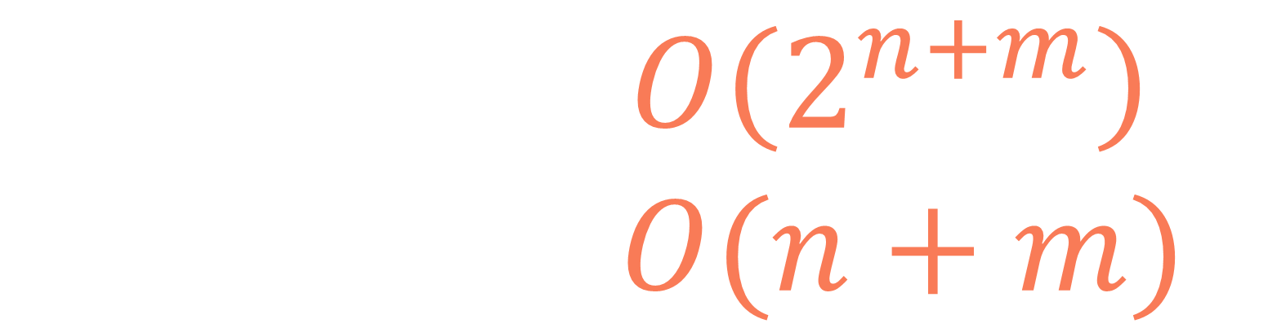
Non-optimized recursive solution:
$$T\left(n,m\right)=O\left(2^{n+m}\right) \\ S\left(n,m\right)=O(n+m)$$

Slide 39
1
def scs(s1, s2, i=0, j=0, lookup=None): lookup = {} if lookup is None else lookup if (i, j) in lookup: return lookup[(i, j)] if i == len(s1): return len(s2)-j elif j == len(s2): return len(s1)-i elif s1[i] == s2[j]: lookup[(i, j)] = 1 + scs(s1, s2, i+1, j+1, lookup) return lookup[(i, j)] else: lookup[(i, j)] = 1 + min(scs(s1, s2, i+1, j, lookup),
scs(s1, s2, i, j+1, lookup)) return lookup[(i, j)]
2
3
4

Slide 40
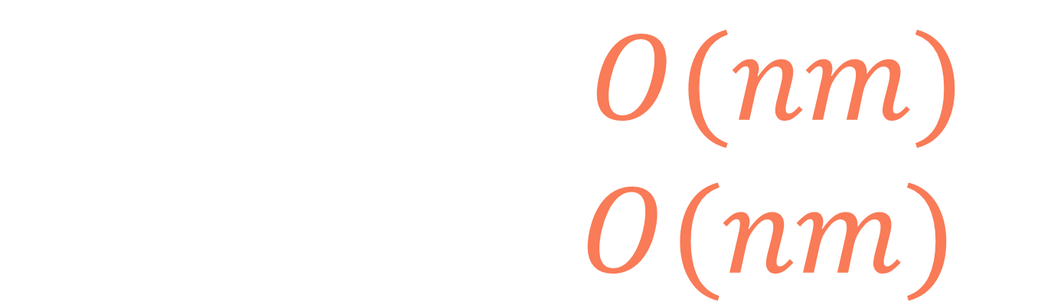
Memoization
solution:
$$T\left(n,m\right)=O(nm) \\ S\left(n,m\right)=O(nm)$$

Slide 41


lcs
$$m+1$$
$$n+1$$

Slide 42


lcs
scs
$$m+1$$
$$m+1$$
$$n+1$$
$$n+1$$

Slide 43

lcs
scs
$$m+1$$
$$m+1$$
0
0
0
0
0
0
0
0
0
0
$$|lcs\left("",s\right)|=0$$
0
$$n+1$$
0
$$n+1$$
0
0
0
0

Slide 44

lcs
scs
$$m+1$$
$$m+1$$
0
0
0
0
0
0
0
0
0
0
$$|scs\left("",s\right)|=|s|$$
0
$$n+1$$
0
$$n+1$$
0
0
0
0

Slide 45
lcs
scs
$$m+1$$
$$m+1$$
0
0
0
0
0
0
0
0
0
1
2
3
4
5
6
7
0
1
0
2
$$|scs\left("",s\right)|=|s|$$
0
3
$$n+1$$
0
$$n+1$$
4
0
5
0
6
0
7
0
8

Slide 46
lcs
scs
def lcs(s1, s2): n, m = len(s1), len(s2) dp = [[0]*(m+1) for i in range(n+1)] for j in range(1, m+1): dp[0][j] = 0 for i in range(1, n+1): dp[i][0] = 0 for i in range(1, n+1): for j in range(1, m+1): if s1[i-1] == s2[j-1]: dp[i][j] = 1 + dp[i-1][j-1] else: dp[i][j] = max(dp[i-1][j],
dp[i][j-1]) return dp[n][m]
def scs(s1, s2): n, m = len(s1), len(s2) dp = [[0]*(m+1) for i in range(n+1)] for j in range(1, m+1): dp[0][j] = j for i in range(1, n+1): dp[i][0] = i for i in range(1, n+1): for j in range(1, m+1): if s1[i-1] == s2[j-1]: dp[i][j] = 1 + dp[i-1][j-1] else: dp[i][j] = 1 + min(dp[i-1][j],
dp[i][j-1]) return dp[n][m]

Slide 47
input:
s1 = "abdacbab"
s2 = "acebfca"
a
c
b
f
c
a
a
e
0
1
2
3
4
5
6
7
a
1
1
2
3
4
5
6
7
def scs(s1, s2): n, m = len(s1), len(s2) dp = [[0]*(m+1) for i in range(n+1)] for j in range(1, m+1): dp[0][j] = j for i in range(1, n+1): dp[i][0] = i for i in range(1, n+1): for j in range(1, m+1): if s1[i-1] == s2[j-1]: dp[i][j] = 1 + dp[i-1][j-1] else: dp[i][j] = 1 + min(dp[i-1][j],
dp[i][j-1]) return dp[n][m]
b
2
2
3
4
4
5
6
7
d
3
3
4
5
5
6
7
8
a
4
4
5
6
6
7
8
8
c
5
5
5
6
7
8
8
9
b
6
6
6
7
7
8
9
10
a
7
7
7
8
8
9
10
10
b
8
8
8
9
9
10
11
11

Slide 48
input:
s1 = "abdacbab"
s2 = "acebfca"
a
c
b
f
c
a
a
e
0
1
2
3
4
5
6
7
a
1
1
2
3
4
5
6
7
def scs(s1, s2): n, m = len(s1), len(s2) dp = [[0]*(m+1) for i in range(n+1)] for j in range(1, m+1): dp[0][j] = j for i in range(1, n+1): dp[i][0] = i for i in range(1, n+1): for j in range(1, m+1): if s1[i-1] == s2[j-1]: dp[i][j] = 1 + dp[i-1][j-1] else: dp[i][j] = 1 + min(dp[i-1][j],
dp[i][j-1]) return dp[n][m]
b
2
2
3
4
4
5
6
7
d
3
3
4
5
5
6
7
8
a
4
4
5
6
6
7
8
8
c
5
5
5
6
7
8
8
9
b
6
6
6
7
7
8
9
10
a
7
7
7
8
8
9
10
10
b
8
8
8
9
9
10
11
11

Slide 49
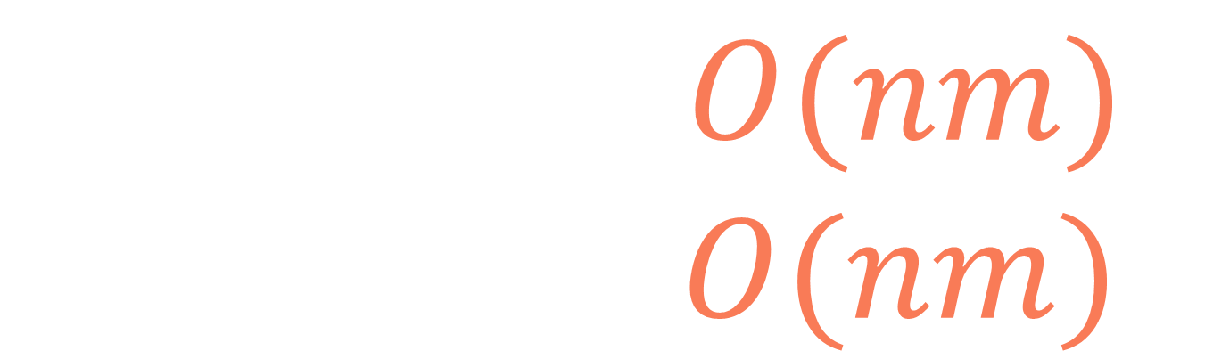
Tabulation
solution:
$$T\left(n,m\right)=O(nm) \\ S\left(n,m\right)=O(nm)$$

Slide 50
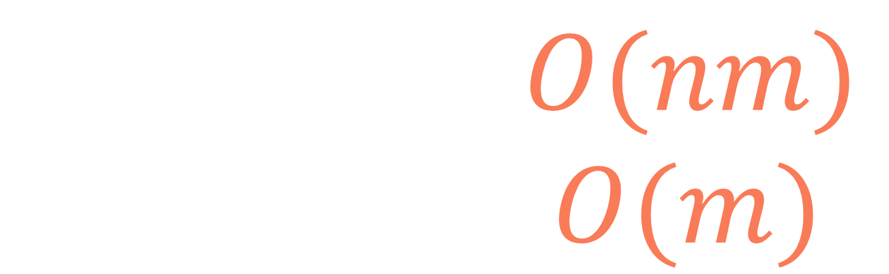
Space-optimized tabulation solution:
$$T\left(n,m\right)=O(nm) \\ S\left(n,m\right)=O(m)$$

Slide 51
Shortest common supersequence

