Slide 1







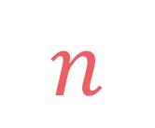
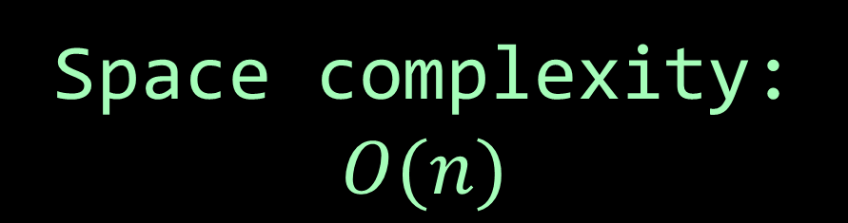
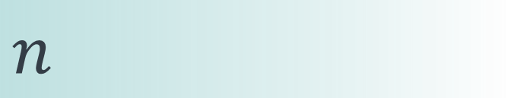

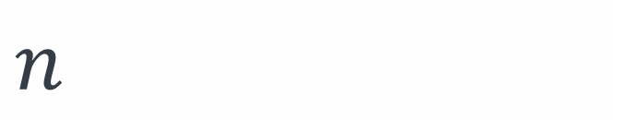
left
[4, 5, 1, 7, 2, 6, 3, 8]
no margin
Space complexity:
$$O(n)$$
list
list
list
list
mid
no margin
"string"
4 | 5 | 1 | 7 | 2 | 6 | 3 | 8
Space complexity:
$$O(n)$$
5
5
$
5
rec(n)
$$n$$
5
$$n$$
$$⇒$$
$$n$$
Time complexity:
$$O(n)$$
text
text
 |  |  | a
$$n$$
text
text
no margin
no margin
no margin
no margin
no margin
no margin
no margin
no margin

Slide 2

Ways to climb

Slide 3
We have a stairs with n steps and a set of possible ways to jump, and we want to know the number of possible ways to jump to the nth step

Slide 4
Example:
input: n = 10,
jumps = [2, 4, 5, 8]
output: 11
2 2 2 2 2
2 2 2 4
2 2 4 2
2 4 2 2
4 2 2 2
2 4 4
4 2 4
4 4 2
5 5
2 8
8 2

Slide 5

$$n$$

Slide 6

jump by $1$ step from step $n−1$ ⇒ step $n$
jump by $2$ steps from step $n−2$ ⇒ step $n$
jump by $3$ steps from step $n−3$ ⇒ step $n$
$$Given \\ ways\left(n−1\right) \\ ways\left(n−2\right) \\ ways\left(n−3\right) \\ then \\ ways\left(n\right)= ?$$
$$ways\left(n−1\right)+ways\left(n−2\right)+ways(n−3)$$

Slide 7
Example:
input: n = 10,
jumps = [2, 4, 5, 8]
output: 11
$$ways\left(n\right)=ways\left(n−2\right)+ways\left(n−4\right)+ways\left(n−5\right)+ways(n−8)$$

Slide 8


$$\sum_{\begin{aligned}jump ∈ \\ jumps\end{aligned}}{ways(n−jump)}$$
$$ways\left(n\right)=$$

Slide 9







$$1$$
$$if n=0$$
$$0$$
$$if n<0$$
$$ways\left(n\right)=$$
$$\sum_{\begin{aligned}jump ∈ \\ jumps\end{aligned}}{ways(n−jump)}$$
$$otherwise$$

Slide 10







def ways(n, jumps): if n == 0: return 1 elif n < 0: return 0 else: nb = 0 for jump in jumps: nb += ways(n-jump, jumps) return nb
$$1$$
$$if n=0$$
$$0$$
$$if n<0$$
$$ways\left(n\right)=$$
$$\sum_{\begin{aligned}jump ∈ \\ jumps\end{aligned}}{ways(n−jump)}$$
$$otherwise$$

Slide 11
def ways(n, jumps): if n == 0: return 1 else: nb = 0 for jump in jumps: if (n-jump) >= 0: nb += ways(n-jump, jumps) return nb

Slide 12
ways(10)

Slide 13
ways(10)
ways(8)

Slide 14
ways(10)
ways(8)
ways(6)

Slide 15
ways(10)
ways(8)
ways(6)
ways(4)

Slide 16
ways(10)
ways(8)
ways(6)
ways(4)
ways(2)

Slide 17
ways(10)
ways(8)
ways(6)
ways(4)
ways(2)
ways(0)

Slide 18
ways(10)
ways(8)
ways(6)
ways(4)
ways(2)
1
ways(0)

Slide 19
ways(10)
ways(8)
ways(6)
ways(4)
1
ways(2)
1
ways(0)

Slide 20
ways(10)
ways(8)
ways(6)
ways(4)
1
ways(2)
ways(0)
1
ways(0)

Slide 21
ways(10)
ways(8)
ways(6)
ways(4)
1
1
ways(2)
ways(0)
1
ways(0)

Slide 22
ways(10)
ways(8)
ways(6)
2
ways(4)
1
1
ways(2)
ways(0)
1
ways(0)

Slide 23
ways(10)
ways(8)
ways(6)
2
ways(4)
ways(2)
1
1
ways(2)
ways(0)
1
ways(0)

Slide 24
ways(10)
ways(8)
ways(6)
2
ways(4)
ways(2)
1
1
ways(2)
ways(0)
ways(0)
1
ways(0)

Slide 25
ways(10)
ways(8)
ways(6)
2
ways(4)
ways(2)
1
1
1
ways(2)
ways(0)
ways(0)
1
ways(0)

Slide 26
ways(10)
ways(8)
ways(6)
2
1
ways(4)
ways(2)
1
1
1
ways(2)
ways(0)
ways(0)
1
ways(0)

Slide 27
ways(10)
ways(8)
ways(6)
2
1
ways(4)
ways(2)
ways(1)
1
1
1
ways(2)
ways(0)
ways(0)
1
ways(0)

Slide 28
ways(10)
ways(8)
ways(6)
2
1
0
ways(4)
ways(2)
ways(1)
1
1
1
ways(2)
ways(0)
ways(0)
1
ways(0)

Slide 29
ways(10)
ways(8)
3
ways(6)
2
1
0
ways(4)
ways(2)
ways(1)
1
1
1
ways(2)
ways(0)
ways(0)
1
ways(0)

Slide 30
ways(10)
ways(8)
3
ways(6)
ways(4)
2
1
0
ways(4)
ways(2)
ways(1)
1
1
1
ways(2)
ways(0)
ways(0)
1
ways(0)

Slide 31
ways(10)
ways(8)
3
ways(6)
ways(4)
2
1
0
ways(4)
ways(2)
ways(1)
ways(2)
1
1
1
ways(2)
ways(0)
ways(0)
1
ways(0)

Slide 32
ways(10)
ways(8)
3
ways(6)
ways(4)
2
1
0
ways(4)
ways(2)
ways(1)
ways(2)
1
1
1
ways(2)
ways(0)
ways(0)
ways(0)
1
ways(0)

Slide 33
ways(10)
ways(8)
3
ways(6)
ways(4)
2
1
0
ways(4)
ways(2)
ways(1)
ways(2)
1
1
1
1
ways(2)
ways(0)
ways(0)
ways(0)
1
ways(0)

Slide 34
ways(10)
ways(8)
3
ways(6)
ways(4)
2
1
0
1
ways(4)
ways(2)
ways(1)
ways(2)
1
1
1
1
ways(2)
ways(0)
ways(0)
ways(0)
1
ways(0)

Slide 35
ways(10)
ways(8)
3
ways(6)
ways(4)
2
1
0
1
ways(4)
ways(2)
ways(1)
ways(2)
ways(0)
1
1
1
1
ways(2)
ways(0)
ways(0)
ways(0)
1
ways(0)

Slide 36
ways(10)
ways(8)
3
ways(6)
ways(4)
2
1
0
1
1
ways(4)
ways(2)
ways(1)
ways(2)
ways(0)
1
1
1
1
ways(2)
ways(0)
ways(0)
ways(0)
1
ways(0)

Slide 37
ways(10)
ways(8)
3
2
ways(6)
ways(4)
2
1
0
1
1
ways(4)
ways(2)
ways(1)
ways(2)
ways(0)
1
1
1
1
ways(2)
ways(0)
ways(0)
ways(0)
1
ways(0)

Slide 38
ways(10)
ways(8)
3
2
ways(6)
ways(4)
ways(3)
2
1
0
1
1
ways(4)
ways(2)
ways(1)
ways(2)
ways(0)
1
1
1
1
ways(2)
ways(0)
ways(0)
ways(0)
1
ways(0)

Slide 39
ways(10)
ways(8)
3
2
ways(6)
ways(4)
ways(3)
2
1
0
1
1
ways(4)
ways(2)
ways(1)
ways(2)
ways(0)
ways(1)
1
1
1
1
ways(2)
ways(0)
ways(0)
ways(0)
1
ways(0)

Slide 40
ways(10)
ways(8)
3
2
ways(6)
ways(4)
ways(3)
2
1
0
1
1
0
ways(4)
ways(2)
ways(1)
ways(2)
ways(0)
ways(1)
1
1
1
1
ways(2)
ways(0)
ways(0)
ways(0)
1
ways(0)

Slide 41
ways(10)
ways(8)
3
2
0
ways(6)
ways(4)
ways(3)
2
1
0
1
1
0
ways(4)
ways(2)
ways(1)
ways(2)
ways(0)
ways(1)
1
1
1
1
ways(2)
ways(0)
ways(0)
ways(0)
1
ways(0)

Slide 42
ways(10)
ways(8)
3
2
0
ways(6)
ways(4)
ways(3)
ways(0)
2
1
0
1
1
0
ways(4)
ways(2)
ways(1)
ways(2)
ways(0)
ways(1)
1
1
1
1
ways(2)
ways(0)
ways(0)
ways(0)
1
ways(0)

Slide 43
ways(10)
ways(8)
3
2
0
1
ways(6)
ways(4)
ways(3)
ways(0)
2
1
0
1
1
0
ways(4)
ways(2)
ways(1)
ways(2)
ways(0)
ways(1)
1
1
1
1
ways(2)
ways(0)
ways(0)
ways(0)
1
ways(0)

Slide 44
ways(10)
6
ways(8)
3
2
0
1
ways(6)
ways(4)
ways(3)
ways(0)
2
1
0
1
1
0
ways(4)
ways(2)
ways(1)
ways(2)
ways(0)
ways(1)
1
1
1
1
ways(2)
ways(0)
ways(0)
ways(0)
1
ways(0)

Slide 45
ways(10)
6
ways(8)
ways(6)
3
2
0
1
ways(6)
ways(4)
ways(3)
ways(0)
2
1
0
1
1
0
ways(4)
ways(2)
ways(1)
ways(2)
ways(0)
ways(1)
1
1
1
1
ways(2)
ways(0)
ways(0)
ways(0)
1
ways(0)

Slide 46
ways(10)
6
ways(8)
ways(6)
3
2
0
1
ways(6)
ways(4)
ways(3)
ways(0)
ways(4)
2
1
0
1
1
0
ways(4)
ways(2)
ways(1)
ways(2)
ways(0)
ways(1)
1
1
1
1
ways(2)
ways(0)
ways(0)
ways(0)
1
ways(0)

Slide 47
ways(10)
6
ways(8)
ways(6)
3
2
0
1
ways(6)
ways(4)
ways(3)
ways(0)
ways(4)
2
1
0
1
1
0
ways(4)
ways(2)
ways(1)
ways(2)
ways(0)
ways(1)
ways(2)
1
1
1
1
ways(2)
ways(0)
ways(0)
ways(0)
1
ways(0)

Slide 48
ways(10)
6
ways(8)
ways(6)
3
2
0
1
ways(6)
ways(4)
ways(3)
ways(0)
ways(4)
2
1
0
1
1
0
ways(4)
ways(2)
ways(1)
ways(2)
ways(0)
ways(1)
ways(2)
1
1
1
1
ways(2)
ways(0)
ways(0)
ways(0)
ways(0)
1
ways(0)

Slide 49
ways(10)
6
ways(8)
ways(6)
3
2
0
1
ways(6)
ways(4)
ways(3)
ways(0)
ways(4)
2
1
0
1
1
0
ways(4)
ways(2)
ways(1)
ways(2)
ways(0)
ways(1)
ways(2)
1
1
1
1
1
ways(2)
ways(0)
ways(0)
ways(0)
ways(0)
1
ways(0)

Slide 50
ways(10)
6
ways(8)
ways(6)
3
2
0
1
ways(6)
ways(4)
ways(3)
ways(0)
ways(4)
2
1
0
1
1
0
1
ways(4)
ways(2)
ways(1)
ways(2)
ways(0)
ways(1)
ways(2)
1
1
1
1
1
ways(2)
ways(0)
ways(0)
ways(0)
ways(0)
1
ways(0)

Slide 51
ways(10)
6
ways(8)
ways(6)
3
2
0
1
ways(6)
ways(4)
ways(3)
ways(0)
ways(4)
2
1
0
1
1
0
1
ways(4)
ways(2)
ways(1)
ways(2)
ways(0)
ways(1)
ways(2)
ways(0)
1
1
1
1
1
ways(2)
ways(0)
ways(0)
ways(0)
ways(0)
1
ways(0)

Slide 52
ways(10)
6
ways(8)
ways(6)
3
2
0
1
ways(6)
ways(4)
ways(3)
ways(0)
ways(4)
2
1
0
1
1
0
1
1
ways(4)
ways(2)
ways(1)
ways(2)
ways(0)
ways(1)
ways(2)
ways(0)
1
1
1
1
1
ways(2)
ways(0)
ways(0)
ways(0)
ways(0)
1
ways(0)

Slide 53
ways(10)
6
ways(8)
ways(6)
3
2
0
1
2
ways(6)
ways(4)
ways(3)
ways(0)
ways(4)
2
1
0
1
1
0
1
1
ways(4)
ways(2)
ways(1)
ways(2)
ways(0)
ways(1)
ways(2)
ways(0)
1
1
1
1
1
ways(2)
ways(0)
ways(0)
ways(0)
ways(0)
1
ways(0)

Slide 54
ways(10)
6
ways(8)
ways(6)
3
2
0
1
2
ways(6)
ways(4)
ways(3)
ways(0)
ways(4)
ways(2)
2
1
0
1
1
0
1
1
ways(4)
ways(2)
ways(1)
ways(2)
ways(0)
ways(1)
ways(2)
ways(0)
1
1
1
1
1
ways(2)
ways(0)
ways(0)
ways(0)
ways(0)
1
ways(0)

Slide 55
ways(10)
6
ways(8)
ways(6)
3
2
0
1
2
ways(6)
ways(4)
ways(3)
ways(0)
ways(4)
ways(2)
2
1
0
1
1
0
1
1
ways(4)
ways(2)
ways(1)
ways(2)
ways(0)
ways(1)
ways(2)
ways(0)
ways(0)
1
1
1
1
1
ways(2)
ways(0)
ways(0)
ways(0)
ways(0)
1
ways(0)

Slide 56
ways(10)
6
ways(8)
ways(6)
3
2
0
1
2
ways(6)
ways(4)
ways(3)
ways(0)
ways(4)
ways(2)
2
1
0
1
1
0
1
1
1
ways(4)
ways(2)
ways(1)
ways(2)
ways(0)
ways(1)
ways(2)
ways(0)
ways(0)
1
1
1
1
1
ways(2)
ways(0)
ways(0)
ways(0)
ways(0)
1
ways(0)

Slide 57
ways(10)
6
ways(8)
ways(6)
3
2
0
1
2
1
ways(6)
ways(4)
ways(3)
ways(0)
ways(4)
ways(2)
2
1
0
1
1
0
1
1
1
ways(4)
ways(2)
ways(1)
ways(2)
ways(0)
ways(1)
ways(2)
ways(0)
ways(0)
1
1
1
1
1
ways(2)
ways(0)
ways(0)
ways(0)
ways(0)
1
ways(0)

Slide 58
ways(10)
6
ways(8)
ways(6)
3
2
0
1
2
1
ways(6)
ways(4)
ways(3)
ways(0)
ways(4)
ways(2)
ways(1)
2
1
0
1
1
0
1
1
1
ways(4)
ways(2)
ways(1)
ways(2)
ways(0)
ways(1)
ways(2)
ways(0)
ways(0)
1
1
1
1
1
ways(2)
ways(0)
ways(0)
ways(0)
ways(0)
1
ways(0)

Slide 59
ways(10)
6
ways(8)
ways(6)
3
2
0
1
2
1
0
ways(6)
ways(4)
ways(3)
ways(0)
ways(4)
ways(2)
ways(1)
2
1
0
1
1
0
1
1
1
ways(4)
ways(2)
ways(1)
ways(2)
ways(0)
ways(1)
ways(2)
ways(0)
ways(0)
1
1
1
1
1
ways(2)
ways(0)
ways(0)
ways(0)
ways(0)
1
ways(0)

Slide 60
ways(10)
6
3
ways(8)
ways(6)
3
2
0
1
2
1
0
ways(6)
ways(4)
ways(3)
ways(0)
ways(4)
ways(2)
ways(1)
2
1
0
1
1
0
1
1
1
ways(4)
ways(2)
ways(1)
ways(2)
ways(0)
ways(1)
ways(2)
ways(0)
ways(0)
1
1
1
1
1
ways(2)
ways(0)
ways(0)
ways(0)
ways(0)
1
ways(0)

Slide 61
ways(10)
6
3
ways(8)
ways(6)
ways(5)
3
2
0
1
2
1
0
ways(6)
ways(4)
ways(3)
ways(0)
ways(4)
ways(2)
ways(1)
2
1
0
1
1
0
1
1
1
ways(4)
ways(2)
ways(1)
ways(2)
ways(0)
ways(1)
ways(2)
ways(0)
ways(0)
1
1
1
1
1
ways(2)
ways(0)
ways(0)
ways(0)
ways(0)
1
ways(0)

Slide 62
ways(10)
6
3
ways(8)
ways(6)
ways(5)
3
2
0
1
2
1
0
ways(6)
ways(4)
ways(3)
ways(0)
ways(4)
ways(2)
ways(1)
ways(3)
2
1
0
1
1
0
1
1
1
ways(4)
ways(2)
ways(1)
ways(2)
ways(0)
ways(1)
ways(2)
ways(0)
ways(0)
1
1
1
1
1
ways(2)
ways(0)
ways(0)
ways(0)
ways(0)
1
ways(0)

Slide 63
ways(10)
6
3
ways(8)
ways(6)
ways(5)
3
2
0
1
2
1
0
ways(6)
ways(4)
ways(3)
ways(0)
ways(4)
ways(2)
ways(1)
ways(3)
2
1
0
1
1
0
1
1
1
ways(4)
ways(2)
ways(1)
ways(2)
ways(0)
ways(1)
ways(2)
ways(0)
ways(0)
ways(1)
1
1
1
1
1
ways(2)
ways(0)
ways(0)
ways(0)
ways(0)
1
ways(0)

Slide 64
ways(10)
6
3
ways(8)
ways(6)
ways(5)
3
2
0
1
2
1
0
ways(6)
ways(4)
ways(3)
ways(0)
ways(4)
ways(2)
ways(1)
ways(3)
2
1
0
1
1
0
1
1
1
0
ways(4)
ways(2)
ways(1)
ways(2)
ways(0)
ways(1)
ways(2)
ways(0)
ways(0)
ways(1)
1
1
1
1
1
ways(2)
ways(0)
ways(0)
ways(0)
ways(0)
1
ways(0)

Slide 65
ways(10)
6
3
ways(8)
ways(6)
ways(5)
3
2
0
1
2
1
0
0
ways(6)
ways(4)
ways(3)
ways(0)
ways(4)
ways(2)
ways(1)
ways(3)
2
1
0
1
1
0
1
1
1
0
ways(4)
ways(2)
ways(1)
ways(2)
ways(0)
ways(1)
ways(2)
ways(0)
ways(0)
ways(1)
1
1
1
1
1
ways(2)
ways(0)
ways(0)
ways(0)
ways(0)
1
ways(0)

Slide 66
ways(10)
6
3
ways(8)
ways(6)
ways(5)
3
2
0
1
2
1
0
0
ways(6)
ways(4)
ways(3)
ways(0)
ways(4)
ways(2)
ways(1)
ways(3)
ways(1)
2
1
0
1
1
0
1
1
1
0
ways(4)
ways(2)
ways(1)
ways(2)
ways(0)
ways(1)
ways(2)
ways(0)
ways(0)
ways(1)
1
1
1
1
1
ways(2)
ways(0)
ways(0)
ways(0)
ways(0)
1
ways(0)

Slide 67
ways(10)
6
3
ways(8)
ways(6)
ways(5)
3
2
0
1
2
1
0
0
0
ways(6)
ways(4)
ways(3)
ways(0)
ways(4)
ways(2)
ways(1)
ways(3)
ways(1)
2
1
0
1
1
0
1
1
1
0
ways(4)
ways(2)
ways(1)
ways(2)
ways(0)
ways(1)
ways(2)
ways(0)
ways(0)
ways(1)
1
1
1
1
1
ways(2)
ways(0)
ways(0)
ways(0)
ways(0)
1
ways(0)

Slide 68
ways(10)
6
3
ways(8)
ways(6)
ways(5)
3
2
0
1
2
1
0
0
0
ways(6)
ways(4)
ways(3)
ways(0)
ways(4)
ways(2)
ways(1)
ways(3)
ways(1)
ways(0)
2
1
0
1
1
0
1
1
1
0
ways(4)
ways(2)
ways(1)
ways(2)
ways(0)
ways(1)
ways(2)
ways(0)
ways(0)
ways(1)
1
1
1
1
1
ways(2)
ways(0)
ways(0)
ways(0)
ways(0)
1
ways(0)

Slide 69
ways(10)
6
3
ways(8)
ways(6)
ways(5)
3
2
0
1
2
1
0
0
0
1
ways(6)
ways(4)
ways(3)
ways(0)
ways(4)
ways(2)
ways(1)
ways(3)
ways(1)
ways(0)
2
1
0
1
1
0
1
1
1
0
ways(4)
ways(2)
ways(1)
ways(2)
ways(0)
ways(1)
ways(2)
ways(0)
ways(0)
ways(1)
1
1
1
1
1
ways(2)
ways(0)
ways(0)
ways(0)
ways(0)
1
ways(0)

Slide 70
ways(10)
6
3
1
ways(8)
ways(6)
ways(5)
3
2
0
1
2
1
0
0
0
1
ways(6)
ways(4)
ways(3)
ways(0)
ways(4)
ways(2)
ways(1)
ways(3)
ways(1)
ways(0)
2
1
0
1
1
0
1
1
1
0
ways(4)
ways(2)
ways(1)
ways(2)
ways(0)
ways(1)
ways(2)
ways(0)
ways(0)
ways(1)
1
1
1
1
1
ways(2)
ways(0)
ways(0)
ways(0)
ways(0)
1
ways(0)

Slide 71
ways(10)
6
3
1
ways(8)
ways(6)
ways(5)
ways(2)
3
2
0
1
2
1
0
0
0
1
ways(6)
ways(4)
ways(3)
ways(0)
ways(4)
ways(2)
ways(1)
ways(3)
ways(1)
ways(0)
2
1
0
1
1
0
1
1
1
0
ways(4)
ways(2)
ways(1)
ways(2)
ways(0)
ways(1)
ways(2)
ways(0)
ways(0)
ways(1)
1
1
1
1
1
ways(2)
ways(0)
ways(0)
ways(0)
ways(0)
1
ways(0)

Slide 72
ways(10)
6
3
1
ways(8)
ways(6)
ways(5)
ways(2)
3
2
0
1
2
1
0
0
0
1
ways(6)
ways(4)
ways(3)
ways(0)
ways(4)
ways(2)
ways(1)
ways(3)
ways(1)
ways(0)
ways(0)
2
1
0
1
1
0
1
1
1
0
ways(4)
ways(2)
ways(1)
ways(2)
ways(0)
ways(1)
ways(2)
ways(0)
ways(0)
ways(1)
1
1
1
1
1
ways(2)
ways(0)
ways(0)
ways(0)
ways(0)
1
ways(0)

Slide 73
ways(10)
6
3
1
ways(8)
ways(6)
ways(5)
ways(2)
3
2
0
1
2
1
0
0
0
1
1
ways(6)
ways(4)
ways(3)
ways(0)
ways(4)
ways(2)
ways(1)
ways(3)
ways(1)
ways(0)
ways(0)
2
1
0
1
1
0
1
1
1
0
ways(4)
ways(2)
ways(1)
ways(2)
ways(0)
ways(1)
ways(2)
ways(0)
ways(0)
ways(1)
1
1
1
1
1
ways(2)
ways(0)
ways(0)
ways(0)
ways(0)
1
ways(0)

Slide 74
ways(10)
6
3
1
1
ways(8)
ways(6)
ways(5)
ways(2)
3
2
0
1
2
1
0
0
0
1
1
ways(6)
ways(4)
ways(3)
ways(0)
ways(4)
ways(2)
ways(1)
ways(3)
ways(1)
ways(0)
ways(0)
2
1
0
1
1
0
1
1
1
0
ways(4)
ways(2)
ways(1)
ways(2)
ways(0)
ways(1)
ways(2)
ways(0)
ways(0)
ways(1)
1
1
1
1
1
ways(2)
ways(0)
ways(0)
ways(0)
ways(0)
1
ways(0)

Slide 75
11
ways(10)
6
3
1
1
ways(8)
ways(6)
ways(5)
ways(2)
3
2
0
1
2
1
0
0
0
1
1
ways(6)
ways(4)
ways(3)
ways(0)
ways(4)
ways(2)
ways(1)
ways(3)
ways(1)
ways(0)
ways(0)
2
1
0
1
1
0
1
1
1
0
ways(4)
ways(2)
ways(1)
ways(2)
ways(0)
ways(1)
ways(2)
ways(0)
ways(0)
ways(1)
1
1
1
1
1
ways(2)
ways(0)
ways(0)
ways(0)
ways(0)
1
ways(0)

Slide 76
11
ways(10)
6
3
1
1
ways(8)
ways(6)
ways(5)
ways(2)
3
2
0
1
2
1
0
0
0
1
1
ways(6)
ways(4)
ways(3)
ways(0)
ways(4)
ways(2)
ways(1)
ways(3)
ways(1)
ways(0)
ways(0)
2
1
0
1
1
0
1
1
1
0
ways(4)
ways(2)
ways(1)
ways(2)
ways(0)
ways(1)
ways(2)
ways(0)
ways(0)
ways(1)
1
1
1
1
1
ways(2)
ways(0)
ways(0)
ways(0)
ways(0)
1
ways(0)

Slide 77
n: number of steps m: number of possible jumps

Slide 78
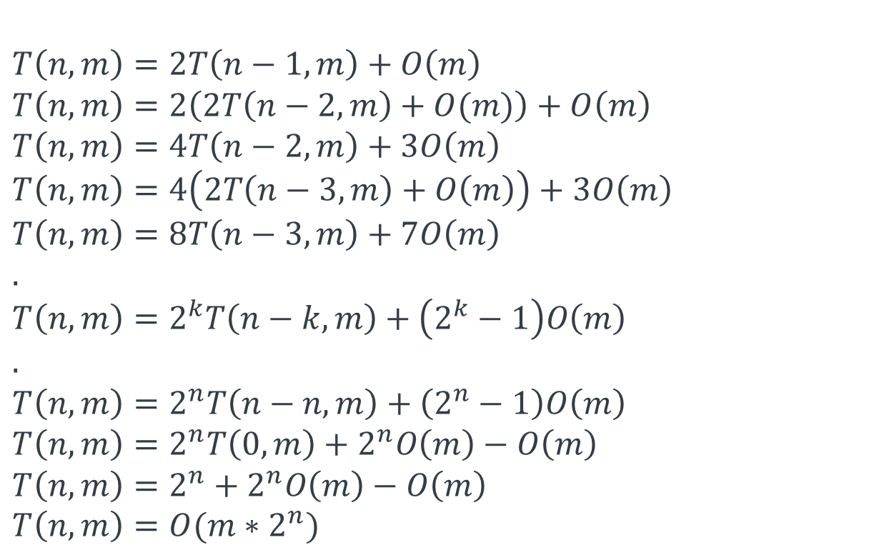
n: number of steps m: number of possible jumps
$$T\left(n,m\right)=T\left(n−1,m\right)+T\left(n−2,m\right)+…T\left(0,m\right)+O\left(m\right) \\ T\left(n,m\right)=2T\left(n−1,m\right)+O\left(m\right) \\ T\left(n,m\right)=2\left(2T\left(n−2,m\right)+O(m)\right)+O\left(m\right) \\ T\left(n,m\right)=4T\left(n−2,m\right)+3O\left(m\right) \\ T\left(n,m\right)=4\left(2T\left(n−3,m\right)+O\left(m\right)\right)+3O\left(m\right) \\ T\left(n,m\right)=8T\left(n−3,m\right)+7O\left(m\right) \\ . \\ T\left(n,m\right)=2^{k}T\left(n−k,m\right)+\left(2^{k}−1\right)O\left(m\right) \\ . \\ T\left(n,m\right)=2^{n}T\left(n−n,m\right)+\left(2^{n}−1\right)O\left(m\right) \\ T\left(n,m\right)=2^{n}T\left(0,m\right)+2^{n}O\left(m\right)−O\left(m\right) \\ T\left(n,m\right)=2^{n}+2^{n}O\left(m\right)−O\left(m\right) \\ T\left(n,m\right)=O(m∗2^{n})$$

Slide 79
n: number of steps m: number of possible jumps
$$T\left(n,m\right)=T\left(n−1,m\right)+T\left(n−2,m\right)+…T\left(0,m\right)+O\left(m\right) \\ T\left(n,m\right)=2T\left(n−1,m\right)+O\left(m\right) \\ T\left(n,m\right)=2\left(2T\left(n−2,m\right)+O(m)\right)+O\left(m\right) \\ T\left(n,m\right)=4T\left(n−2,m\right)+3O\left(m\right) \\ T\left(n,m\right)=4\left(2T\left(n−3,m\right)+O\left(m\right)\right)+3O\left(m\right) \\ T\left(n,m\right)=8T\left(n−3,m\right)+7O\left(m\right) \\ . \\ T\left(n,m\right)=2^{k}T\left(n−k,m\right)+\left(2^{k}−1\right)O\left(m\right) \\ . \\ T\left(n,m\right)=2^{n}T\left(n−n,m\right)+\left(2^{n}−1\right)O\left(m\right) \\ T\left(n,m\right)=2^{n}T\left(0,m\right)+2^{n}O\left(m\right)−O\left(m\right) \\ T\left(n,m\right)=2^{n}+2^{n}O\left(m\right)−O\left(m\right) \\ T\left(n,m\right)=O(m∗2^{n})$$
$$T\left(n−1,m\right)=T\left(n−2,m\right)+T\left(n−3,m\right)+…T\left(0,m\right)+O(m)$$

Slide 80

n: number of steps m: number of possible jumps
$$T\left(n,m\right)=T\left(n−1,m\right)+T\left(n−2,m\right)+…T\left(0,m\right)+O\left(m\right) \\ T\left(n,m\right)=2T\left(n−1,m\right)+O\left(m\right) \\ T\left(n,m\right)=2\left(2T\left(n−2,m\right)+O(m)\right)+O\left(m\right) \\ T\left(n,m\right)=4T\left(n−2,m\right)+3O\left(m\right) \\ T\left(n,m\right)=4\left(2T\left(n−3,m\right)+O\left(m\right)\right)+3O\left(m\right) \\ T\left(n,m\right)=8T\left(n−3,m\right)+7O\left(m\right) \\ . \\ T\left(n,m\right)=2^{k}T\left(n−k,m\right)+\left(2^{k}−1\right)O\left(m\right) \\ . \\ T\left(n,m\right)=2^{n}T\left(n−n,m\right)+\left(2^{n}−1\right)O\left(m\right) \\ T\left(n,m\right)=2^{n}T\left(0,m\right)+2^{n}O\left(m\right)−O\left(m\right) \\ T\left(n,m\right)=2^{n}+2^{n}O\left(m\right)−O\left(m\right) \\ T\left(n,m\right)=O(m∗2^{n})$$
$$T(n−1,m)$$
$$T\left(n−1,m\right)=T\left(n−2,m\right)+T\left(n−3,m\right)+…T\left(0,m\right)+O(m)$$

Slide 81
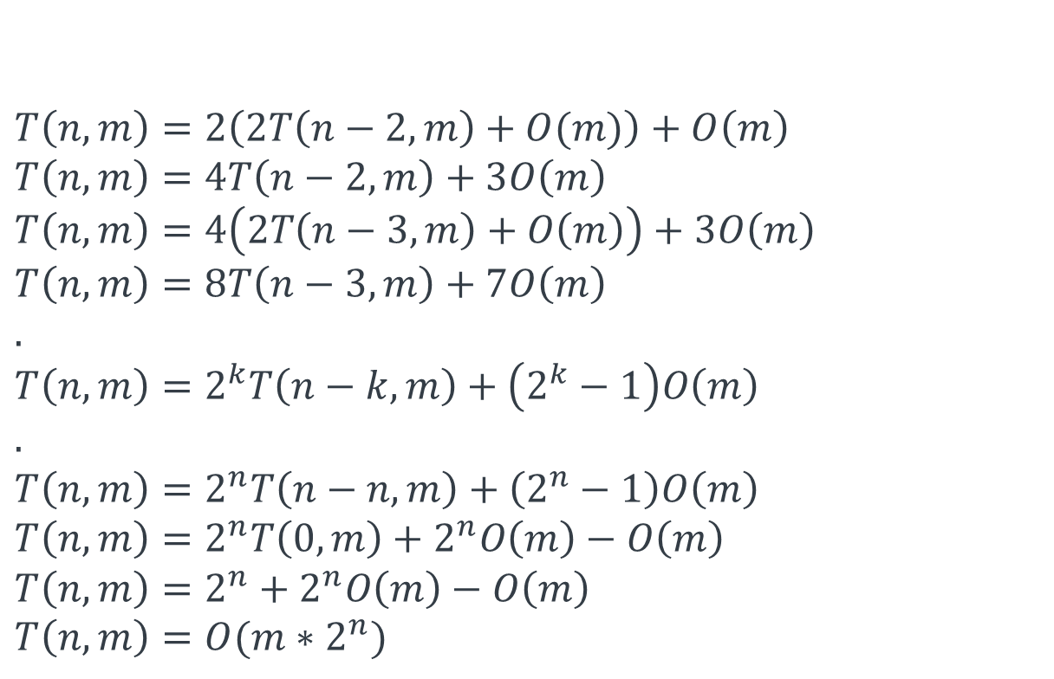
n: number of steps m: number of possible jumps
$$T\left(n,m\right)=T\left(n−1,m\right)+T\left(n−2,m\right)+…T\left(0,m\right)+O\left(m\right) \\ T\left(n,m\right)=2T\left(n−1,m\right)+O\left(m\right) \\ T\left(n,m\right)=2\left(2T\left(n−2,m\right)+O(m)\right)+O\left(m\right) \\ T\left(n,m\right)=4T\left(n−2,m\right)+3O\left(m\right) \\ T\left(n,m\right)=4\left(2T\left(n−3,m\right)+O\left(m\right)\right)+3O\left(m\right) \\ T\left(n,m\right)=8T\left(n−3,m\right)+7O\left(m\right) \\ . \\ T\left(n,m\right)=2^{k}T\left(n−k,m\right)+\left(2^{k}−1\right)O\left(m\right) \\ . \\ T\left(n,m\right)=2^{n}T\left(n−n,m\right)+\left(2^{n}−1\right)O\left(m\right) \\ T\left(n,m\right)=2^{n}T\left(0,m\right)+2^{n}O\left(m\right)−O\left(m\right) \\ T\left(n,m\right)=2^{n}+2^{n}O\left(m\right)−O\left(m\right) \\ T\left(n,m\right)=O(m∗2^{n})$$

Slide 82


n: number of steps m: number of possible jumps
$$T\left(0,m\right)=1$$
$$T\left(n,m\right)=T\left(n−1,m\right)+T\left(n−2,m\right)+…T\left(0,m\right)+O\left(m\right) \\ T\left(n,m\right)=2T\left(n−1,m\right)+O\left(m\right) \\ T\left(n,m\right)=2\left(2T\left(n−2,m\right)+O(m)\right)+O\left(m\right) \\ T\left(n,m\right)=4T\left(n−2,m\right)+3O\left(m\right) \\ T\left(n,m\right)=4\left(2T\left(n−3,m\right)+O\left(m\right)\right)+3O\left(m\right) \\ T\left(n,m\right)=8T\left(n−3,m\right)+7O\left(m\right) \\ . \\ T\left(n,m\right)=2^{k}T\left(n−k,m\right)+\left(2^{k}−1\right)O\left(m\right) \\ . \\ T\left(n,m\right)=2^{n}T\left(n−n,m\right)+\left(2^{n}−1\right)O\left(m\right) \\ T\left(n,m\right)=2^{n}T\left(0,m\right)+2^{n}O\left(m\right)−O\left(m\right) \\ T\left(n,m\right)=2^{n}+2^{n}O\left(m\right)−O\left(m\right) \\ T\left(n,m\right)=O(m∗2^{n})$$

Slide 83

ways(0)
.
.
.
ways(n-2)
$$n+1$$
ways(n-1)
ways(n)

Slide 84

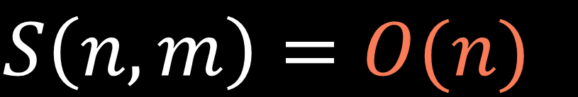
ways(0)
.
.
.
$$S\left(n,m\right)=O(n)$$
ways(n-2)
$$n+1$$
ways(n-1)
ways(n)

Slide 85
Example:
input: n = 10,
jumps = [2, 4, 5, 8]
output: 11
11
ways(10)
6
3
1
1
ways(8)
ways(6)
ways(5)
ways(2)
3
2
0
1
2
1
0
0
0
1
1
ways(6)
ways(4)
ways(3)
ways(0)
ways(4)
ways(2)
ways(1)
ways(3)
ways(1)
ways(0)
ways(0)
2
1
0
1
1
0
1
1
1
0
ways(4)
ways(2)
ways(1)
ways(2)
ways(0)
ways(1)
ways(2)
ways(0)
ways(0)
ways(1)
1
1
1
1
1
ways(2)
ways(0)
ways(0)
ways(0)
ways(0)
1
ways(0)

Slide 86
Example:
input: n = 10,
jumps = [2, 4, 5, 8]
output: 11
11
ways(10)
6
3
1
1
ways(8)
ways(6)
ways(5)
ways(2)
3
2
0
1
2
1
0
0
0
1
1
ways(6)
ways(4)
ways(3)
ways(0)
ways(4)
ways(2)
ways(1)
ways(3)
ways(1)
ways(0)
ways(0)
2
1
0
1
1
0
1
1
1
0
ways(4)
ways(2)
ways(1)
ways(2)
ways(0)
ways(1)
ways(2)
ways(0)
ways(0)
ways(1)
1
1
1
1
1
ways(2)
ways(0)
ways(0)
ways(0)
ways(0)
1
ways(0)

Slide 87
Example:
input: n = 10,
jumps = [2, 4, 5, 8]
output: 11
ways
(10)
ways
(8)
ways
(6)
ways
(5)
ways
(4)
ways
(3)
ways
(2)
ways
(1)
ways
(0)

Slide 88
Example:
input: n = 10,
jumps = [2, 4, 5, 8]
output: 11
ways
(10)
ways
(8)
ways
(6)
ways
(5)
ways
(4)
ways
(3)
ways
(2)
ways
(1)
ways
(0)

Slide 89
1
def ways(n, jumps, lookup=None): lookup = {} if lookup is None else lookup if n in lookup: return lookup[n] if n == 0: return 1 else: nb = 0 for jump in jumps: if (n-jump) >= 0: nb += ways(n-jump, jumps) lookup[n] = nb return lookup[n]
2
3
4

Slide 90


$$n∈\{n_{0},n_{0}−1,…,0\}$$
$$n+1$$

Slide 91

$$n∈\{n_{0},n_{0}−1,…,0\}$$
$$n+1$$
def ways(n, jumps, lookup=None): lookup = {} if lookup is None else lookup if n in lookup: return lookup[n] if n == 0: return 1 else: nb = 0 for jump in jumps: if (n-jump) >= 0: nb += ways(n-jump, jumps) lookup[n] = nb return lookup[n]
$$O(1)$$

Slide 92

$$n∈\{n_{0},n_{0}−1,…,0\}$$
$$n+1$$
def ways(n, jumps, lookup=None): lookup = {} if lookup is None else lookup if n in lookup: return lookup[n] if n == 0: return 1 else: nb = 0 for jump in jumps: if (n-jump) >= 0: nb += ways(n-jump, jumps) lookup[n] = nb return lookup[n]
$$m$$

Slide 93
$$n∈\{n_{0},n_{0}−1,…,0\}$$
$$n+1$$
$$T\left(n,m\right)=n∗O\left(m\right)+1∗O\left(1\right)=O(nm)$$

Slide 94
$$S\left(n,m\right)=O(n)+O\left(n\right)=O(n)$$
call stack size
lookup table size

Slide 95

$$n∈\{n_{0},n_{0}−1,…,0\}$$
$$n+1$$
dp
$$n+1$$

Slide 96
$$n∈\{n_{0},n_{0}−1,…,0\}$$
$$n+1$$
dp
0
1
...
i
...
n
ways to climb n steps

Slide 97
$$n∈\{n_{0},n_{0}−1,…,0\}$$
$$n+1$$
dp
0
1
...
i
...
n
ways to climb i steps

Slide 98
def ways(n, jumps): dp = [0]*(n+1) dp[0] = 1 for i in range(1, n+1): for jump in jumps: if (i-jump) >= 0: dp[i] += dp[i-jump] return dp[n]

Slide 99
def ways(n, jumps): dp = [0]*(n+1) dp[0] = 1 for i in range(1, n+1): for jump in jumps: if (i-jump) >= 0: dp[i] += dp[i-jump]

Slide 100
def ways(n, jumps): dp = [0]*(n+1) dp[0] = 1 for i in range(1, n+1): for jump in jumps: if (i-jump) >= 0: dp[i] += dp[i-jump]

Slide 101
def ways(n, jumps): dp = [0]*(n+1) dp[0] = 1 for i in range(1, n+1): for jump in jumps: if (i-jump) >= 0: dp[i] += dp[i-jump] return dp[n]

Slide 102
Example:
input: n = 10,
jumps = [2, 4, 5, 8]
def ways(n, jumps): dp = [0]*(n+1) dp[0] = 1 for i in range(1, n+1): for jump in jumps: if (i-jump) >= 0: dp[i] += dp[i-jump] return dp[n]
dp
0
1
2
3
4
5
6
7
8
9
10

Slide 103
Example:
input: n = 10,
jumps = [2, 4, 5, 8]
def ways(n, jumps): dp = [0]*(n+1) dp[0] = 1 for i in range(1, n+1): for jump in jumps: if (i-jump) >= 0: dp[i] += dp[i-jump] return dp[n]
dp
1
0
1
2
3
4
5
6
7
8
9
10

Slide 104

Example:
input: n = 10,
jumps = [2, 4, 5, 8]
def ways(n, jumps): dp = [0]*(n+1) dp[0] = 1 for i in range(1, n+1): for jump in jumps: if (i-jump) >= 0: dp[i] += dp[i-jump] return dp[n]
dp
1
0
1
2
3
4
5
6
7
8
9
10

Slide 105
Example:
input: n = 10,
jumps = [2, 4, 5, 8]
def ways(n, jumps): dp = [0]*(n+1) dp[0] = 1 for i in range(1, n+1): for jump in jumps: if (i-jump) >= 0: dp[i] += dp[i-jump] return dp[n]
dp
1
0
0
1
2
3
4
5
6
7
8
9
10

Slide 106
Example:
input: n = 10,
jumps = [2, 4, 5, 8]
def ways(n, jumps): dp = [0]*(n+1) dp[0] = 1 for i in range(1, n+1): for jump in jumps: if (i-jump) >= 0: dp[i] += dp[i-jump] return dp[n]
8
5
4
dp
2
1
0
0
1
2
3
4
5
6
7
8
9
10

Slide 107
Example:
input: n = 10,
jumps = [2, 4, 5, 8]
def ways(n, jumps): dp = [0]*(n+1) dp[0] = 1 for i in range(1, n+1): for jump in jumps: if (i-jump) >= 0: dp[i] += dp[i-jump] return dp[n]
8
5
4
dp
2
1
0
1
0
1
2
3
4
5
6
7
8
9
10

Slide 108
Example:
input: n = 10,
jumps = [2, 4, 5, 8]
def ways(n, jumps): dp = [0]*(n+1) dp[0] = 1 for i in range(1, n+1): for jump in jumps: if (i-jump) >= 0: dp[i] += dp[i-jump] return dp[n]
8
5
4
dp
2
1
0
1
0
1
2
3
4
5
6
7
8
9
10

Slide 109
Example:
input: n = 10,
jumps = [2, 4, 5, 8]
def ways(n, jumps): dp = [0]*(n+1) dp[0] = 1 for i in range(1, n+1): for jump in jumps: if (i-jump) >= 0: dp[i] += dp[i-jump] return dp[n]
8
5
4
dp
2
1
0
1
0
0
1
2
3
4
5
6
7
8
9
10

Slide 110
Example:
input: n = 10,
jumps = [2, 4, 5, 8]
def ways(n, jumps): dp = [0]*(n+1) dp[0] = 1 for i in range(1, n+1): for jump in jumps: if (i-jump) >= 0: dp[i] += dp[i-jump] return dp[n]
8
5
4
dp
2
1
0
1
0
0
1
2
3
4
5
6
7
8
9
10

Slide 111
Example:
input: n = 10,
jumps = [2, 4, 5, 8]
def ways(n, jumps): dp = [0]*(n+1) dp[0] = 1 for i in range(1, n+1): for jump in jumps: if (i-jump) >= 0: dp[i] += dp[i-jump] return dp[n]
8
5
4
dp
2
1
0
1
0
2
0
1
2
3
4
5
6
7
8
9
10

Slide 112
Example:
input: n = 10,
jumps = [2, 4, 5, 8]
def ways(n, jumps): dp = [0]*(n+1) dp[0] = 1 for i in range(1, n+1): for jump in jumps: if (i-jump) >= 0: dp[i] += dp[i-jump] return dp[n]
8
5
4
dp
2
1
0
1
0
2
0
1
2
3
4
5
6
7
8
9
10

Slide 113
Example:
input: n = 10,
jumps = [2, 4, 5, 8]
def ways(n, jumps): dp = [0]*(n+1) dp[0] = 1 for i in range(1, n+1): for jump in jumps: if (i-jump) >= 0: dp[i] += dp[i-jump] return dp[n]
8
5
4
dp
2
1
0
1
0
2
1
0
1
2
3
4
5
6
7
8
9
10

Slide 114
Example:
input: n = 10,
jumps = [2, 4, 5, 8]
def ways(n, jumps): dp = [0]*(n+1) dp[0] = 1 for i in range(1, n+1): for jump in jumps: if (i-jump) >= 0: dp[i] += dp[i-jump] return dp[n]
8
5
4
dp
2
1
0
1
0
2
1
0
1
2
3
4
5
6
7
8
9
10

Slide 115
Example:
input: n = 10,
jumps = [2, 4, 5, 8]
def ways(n, jumps): dp = [0]*(n+1) dp[0] = 1 for i in range(1, n+1): for jump in jumps: if (i-jump) >= 0: dp[i] += dp[i-jump] return dp[n]
8
5
4
dp
2
1
0
1
0
2
1
3
0
1
2
3
4
5
6
7
8
9
10

Slide 116
Example:
input: n = 10,
jumps = [2, 4, 5, 8]
def ways(n, jumps): dp = [0]*(n+1) dp[0] = 1 for i in range(1, n+1): for jump in jumps: if (i-jump) >= 0: dp[i] += dp[i-jump] return dp[n]
8
5
4
dp
2
1
0
1
0
2
1
3
0
1
2
3
4
5
6
7
8
9
10

Slide 117
Example:
input: n = 10,
jumps = [2, 4, 5, 8]
def ways(n, jumps): dp = [0]*(n+1) dp[0] = 1 for i in range(1, n+1): for jump in jumps: if (i-jump) >= 0: dp[i] += dp[i-jump] return dp[n]
8
5
4
dp
2
1
0
1
0
2
1
3
2
0
1
2
3
4
5
6
7
8
9
10

Slide 118
Example:
input: n = 10,
jumps = [2, 4, 5, 8]
def ways(n, jumps): dp = [0]*(n+1) dp[0] = 1 for i in range(1, n+1): for jump in jumps: if (i-jump) >= 0: dp[i] += dp[i-jump] return dp[n]
8
5
4
dp
2
1
0
1
0
2
1
3
2
0
1
2
3
4
5
6
7
8
9
10

Slide 119
Example:
input: n = 10,
jumps = [2, 4, 5, 8]
def ways(n, jumps): dp = [0]*(n+1) dp[0] = 1 for i in range(1, n+1): for jump in jumps: if (i-jump) >= 0: dp[i] += dp[i-jump] return dp[n]
8
5
4
dp
2
1
0
1
0
2
1
3
2
6
0
1
2
3
4
5
6
7
8
9
10

Slide 120
Example:
input: n = 10,
jumps = [2, 4, 5, 8]
def ways(n, jumps): dp = [0]*(n+1) dp[0] = 1 for i in range(1, n+1): for jump in jumps: if (i-jump) >= 0: dp[i] += dp[i-jump] return dp[n]
8
5
4
dp
2
1
0
1
0
2
1
3
2
6
0
1
2
3
4
5
6
7
8
9
10

Slide 121
Example:
input: n = 10,
jumps = [2, 4, 5, 8]
def ways(n, jumps): dp = [0]*(n+1) dp[0] = 1 for i in range(1, n+1): for jump in jumps: if (i-jump) >= 0: dp[i] += dp[i-jump] return dp[n]
8
5
4
dp
2
1
0
1
0
2
1
3
2
6
5
0
1
2
3
4
5
6
7
8
9
10

Slide 122
Example:
input: n = 10,
jumps = [2, 4, 5, 8]
def ways(n, jumps): dp = [0]*(n+1) dp[0] = 1 for i in range(1, n+1): for jump in jumps: if (i-jump) >= 0: dp[i] += dp[i-jump] return dp[n]
8
5
4
dp
2
1
0
1
0
2
1
3
2
6
5
0
1
2
3
4
5
6
7
8
9
10

Slide 123
Example:
input: n = 10,
jumps = [2, 4, 5, 8]
def ways(n, jumps): dp = [0]*(n+1) dp[0] = 1 for i in range(1, n+1): for jump in jumps: if (i-jump) >= 0: dp[i] += dp[i-jump] return dp[n]
8
5
4
dp
2
1
0
1
0
2
1
3
2
6
5
11
0
1
2
3
4
5
6
7
8
9
10

Slide 124
Example:
input: n = 10,
jumps = [2, 4, 5, 8]
def ways(n, jumps): dp = [0]*(n+1) dp[0] = 1 for i in range(1, n+1): for jump in jumps: if (i-jump) >= 0: dp[i] += dp[i-jump] return dp[n]
dp
1
0
1
0
2
1
3
2
6
5
11
0
1
2
3
4
5
6
7
8
9
10

Slide 125
def ways(n, jumps): dp = [0]*(n+1) dp[0] = 1 for i in range(1, n+1): for jump in jumps: if (i-jump) >= 0: dp[i] += dp[i-jump] return dp[n]

Slide 126
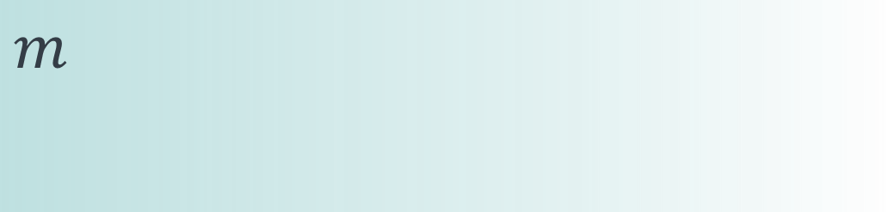
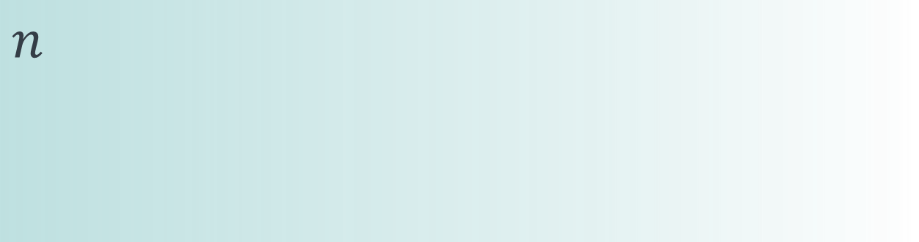
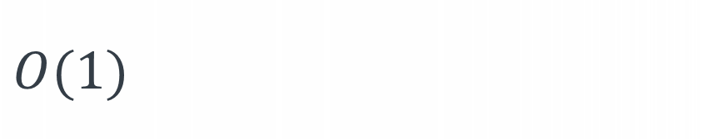
def ways(n, jumps): dp = [0]*(n+1) dp[0] = 1 for i in range(1, n+1): for jump in jumps: if (i-jump) >= 0: dp[i] += dp[i-jump] return dp[n]
$$n$$
$$m$$
$$O(1)$$
$$T\left(n,m\right)=n∗m∗O\left(1\right)=O(nm)$$

Slide 127
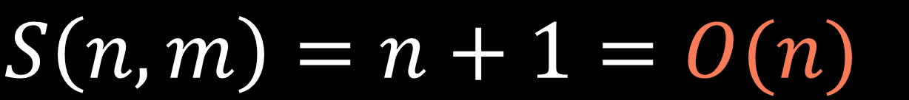

def ways(n, jumps): dp = [0]*(n+1) dp[0] = 1 for i in range(1, n+1): for jump in jumps: if (i-jump) >= 0: dp[i] += dp[i-jump] return dp[n]
$$n+1$$
$$S\left(n,m\right)=n+1=O(n)$$

Slide 128
Example:
input: n = 10,
jumps = [2, 4, 5, 8]
def ways(n, jumps): dp = [0]*(n+1) dp[0] = 1 for i in range(1, n+1): for jump in jumps: if (i-jump) >= 0: dp[i] += dp[i-jump] return dp[n]
8
5
4
dp
2
1
0
1
0
2
1
3
2
6
0
1
2
3
4
5
6
7
8
9
10

Slide 129
Example:
input: n = 10,
jumps = [2, 4, 5, 8]
def ways(n, jumps): dp = [0]*(n+1) dp[0] = 1 for i in range(1, n+1): for jump in jumps: if (i-jump) >= 0: dp[i] += dp[i-jump] return dp[n]
8
5
4
dp
2
?
?
?
?
6
8
9
10

Slide 130
Ways to climb

