Slide 1

Topic :Mortality profit
By : Krishna Kumar Shrestha
Roll no: 08

Slide 2
Topic :
Allowing for death benefits payable immediately
Allowing for survival benefits

Slide 3

Allowing for death benefits payable immediately
0 if the life survives to t+1
DS
$S{\left(1+i\right)}^{\frac{1}{2}}−{}_{1+t}^{.}V$ if the life dies in the year [t,t+1)

Slide 4
Allowing for death benefits payable after 2 month
Accumulation
assumption
t
t+1
1 2 3 4 5 6 7 8 9 10 11 12
Accumulation
0 if the life survives to t+1
DS
$S{\left(1+i\right)}^{\frac{4}{12}}−{}_{1+t}^{ }V$ if the life dies in the year [t,t+1)

Slide 5
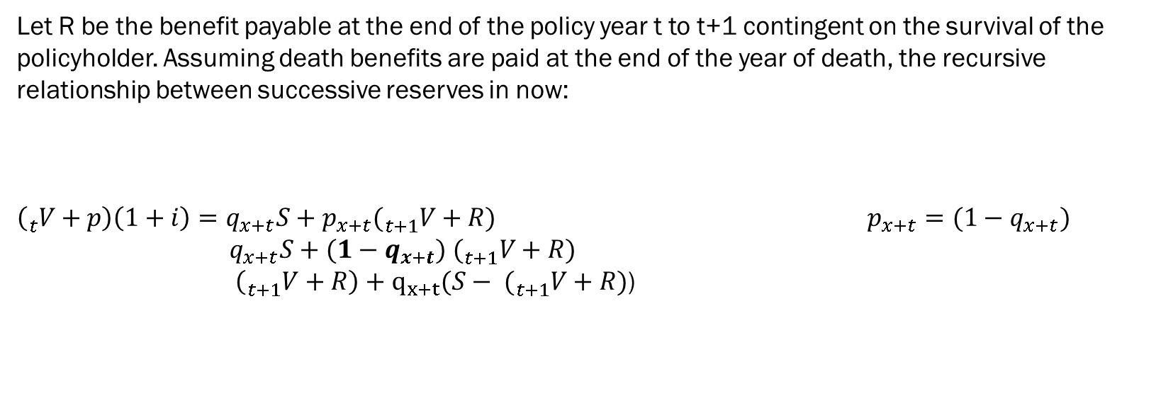
Allowing for survival benefits
Let R be the benefit payable at the end of the policy year t to t+1 contingent on the survival of the policyholder. Assuming death benefits are paid at the end of the year of death, the recursive relationship between successive reserves in now:
$\left({}_{t}^{ }V+p\right)\left(1+i\right)=q_{x+t}S+p_{x+t}({}_{t+1}^{ }V+R)$ $p_{x+t}=(1−q_{x+t})$
$q_{x+t}S+(1−q_{x+t}) ({}_{t+1}^{ }V+R)$
$\left({}_{t+1}^{ }V+R\right)+q_{x+t}(S− ({}_{t+1}^{ }V+R)$)
0 if the life survives to t+1
DS
$S−({}_{1+t}^{ }{V+R)}$ if the life dies in the year [t,t+1)

Slide 6
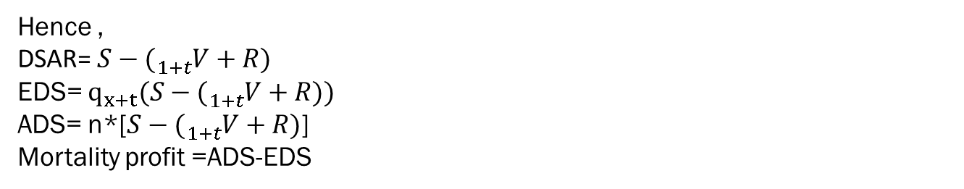
Hence ,
DSAR= $S−({}_{1+t}^{ }{V+R)}$
EDS= $q_{x+t}(S−({}_{1+t}^{ }{V+R))}$
ADS= n*[$S−({}_{1+t}^{ }{V+R)}$]
Mortality profit =ADS-EDS

Slide 7
Annuities
In the case of an annuity of R pa, payable annually in arrears, with no death benefit, the
DSAR would be − ( t +1V + R) . In this case each death causes a negative strain or release of
reserves.
In the case of an annuity of R pa, payable annually in advance, with no death benefit, the
DSAR would be −t +1V only. The annuity payment is made by all policies in force at the
start of the year, and is not affected by whether or not the policyholder survives the year.

Slide 8
Thank You

