Slide 1


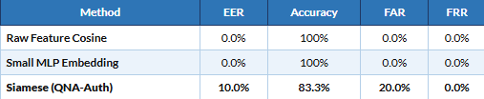
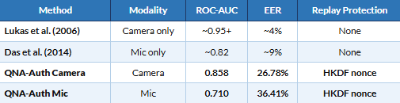
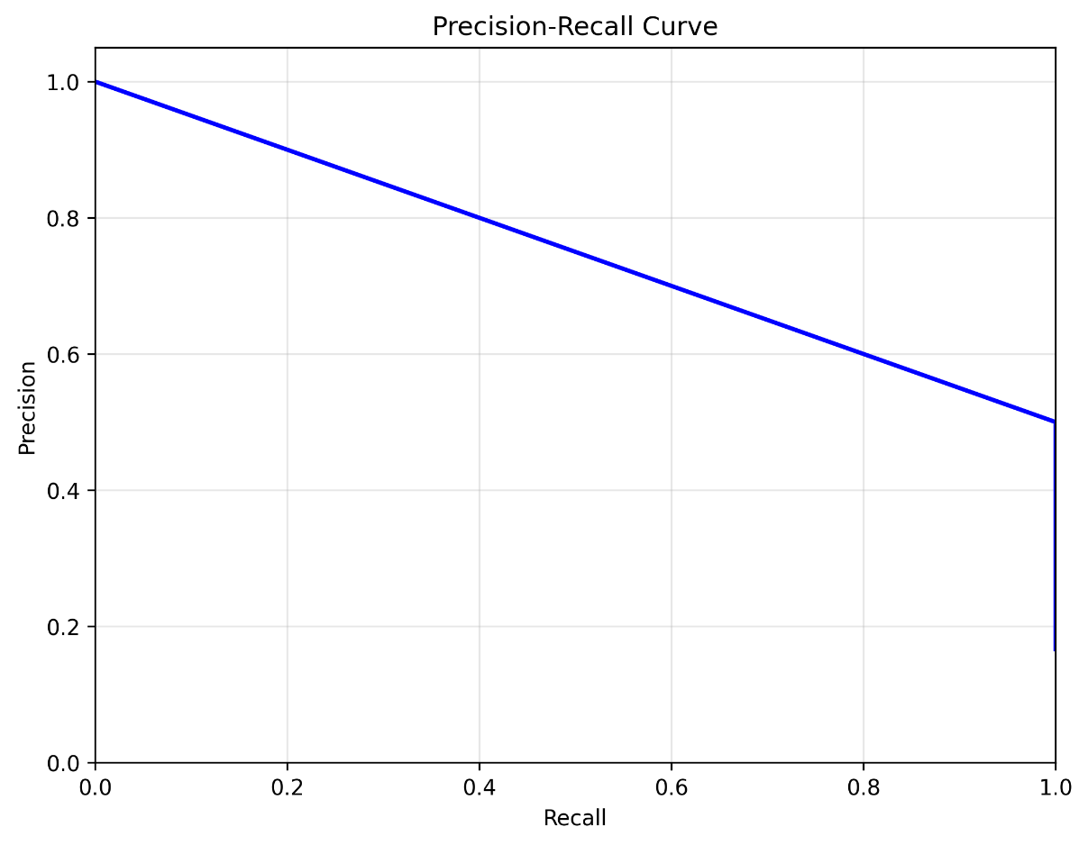
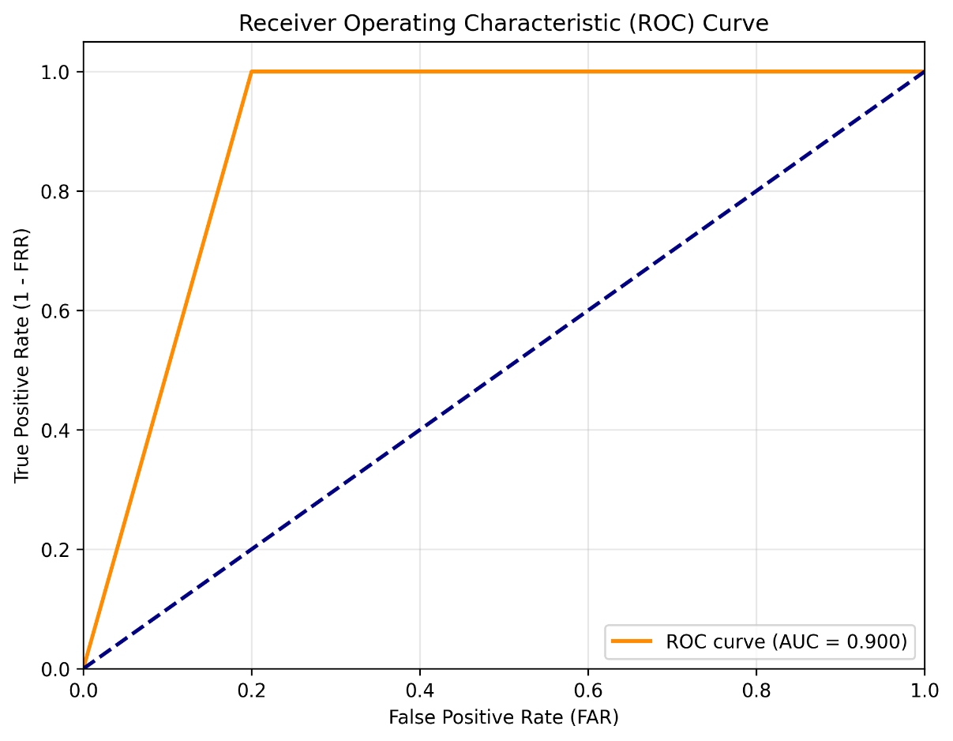
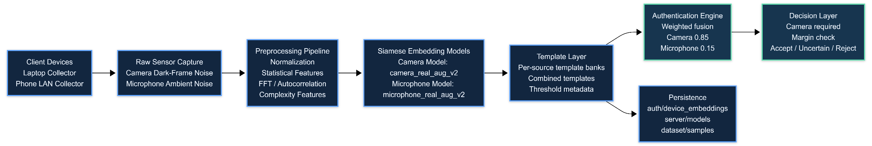
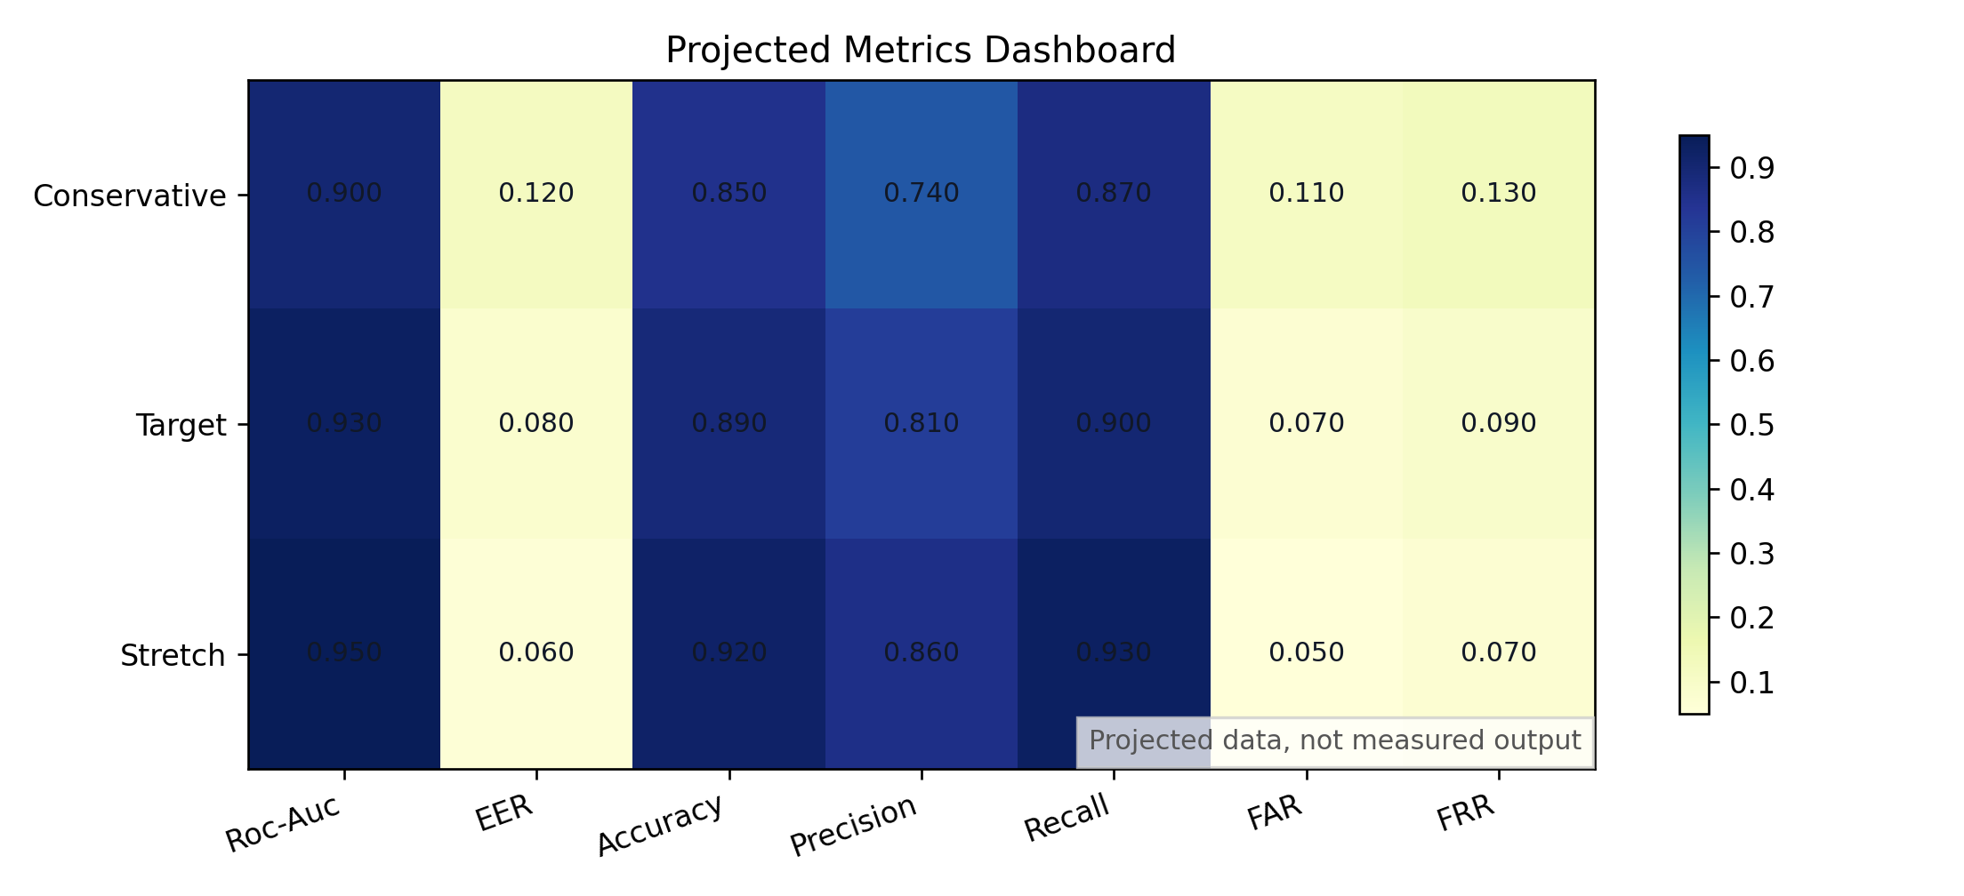
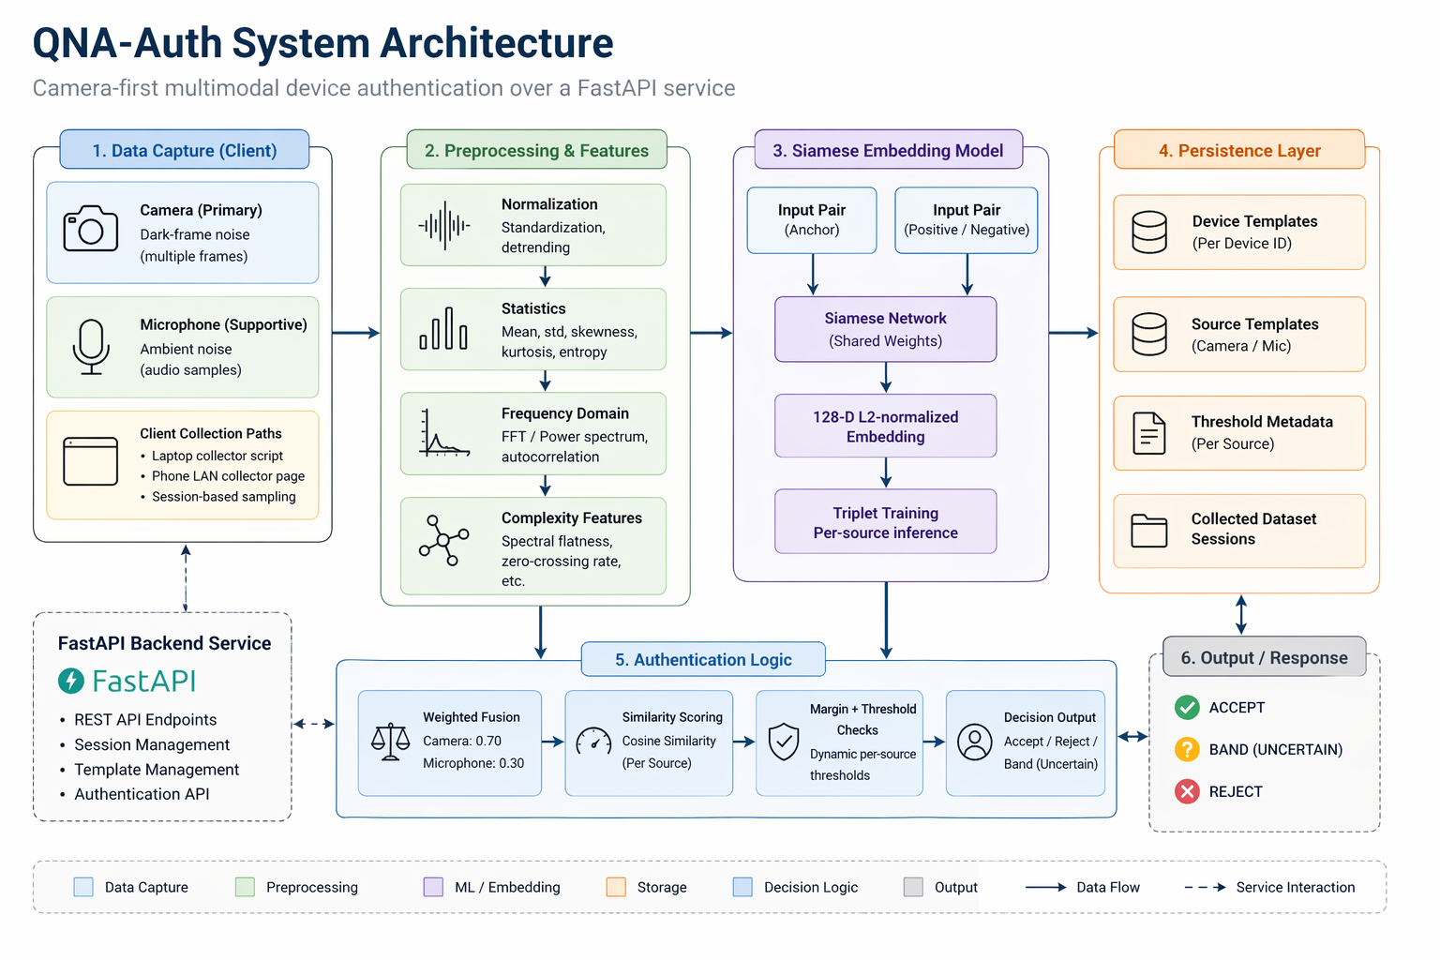
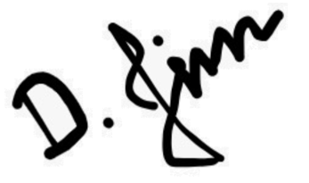

Quantum Noise-Assisted AI Authentication System for Authentication
School of Computer Science and Engineering – Winter Semester 2025 - 26
Introduction
Results
Static credentials are device-agnostic and vulnerable to replay or theft. Camera PRNU and microphone thermal noise create unique hardware fingerprints, but prior methods required large offline batches. QNA-Auth bridges this gap using short live samples, Siamese-learned similarity, and nonce-bound challenges to block replay.
Table 1. Full Modality Comparison (Thesis — report_metrics_tables.md)
Table 2. Baseline Comparison (Capstone Run, Microphone)
Table 3. Prior Work Comparison
ROC & PR Curves (Capstone Run — Microphone Siamese)
Motivation
Static credentials authenticate knowledge, not hardware, and replayable unlike manufacturing-induced sensor fingerprints, which are device-bound and unique. QNA-Auth exploits these fingerprints via short live samples, learned embeddings, and HKDF nonce-binding to close the replay vector.
Scope of the Project
Uses camera PRNU dark-frame noise and microphone thermal noise to generate 128D L2-normalized embeddings via a Siamese network (triplet loss, margin 1.0), with weighted fusion (0.85 camera, 0.15 mic). Replay is hardened using HKDF(template ∥ nonce ∥ server_secret) with single-use nonces, and drift is managed via EMA re-enrollment gated to strong acceptance. API includes /enroll, /authenticate, /challenge, /verify, /devices; excludes production-grade crypto identity, TEEs, and formal proofs.
Note: All three methods evaluated on same device-held-out split (seed=42). Raw cosine and MLP show 100% on this small 40-sample run; Siamese generalises differently — broader evaluation needed for claim strength.
Methodology
Noise Capture: Camera dark-frame subtraction isolates PRNU; microphone captures ambient thermal noise. Short live samples — no batch offline collection.
Feature Extraction: Versioned statistical feature pipeline (mean, std, entropy, spectral moments, kurtosis). Same pipeline used at train and serve time for consistency.
Siamese Embedding: Shared EmbeddingNetwork [input → 256 → 256 → 128 → 128-d], Tanh activations, L2-normalised output. Trained with Triplet Loss.
Decision Logic: Cosine similarity + nearest-impostor margin guard (≥ 0.02 margin). Source consistency and profile checks applied first.
Challenge Hardening: MAC key = HKDF(feature_template ∥ nonce ∥ server_secret). Embedding never transmitted as credential.
Evaluation: Device-held-out split (seed=42). Baselines: raw-feature cosine + small MLP. Metrics: FAR, FRR, EER, ROC-AUC, PR-AUC. Attack surface evaluated.
Fig. 3 — ROC and Precision-Recall curves, Siamese model, microphone source, capstone run 20260422T122948Z.
Fig. 1 — QNA-Auth system architecture: noise capture → feature extraction → Siamese embedding → confidence-band decision with HKDF challenge hardening.
Fig. 4. Projected Metrics Dashboard for one shot training for more than 20 devices
Conclusion
Camera PRNU feasible (AUC 0.858 under short-sample); mic weaker (0.710); 85/15 fusion justified; replay/impersonation/synthetic attacks → 0% ASR, supporting viability. Small scale (6 devices, single-session); needs 25+ devices, multi-session + cross-session eval, env-specific thresholds, stronger anti-spoofing. Not a crypto identity replacement.
References
[1] Lukas, Fridrich, & Goljan, M. (2006). Digital camera identification from sensor pattem
noise. IEEE TIES, 1(2), 205-214-
[2] Goljan, M- Fridrich, J., & Filler, T. (2009). Large scale test of sensor fingerprint camera
identification. SPIE Media Forensics and Security, 7254.CCS
Demo Video
Fig. 2 — Full QNA-Auth pipeline: data capture, preprocessing, Siamese embedding, authentication logic and output decision flow.
Student RegNo, Name:
Ayan Kumar Singh-22BCI0182,
Krishnam Biyani-22BCI0190
Guide Name: Prof. Jim Solomon Raja D
https://drive.google.com/file/d/1VOirTT2gYiA3i3swWXDlJlvCnzDcECba/view?usp=sharing

